Slide 1
Toddler Development
Chapter 10

Slide 2
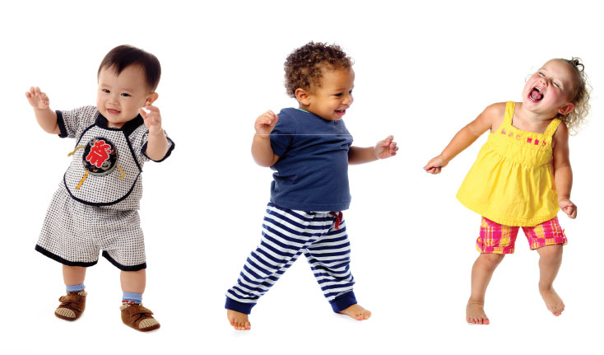
Growth from One to Three
Physical growth slows
At about the age of one, most children begin to walk a few unsteady steps
The term toddler refers to one- and two-year-olds
Heredity and environment influence the rate at which children grow in height and weight.
Until age two, the circumference of child’s head, abdomen and chest are about the same.
Between ages two and three the chest becomes larger around than head and abdomen. During this time, the arms, legs, and torso get longer.
These changes help improve balance and motor skills.

Slide 3
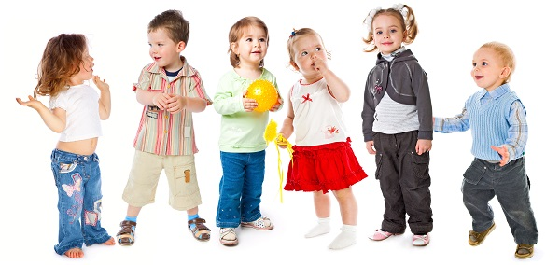
Growth from One to Three
By age of two, postures is straighter but still not completely straight.
By their third birthday, children stand straighter because their spines are stronger.
One year olds typically have about eight teeth. For most, the last four back teeth emerge early in the third year of life completing their set of 20 primary teeth.
Health of teeth is influenced by diet, heredity and dentist
Sensory integration is the process of combining information taken in through sense to make a whole.
Sensory dysfunction is when a child is unable to normally process all the information their sense take in. He/she reacts more strongly to some stimulations which may indicate a learning and behavioral problem.

Slide 4
Physical Developmental Milestones
Age | Fine Motor (using small muscles of hands) | Gross motor (using large muscles of body like legs)
12-18 Months | Turns several pages of book Pick up objects with thumb and forefinger Move objects from hand to hand | May walk alone or while holding someone’s hand Sits down without help Slide down stairs backwards
18-24 Months | Stack from 2-4 blocks Grasps crayons with a fist and scribbles | Walks well Jumps in place Climbs up or down one stair Pulls toys with wheels

Slide 5
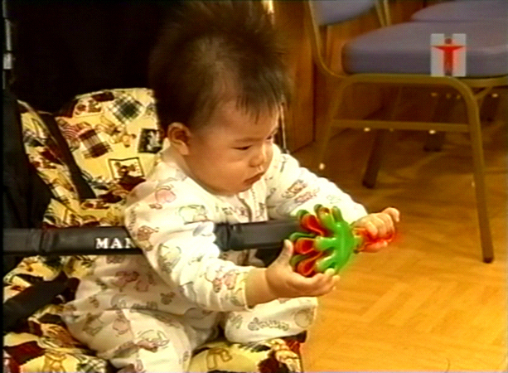
Which type of motor skill would this an example of?

Slide 6
Fine

Slide 7
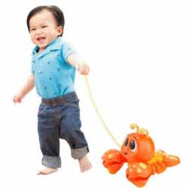
Which type of motor skill would this item help?

Slide 8
Gross

Slide 9
Physical Developmental Milestones
Age | Fine Motor Skills | Gross Motor Skills
2-2 ½ Years | Stacks six blocks Turns one page of book Picks up objects from the floor without losing balance | Walks with more coordination and confidence Jumps off the bottom step Pushes self on wheeled toy
2 ½ - 3 Years | Stacks eight blocks Screw lids on and off container Draws circles and horizontal and vertical lines | Alternates feet going up stairs but on going down Runs but may not be able to stop smoothly Throw a ball overhead but inaccurately

Slide 10
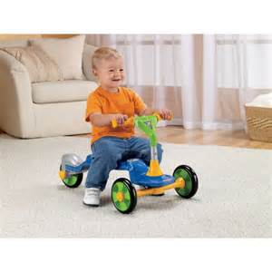
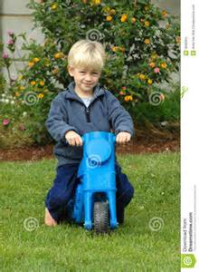
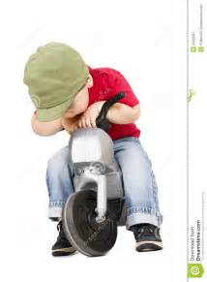
What type of development are these?

Slide 11
Gross

Slide 12
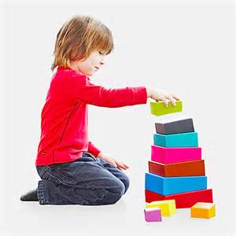
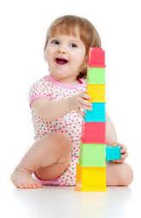
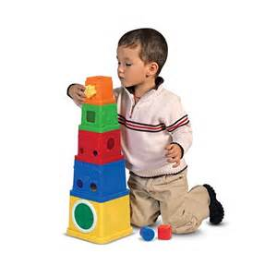
What type of motor skill is shown?

Slide 13
Fine

Slide 14
Sleeping
Most one-year-olds sleep eight or more hours at night.
As they get older, daytime naps become shorter.
Fears or anxiety about separation from parents can make falling asleep difficult
Night terrors are a sleep disturbance that occurs during the first few hours of sleep.

Slide 15
Physical Health and Wellness
Checkups every 12 months to check growth and development.
Immunizations protect children from specific disease, usually by giving a child a vaccine (a small amount of disease-carrying germs is introduced to the body on purpose so that boyd can build resistance to that disease.
Safety is a concern since toddlers love to explore their environment. Therefore childproofing home is critical.
Environmental concerns - choking hazards, toys, poisons, fire, burns, cars, sunburn, pets, drowning.

Slide 16
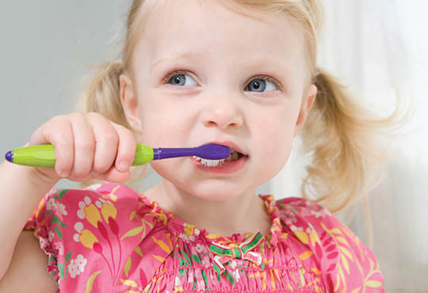
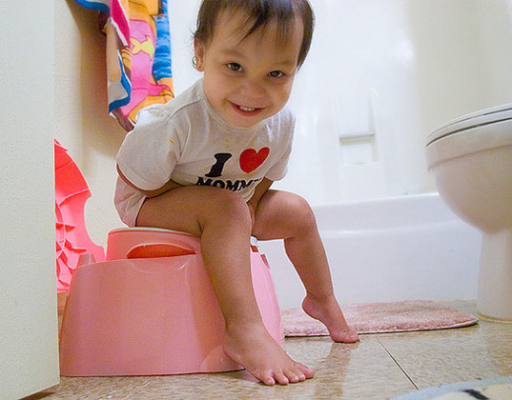
Hygiene
- Daily baths help children develop good hygiene skills.
- Brushing teeth daily with soft toothbrush and by two years of age can be done independently.
- Toilet training depends on readiness

