Slide 1
Emotional Development
Chapter 11

Slide 2
Eighteen Months
Self-centered
Are likely to do the opposite of what is asked
Desire for independence - saying “no” is child’s way of saying, “Let me decide for myself.”
Frustration- want to do more than their bodies are able to do
Realization of being a separate person
Temper tantrums

Slide 3
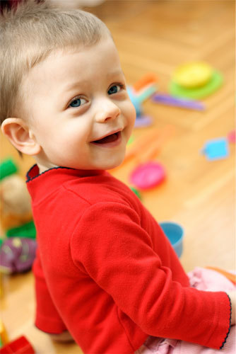
So what should you do?
Give Choices
Redirect the child
Encourage talking
Try to help child find calmer ways of expressing feelings.

Slide 4
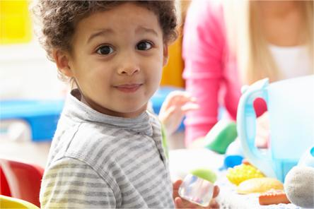
Two year olds
Child expresses love and affection freely and seeks approval and praise.
Still have some emotional outbursts but they are fewer and less intense.
Easier to reason with.
More outgoing and friendly and less self-centered.

Slide 5
Two 1/2
Not easily distracted
Learning so much they sometimes feel overwhelmed.
Struggle with immaturity and a powerful need for independence.
Need consistency

Slide 6
Specific Emotions
Anger is often the child's way of reacting to frustration. Teach them to use words, speak calmly, take deep breaths
Fear of different things. Phobias are unexplainable fear of something and separation anxiety is common.
Jealousy and sibling rivalry
Love and affection
Empathy (the ability to understand how another person feels)
Self-concept in response to actions, attitudes and comment of others.

Slide 7
Encourage Positive Behaviors
Explore feelings
Acknowledge feelings
Give choices

Slide 8
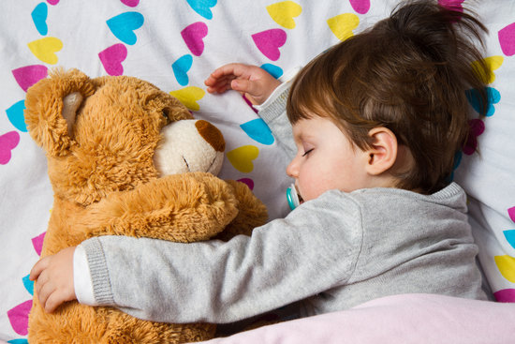
Importance of Adequate Sleep
Sleep is essential to good physical and emotional health as well as adequate nutrition.
Prevent sleep deprivation - determine child’s best bedtime, limit toys in bed, establish a bedtime routine, keep bedtime pleasant

Slide 9
Social Development
Socialization is the process of learning to get along with others.
Eighteen month olds do parallel play (is when children play near, but not actually with, other children).
Making friends is important to normal social development.
Imaginary friends help a child experiment with different feelings.

Slide 10
Guiding Behavior/Discipline
Guidance means using firmness and understanding to help children learn self-discipline (the ability to control their own behavior)
One year to 15 months - remove them from forbidden activities.
15 months to 2 years - spoken restrictions as well as distraction.
2 to 3 years - can grasp the reasoning of adults.

Slide 11
Set Limits
Show an understanding of child’s desire
Set the limit and explain it
Acknowledge the child’s feelings
Give alternatives

Slide 12
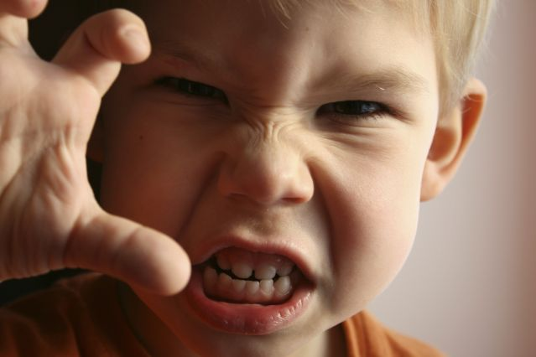
Deal with Aggressive Behavior
Aggressive behavior says that a child is upset or that some need is not being met. Adult should look for reason for behavior.
Biting occurs for various reasons - infants don’t understand difference between chewing on a toy versus a person, one year old want to see what happens, two year olds do it to get their way
Hitting, kicking and shoving often occur. Two and three year olds have trouble controlling impulses.
Time-out can give a toddler time to calm down when they are upset.

Slide 13
Social Milestones
Age | Developmental Milestones
1 year | Plays along but often near others Dislike sharing toys Fears some stranger
2 Years | Engages in parallel play Plays simple games with others Bosses oter children Says”please” if prompted

Slide 14
Social Skills
Establish a basic set of rules to guide social behavior (ie. not hitting)
Model good social skills
Help children understand and respect other’s feelings.
Show respect for other people's belongings
Show children how to use words rather than physically striking out

