Slide 1
Practicum Expectations

Slide 2
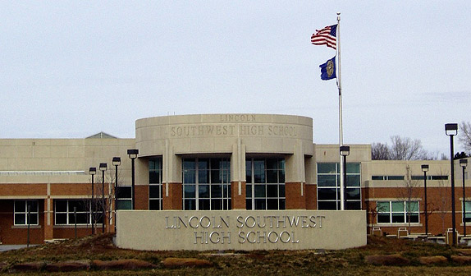
REPRESENT
You represent Southwest, are an example to these kids and it is a HUGE privilege to get to go out to go out to daycares and schools. In order to continue with this opportunity and hands on experience we must conduct ourselves as leaders and professionally in our community.

Slide 3
Do’s & Don’t’s
Either on your own or with a person by you create a T Chart of do’s and dont’s for students when going out to practicum’s twice a week.

Slide 4
Do
Come to class ON TIME! We leave right after announcements. If you are late and the class is gone you should report to A100 and come back to class before the bell rings.
Be here consistently. The children and teachers will expect you to be there.
Wear appropriate clothes! No short skirts, dresses, or shorts. No Cleavage, Cutouts , bra straps, holey jeans, leggings, or yoga pants. Avoid printed tops. You don’t have to dress up, but dress conservatively. It’s a good idea to ask your daycare and school what appropriate dress might be in that setting.
Volunteer to Drive! It’s really helpful to have other drivers to take turns or in case someone is sick or can’t come in.
Go straight to and from Field Placements. Nothing Else or you won’t go out.
Drive SAFE in the parking lot’s and on the roads.

Slide 5
DO
Be engaged and hands on, when you can.
Communicate with you’re teachers. (If you’ll be gone, lesson plans, how you can help, etc.)
Let the Daycares or Schools know if you’re going to be absent. Teachers are online on the LPS homepage under schools.
Leave your bag in the room.
Wear Your ID.
Make sure your whole group is accounted for.
Make sure to make a good impression and go over and beyond with your teachers. They complete evaluations, which is part of your final grade.

Slide 6
Don’t
NO CELLPHONES- Don’t have your cellphones out at the field placements. Keep them in your car, a purse or a bag. Pictures are not allowed of children.
Do Not be Late or skip class!!!!
Don’t chat with your friends field placements. You are there to be with the kiddos.
Forget your coat. Even on cold days days, the kids go outside.
Don’t lock your keys in your car. ☺
Forget to sign in!
Bring attitude or drama to the daycares!
Don’t forget these schools and daycares are doing us a favor by allowing us to come in, so please keep this in mind.

Slide 7
FIELD Placements
Be to class on time. Sit in your assigned seat so I can take attendance.
Once announcements are done, meet with your group in the classroom and decide who’s driving.
Check in at placements (If applicable).
Decide when & where to meet (around 9:30/9:35)
Introduce yourself to the teacher.
Observe and get hands on experience, when you can.
Come back to the classroom by 9:45, before the bell rings.
SIGN IN!

Slide 8
In the Practicums…
Just like the High School Level, there is a certain amount of germs and illness that goes around in daycares and school.
Expect to be exposed to a certain amount of germs. The joys of working with little ones. ☺
If you’re well enough to come to school, then your wel enough to go to the daycares. If you are too sick, then you shouldn’t be at school.

Slide 9
Question #1
You are running late to class and you are a driver for the field placements/practicums. What should you do?
a. text your classmate
b. text your teacher
c. don't worry about it, we will just wait for you
d. just go directly to the daycare/school

Slide 10
Question #2
You are "dressed up" in your pajama pants for spirit week. What should you do before going out to the field placements/practicums?
a. don't change just explain to the teacher what is going on
b. change into clothes that are appropriate for site
c. skip class

Slide 11
Question #3
You missed your morning coffee this morning. What should you do?
a. purchase something from the snack shop before school
b. stop by Starbuck on your way back to school
c. live without it today
d. a and c

Slide 12
Question #4
You are a smoker. What should you do?
a. smoke at the field placements/practicums
b. smoke in your car on the way to the field placements/practicums
c. do not smoke on the way and use a breath mint before going to the field placements/practicums

Slide 13
Question #5 & #6
You are mixing some cranberry juice with vodka before school. What should you do?
a. never do it
b. go to the daycares
You are wearing something inappropriate. What should you do?
a. stop by your house on your way to the daycare and change
b. say you are going to daycares but hang out at Starbucks instead
c. cover up with something appropriate

