Slide 1
Chapter 5:
The First Month
By Keely Anderson

Slide 2

The First Step:
The first month is full of doctor’s
visits.
You will get your first prenatal
visit (longest and most comprehensive).
Practitioner will check pregnancy
symptoms and decide date of last
menstrual period to determine the due
date.
Practitioner will also want to know
everything about you: checking records
past doctors, illnesses, family medical
history, allergies, medication your on,
gynechological history, first period, if
you’ve been pregnant before, etc.

Slide 3

What Kind of Tests?
Your doctor will give you a ton of
tests to make sure you are healthy.
Blood Test- determine blood type
and Rh status, hcG levels, and check
for anemia.
Urinalysis- checking glucose, protein,
white blood cells, blood, and bacteria.
Pap Smear- Check for Cervical cancer.
Blood Sugar level- check for diabetes.
Blood Screens- to determine antibody
levels and immunity to disease.

Slide 4
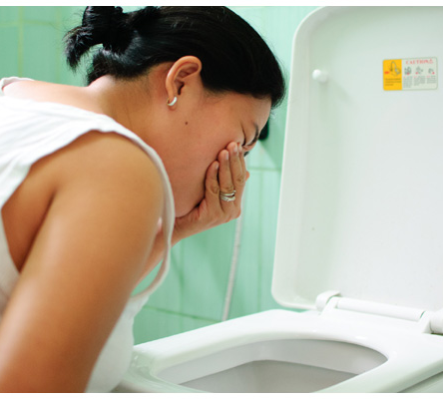
How You Feel:
Physically:
Absence of menstruation
Fatigue and sleepiness
Frequent urination
Nausea, with or without vomiting
Excessive salivation
Heartburn, indigestion, flatulence, bloating
Food Cravings
Breast changes: fullness, heaviness,
tenderness, tingling, etc.
Emotionally:
Instability: mood swings, premenstrual
syndrome
Misgivings, fear, joy

Slide 5

Breaking the News:
Only you can choose when the
time is right to tell everyone
Some people can’t wait to
tell the news their pregnant
Some people decide to tell only
a few until conditions are obvious.

Slide 6

Signs of Miscarriage:
Call Practitioner when:
Pain is severe and continues for
A couple of days.
Bleeding is as heavy as a period, or
A light staining for more than 3 days.
History with miscarriages.
Seek Medical Attention when:
Bleeding is heavy enough to soak
Several pads an hour or pain is so
Severe you can’t bare it.
When you pass clots of grayish or
Pink material- miscarriage may have
Already taken place.
Go to ER if you can’t reach
practitioner.

Slide 7
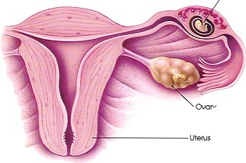
Ectopic Pregnancy:
Ectopic Pregnancy- a pregnancy
in which the fetus develops
outside the uterus, typically in a
Fallopian tube.
Very few pregnancies are
ectopic.
Practitioner confirmed pregnancy
through a blood test and physical
exam and no sign of ectopic
pregnancy, don’t worry.

Slide 8

Stress in you Life:
Talk about it- Identify the sources of
of stress in your life and determine how
they don’t get you down.
Do something about it- Identify sources
of stress and determine how they can be
modified.
Sleep it off- sleep is ticket to regeneration.
Nourish it- Get 3 large or 6 small meals a
day with plenty of snacks.
Wash it away- take a warm bath.
Get away from it temporarily- anything
you find relaxing.

Slide 9

Overwhelming Fear of Babies Health:
Every expectant mother and father
worry about whether their baby will
be healthy.
Worrying is a unavoidable side effect
of pregnancy.
Talk to practitioner, an ultrasound
evaluation of fetus and prenatal
screening can help calm fears.
If nothing calms you down, professional
counseling may be needed to reduce
anxiety.

Slide 10

Picking up Older Children:
Limit your weight
Blame back not your baby when
you can’t pick up your toddler.
Blaming unborn child for why you can’t
carry your other child may bring feelings
of rivalry and resentment toward baby.

Slide 11

Taking Care of the Rest of you:
Pay a visit to your dentist
Go to your allergist if necessary
Family doctor or specialist should
monitor chronic illnesses or other
medical problems.

