Slide 1
Brain Development - Toddlers
Chapter 12

Slide 2
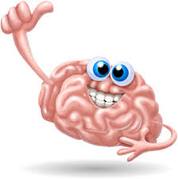
Brain Development
People used to think that providing a child with food, clothing, and shelter in a loving, healthy, and safe environment was all a child needed for development.
Neuroscience (study of brain) has show that a child’s experiences can help determine the physical structure of the brain and the extent to which a child reaches his/her potential

Slide 3
Brain Development (cont.)
Intelligence is the ability to interpret and understand everyday situations and to use prior experiences when faced with new situations.
In addition, intelligence is the ability to learn.
Both heredity and environment influence intelligence.
Children learn concepts and the words for those concepts in stages. It takes time for misconceptions that result from board generalization to be sorted out.

Slide 4
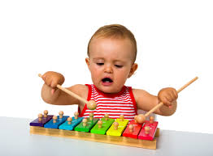
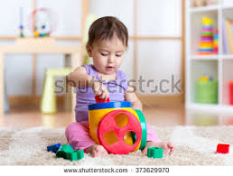
Methods of Learning
Incidental learning is unplanned learning. For example, a noise occurs when a child hits the xylophone.
Trial-and-error is learning that takes place when a child tires several solutions to find one that works. For example, will this block fit in this whole?

Slide 5
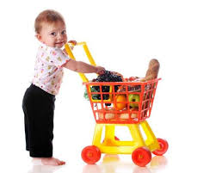
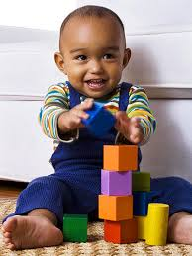
Methods of Learning (cont.)
Imitation is learning by watching and copying others.
Directed learning results from being taught.

Slide 6
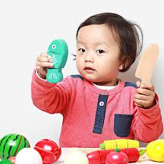
Intellectual Activity Areas
Attention is the ability to ignore most sensory information and concentrate on one item of interest.
Without memory, there would be no learning.
Short term memories are helpful in accomplishing everyday tasks without making the brain store the unimportant information indefinitely.
Babies demonstrate memory early by recognizing faces of their primary caregivers. Between six months and a year, babies have the ability to remember more information for longer periods of time.
As children develop, they become able to react to a situation by remembering similar experiences in the past.

Slide 7
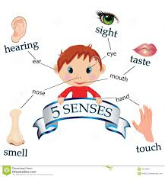
Intellectual Activity Areas (cont.)
A newborn learns about the world through perceptions (information received through sense). This sensory information reinforces established connections in the brain and can spark new connections.
Reasoning is necessary to solve problems, make decisions, recognize relationships and form concepts. Babies show signs of simple problem-solving skills at about four to six months of age. One-, and two-year-olds gradually learn more sophisticated reasoning skills. Making decisions involves choosing from different alternatives.

Slide 8
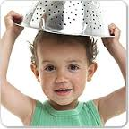
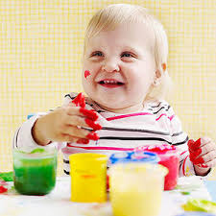
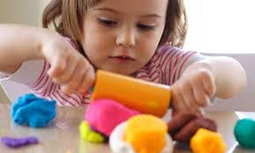
Intellectual Activity Areas (cont.)
Imagination becomes very apparent at about two years of age. An active imagination improves learning because it allows the child to try new things.
Creativity is a mental ability that involves using the imagination to produce original ideas.

Slide 9
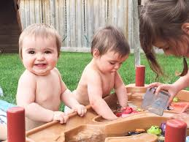
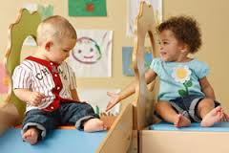
Intellectual Activity Areas (cont.)
Children are curious about the world around them, and that curiosity helps brain development and learning. It is curiosity that make children wonder why and how about things. Curiosity make children try new activities. However, if a child is overprotected it can stifle or suppress curiosity.

Slide 10
Intellectual Developmental Milestones
Age | Developmental Milestones
1 year | Begins to put two words together Names common objects and people Understands “no”, but ignore it Finds hidden objects
2 years | Uses two -to three-word sentences Knows about 500 words Follows simple directions Identifies colors

