Slide 1
La Culture!
Final sem 1
French 2
LSE 2013

Slide 2
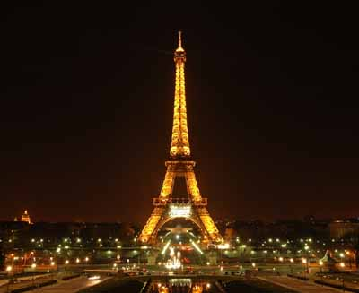
La Tour Eiffel
Built by Gustave Eiffel in 1889.
Originally built for the World Exposition; was only to stand for 20 years.
It later proved to be useful as a radio tower!

Slide 3
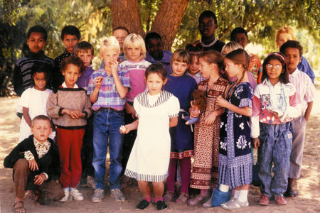
When do French students start to write in cursive?
When they are at the lycée (High School)?
When they are at the Collège? (Middle School)?
When they are very young-in fact, they learn cursive before printing!

Slide 4
What is a reveillon?
A. A parade
B. A type of cake eaten on Mardi Gras
C. a French breed of dog that is popular?
D. A midnight dinner served on Christmas or New Year’s eve.

Slide 5
When do we eat a buche de Noël?
Before Christmas dinner
During Christmas dinner
After Christmas dinner

Slide 6
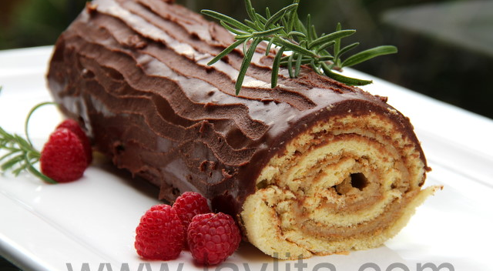

Slide 7
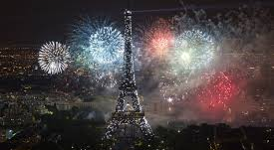
What’s the big deal in France about le 14 juillet?

Slide 8
La maison Française
What is the difference between an American Bathroom and a French Bathroom?
What won’t you find in a French bedroom that you would find in an American bedroom?
Do the French like to keep their interieur doors open or shut?

Slide 9
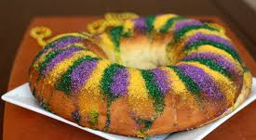
When is King’s cake served? Where?

Slide 10
You had better know something about…
Lascaux
Carnac
Vercingétorix
Centre Pompidou
Sacré Coeur
Geveviève
Gaul
Saint Denis: head carrier!
Fleur de Lyse
Louvre: what was it’s original purpose?
Druids liked gui. What is gui?
Bateaux Mouches…what are they?

