Slide 1
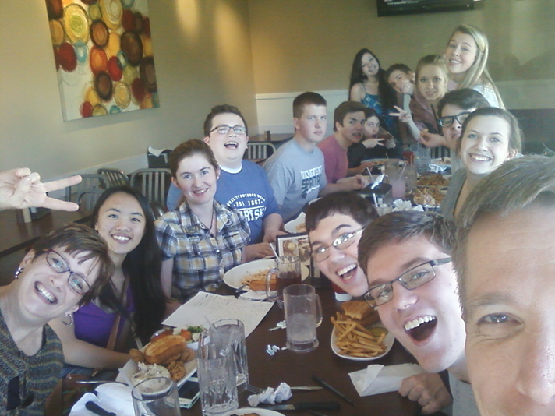
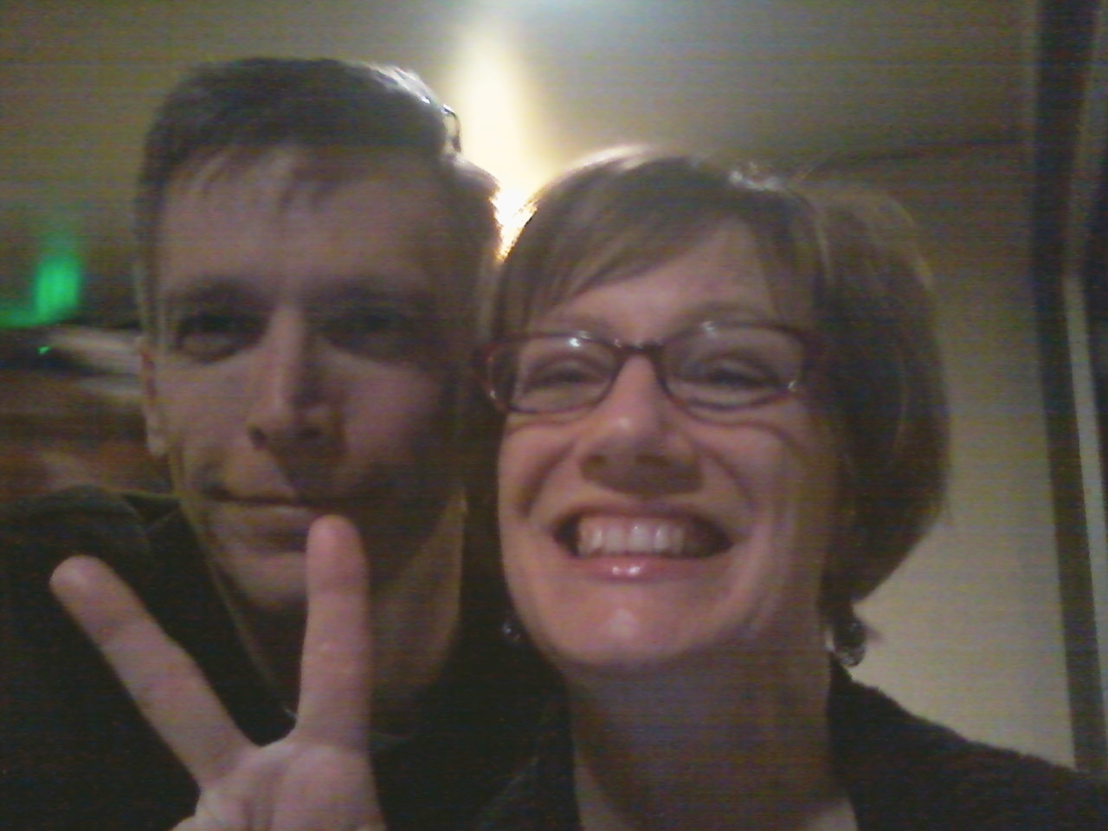
Next Fall…
Classes you can take
There is a Competitive Forensics Class. You will need to take it independent study, and have me be the teacher. Ask your counselor when school starts next year.
Oral Comm Diff or Oral Comm Forensics can also be helpful.
Shortly after school starts
We will start team meetings and social gatherings.
We will check in on materials and progress.
The goal is to have a good start on at least one event by the time school starts.

Slide 2
Other things to consider…
Competitive speech broadens your future!
You’ll be part of a program with a long history
College Resumes
Confidence
Challenging
Wide circle of friends
Most future employers are looking for the skills you’ll develop with us!
We’ve been an NSDA Chapter since we opened in 1955
We’ve had national finalist and semi-finalists
We’ve had state finalists and champions
We’ve had district finalists and champions
Our alums have a wide variety of jobs, including teachers, lawyers, journalists, and performers.

Slide 3
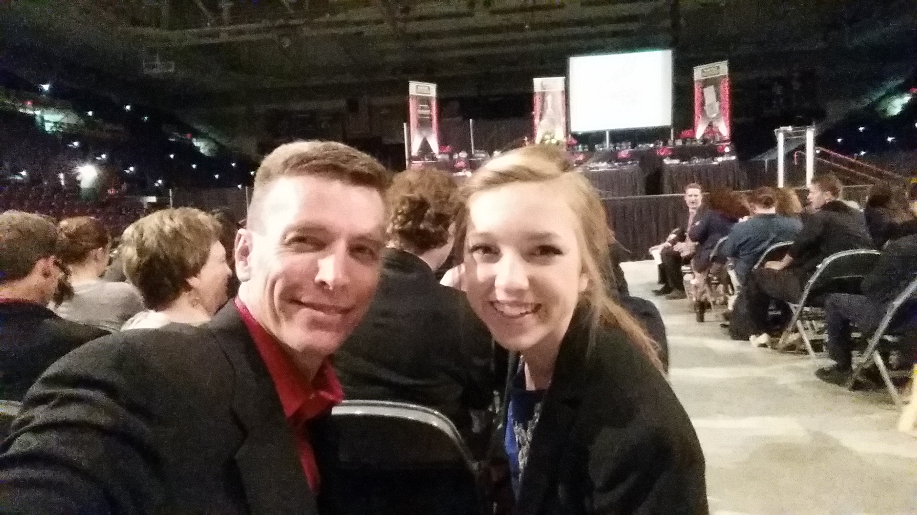
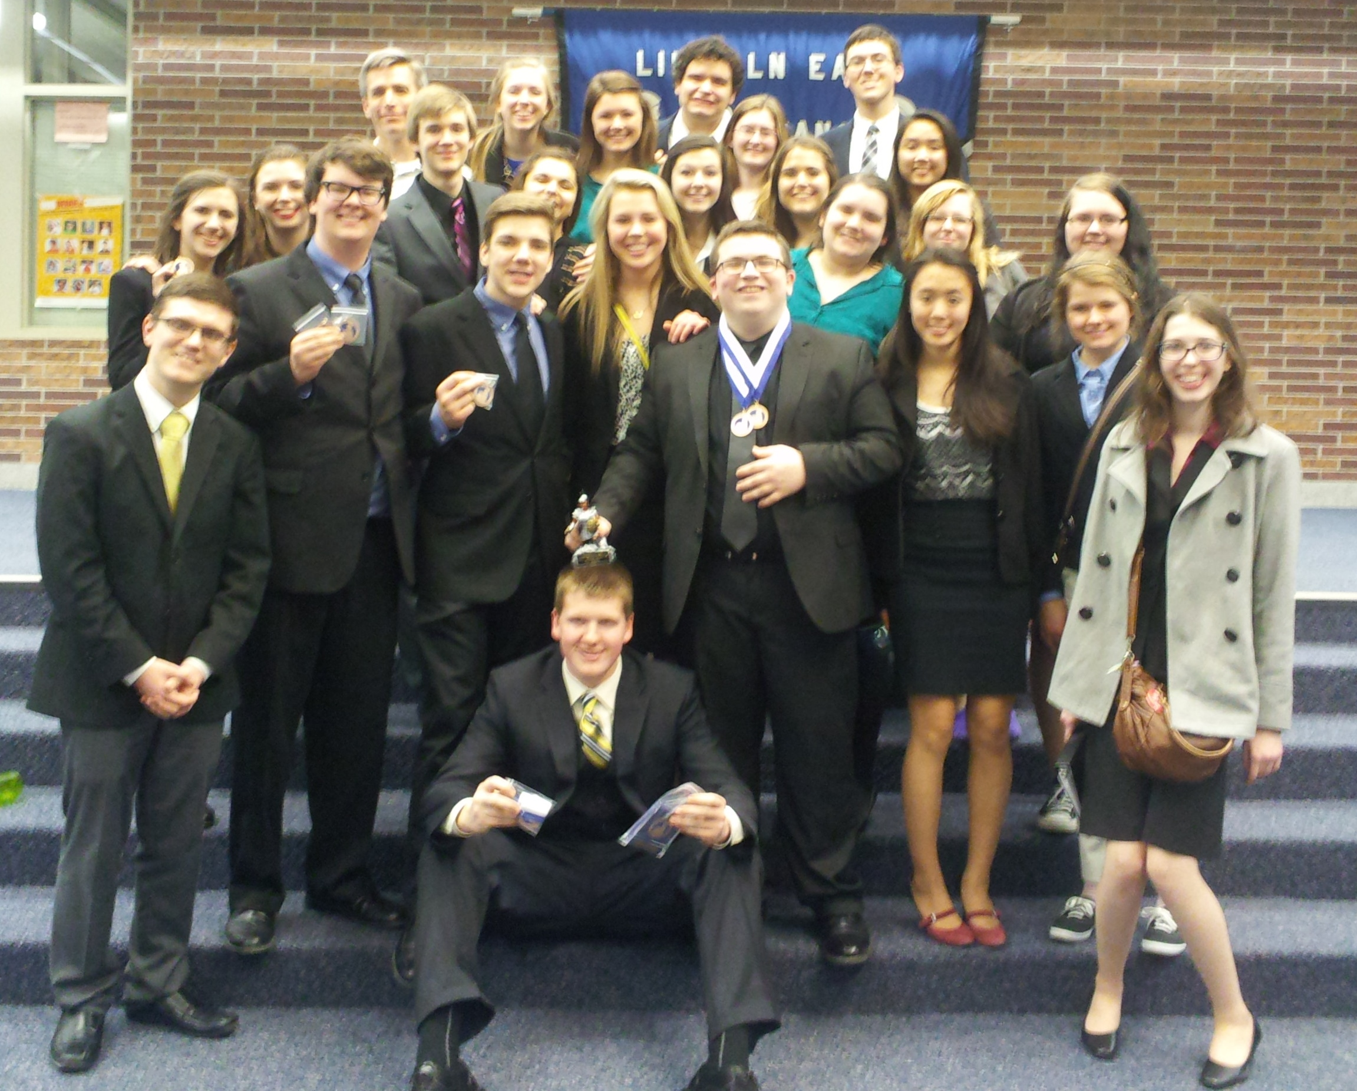
Come Join Us!

