Slide 1
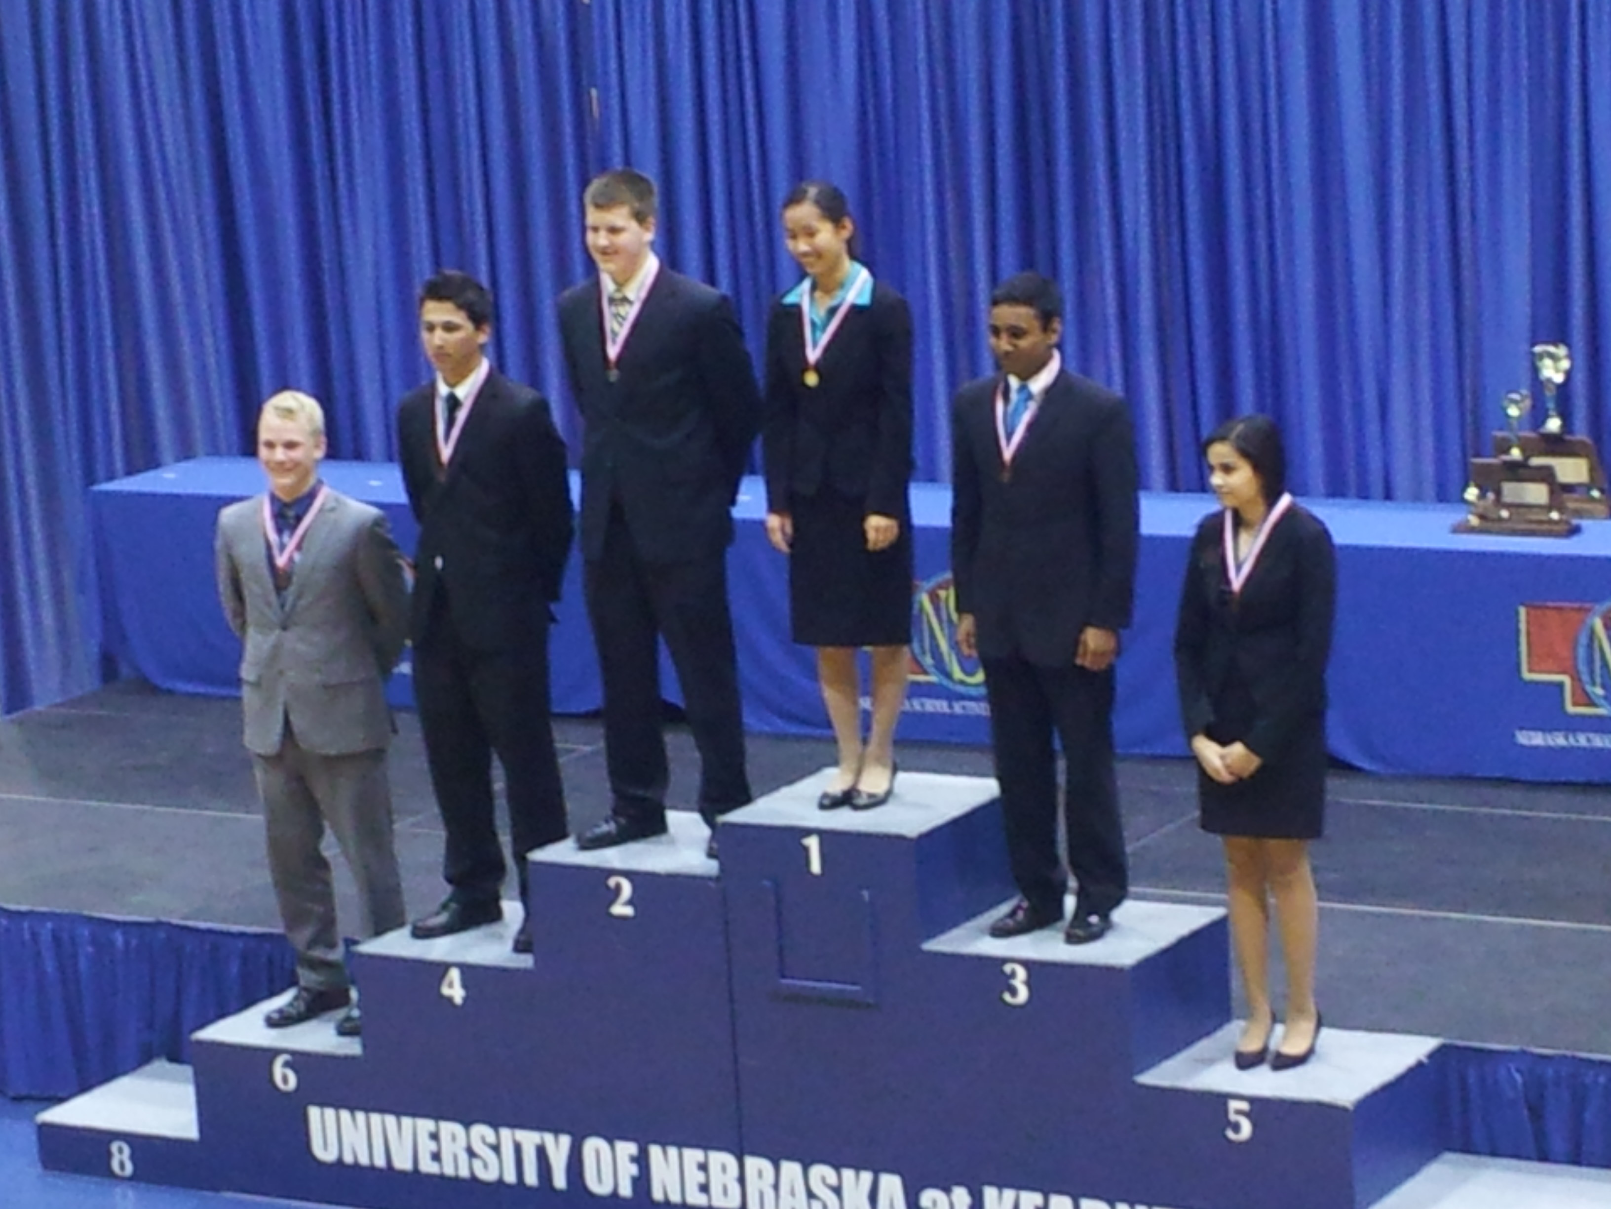
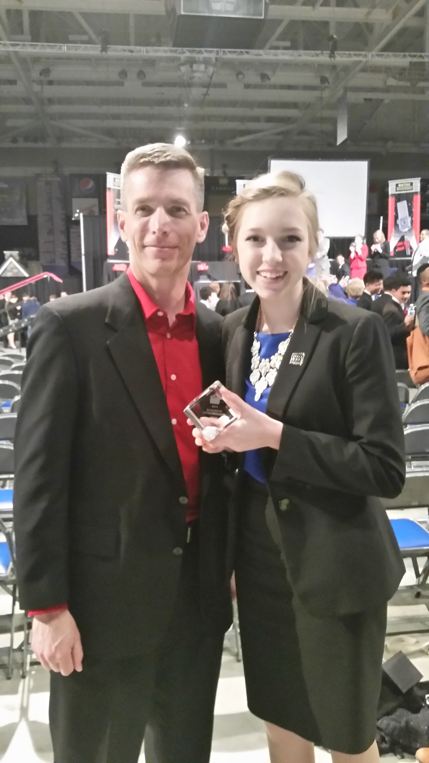
Tournament Attire
Do:
Do:

Slide 2
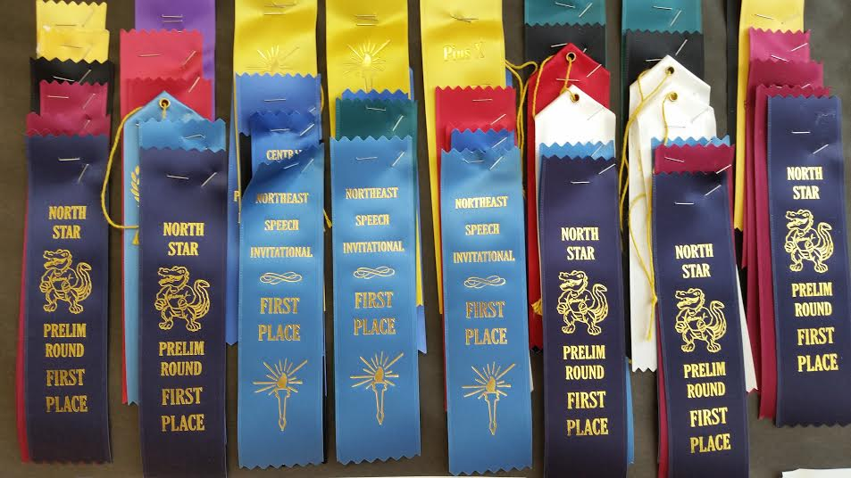
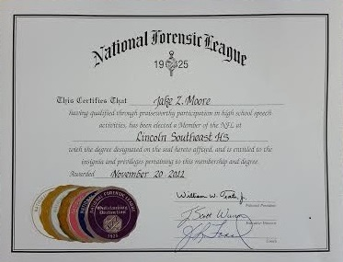
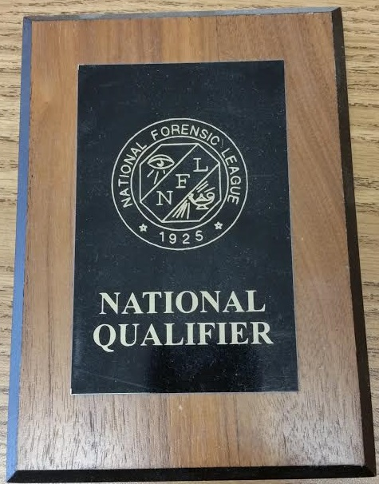
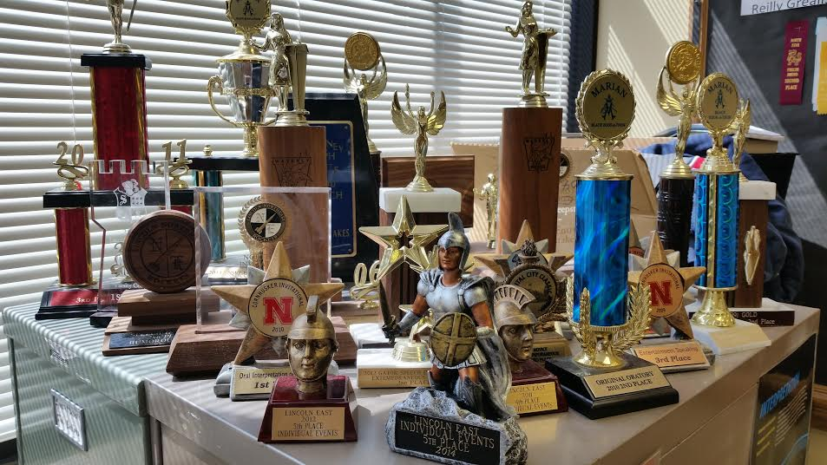
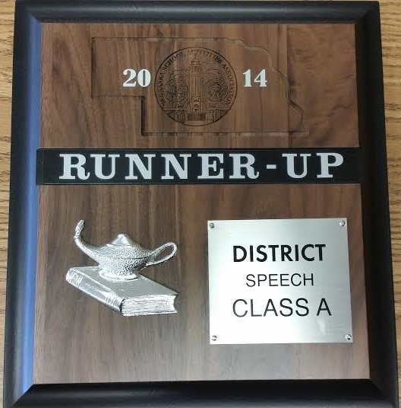
Awards and Organizations
www.speechanddebate.org
www.nsaahome.org

Slide 3
How to get started!!!
* Get Connected!
Fill out contact information
Find our Facebook page
https://www.facebook.com/groups/2363894635/
Meet others on the team today, especially the captains and those who do events you might like to do
Meet up with team members over the summer to talk about events, look for materials, or just get to know each other
* Start thinking about events you’d like!
Read the brochures about events
Discuss events with current members
Find example events online
Bounce ideas off Mr. Bender during the summer
Read, read, read, read, read!

Slide 4
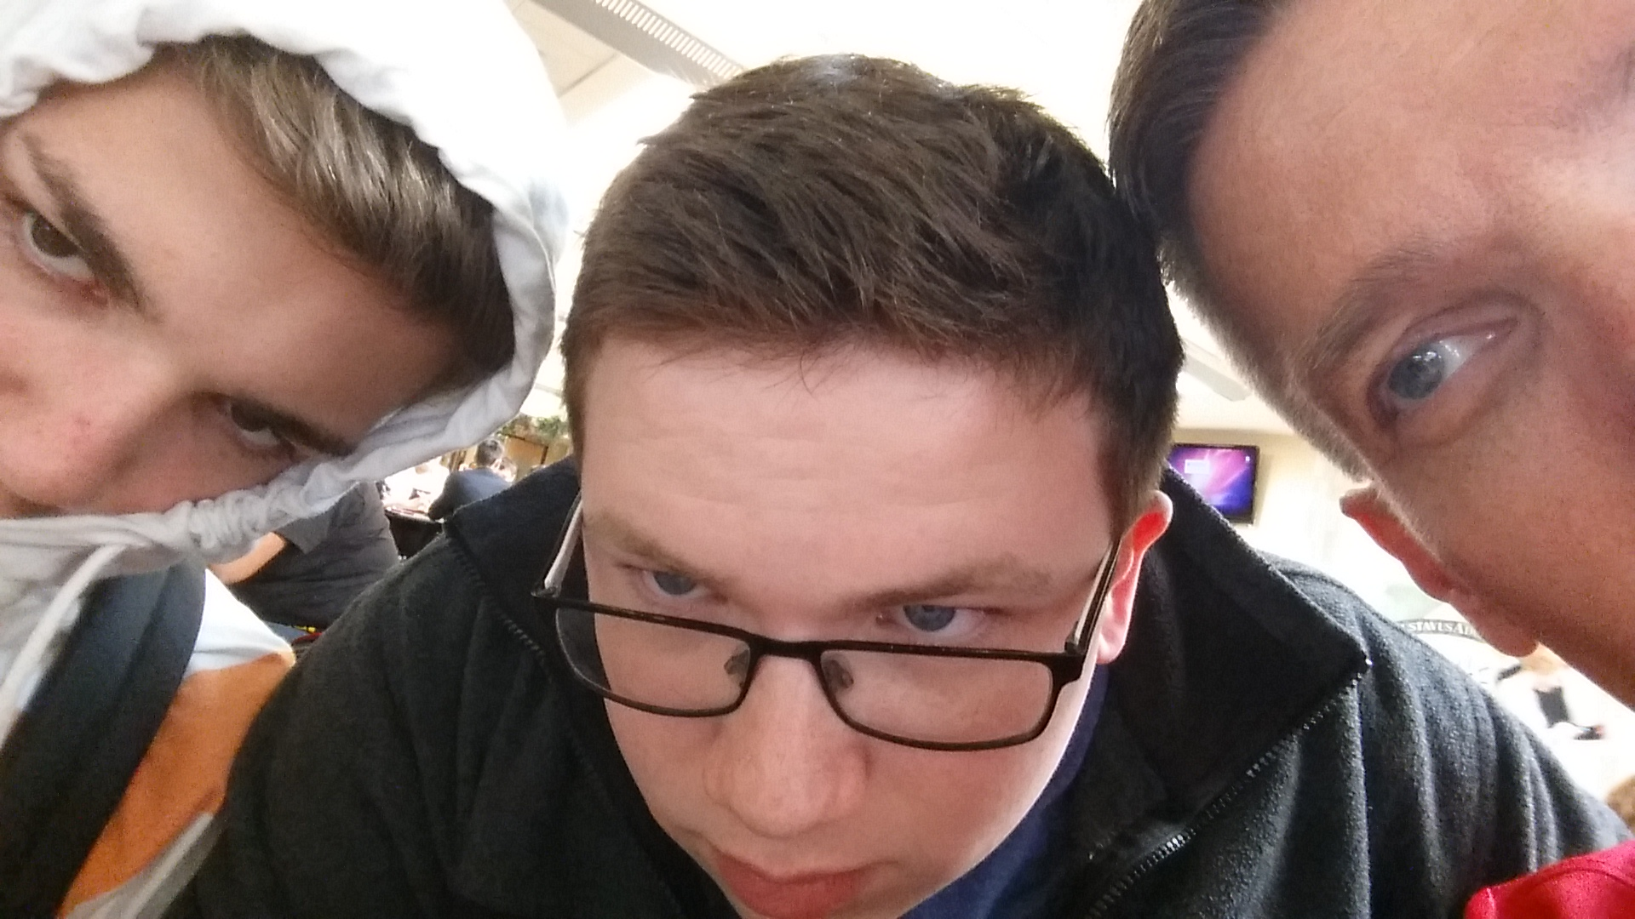
Summer Activities
Official Summer team meetings
Summer camps
We will meet from time to time as a team over the summer at school, where we will meet and discuss events and materials.
Stay in touch with Mr. Bender for specific dates.
tbender@lps.org
There are many local and out of state camps that will give you a huge leg up on getting ready for the season. Most camps are several days, and should go a long ways towards being competition ready before school even starts!
* UNL
* Perfect Performance at LSW
* Hastings
* Gustavus Adolphus
* Many out of state…

