Slide 1
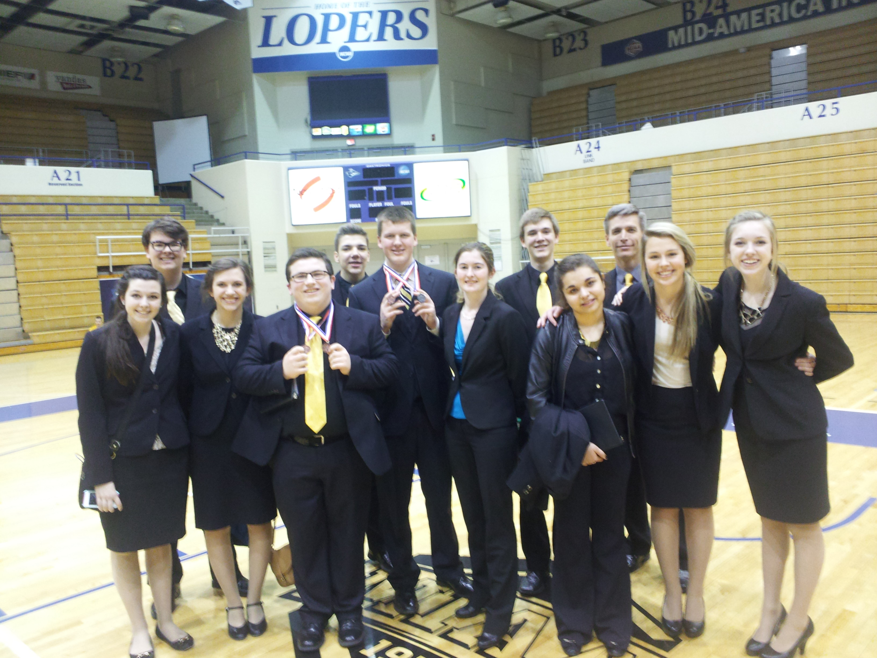
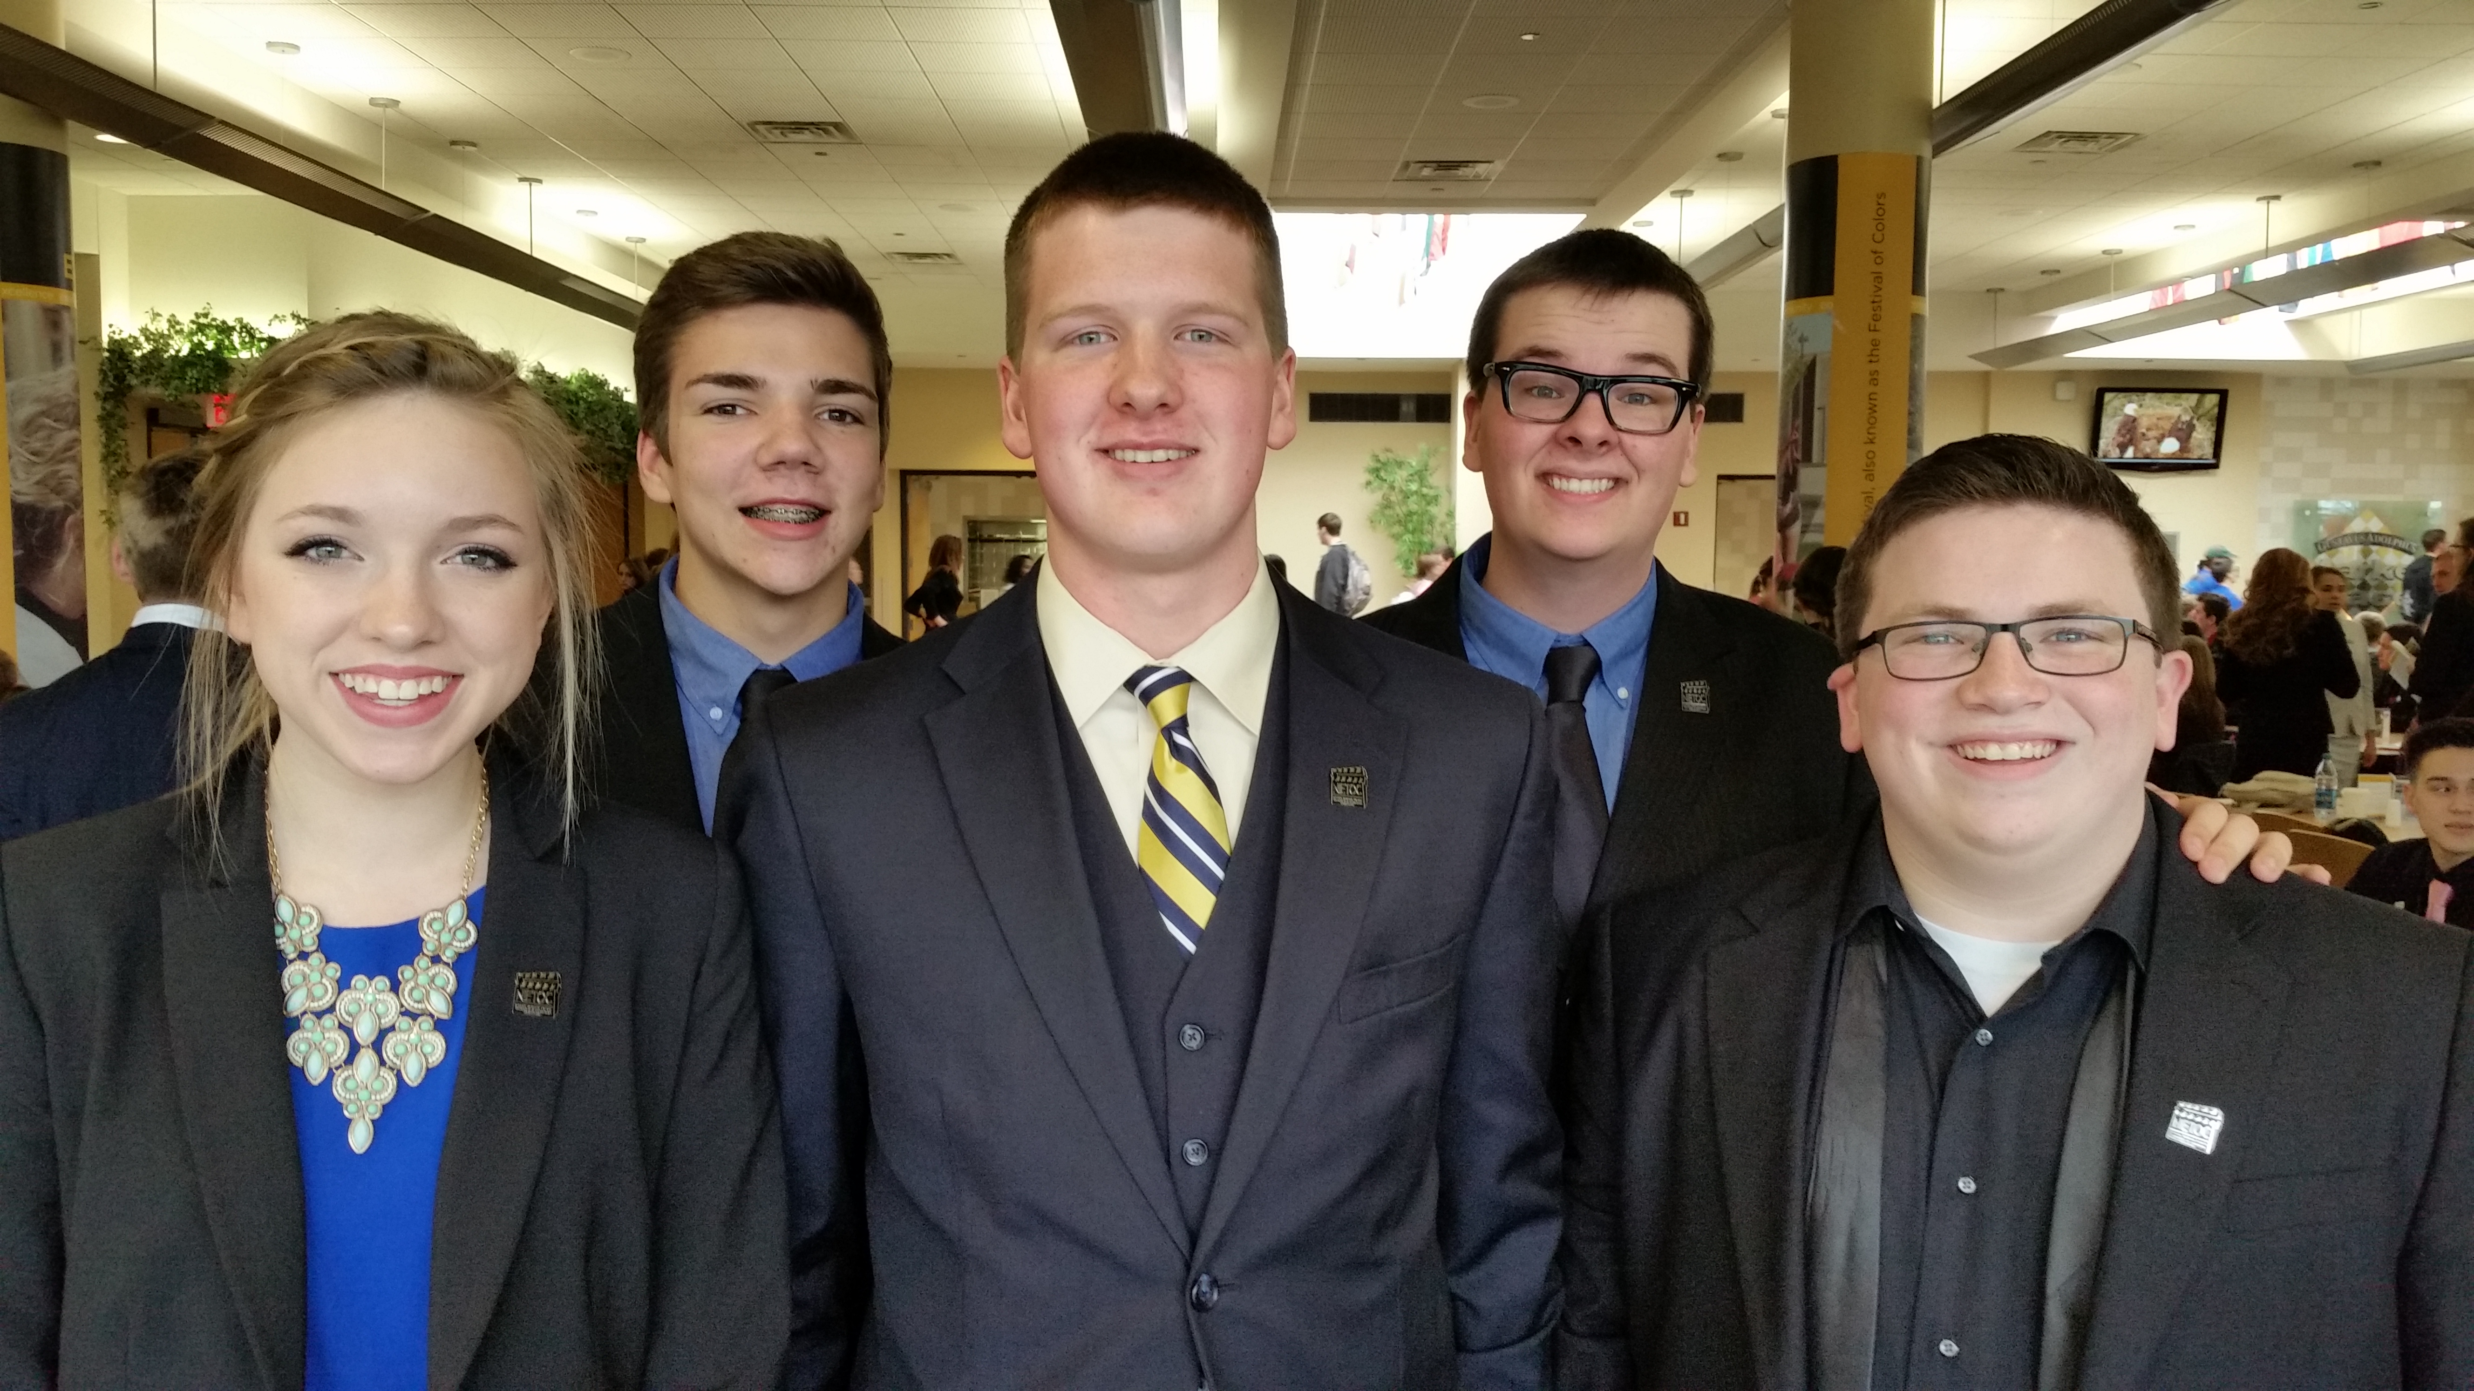
Districts – State - Nationals
After the regular season is over, we then compete in Districts, State, and National tournaments. Qualification criteria for each tournament varies, but usually starts with regular season performance. Do your best every tournament!

Slide 2
Practice Makes Perfect!
Team members are expected to practice twice per week with a coach
Sign up times are flexible, with both evening and afternoon time slots available.
Team members only need to be present during their time slot (You can go once finished).
Team members are also expected to practice on their own during the week.
We’re all in this together – help each other out!

Slide 3
Monday Team Meetings
During the season, we meet every Monday after school.
We use these times to discuss current issues (like team shirts or hosting tournaments), as well as signing up for practice.
Team meetings are generally mandatory, unless you have prior approval for absence.
Approval can include – fall sport, family emergency, etc.
Most other things should be scheduled around this time.
Missing Team Meetings Makes Mr. Bender Sad!!!!

