Slide 1
Lincoln Southeast Competitive Speech
2014-15

Slide 2
Welcome to LSE Competitive Speech!
We’re coming off a great year in 2013-2014, where we:
Had many top 5 finishes at regular season tournaments.
Placed 2nd at NSAA Districts and qualified 11 events to State.
Had 4 events make finals at state, and placed 4th overall in Class A
Qualified 4 events to NIETOC Nationals, and had 1 make semi-finals
Have another event qualified for NSDA Nationals in June

Slide 3
There’s an event for everyone!
Interpretation and Acting
* Humorous Interpretation
* Dramatic Interpretation
* Poetry Interpretation
* Duet Acting
* Duo Interpretation
* Oral Interpretation of Drama
Public Speaking and Limited Preparation
* Persuasive Speaking
* Informative Speaking
* Entertainment Speaking
* Extemporaneous Speaking
* Impromptu Speaking

Slide 4
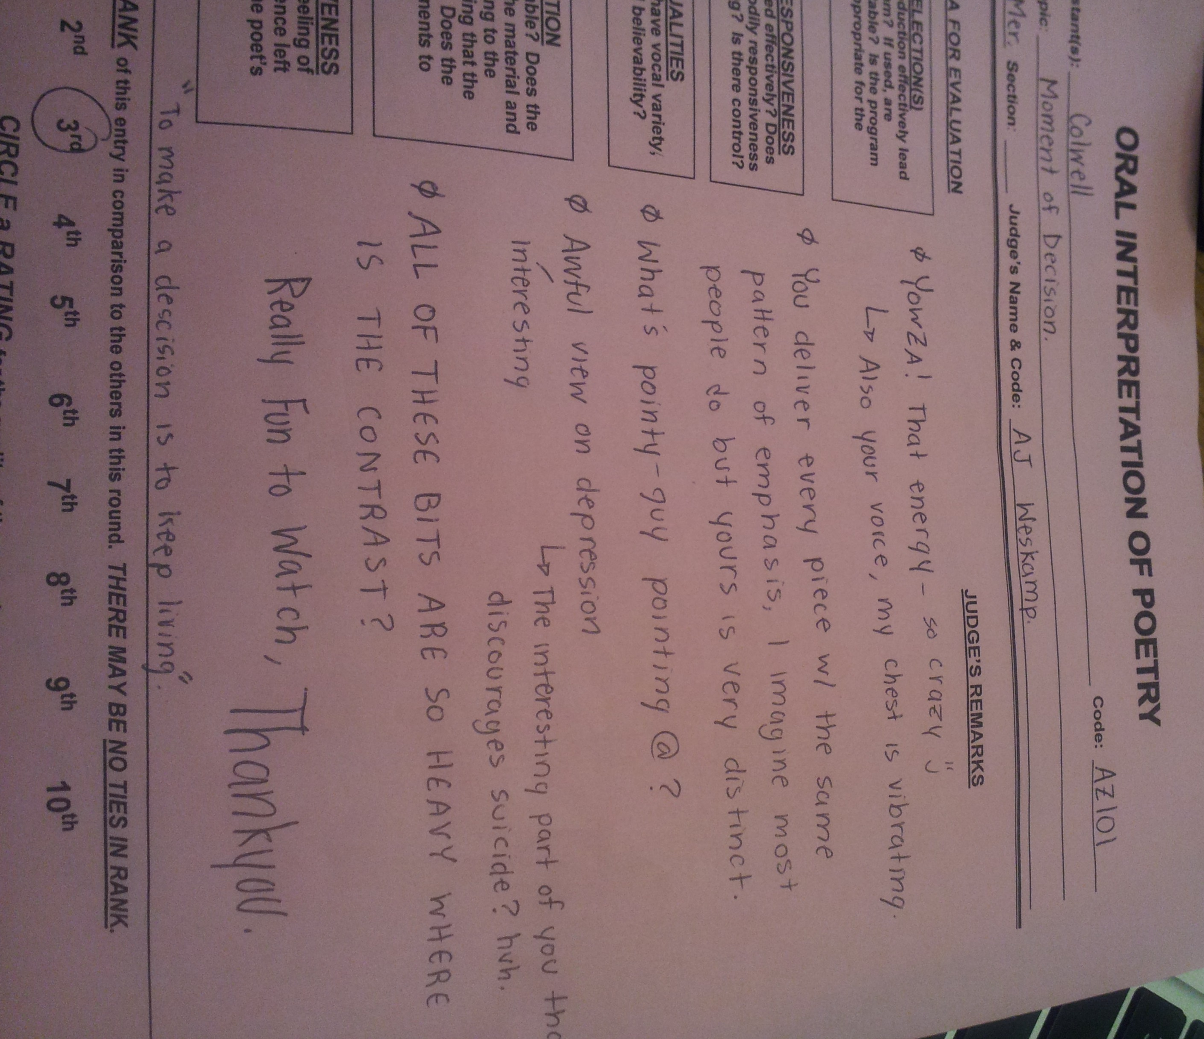
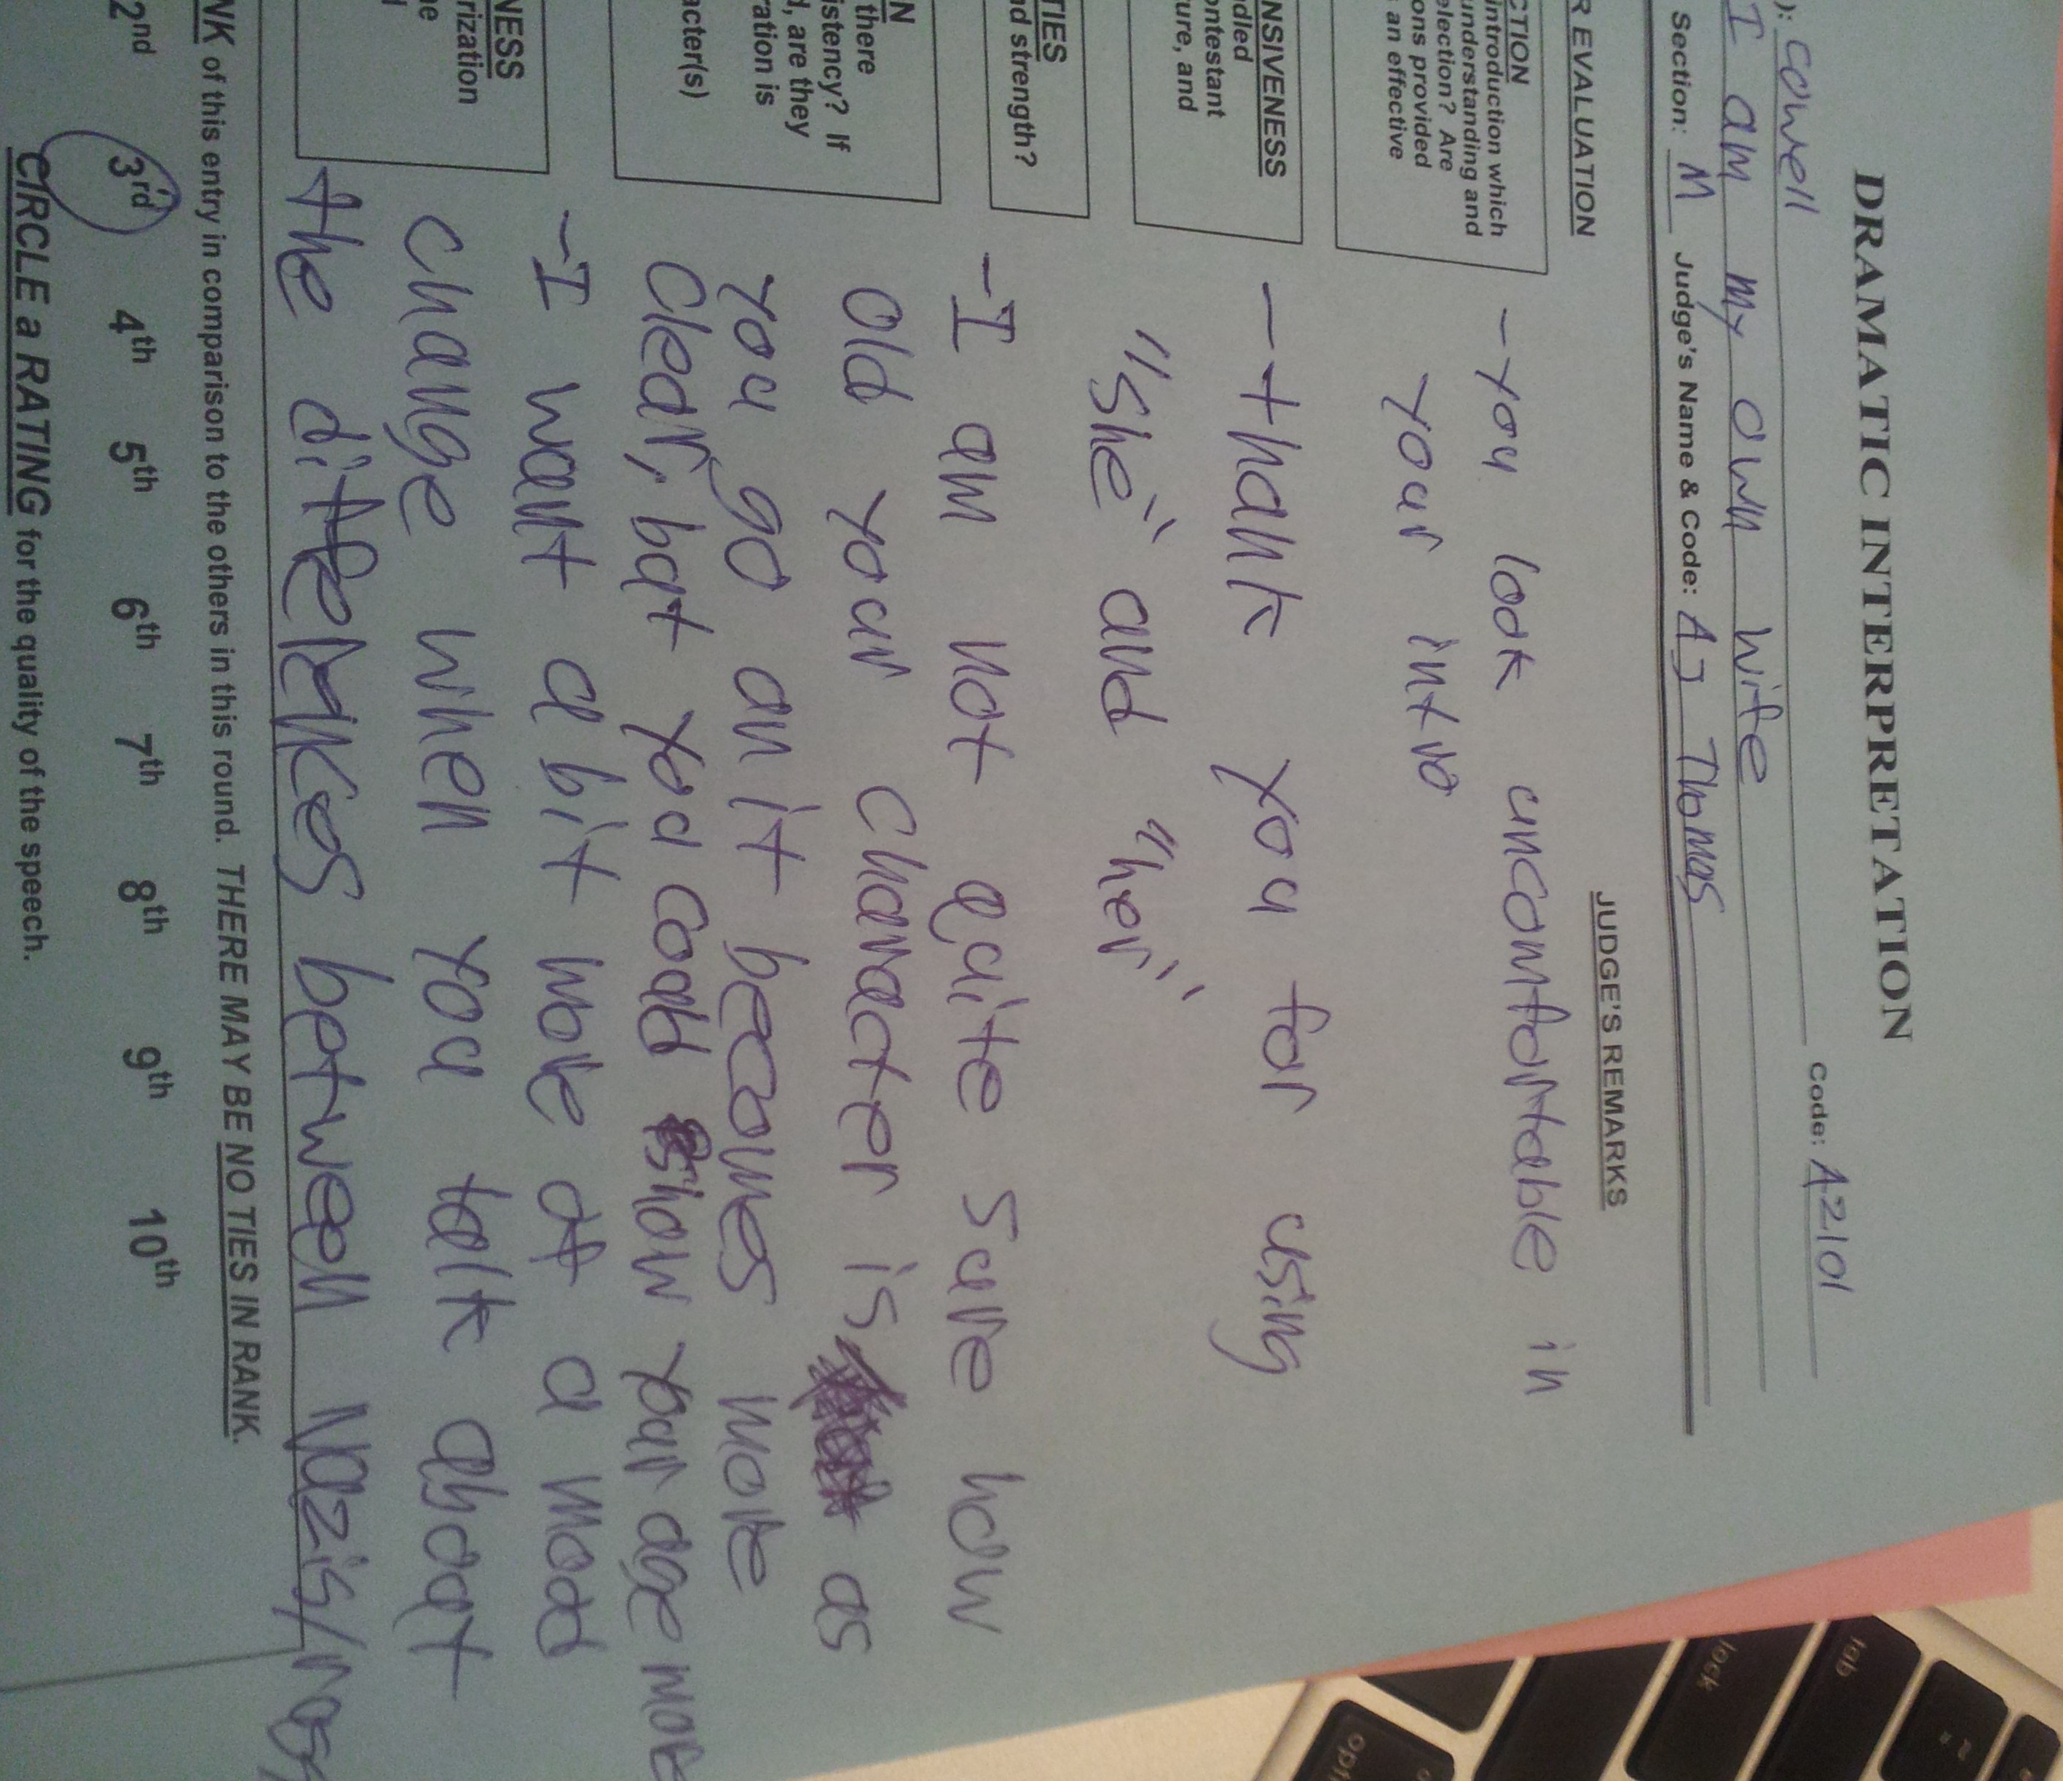
The Tournament Day:
You compete against other teams from our area.
No matter how many are in your event, you usually only compete against 5-7 at a time.
Tournaments are on Fridays and Saturdays from November until March.
Friday tournaments are generally from 3-10 plus travel time.
Saturday tournaments are generally 9-5 plus travel time.
There are around 18 regular season tournaments on the schedule, but you only have to commit to 8.
You can go to as many as 12 regular season tournaments.

