Slide 1
Critical Thinking
The World Around Us

Slide 2
In Your Notes…
What is Critical Thinking? What does it mean to be a Critical Thinker?

Slide 3
“Critical Thinking; Where to Begin”
“Critical thinking is the intellectually disciplined process of actively and skillfully conceptualizing, applying, analyzing, synthesizing, and/or evaluating information gathered from, or generated by, observation, experience, reflection, reasoning, or communication, as a guide to belief and action.”

Slide 4
-- Linda Elder (2007)
It is self-guided, self-disciplined thinking…
Critical thinkers use the intellectual tools that critical thinking has to offer– concepts and principles that enable them to analyze, assess, and improve thinking.
Critical Thinkers strive to improve the world in whatever ways they can and contribute to a more rational, civilized society.

Slide 5
Simply Put…
Critical Thinking is a way of experiencing education and the world around us. It allows students to analyze, wonder, and question their surroundings, their education, others in a respectful and empowering way.

Slide 6
Francis Bacon (1605)
“Critical thinking is a desire to seek, patience to doubt, fondness to meditate, slowness to assert, readiness to consider, carefulness to dispose and set in order; and hatred for every kind of imposture.”

Slide 7
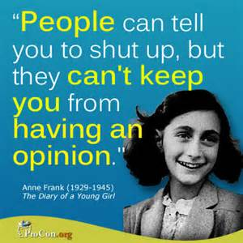

Slide 9
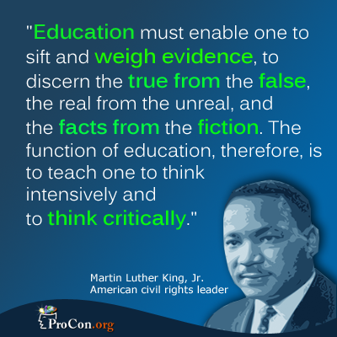

Slide 10
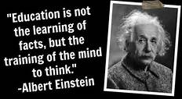

Slide 11
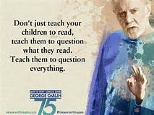

Slide 12
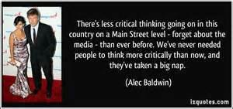

Slide 13
Bloom’s Taxonomy
Bloom's taxonomy is a set of three hierarchical models used to classify educational learning objectives into levels of complexity and specificity. The three lists cover the learning objectives in cognitive, affective and sensory domains.
Benjamin Bloom

