Slide 1
Elements of Fiction
Short Story Unit

Slide 2
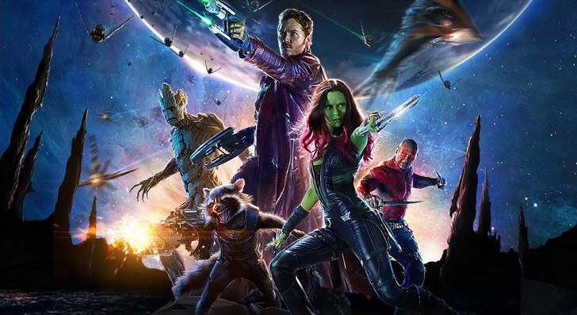
Setting
The time and place of the story.
Geographical Location
Time Period
Specific building or room

Slide 3
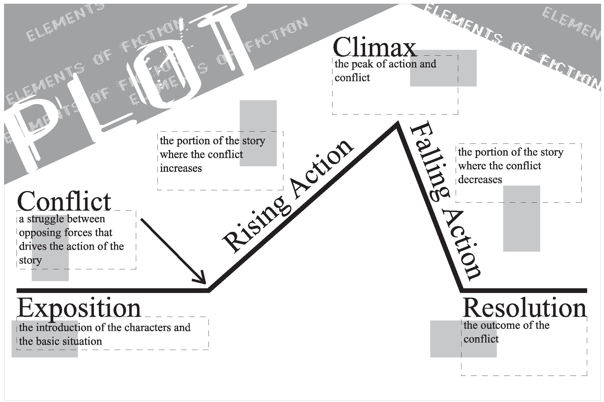
Plot
This is the literary element that describes the structure of the story. It shows arrangement of events and actions within a story.

Slide 4
Plot Components

Slide 5
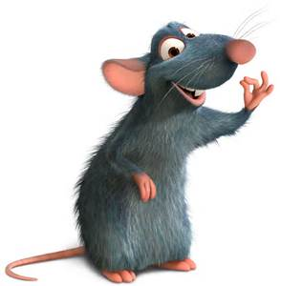
Point of View
The perspective from which the story is told.
Who is telling the story?
2. How do we know what is happening?

Slide 6
First Person Point of View
Told from the viewpoint of one of the characters, using the first person pronoun “I.”
“The thousands of injuries of Fortunato I had borne as I best could, but when he ventured upon insult I vowed revenge. You, who so well know the nature of my soul, will not suppose, however, that I give utterance to a threat.”
“The Cask of Amontillado” by Edgar Allan Poe

Slide 7
Third Person Point of View
A narrator tells the events of the story using third person pronouns such as “he” or “she.”
“When Jane and Elizabeth were alone, the former, who had been cautious in her praise of Mr. Bingley before, expressed to her sister how very much she admired him. ‘He is just what a young man ought to be,” said she…”
Pride and Prejudice Jane Austen

Slide 8
Omniscient Point of View
The author is telling the story directly.
Omniscient = All Knowing
“Myop carried a short, knobby stick. She struck out random at chickens she liked, and worked out the beat of a song on the fence around the pigpen. She felt light and good in the warm sun. She was ten, and nothing existed for her but her song, the stick clutched her dark brown hand, and the tat-de-ta-ta-ta of accompaniment.” “The Flowers” by Alice Walker

Slide 9
Limited Omniscient Point of View
Third person, told from the viewpoint of a character in the story.
“They all laughed, and while they were laughing, the quiet boy moved his bare foot on the sidewalk and merely touched, brushed against a number of red ants that were scurrying about on the sidewalk. Secretly, his eyes whining, while his parents chatted with the old man, he saw the ants hesitate, quiver, and lie on the cement. He sensed they were cold now.”
“Fever Dream” by Ray Bradbury

Slide 10
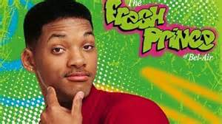
Theme
Theme is the main idea or central message of the story. It usually contains some insight into the human condition– telling something about humans and life.
The theme can be stated directly or implied by the events and actions in the story.

Slide 11
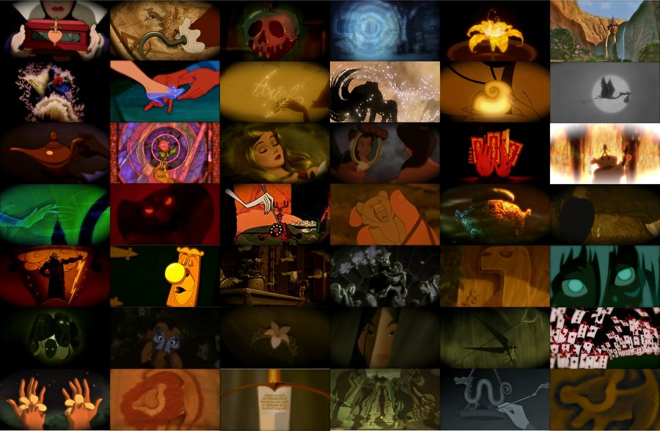
Symbolism
A symbol represents an idea, quality, or concept larger than itself.

Slide 12
Symbolism
What can these symbols represent?
A journey can symbolize…
A lion can symbolize…
A red rose can represent…
Water can be a symbol of…

Slide 13
Tone
The author’s attitude/feelings about the subject reflected in the text.
Mood
The overall feeling or atmosphere of a story. It is the way that you feel when you are reading.

Slide 14
Characterization
How characters develop throughout a story.
Round Characters: Convincing, true to life. Have many different and sometimes contradictory personality traits.
Dynamic Characters: Undergo some type of change or development in the story, often because of something that happens to them.
Flat Characters: Stereotyped, shallow, and often symbolic. Have only one or two personality traits.
Static Characters: Do not change in the course of a story.

Slide 15
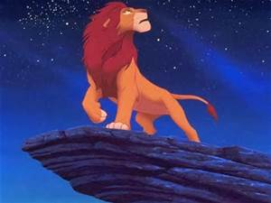
The Protagonist
The main character in a literary work.

Slide 16
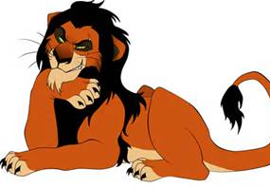
Antagonist
The character who opposes the protagonist.

Slide 17
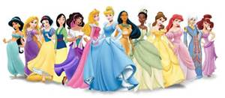

Slide 19
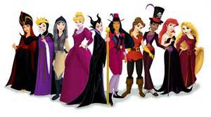

Slide 20
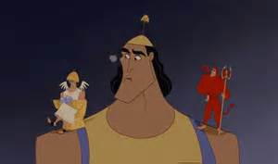
Conflict
The struggle between opposing forces.

Slide 21
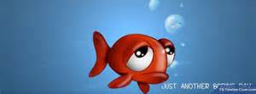
Conflict
CONFLICT IS THE PLOT. Without it, we have no story!
Imagine FINDING NEMO without any conflict….

Slide 22
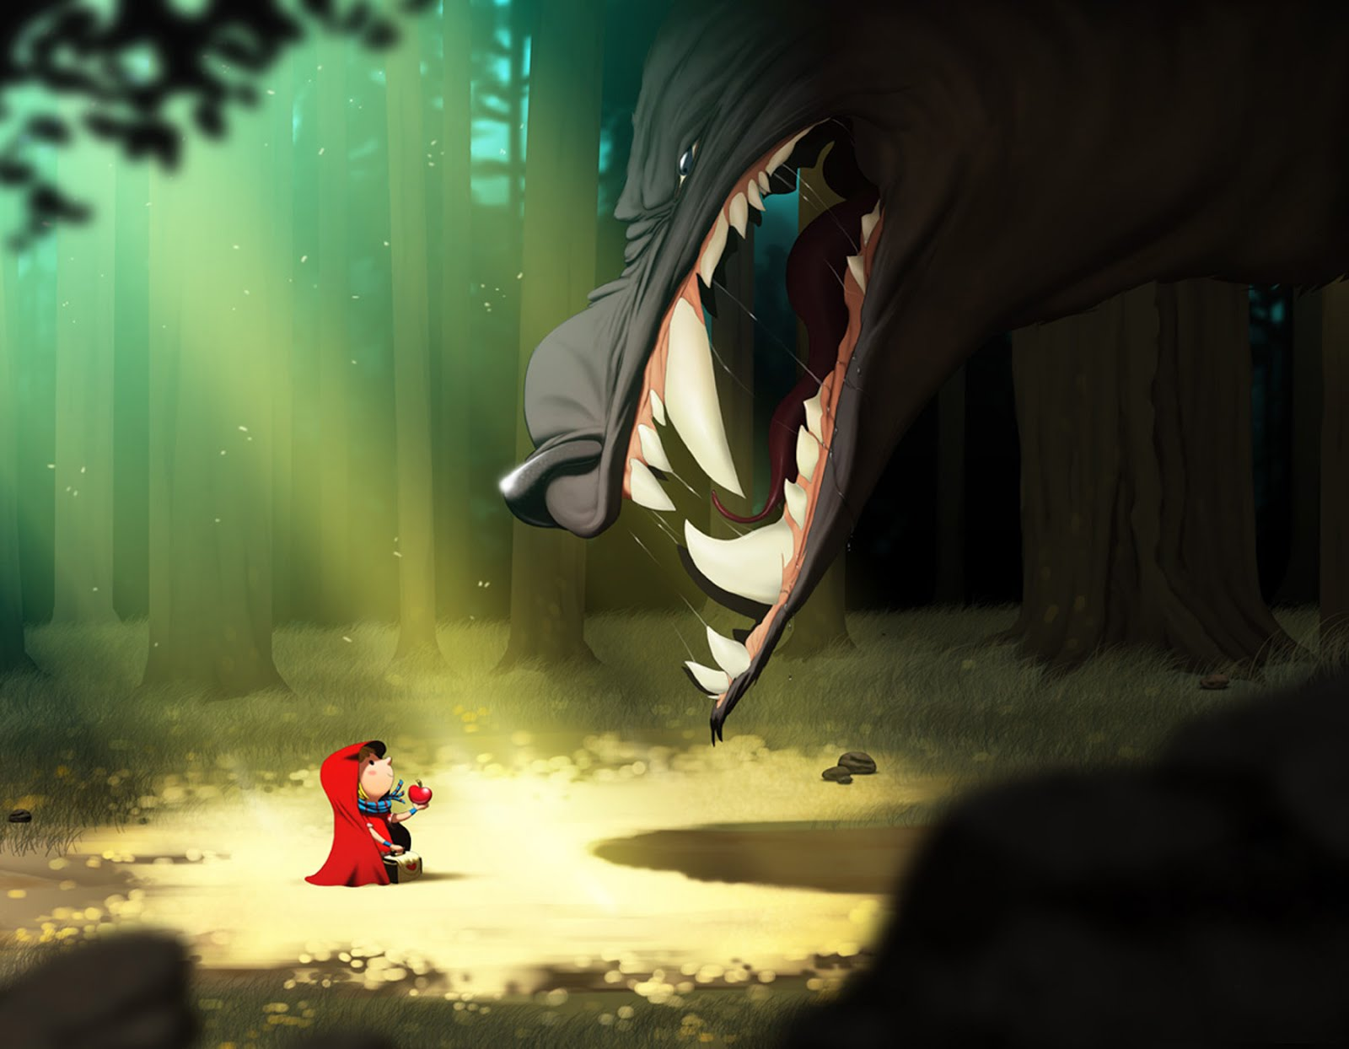
Conflict in literature
Sets a protagonist against an antagonist.

Slide 25
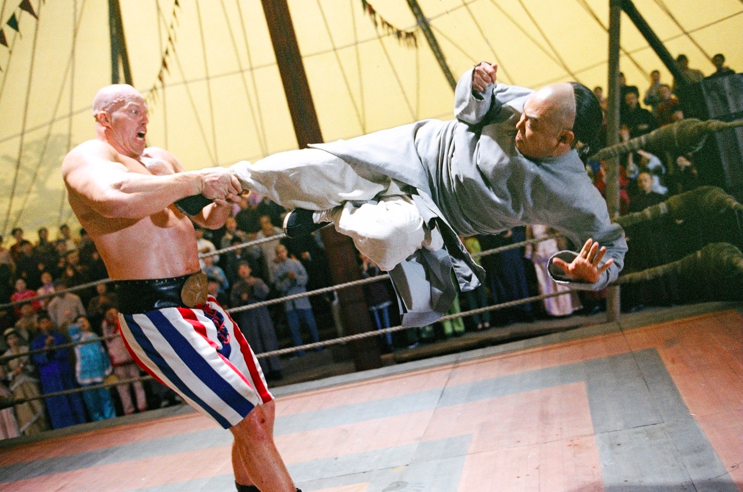
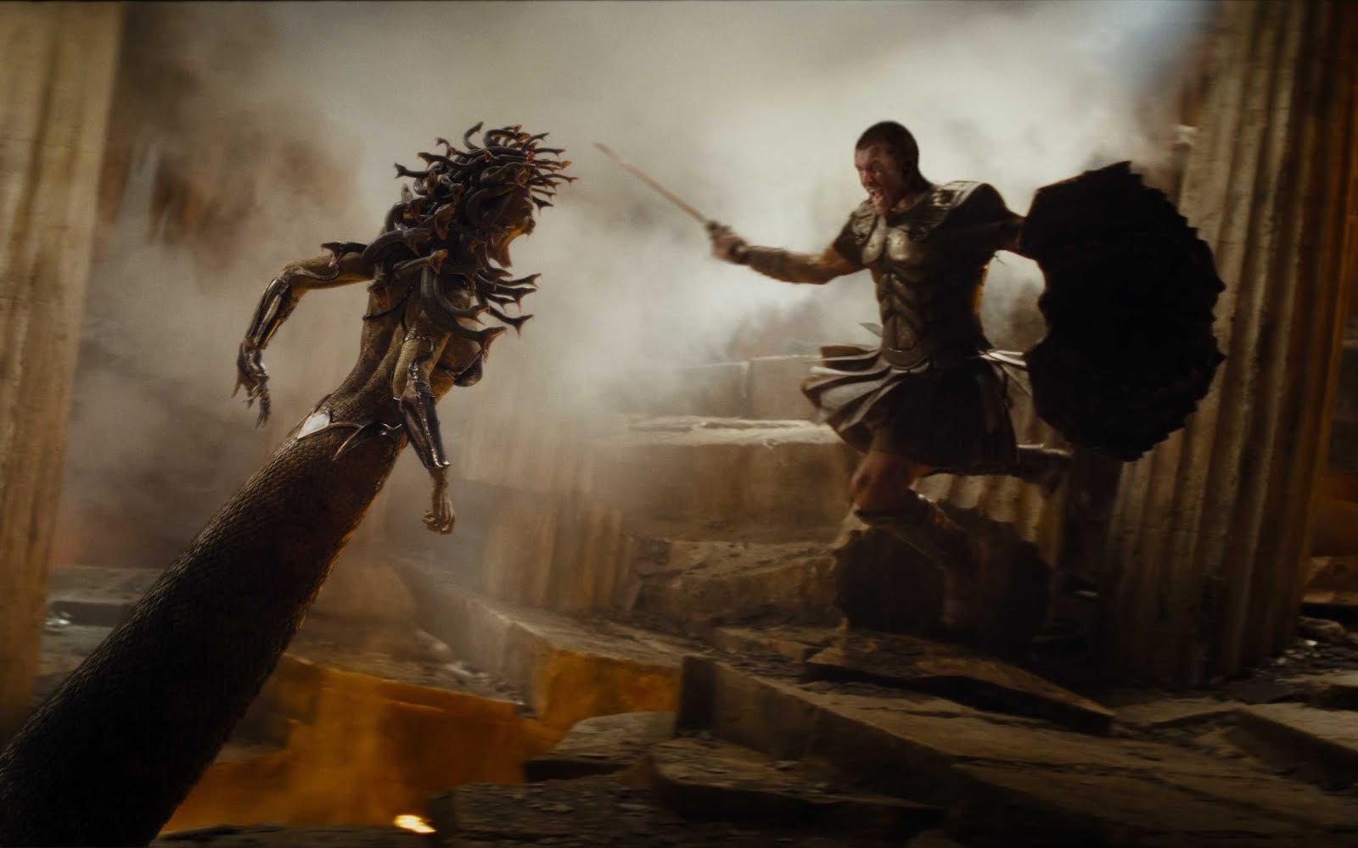
Man vs. Man
This includes conflicts against supernatural or fantasy beings that are human-like…
Conflict sets a protagonist against human (or human-like) antagonist.

Slide 26
…and animal vs. animal if your protagonist is an animal

Slide 27
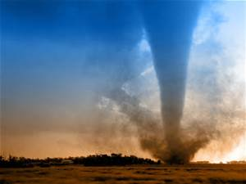
Man vs. Nature
Protagonist against a force of nature.

Slide 30
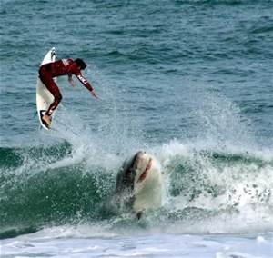
Man vs. Nature
Can also be living things from nature if they are not human-like characters in the story.

Slide 31
NOT THIS…

Slide 32
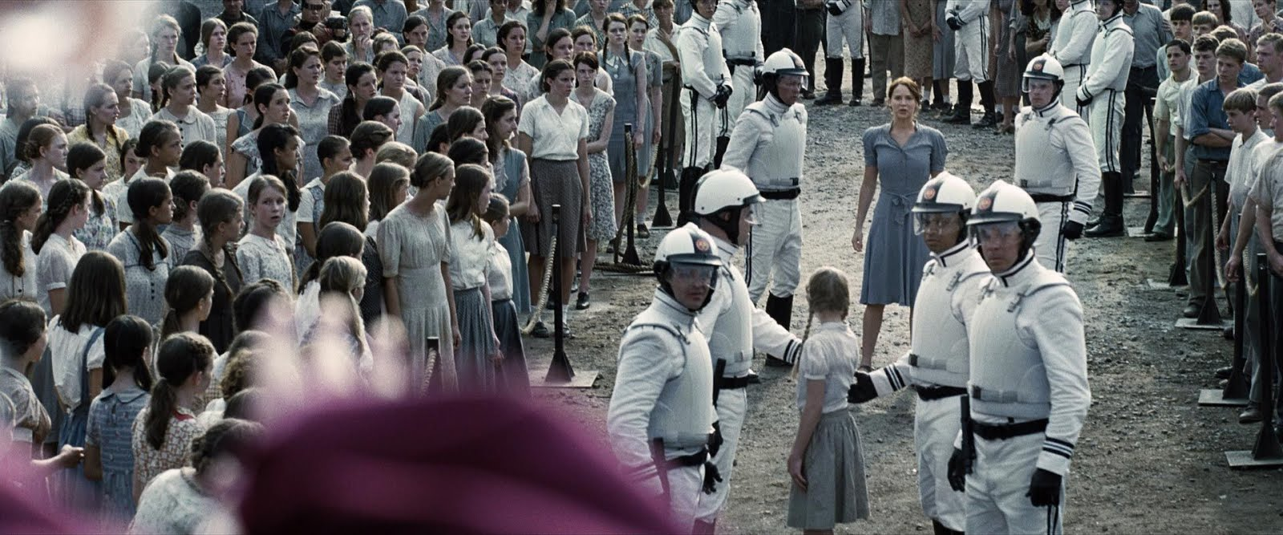
Man vs. society
Protagonist against elements of government or culture.

Slide 33
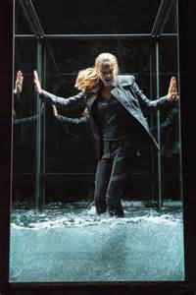
Man vs. self
Conflict sets the protagonist against himself or herself.
This is internal conflict. It all happens inside the character’s mind.
Making a decision or overcoming guilt, sadness, or fear are all examples of man vs. self conflict.

Slide 34
What type of conflict?

Slide 35
foreshadowing
The use of hints or clues to suggest what will happen later in the story. This helps the reader anticipate the outcome of the story.
An author’s use of hints or clues to suggest events that will occur later in the story. Not all foreshadowing is obvious. Frequently, future events are merely hinted at through dialogue, description, or the attitudes and reactions of the characters.
Foreshadowing frequently serves two purposes. It builds suspense by raising questions that encourage the reader to go on and find out more about the event that is being foreshadowed. Foreshadowing is also a means of making a narrative more believable by partially preparing the reader for events which are to follow.

Slide 36
Suspense
A feeling of excitement, curiosity, or expectations about what will happen.

Slide 37
Imagery
Language that appeals to the senses. Descriptions of people or objects stated in terms of our senses.

Slide 38
Allusion
A reference to a well-known person, place, event, literary work, or work of art.

Slide 39
Simile
Comparison of two things using “like” or “as”

Slide 40
Metaphor
Comparison of two things essentially different but with some commonalities; does not use “like” or “as”

Slide 41
Irony
A technique that involves surprising, interesting, or amusing differences between appearance and reality.
Irony = contradictions or contrasts.
There are three types:
Verbal
Dramatic
Situational

Slide 42
Verbal Irony
Words used to suggest the opposite of their usual meaning.

Slide 43
Dramatic Irony
A contradiction between what a character thinks and what the reader or audience knows to be true.

Slide 44
Situational Irony
An event occurs that directly contradicts the expectations of the character, reader, or audience.

