Slide 1
CHAPTER 9.1
THE BENEFITS OF PHYSICAL ACTIVITY
(PAGES 204-208)

Slide 2
OBJECTIVES……
ANALYZE THE BENEFITS OF PHYSICAL ACTIVITY
DEVELOP HABITS TO IMPROVE YOUR PHYSICAL HEALTH
DESCRIBE VARIOUS TYPES OF PHYSICAL ACTIVITIES
EXPLAIN THE IMPORTANCE OF EXERCISES TO OVERALL FITNESS
VOCAB WORDS: physical activity; balance; coordination; calories; physical fitness; exercise; AEROBIC EXERCISE; ANAEROBIC EXERCISE

Slide 3
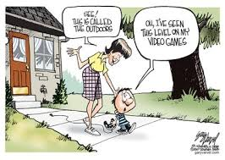
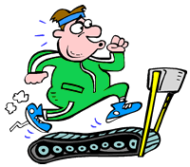
WHAT IS PHYSICAL ACTIVITY?
PHYSICAL ACTIVITY: Any form of BODILY movement that uses up ENERGY
How many minutes per day is recommended?

Slide 4
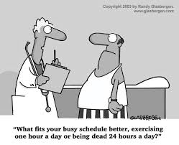
Why Physical Activity?
Benefits ALL sides of the HEALTH TRIANGLE
Physical, Mental/Emotional, Social

Slide 5
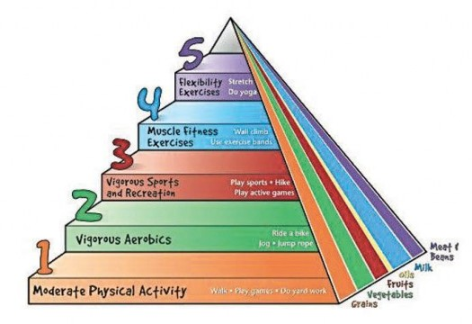
Physical Activity Pyramid

Slide 6
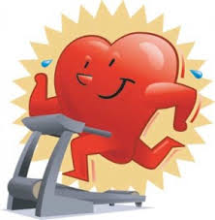
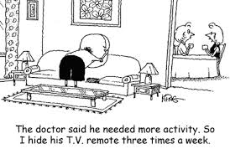
Physical Health Benefits
More Energy to complete daily activities
Helps the HEART & LUNGS work more efficiently
Strengthens Bones, improves coordination, and muscle strength, and balance

Slide 7
Mental/Emotional Health Benefits
Being active helps you HANDLE STRESS and challenges of everyday life.
Better SELF-ESTEEM
Helps ability to think clearly & CONCENTRATE.

Slide 8
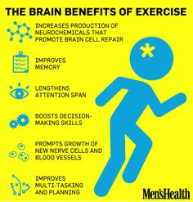
Mental/Emotional Benefits Cont…

Slide 9
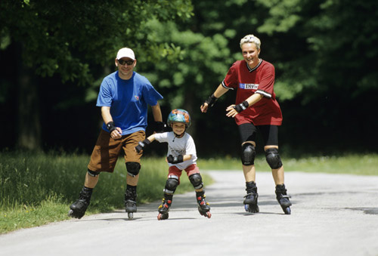
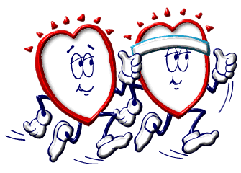
SOCIAL HEALTH BENEFITS
Can help you meet NEW PEOPLE. (What? How?)
Improved ability to work as a TEAM.
Meet many diverse people.

Slide 10
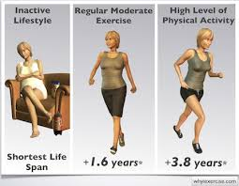
Physical Activity & Fitness
PHYSICAL FITNESS: the ability to handle the physical DEMANDS of everyday life without becoming overly TIRED.
Have plenty of energy plus a RESERVE for when their bodies need it.
Can lengthen life expectancy (What is that?)

Slide 11
Importance of Exercise
Exercise: planned physical activity done REGULARLY to build or maintain one’s fitness.
Physical activity WORKS various muscles, but exercise TARGETS specific muscles.
Two Basic Categories of Exercise
Aerobic: LARGE AMOUNTS OF OXYGEN
Anaerobic: LITTLE OXYGEN

Slide 12
AEROBIC EXERCISE
Aerobic: rhythmic, nonstop, moderate to vigorous activity that requires large amounts of OXYGEN.
Works very important muscle the HEART
EXAMPLES: RUNNING (WHAT KIND OF RUNNING?); BIKING; STAIR CLIMBING; BRISK WALKING

Slide 13
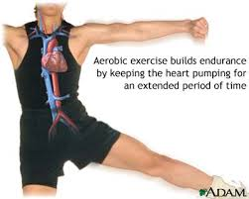
Aerobic Exercise

Slide 14
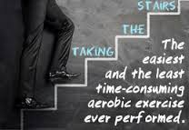
Aerobic Examples

Slide 15
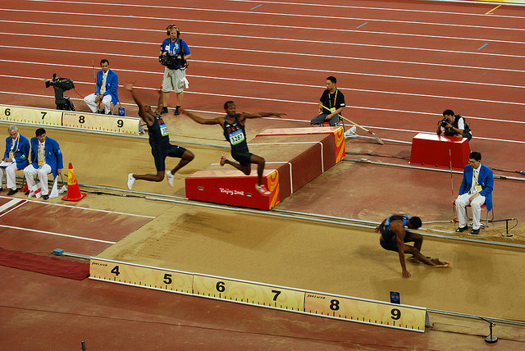
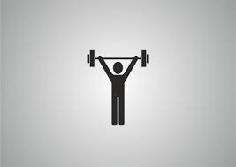
ANAEROBIC EXERCISE
Anaerobic: intense physical activity that requires LITTLE OXYGEN but uses short bursts of ENERGY.
What are 3 examples of anaerobic exercises?
LIFTING WEIGHTS, GYMNASTICS, FOOTBALL, TRACK & FIELD EVENTS

Slide 16
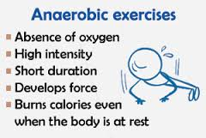
Anaerobic Examples

Slide 17
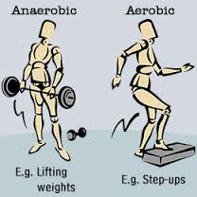
Anaerobic vs Aerobic…..

