Slide 1
Setting Fitness Goals
Chapter 9.3
(Pages 215 -220)

Slide 2
Identifying Your Fitness Goals
Reaching a fitness goal requires a plan. (GOAL)
Ask yourself:
What do you personally hope to accomplish?
Goals should include strategies that will help you improve and maintain your fitness level.

Slide 3
Choosing Activities & Exercises
Consider the following when choosing activities:
Personal tastes: Choose activities that you enjoy doing.
Vary your routine by cross training.
Cross Training: Switching between different activities & exercises on different days.
*Helps to keep your interest level high

Slide 4
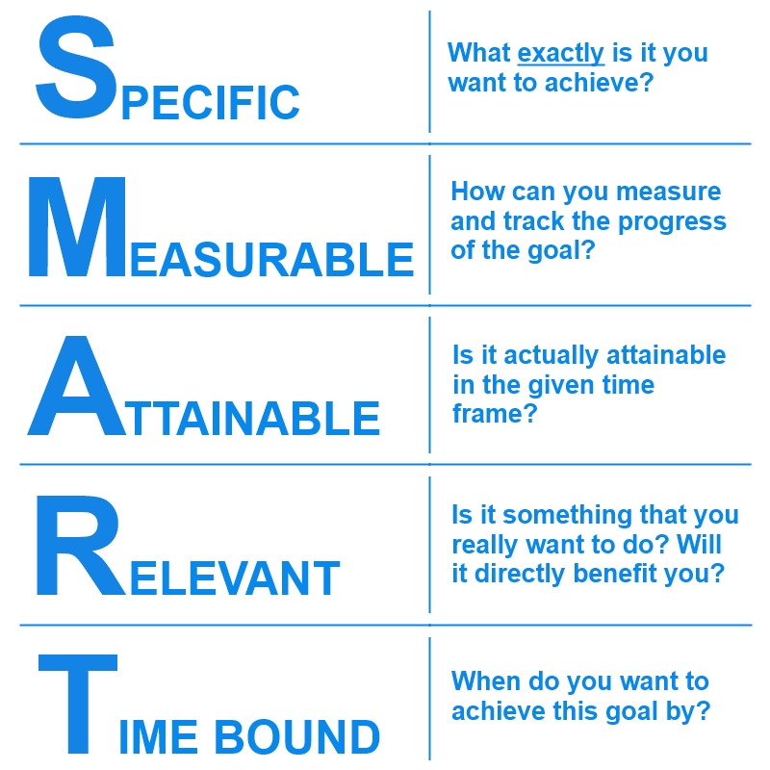
S M A R T GOALS

Slide 5
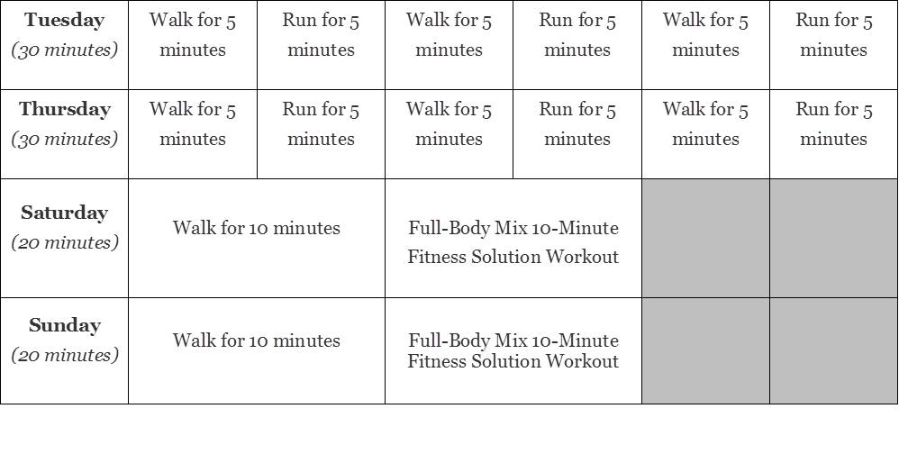
Creating A Fitness Plan Schedule Considerations
Time of Day
Season/Climate
Put your plan into writing to help you stay on track with your goal.

Slide 6
Building Fitness Levels
F.I.T.T. Principle: method for safely increasing aspects of your workout plan without injuring yourself.
In order to progress and improve our fitness we have to put our bodies under additional stress. Doing this will cause long-term adaptations. This will enable our bodies to work more efficiently and be able to cope with a higher level of performance. Overloading can be achieved by following the acronym FITT.
TRYING TO DO TOO MUCH TOO SOON CAN RESULT IN INJURIES!! This is why we use the FITT principle…….

Slide 7
F.I.T.T.
Frequency: Increasing the number of times you train per week
Intensity: Increasing the difficulty of the exercise you do. For example, running at 7 miles an hour instead of 6 or increasing the number repetitions of a specific exercise (30 situps to 45 situps)
Time: Increasing the length of time that you are training for each session. For example cycling for 45 minutes instead of 30.
Type: Increase the difficulty of the training you are doing. For example progress from walking to running.

Slide 8
Disscuss…..
Joey has planned out a schedule that includes 2 hours of activity and exercise each day.
Joey’s plan includes 30 minutes before school circuit training then jogging for 30 minutes & walking for 30 minutes after school. Then he plans to swim at the local YMCA for 30 minutes in the evenings.
Joey has previously been inactive 5 of 7 days.
What do you think his chances of success will be with his fitness program?
Are Joey’s goals realistic? Why do you think that?

Slide 9
Resting Heart Rate
RESTING HEART RATE: Number of times your heart beats per minute when you are RELAXING.

Slide 10
TARGET HEART RATE
TARGET HEART RATE: RANGE OF NUMBERS BETWEEN WHICH YOUR HEART AND LUNGS RECEIVE THE MOST BENEFIT FROM A WORKOUT.
HOW TO FIND TARGET HEART RATE:
SUBTRACT YOUR AGE FROM 220.
Multiply result by 0.6
Multiply that resulting product by 0.8
14yr old male: 220 -14 = 206 x 0.6 = (123) x 0.8 = 98
TARGET HEART RATE RANGE : 123 BPM to 98 BPM

Slide 11
WARMING UP & COOLING DOWN
EVERY EXERCISE OR ACTIVITY SESSION SHOULD BEGIN WITH A WARM UP.
WARMUP: Performing low to moderate exercise to prepare your body for more vigorous activity.
Why? : To prevent injury. Cold muscles become injured easier.
Should last at least 10 minutes.
Combination of walking/jogging/stretching exercises

Slide 12
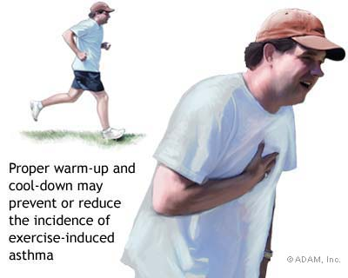
COOL DOWN
COOL DOWN: Period of low to moderate exercise to prepare your body to END a workout session.
Why? : to return your blood circulation, heart rate, and body temperature to normal. Prevent injuries.
Should last about 10 minutes. Can be the same as the warmup exercises.

