Slide 1
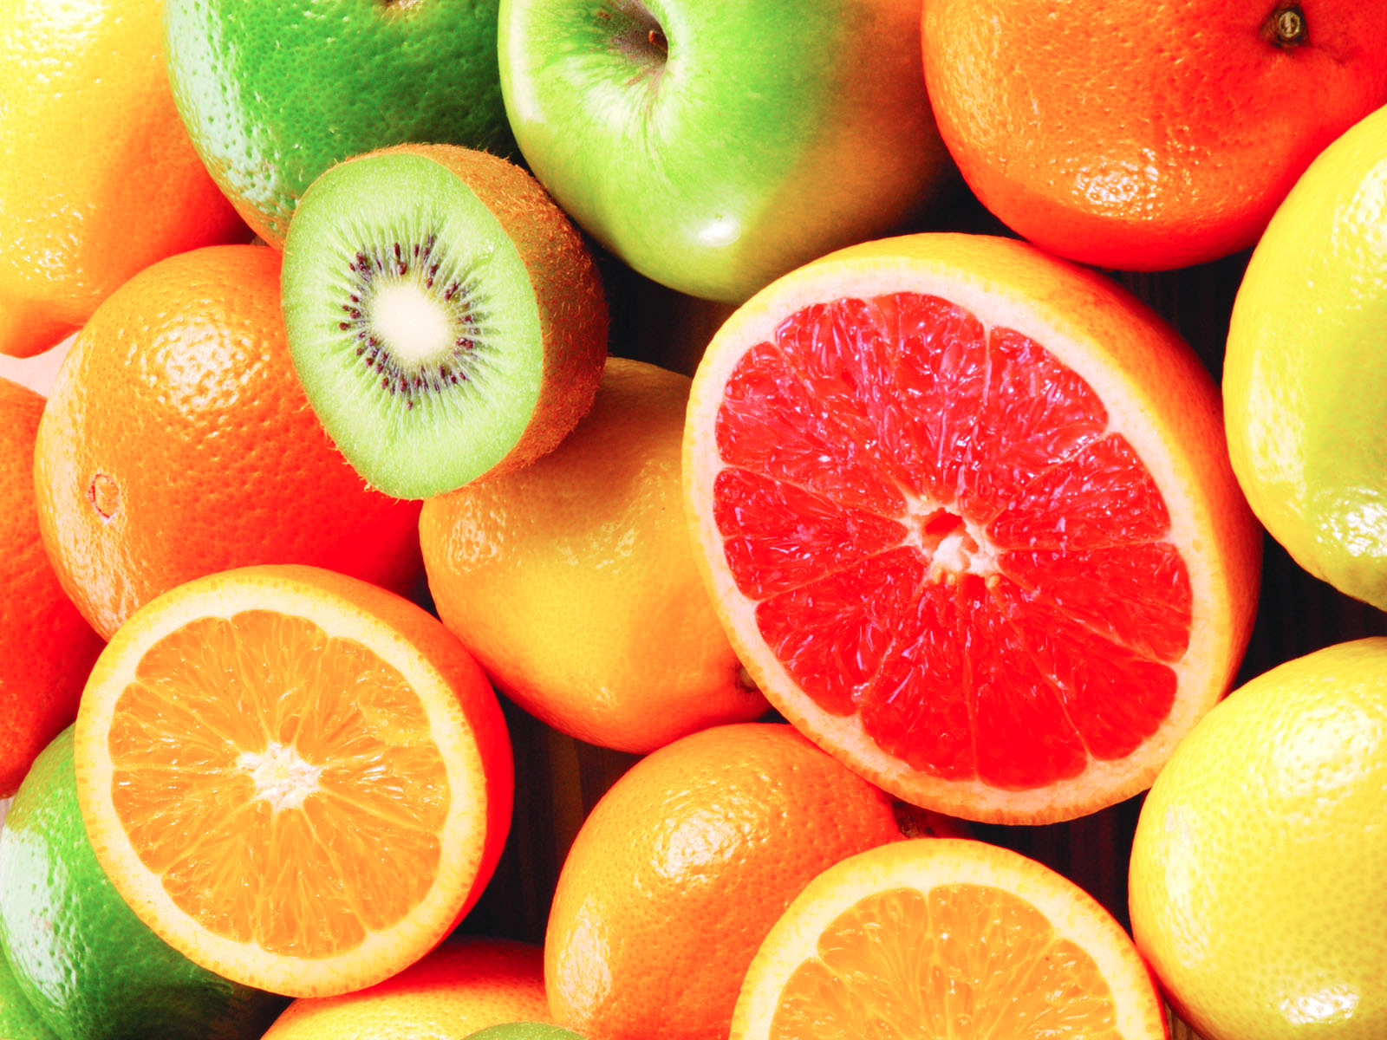
Fruits

Slide 2
Besides having color, flavor, and usefulness, fruit is a food of great value.
1. Fruit contains a type of sugar that gives quick energy.
2. Fruit is rich in vitamins and minerals. Both are important to health. Citrus fruits particularly oranges and grapefruit, are especially rich in vitamin C
3. Fruit contains little or no fat and very little protein.

Slide 3
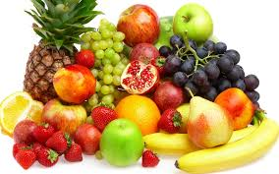
Because fruit is rich in vitamins and minerals and stimulates the appetite, it is a very good food to eat between meals. Fruit makes a much better snack than a soft drink, candy, a piece of cake, or other sweets.

Slide 4
Fruit Buying Tips:
In general, high quality fruit means firm heavy, fruit, full of juice, not too green or too ripe.
Shop for fruit early in the morning.
Buy fruit in season.
Decide how the fruit is to be used before buying it.
Do not buy fruits which show signs of decay.
When selecting fruit handle it as little as possible.
Avoid buying too much fruit, even when it is cheap.
Fruit bought in containers should be uniform throughout.

Slide 5
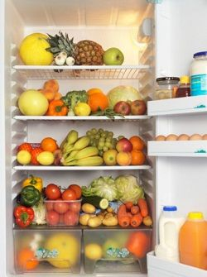
Storing Fruit:
Fresh fruit should be stored in the refrigerator.
All fruit, except berries, should be washed before being stored. Berries should be washed just before you use them to prevent rapid spoiling and loss of vitamins.
Cold storage is the best because cold delays the ripening processing loss of vitamin C.
To prevent their odor from being absorbed by other foods; fruits with a strong aroma, such as pineapple and cantaloupe, should be wrapped tightly in a plastic bag before being placed in the refrigerator.

Slide 6
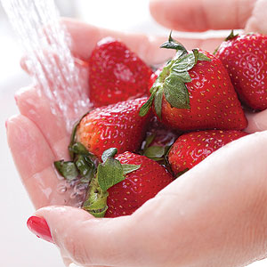
To prepare fruits:
Wash them.
Cook fruits in their skins and natural juice.
Cook fruits in as little water as possible.
Canned fruits are ready to serve. Cooking causes further loss of vitamins and softens the fruit to cook them again.
Canned or frozen fruit juice should be opened and mixed just before serving.

Slide 7
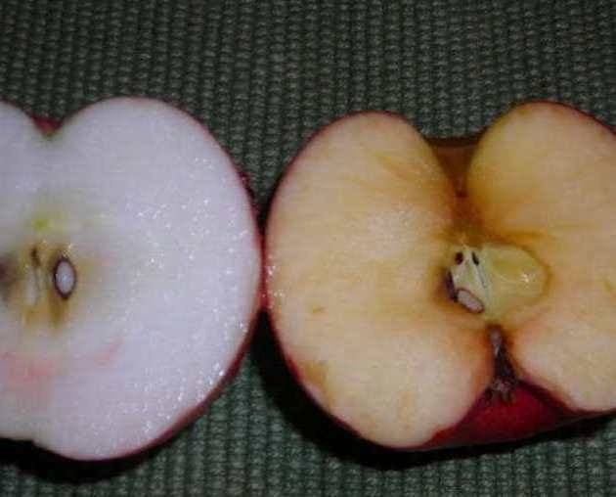
Oxidation:
Cutting fruit with a peeling when exposed to the air, the cut surface turns brown and discolored. Put fruit in fruit fresh, lemon juice, etc.

