Slide 1
WW II Dictators

Slide 2
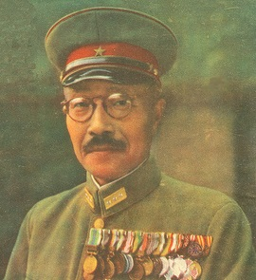
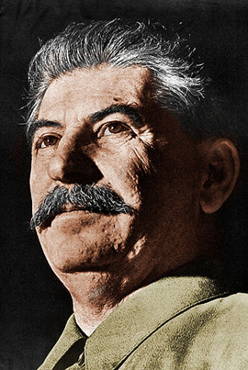
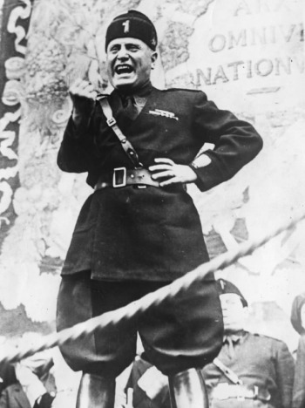
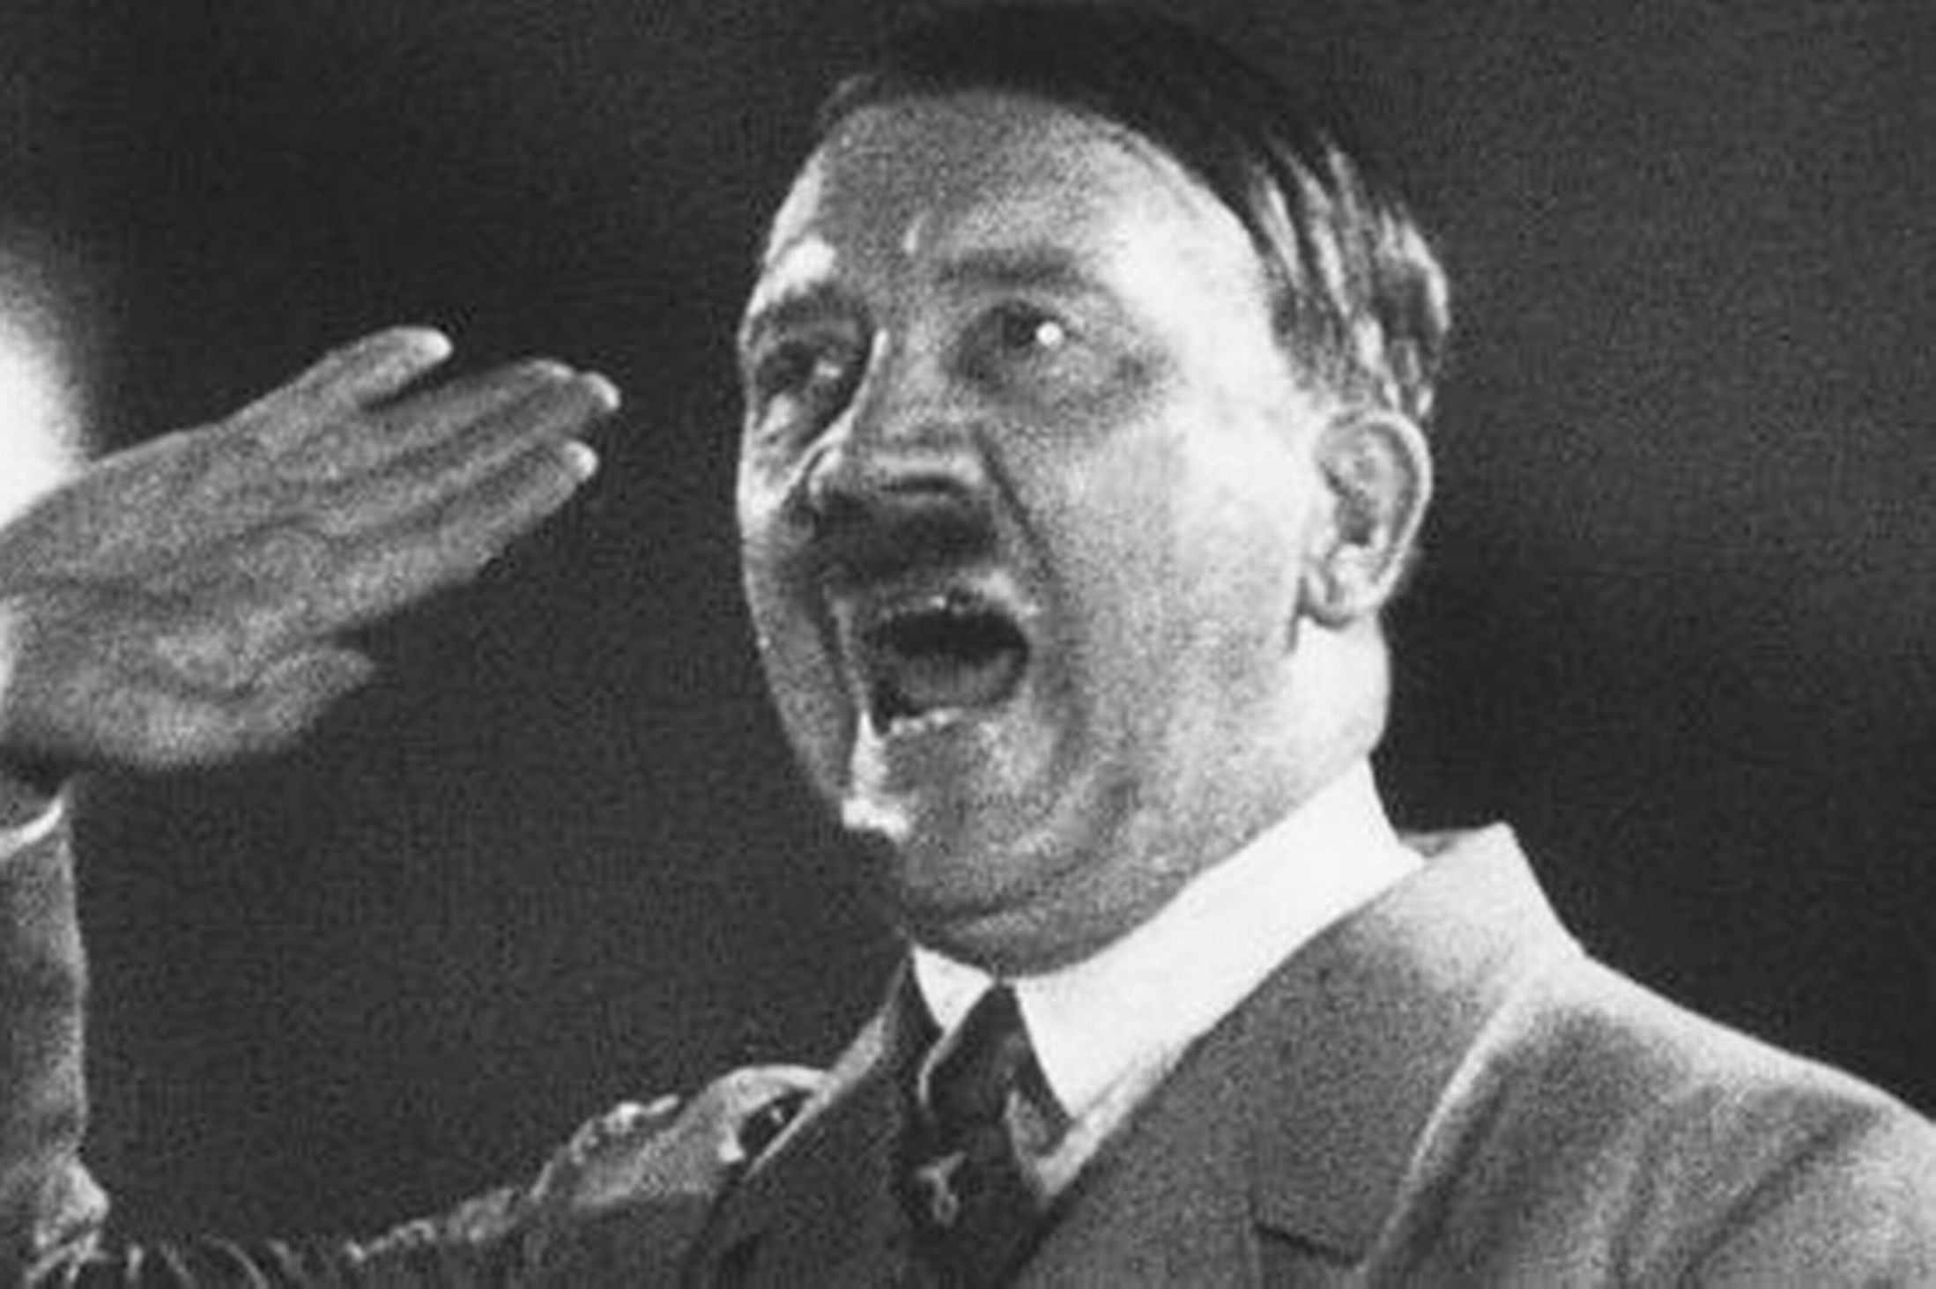
Totalitarian Rulers In Europe
During the 1930s, totalitarian governments gained power in Germany, Italy, Japan, and the Soviet Union. These governments exerted total control over a nation, using terror to suppress individual rights and silence all opposition.

Slide 3
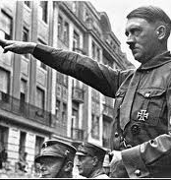
Adolf Hitler
-Joined the Nazi Party in 1919
-Fascism- this emphasizes the importance of the nation or and ethnic group and the supreme authority of the leader.
-Nazism-Was a form of fascism shaped by Hitler's fanatical ideas about German nationalism and racial superiority.

Slide 4
Hitler's Political Beliefs and Movements
Wrote Mein Kampf (“My Struggle”) while in prison. In this he criticized the nations Jewish population, which he blamed for the Germany’s defeat in WW I.
Hitler Becomes Chancellor: Between 1930 and 1934, the Nazi Party gained a majority in the Reichstag, the lower house of the German parliament. Hitler became first chancellor and then president of Germany. He moved to suppress many German freedoms and gave himself the title Der Führer, or “the leader.”

Slide 5
Aggressive Actions taken in the 20s & 30s
In 1923, with about 3000 followers, Hitler tried to over-throw the German Government. (Beer Hall Putsch)
On March 7, 1936, German troops entered the Rhineland, a region in western Germany that the Versailles Treaty explicitly banned them from occupying. In 1936 Hitler and Italian dictator Mussolini signed and alliance, later joined by Japan, known as Axis Powers.
In March 1938, Germany took over Austria. Several months later, Hitler demanded the Sudetenland, a region of Czechoslovakia. Following the policy of appeasement, or giving into a competitor’s demands in order to keep the peace, British Prime Minister Neville Chamberlain agreed to allow Hitler to occupy the Sudetenland.

Slide 6
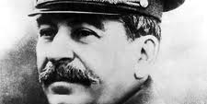
Joseph Stalin
“Man of Steel”

Slide 7
Political Beliefs and Movements
Stalin’s Economic Plans
Stalin’s state takeover of farmland resulted in a dramatic fall in agricultural production as well as mass starvation.
Stalin poured money and labor into industrialization rather than basic necessities such as housing and clothing.
Due to Stalin’s policies, the Soviet Union soon became a modern industrial power, although one with a low standard of living
Stalin’s Reign of Terror
-To eliminate opposition, Stalin began a series of purges, the removal of enemies and undesirable individuals from positions of power.
-Stalin’s purges extended to all levels of society.

Slide 8
Aggressive Actions taken in the 20s & 30s
1920s Stalin forces peasants off their land.
1934 The Great Purge began with a series of “show trials”.
By 1939, Stalin’s agents had arrested more than 7 million people from all levels of society. A million were executed the rest forced into labor camps.

Slide 9
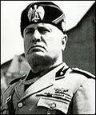
Benito Mussolini
“Il Duce”

Slide 10
Political Beliefs and Movements
Benito Mussolini gained power in Italy both by advocating the popular idea of Italian conquest in East Africa and by terrorizing those who opposed him.
Once appointed prime minister by the king, Mussolini suspended elections, outlawed other political parties, and established a dictatorship.
Thought Versailles Treaty should have granted Italy more territory.

Slide 11
Aggressive Actions taken in the 20s & 30s
1922 threatened to march on Rome, the king panicked and appointed Mussolini prime minister.
October 1935, Mussolini invaded Ethiopia, by May of 1936, Ethiopians emperor had fled to England and the capital, Addis Ababa, was in Italian hands.

Slide 12
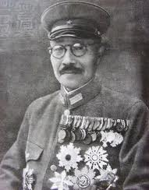
Hideki Tojo

Slide 13
Political Beliefs and Movements
After World War I, Japan had established a parliamentary government and granted many citizens the right to vote.
When economic conditions worsened during the 1930s, many Japanese became dissatisfied with multiparty democratic government.
Several radical nationalist groups formed in response to the government’s perceived weaknesses.
An island country…NEED RESOURCES!!

Slide 14
Aggressive Actions take in the 20s & 30s
In September 1931, a Japanese army stationed in Manchuria captured several cities. By February 1932, the army had seized all of Manchuria.
Japan set up Manchuria as a puppet state, or a supposedly independent country under the control of a powerful neighbor.
1932 Naval officers assassinated the Prime Minster.
In 1933 Japan invades China.
Continues conquest of SE Asia in the 30’s

