Slide 1
WAR in the PACIFIC
WWII Notes

Slide 2
Setting the scene
December 7, 1941: Japan Attacks U.S. at Pearl Harbor
STRATEGY:
Defensive War
Win in Europe first

Slide 3
Japanese Advances (1941-1942)
Japanese roll through Southeast Asia
Hong Kong, Singapore, Dutch East Indies
Set sights on the Philippines
U.S. Controlled

Slide 4
The Philippines Fall
Attack April, 1942
11,000 U.S. & Filipino troops surrender
General Douglas McArthur vows to return
Bataan Death March
60 mile trek to Prison Camp
10,000 die
POW Camp conditions awful
15,000 more die

Slide 5
U.S. Response to pearl harbor
The Doolittle Raids
Counterattack on Tokyo
Crash landed in China
Emotional Morale Boost for the United States

Slide 6
TURNING THE Tides of the war
Battle of Midway (June 1942)
Japan’s Goal: Destroy U.S. Pacific Fleet
Fought 100% in the air
U.S. intercepted intelligence and knew they were coming
Result: 4 sunk Japanese carriers & 250 destroyed planes

Slide 7
Island Hopping Campaign
U.S. Offensive Goals:
Retake Philippines
Invade Japan mainland
Strategically selected islands to invade for military purpose
Get to Japan quicker

Slide 8
Battle of Iwo Jima
Iwo Jima: small volcanic island 700 miles from Japan
U.S. pours island with bombs for 74 days
Japan’s tunnel system
Stormed Island w/ 110,000 U.S. troops to 25,000 Japanese
Only 216 Japanese taken prisoner

Slide 9
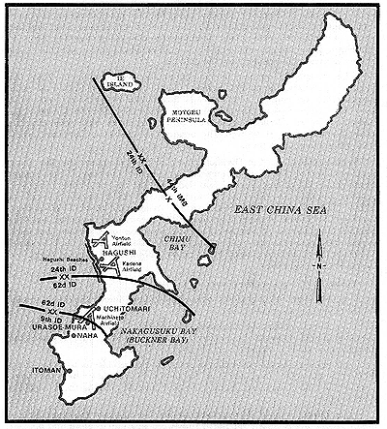
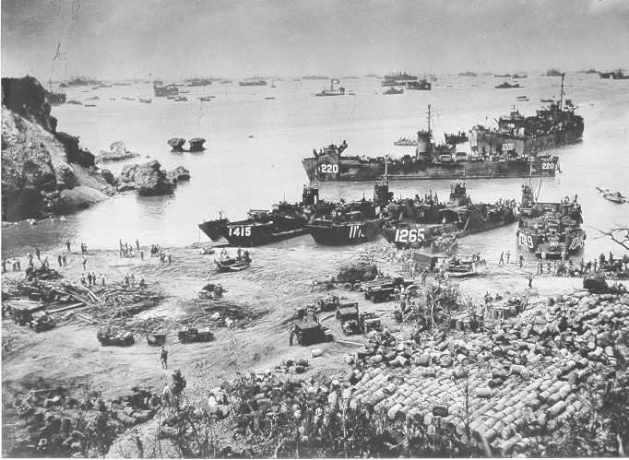
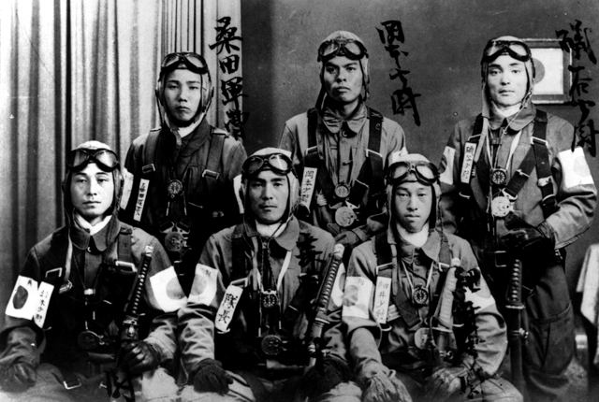
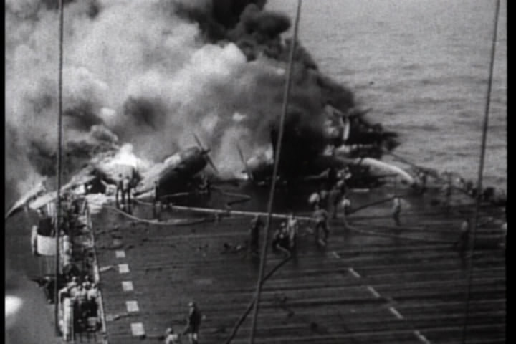
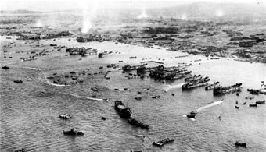
Battle of Okinawa
Perfect launch point for invasion of Japan (350 miles)
100,000 Japanese defend island
U.S. sent 1,300 warships & 180,000 troops
2nd largest of war (D-day)
Japanese used 2,000 kamikaze fighters
Sank 32 U.S. ships
Bloodiest battle of Pacific War
50,000 U.S. casulties
93,000 Japanese
Nothing standing in way of Japanese invasion…

Slide 10
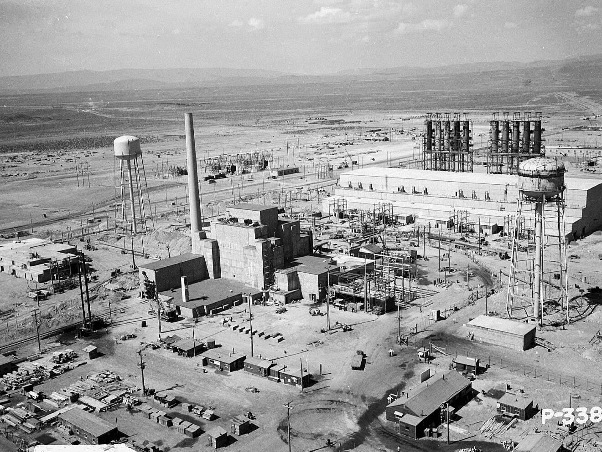
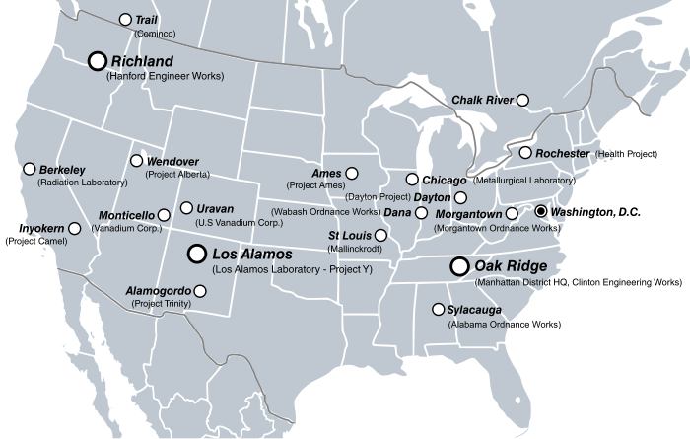
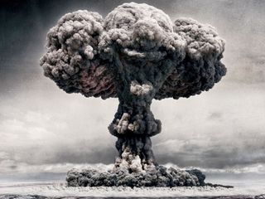
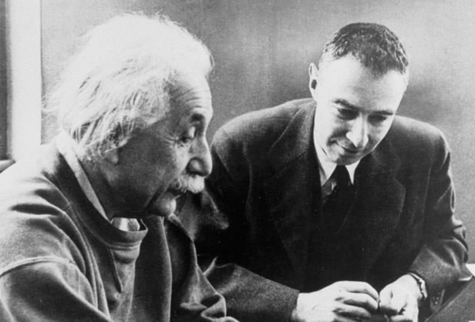
The manhattan project
TOP SECRET project to create an atomic weapon
Key Players:
Albert Einstein
J. Robert Oppenheimer
Franklin D. Roosevelt
Harry S. Truman
Alamogordo, New Mexico is where first bomb is detonated
Bomb = Trinity

Slide 11
Truman weighs his decision
Yes we should use it:
Invading Japan would result in massive casualties (both)
It should END THE WAR
“You should do your weeping at Pearl Harbor” Harry Truman
Show U.S.S.R. our strength
No we shouldn’t use it:
Change war & power structure forever
Killing many civilians w/o their “consent”

Slide 12
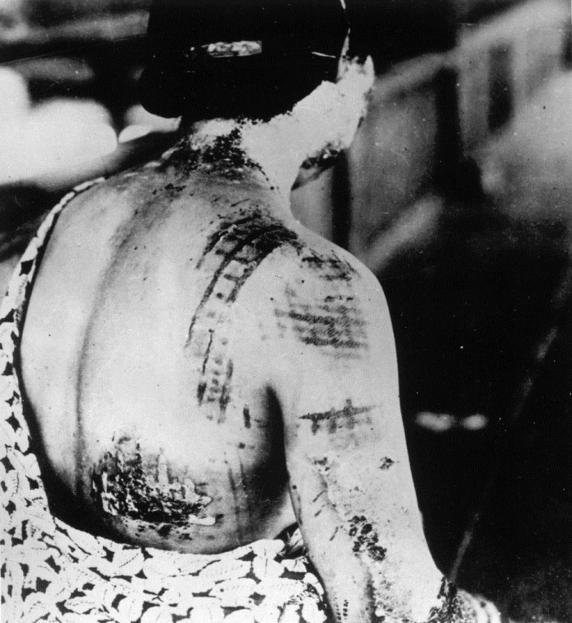
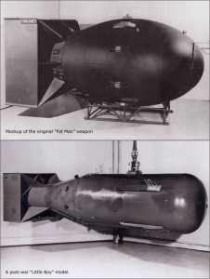
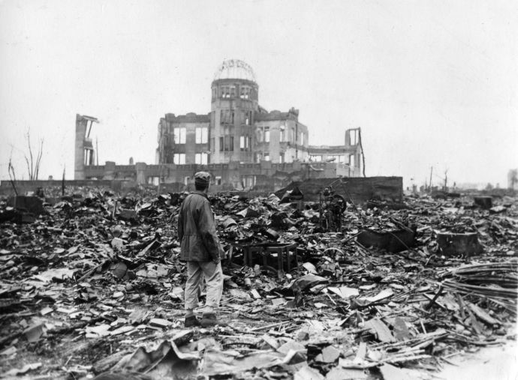
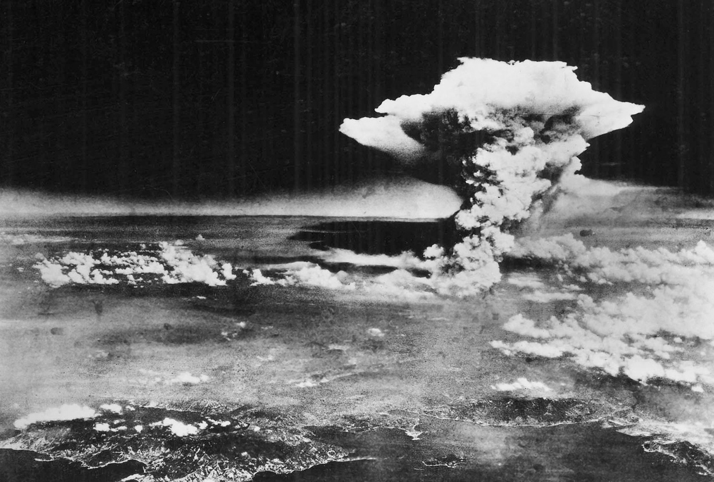
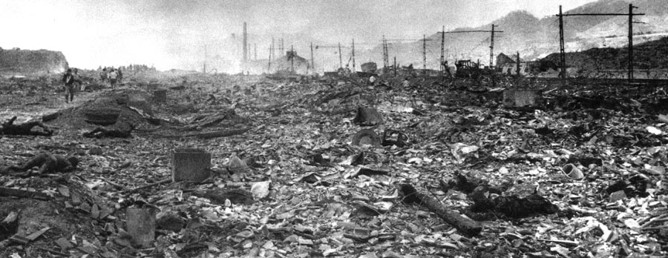
Dropping the bomb
August 6, 1945
Enola Gay drops “Little Boy” over Hiroshima
80,000 dead and 90% buildings destroyed in seconds
Japan DOES NOT surrender
August 9, 1945
Box Car drops “Fat Man” over Nagasaki
70,000 dead & most of city destroyed

Slide 13
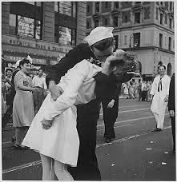
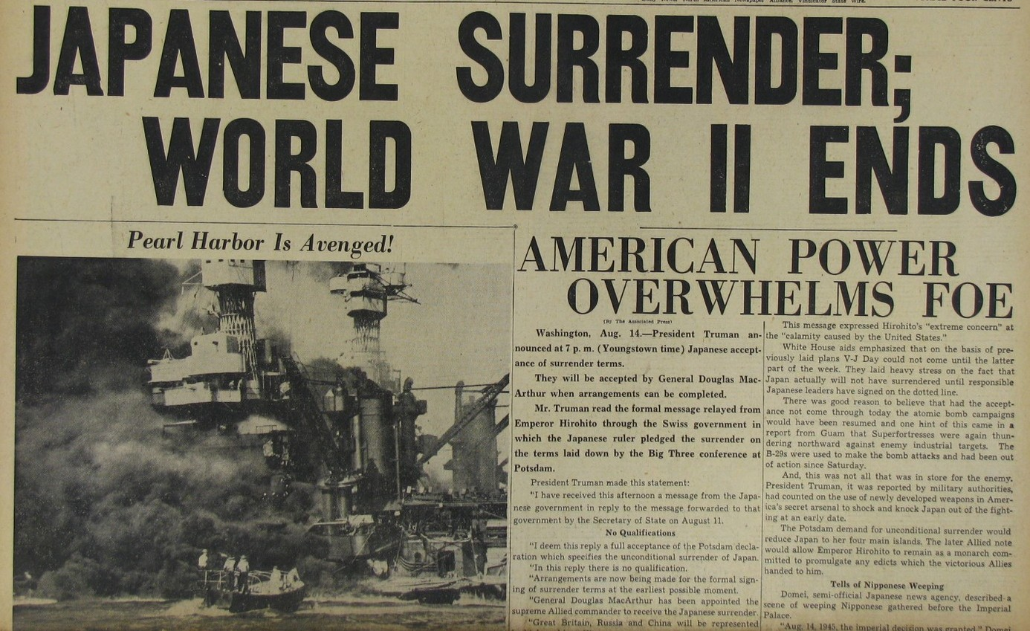
V-J Day
Emperor Hirohito visits site of bomb and surrenders on August 14th.
Formal surrender signed on September 2nd on U.S.S. Missouri in Tokyo Bay
General Douglas McArthur gets his “revenge”

