Slide 1
The War in Europe
WWII notes

Slide 2
Where do we start?
Europe?
North Africa?
Asia (Pacific)?
Hitler was everywhere!!

Slide 3
Fronts
EUROPE
Allies take on Germany
Goal: Defeat them!!
PACIFIC
Defensive
Defeat Nazi’s First

Slide 4
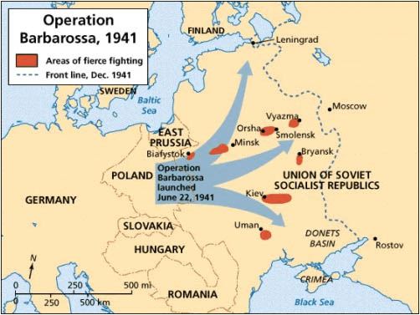
European Front
MAJOR BATTLES: Battle of Stalingrad
SOVIETS BATTLE GERMANS AT STALINGRAD- AUGUST 1942-1943
Bloodiest standoff of the war (to this point)
Over one million casualties: 199 days
Allies decided to let Russia fight on their own
THIS DECISION WILL COST THE U.S. FUTURE RELATIONS WITH SOVIETS.

Slide 5
North AFrica
OFFENSIVE FIGHT
ROOSEVELT AND CHURCHILL MEET IN MOROCCO: 1943
DECIDE NOT TO HELP SOVIETS INSTEAD STICK TO PLAN TO ATTACK FROM NORTH AFRICA INTO SICILY

Slide 6
North Africa

Slide 7
INVASION of ITaly
Eisenhower plans attacks on Italy after success in N. Africa with help of British
Italy is the SOFT UNDERBELLY of Europe
Led by George Patton, start with Sicily and work north through Italy
Mussolini forced to resign in August 1943. Killed by own in 1945

Slide 8
Italy Invasion

Slide 9
Mussolini killed

Slide 10
Allied invasion of western europe
NORMANDY, FRANCE (D-DAY)
LARGEST AMPHIBIOUS INVASION
JUNE 6, 1944
*Code Breakers intercept Axis correspondence*
150,000 ALLIED SOLDIERS
600 WARSHIPS
GENERAL DWIGHT D. EISENHOWER/Rommel for Germans
BY JULY: ALLIED FORCES IN FRANCE WAS OVER 1 MILLION
HITLER HESITATES TO FIGHT BACK
Notes:
Operation Overlord, meant to be June 5 but weather delays, Operation Fortitude (fake army for deception)
Bombardment starts at midnight, airborne attack shortly thereafter (attack from the rear)

Slide 11
D-day

Slide 12
D-day beaches
Notes:
Omaha
Sword
Juno
Utah
Gold
Point Du Hoc (98ft cliff)

Slide 13
Battle of the bulge
Battle of the Bulge
When? – December 16, 1944
Where? – border areas near Luxembourg, France and Germany
Results? – The Germans began a counterattack against the Allies as the Allies attempted to drive the Germans completely out of France.
Importance? – Germans begin retreat signaling their defeat.
First time allies will enter Germany since war started
First time allies will see concentration camps
Notes:
Winter conditions again play a significant role

Slide 14
Battle of the bulge

Slide 15
Hitler’s last days
After Battle of the Bulge Germany is on retreat
Following Stalingrad Germany is on retreat
Allied forces move toward Berlin from East, USSR from West
Hitler commits suicide instead of facing defeat

Slide 16
V-E Day
May 8, 1945, Victory in Europe is declared
Celebration throughout Europe and in the U.S.

