Slide 1
World war II
Odds and Ends

Slide 2
African Americans in WWII
More than 1 million served in WWII
Fought in SEGREGATED regiments
Rode in bottom of boats
Separated blood
99th Fighter Squadron
Tuskegee Airmen
700 flying crosses
111 aircraft shot down

Slide 3
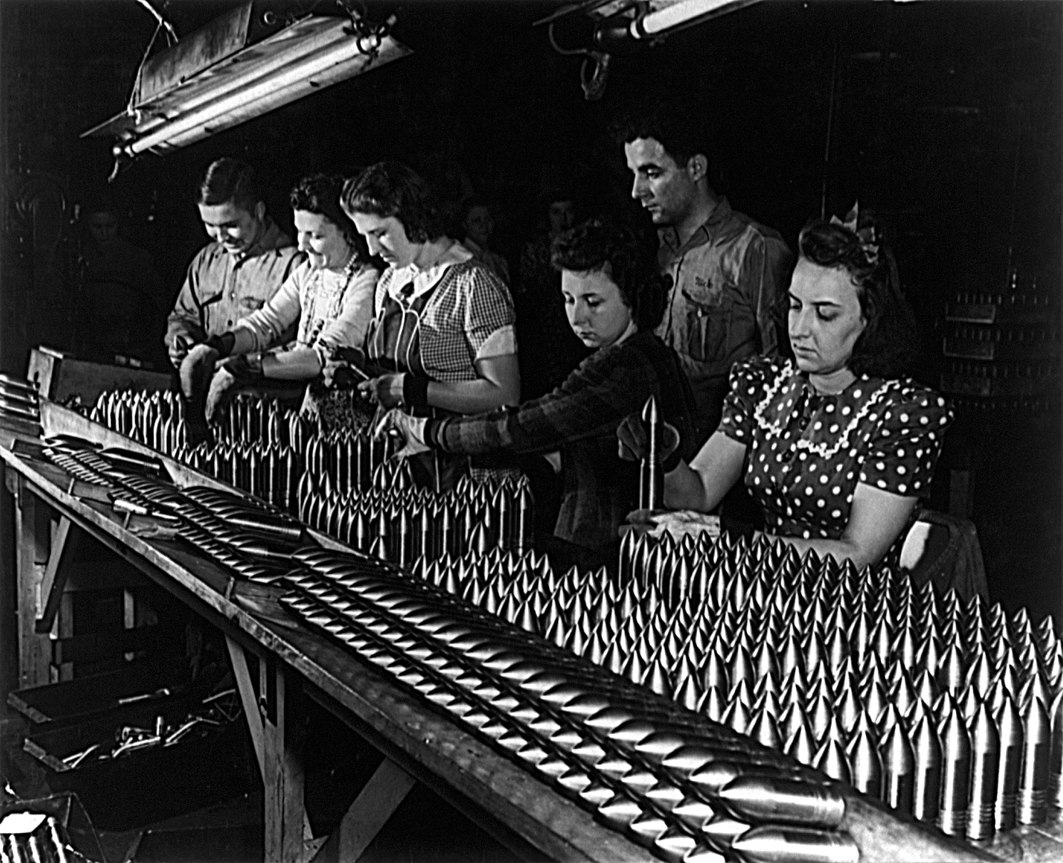
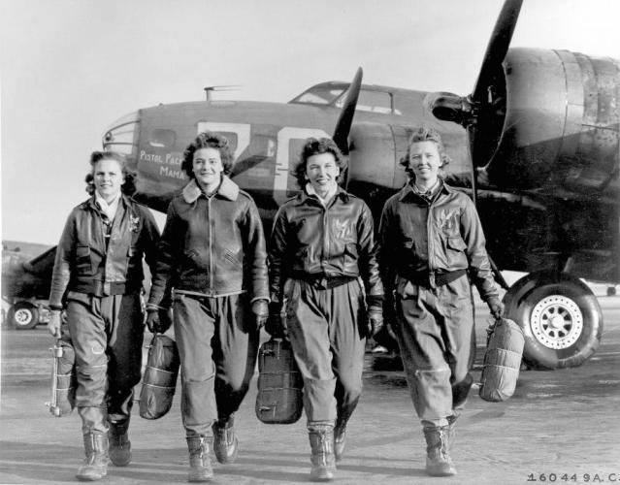
Women in WWII
On the Home Front
Most important role was as factory workers
“Rosie the Riveter”
6 million to factories
In the Military
250,000-400,000 join military
Medical, pilots, mechanics

Slide 4
Internment of Japanese Americans
Pearl Harbor
Immediate evacuation of Japanese (1,400)
Executive Order 9066
Issued by FDR
Arrest ALL anyone with Japanese decent w/o warrant or trial
110,000 taken into custody
Supreme Court Decision
OK due to military necessity

Slide 5
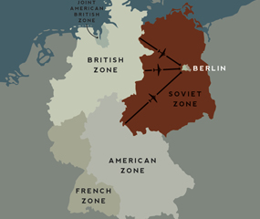
Yalta conference
Meeting of Allied Leaders in Feb. 1945
Stalin, Churchill, FDR
Discuss post-war world
Results:
United Nations Created
Stalin to enter war vs. Japan
USSR allow for free elections in Poland
Germany Divided into 4 zones
Berlin split in 2 sections

Slide 6
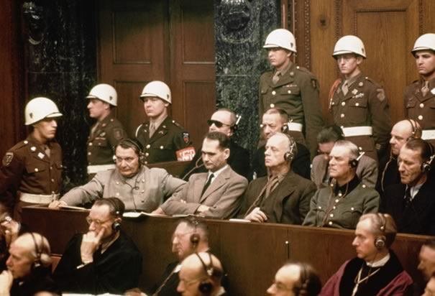
Nuremberg war trials
International Tribunal
23 nations present
Nazi war criminals on trial
22 Leaders charged
Results:
12 of 22 sentenced to death
10 hung, 2 suicide
4 life in prison
4 up to 20 yrs in prison
3 aquitted
1st time leaders held responsible for actions in war

