Slide 1
WE the People assignment
The Foundation of American Government

Slide 2
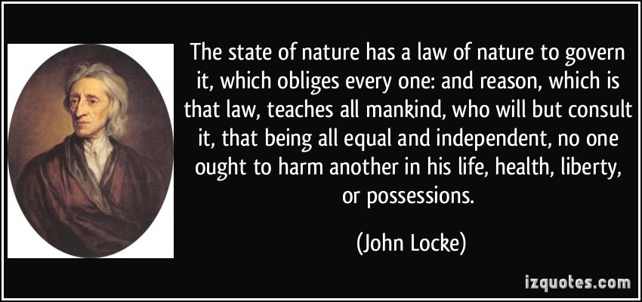
“The law of nature” or “natural law”
Laws of nature are the laws that exist whether or not a government exists or not. Those include Life, Liberty, and Property
Laws made by our Supreme Being
Limitations:
Life, Liberty, and Possession should not be taken away and SHOULD be fought for.
Notes:
Question #2: What is meant by “the law of nature” or “natural law”? How did Locke try to establish of figure our what limitations it imposes on human conduct?
Question #3: How did Locke use the idea of a “state of nature” to try to establish or figure out what the purpose of government should be?
- IF law of nature should prevail and IF people are not ALWAYS good and reasonable then something should protect these rights.

Slide 3
Locke’s view of human nature…
Human Nature
Most are reasonable and good however most will have individual interests at heart
People who are stronger or smarter will try to take away Life, Liberty, Possessions of the weak
The weak will bond together to protect their own natural rights
Type of Government
Only individuals should be able to consent to be governed by a legitimate government. Without consent it is not legitimate
Government that guarantees rights to preserve natural rights.
Civil and Political Rights.
Notes:
Question 4: What was Locke’s view of human nature? How did it influence his ideas about what type of government is best?

Slide 4
The Social Contract
Social Contract: Individuals agree with others to create and live under a government and give it power to make and enforce laws.
Quid Pro Quo: an exchange…absolute freedom for order
Government is a better alternative to an imperfect state of nature where some will not obey the laws of nature. Governments purpose is to protect our natural rights which an individual cannot do effectively in a state of nature.
Notes:
What is meant by the term “social contract”? How is it connected to the idea that government derives its authority from the consent of the governed?

Slide 5
“The Common Good”
- Common Good: What is best for the entire society
- Examples: ??

Slide 6
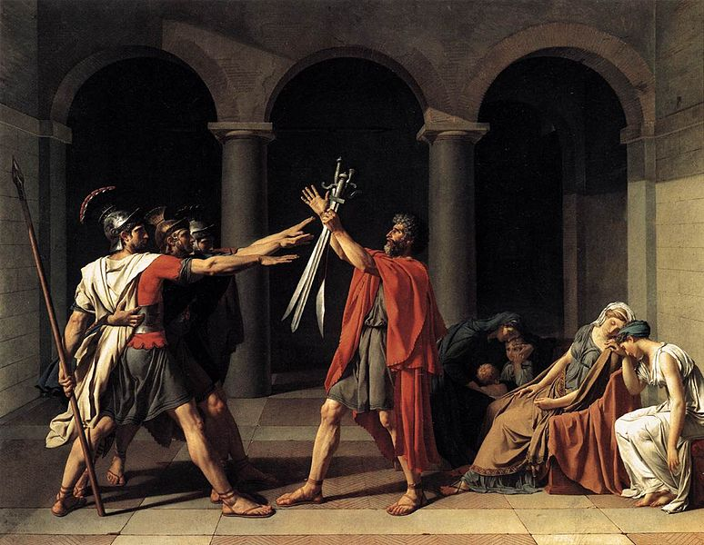
Civic Virtue
Cultivation of personal habits that are centered around success of a community.
Ex: Relinquishing Power
Moral Education
Small Communities: Know and care for one another. Typically fundamentally alike
Large Communities: More difficult, embracing differences.
Setting aside personal interests to
Promote the common good

Slide 7
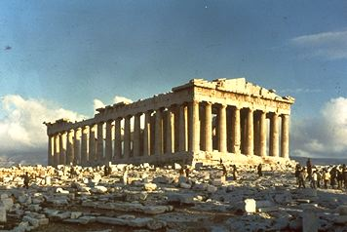
Classical Republicanism
Purpose of Government: Work together with their citizens to promote common good
Essential Characteristics: Civic virtue, moral education, and small uniform communities
Why those characteristics were important: ??
How can they be maintained or established: ??

Slide 8
Classical Republicanism | Natural Rights Theory
Promote the common good, exercise civic virtue, achieve human “excellence” (moral education) | Ensure protection of life, liberty, and property
Putting community interest ahead of individual interest | Self-interest, pursuing opportunities
Public sphere most important; therefore need to limit individual privacy, belief, expression, and opportunity | Public sphere a collection of private individuals and interests; no limits on acquisitions. Government must be limited; public sphere as small as possible
All citizens should participate fully in community to promote common good; civic virtue related to office holding—the “office” of citizen | Deciding whether to participate in community or government is up to individual
Notes:
Box 1: What is the primary goal of humans living together
Box 2: What ought to motivate human behavior?
Box 3: What is the relationship between the public sphere and the private sphere?
Box 4: How important is participation in civic activities?

