Slide 1
FOCUS QUESTION: What do you think the cold war was?
What made it a “Cold” War and not a “Hot” War?

Slide 2
The COLD War UnFOLDS

Slide 3
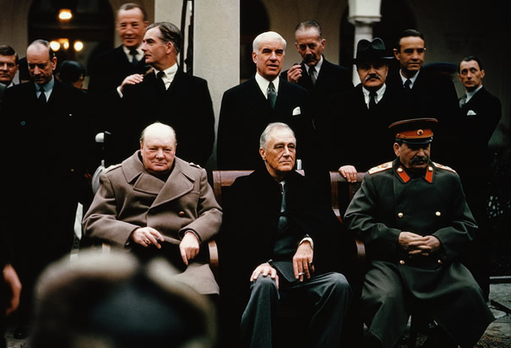
Yalta Conference
Meeting of Allied Leaders in Feb. 1945
Stalin, Churchill, FDR
Discuss post-war world
Results:
United Nations Created
Stalin to enter war vs. Japan
USSR allow for free elections in Poland
Germany Divided into 4 zones
Berlin split in 2 sections

Slide 4
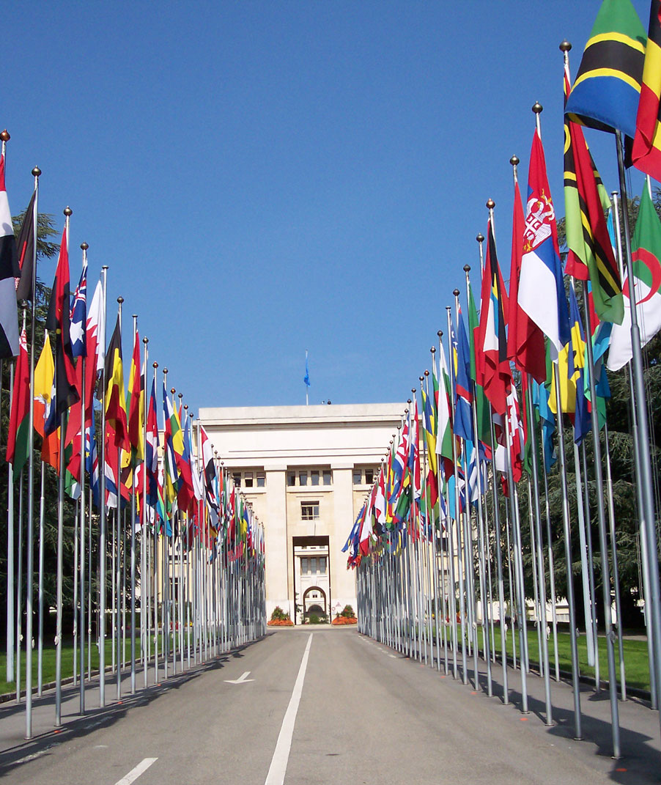
The United Nations
International Peacekeeping Organization
Use peaceful solution and promote justice
United States Congress approves
Remember League of Nations?
11 Countries on the Security Council
U.S., Soviet Union, Great Britain, France, and China have veto power

Slide 5
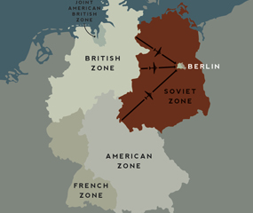
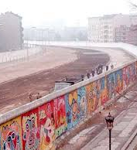
Germany Divided
Germany split into 4 zones
US, Britain, France, Soviet Union control
US, Britain, France combine = West Germany
Soviet Union = East Germany
Berlin also split into 4 zones

Slide 6
Conflicting post war goals
United States
Soviet Union
Americans fought to bring democracy and economic opportunity to conquered nations of Europe.
An economically strong and politically open world created markets for American products.
Lost 17 million in war
Determined to re-build protecting own interests
Established satellite nations
Created buffer zone on western border
Looked to spread communism across world

