Slide 1
Police Use of Force
National Institute of Justice

Slide 2
Use of Force
Defined as
“amount of effort required by police to compel compliance by an unwilling subject.”
Becomes necessary and permitted under specific circumstances, such as self-defense or in defense of another individual or group

Slide 3
Context Counts
No two situations the same
No two officers the same
Forced to quickly tailor a response in a threatening situation.
Trained to judge when crisis requires force

Slide 4
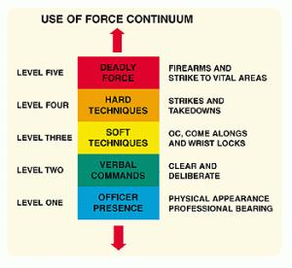
Amount of Force Used
Only the amount necessary to mitigate an incident, make an arrest, or protect themselves or others from harm.
Levels, or continuum, ranges from presence to lethal force
Guidelines for use of force are based on many factors

Slide 5
Use of Force Continuum
Officer Presence (No force used…considered best practice)
Professional and non-threatening
Verbalization (Force is not physical)
Calm, non-threatening commands; increase volume to gain compliance
Empty-Hand Control (Bodily Force)
Soft Technique: Grabs, holds, joint locks, etc
Hard Technique: Punches and kicks
Less-Lethal Methods
Blunt Impact, Chemicals, Conducted Energy Devices (CEDs)
Lethal Force
Deadly weapons such as firearms

Slide 6
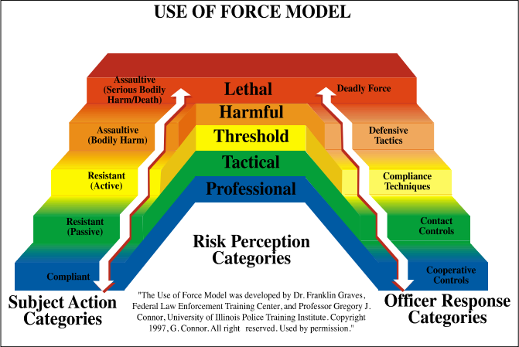
Use of Force Model

Slide 7
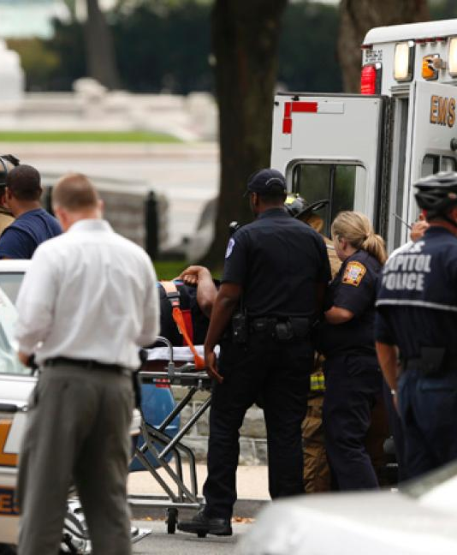
Amount of Forced Used
Goal should be to regain control as soon as possible while protecting the community
Should be last option
Injuries should receive medical attention as soon as possible and family notified

Slide 8
Excessive Force
Hard to determine if/when an event can be defined as justified or excessive
According to Bureau of Justice Statistics there were 6.6 complaints per 100 officers.
Only 8% had evidence to support their claim

