Slide 1
Intro to Corrections
Criminal Justice

Slide 2
What is corrections?
Corrections is that portion of the criminal justice system charged with carrying out the sentences of our courts.
Corrections refers to the programs, services, agencies and institutions responsible for supervising individuals charged with or convicted of crimes.

Slide 3
Conflicting view of corrections
Classical view
Humans have free will and are responsible for their own actions.
This view focuses on crime.
Positivist view
Humans are the product of environmental and cultural influences.
This view focuses on the criminal.

Slide 4
Correctional Ideologies
Punishment: Justice model
Assumes offenders are victims of society and their environment who need to be cured.
Control: Custodial model
Goal is restraint of those convicted

Slide 5
Correctional Ideologies
Treatment: Medical model
Assumes offenders are self-directed, acting on free will and are responsible for their crimes
Prevention: Reintegration model
Goal is to prevent further offenses

Slide 6
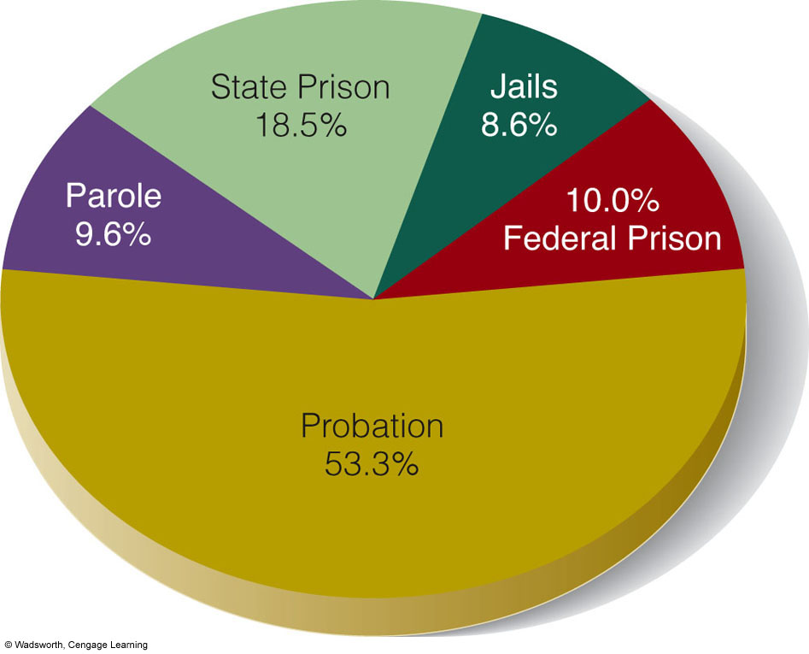
People in Each Category of Correctional Supervision

Slide 7
PROBATION
The oldest community-based correctional program.
The most common alternative to a prison sentence.
Offender is put under the control, supervision and care of a probation field staff member in lieu of imprisonment as long as the probationer meets certain standards of conduct.
Allows offenders to remain in the community, able to maintain important family ties and fulfill vital work, family and community obligations.

Slide 8
Who gets probation?
First-time offenders
Property offenders
Low-risk offenders
Nonviolent offenders

Slide 9
Conditions of probation
The general purpose of probation is to help offenders maintain law-abiding behavior through supervision.
One universal condition for all probationers is to obey the law.
Other conditions may include
Adherence to a curfew
Maintaining steady employment
Completing prescribed training
Meeting family responsibilities
Staying away from certain types of people or places
Abstaining from drug and alcohol use
Abiding by firearms possession restrictions
Performing community service
Making restitution

Slide 10
Incarceration
The primary goal of these correctional institutions is to protect society.
Secondary goals include
Deterring offenders
Rehabilitating offenders
Reintegrating offenders
Notes:
What is primary goal? Secondary

Slide 11
Jails
Detain individuals waiting to appear before the court
For trial (preconviction)
For sentencing (postconviction)
Hold those sentenced to a year or less of incarceration
Jail differs from prison in that
Inmates are there for shorter terms, usually for less serious crimes.
Jails are usually the responsibility of local or county law enforcement.

Slide 12
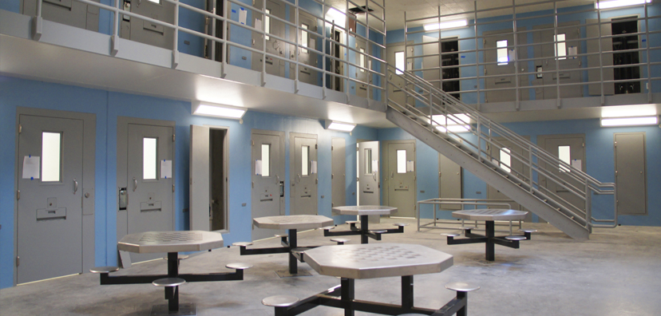
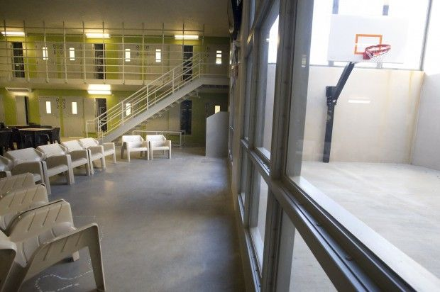
Lancaster county Jail
Opened in July 2013
West O St.
786 inmate capacity
Living Quarters
6 Gen Pop Pods
12 Gen Pop Dorms
Segregation Pod
Mental Health Pod
29 multipurpose rooms for classes
GED, AA, NA, Release & Restored, Religion, Work Release

Slide 13
Prisons
Where the inmates have been convicted of a crime
Holds offenders sentenced to more than one year of incarceration
May be punitive
More formal and rigid
Emphasis on obedience through negative incentives
May be treatment-oriented
More informal and flexible
Positive incentives through good behavior

Slide 14
Nebraska State Prison System
Lincoln Correctional Center (506 pop)
Nebraska Correctional Center for Women (322 pop)
Nebraska State Penitentiary (1319 pop)
Omaha Correctional Center (761 pop)
Tecumseh State Correctional Institution (1014 pop)

Slide 15
parole
The conditional release from prison before the expiration of the sentence and the period of supervision in the community following this release
Differs from probation in that a person who is paroled has spent some time serving a prison sentence
Required supervision and a set of certain conditions the offender must meet

Slide 16
Factors w/ eligibility of parole
Type of offense committed
Offender’s prior record
State statutes
Inmate’s behavior while incarcerated
Participation in programs
Whether the inmate has a plan for life on the outside
If the inmate poses any public risk
Notes:
Ask question

Slide 17
Conditions of parole
Regular meetings between the parolee and officer
Requirement to hold a job
Promise to act lawfully
Restriction on leaving the county or state without permission
Prohibition on purchasing or using a firearm
Submission to random or routine drug testing

