Slide 1
Federalists vs. Anti-Federalists
A Ratification Debate

Slide 2
Setting the Scene:
After Convention 9 of 13 states needed to ratify
Each state holds it’s own State Convention
Sets the stage for the two-party political system still in place today
The Federalist and Anti-Federalist Debate

Slide 3
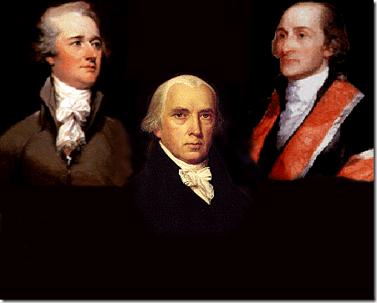
Key Players The Federalists
Publius
AlexanderHamilton
John Jay
James Madison

Slide 4
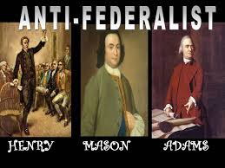
Key Players The Anti-Federalists
Cato’s Letters
Brutus & Sydney Letters
Federal Farmer

Slide 5
Key Issue: Biggest Threat to the People
The Federalists
Anti-Federalists
The largest threats to the people is having a small government in which those in the minority will never have power. If there is a large government the diverse populations will ensure that a small group of people, a dangerous minority with radical ideas does not gain power.
The biggest threat to the people is the tyranny of the government. If a government is too big, it will have too much power, and consolidate, eventually leading to the government being ruled by a powerful elite.

Slide 6
Key Issue: Protection of Individual Rights
The Federalists
Anti-Federalists
The checks and balances are enough to keep the government from taking the rights of the people away.
The rights guaranteed to the people should be included in the Constitution or else they are not guaranteed

Slide 7
Key Issue: Representation
The Federalists
Anti-Federalists
The federal government should be run by well educated and experienced men, the elite. These are the men that are best educated and will be able to make the best decisions.
The government should be run by representatives that are very similar to those who they are representing. This new government will encourage only the well educated elite to be representatives who are using this as an opportunity to gain power

Slide 8
Key Issue: People will not hold government accountable
The Federalists
Anti-Federalists
The central government created cannot take the rights of the people because of the many checks and balances in the Constitution
A free government requires the active support of the people. The new government would be so large that people would not be involved in government, leading eventually to the government taking too much power.

Slide 9
Key Issues: Power given to Federal Government
The Federalists
Anti-Federalists
The checks and balances in the Constitution will be effective in restraining the power of the federal government. The president does not have the power to make laws, so he/she cannot become a monarch
The limits of the power given to the federal government are not clear and will result in the president becoming a monarch. More limits should be made through a Bill of Rights

Slide 10
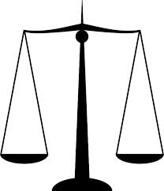
Reflection
Do the Anti-Federalists care more about protecting individual rights or promoting the common good?
How about the Federalists?

Slide 11
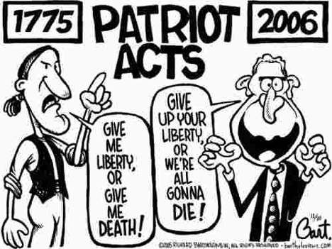
Individual Rights
The Anti-Federalists were more concerned with protecting the rights of the individual people and states, then promoting the pubic good as a whole.

Slide 12
Common Good
The Federalists were more concerned with promoting the common good of everyone then protecting individual rights

Slide 13
Quote Throw Down
You will be shown a quote and you must decide WHO SAID THIS?
The Anti-Federalists or the Federalists
You will work in groups, and write the answer on your white board
Do not show other groups.
You will reveal your answer on the count of three.

Slide 14
Quote #1
“All communities divide themselves into the few and the many. The first are the rich and well born; the other, the mass of people…. The people are turbulent and changing; they seldom judge or determine right. Give therefore the first class a ….permanent share in the government….they therefore will ever maintain good government.”
Who said it???

Slide 15
FEDERALISTS

Slide 16
Quote #2
“It must be by this time evident to all men…that (the Articles of Confederation) is a system so radically vicious and unsound as to admit….an entire change.”
Who said it???

Slide 17
FEDERALISTS

Slide 18
Quote #3
“I consider the foundation of the Constitution as laid on this ground – that all powers not delegate (given) to the United States by the Constitution, nor prohibited by it to the states, are reserved to the states, or to the people….”
Who said it???

Slide 19
Anti-Federalists

Slide 20
Quote #4
“The powers contained in the constitution….ought to be construed liberally in advancement of the public good.”
Who said it???

Slide 21
FEDERALISTS

Slide 22
Quote #5
“I am not among those who fear the people. They, not the rich, are our dependence for continued freedom.”
Who said it???

Slide 23
Anti-Federalists

Slide 24
Quote #6
“Among the numerous advantages promised by a well-constructed Union, none deserves to be more accurately developed than its tendency to break and control the violence of faction.”
Who said it???

Slide 25
FEDERALISTS

Slide 26
Quote #7
“An elective [monarchy] was not the government we fought for; but one in which the powers of government should be so divided and balanced among the several bodies of magistracy as that no one could transcend their legal limits without being effectually checked and restrained by the others.”
Who said it???

Slide 27
FEDERALISTS

Slide 28
Quote #8
“When the government fears the people, there is liberty. When the people fear the government, there is tyranny.
Who said it???

Slide 29
Anti-Federalists

Slide 30
Quote #9
“… the power vested in congress of sending troops for suppressing insurrections will always enable them to stifle the first struggles of freedom."
Who said it???

Slide 31
Anti-Federalists

Slide 32
Quote #10
“The Small landowners are the most precious part of the state”
Who said it???

Slide 33
Anti-Federalists

