Slide 1
Segundo paso
Vocabulario

Slide 2
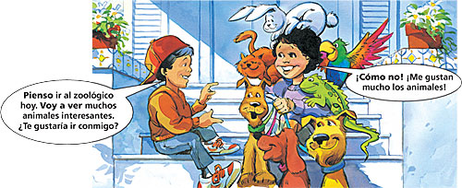
Making plans

Slide 3
Making plans
Pienso ir al zoológico hoy. Voy a ver muchos animales interesantes. ¿Te gustaría ir conmigo?
Pienso = I think/I plan
¡Cómo no! ¡Me gustan mucho los animales!
Why not?

Slide 4
Pensar
How do we conjugate “pensar”?
Yo –
penso

Slide 5
Pensar
Except that the word pensar (to think) is another e › ie stem-changing verb.
Yo –
penso

Slide 6
Pensar
Pensar (to think) is another e › ie stem-changing verb.
Yo –
pienso
Nosotros – pensamos
Tú – piensas
Él/Ella – piensa
Ellos(as) – piensan

Slide 7
Pensar
When followed by an infinitive, “pensar” means to plan, or to intend to do something.
¿Piensas jugar al tenis?
Do you plan to play tennis?
Pienso ver la pelicula “Unknown” este semana.
I plan to watch “Unkown” this week.

Slide 8
Going to …
You already know the verb ir. This verb can also be used to talk about the future, using the formula ir + a + infinitive.
¿Cuándo vas a practicar el piano?
… are you going to practice …
Voy a practicar mañana.
I’m going to practice …

Slide 9
Nota cultural
If you and a friend were making plans in Spain or Latin America, you probably would have to plan to get around without a car. There are several reasons for this. Cars are more expensive, so not all families have one. In some countries, you must be 18 years or older to get a driver’s license. Finally, public transportation is inexpensive and convenient in most cities. In major cities, most people use the subway, taxis, buses, or motos (mopeds). Sometimes they just walk!

Slide 10
Talking about getting ready
To ask if a friend is ready, Your friend might answer: say:
¿Estás listo/a?
Are you ready?
No, todavía necesito ducharme y
afeitarme.
… I still need to shower and to shave.
No, porque necesito lavarme los
dientes, peinarme y maquillarme.
… I need to brush my teeth,
comb my hair, and put on makeup.
No, todavía necesito ponerme los
zapatos.
… I still need to put on my shoes.

Slide 11
Reflexive verbs
A reflexive verb is a verb in which the action reflects back on the subject: I bathe myself. In Spanish, the infinitives of reflexive verbs have se attached to them (afeitarse, ponerse). The se changes according to the subject of the verb:
(Yo) necesito ducharme.
(Tú) necesitas afeitarte.
Juanito necesita peinarse.

