Slide 1
Rise in totalitarianism

Slide 2
Onjectives
Understand how the rise of dictators and totalitarian states led to WWII
Understand how appeasement of Hitler only fed power hungry intentions.

Slide 3
Behavioral Objectives
Take notes, participate in discussion and complete activity on dictators and appeasement.

Slide 4
TDIH
1836, defenders of the Alamo in San Antonio, TX call for help against Santa Anna and the Mexican Army.
1917 The U.S is presented the Zimmermann Note by the British
1968 The Tet offensive is halted by U.S and allied forces in South Vietnam

Slide 5
Fun Facts About Animals
Bats save the U.S. agriculture industry around $3 billion dollars every year by eating bugs.
Sharks kill less than 10 humans per year. More likely to be killed by a cow, averaging 20 deaths per year in America.
Butterflies can taste with their feet
Sheep and rabbits are immune to black widow venom.

Slide 6
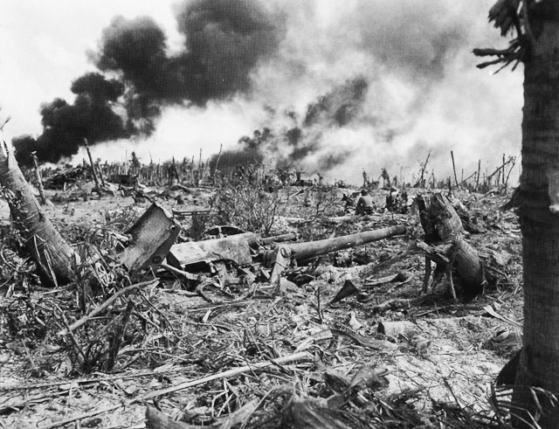
Post WWI Outcomes
Reparations leave losers bitter
Governments fall in Germany, Russia, Austria-Hungary, Italy
Great Depression led to economic turmoil throughout all of the World.
Made it easier for new forms of Gov. like fascism: centralized government that values the state over the individual. Is not communism.
Totalitarian state: A dictator attempts to control every aspect of the lives of its citizens.

Slide 7
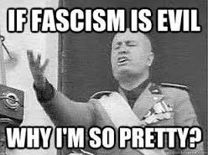
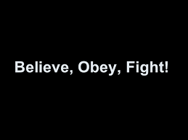
Benito Mussolini
Italy joined Allies, was promised land but didn't receive all of it, led to outrage and Italian Nationalism.
Government divided, peasants and workers went on strike, similar to Russia.
Benito Mussolini, nicknamed “Il Duce” = The Leader
Grew up a socialist, instead favored an intense form of nationalism.
Organized veterans and other Italians into the fascist party. Comes from the Roman symbol of a bundle of sticks wrapped around an axe, stands for unity and authority.

Slide 8
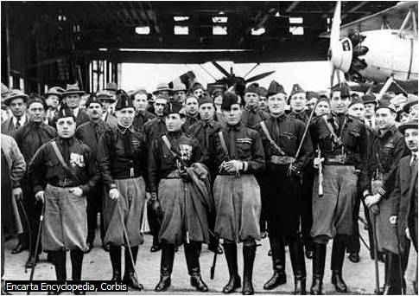
Benito Mussolini (continued)
Created the Black Shirts: fascists members who favored violent action over democratic process
After gaining support, Mussolini March on Rome: Tens of thousands of fascists members march on Rome in support of Mussolini.
Gains power as prime minister of
Creates the first totalitarian state.

Slide 9
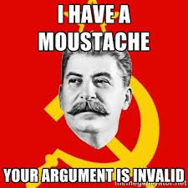
Joseph Stalin
Assumes power after the death of Vladimir Lenin
Created a command economy: government makes all economic decisions.
Industry boomed, but the workers suffered.
Attempted to put communism in a bright light using Socialist realism: promoting communism as a good thing.
Used terror tactics to strike fear in those who would oppose him. Created a secret police: NKVD
Created Gulags: brutal labor camps were enemies of Stalin would go.

Slide 10
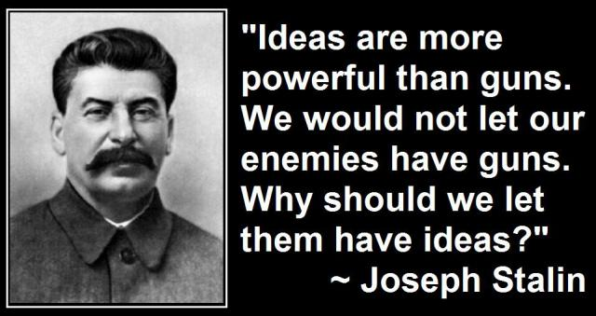
Joseph Stalin (Continued)
Used propaganda to force people to think the same
Forced writers and thinkers to only portray communism as good.
Forced people to adopted atheism or face persecution
Benefits did include free education, healthcare, and housing, but didn't have real quality.
Joseph Stalin used fear to his advantage, but did help Russia become a superpower by forcing Russians to do as he said.

Slide 11
Fascism vs. Communism
Centralized Government
“Survival of the Fitness”
Dictator is leader
Religion if it supports the state
Centralized Government
“Everyone Equal”
The party rules/ people rule
Atheist, only communist ideology

Slide 12
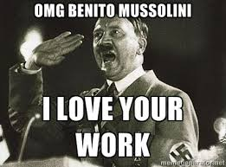
Adolph Hitler
Treaty of Versailles leaves Germany Bankrupt
Create a new Democratic Gov. called the Weimar Republic
Political groups begin to form, including the National Socialist German Workers, NAZI for short.
Hitler joins the Nazis, but is arrested for staging a coup.
Eventually is elected Chancellor through the Weimar constitution, but is then made dictator for life.

Slide 13
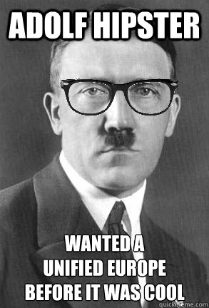
Adolph Hitler (Continued)
Created the Third Reich, the first being the Holy Roman Empire, the second the monarchy under Otto van Bismarck
Creates a totalitarian state, with more people supporting the Nazi party
Created the Gestapo: German secret police, to enforce laws
Nuremberg Laws: deprived Jews living in Germany of citizenship.
Lead to more purges against Jews and those who opposed, like The Night of Broken Glass.
Used propaganda and education to twist the German culture around Hitler views.
Would lead to German militarization.

Slide 14
The setup to WWII
Japan completes its takeover of Manchuria, League of Nations does nothing
Italy invades Ethiopia, League of nations does nothing
Hitler militarizes Germany, going against the Versatile treaty, League of Nations begins an Appeasement: giving in to the demands of an aggressor to keep the peace.
U.S. signs Neutrality Acts: Keeping the U.S. out of European conflicts.
Japan, Italy, Germany sign a treaty initially to fight Soviet Communism, called the Axis Powers
Fascism spreads to Spain, leads to the rise of Francisco Franco

Slide 15
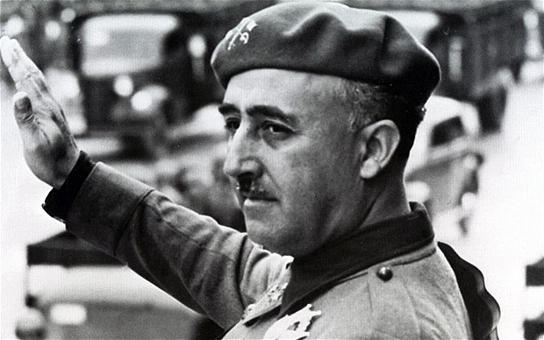
Francisco Franco
A military general who revolted against the new democratic government in Spain
Civil war broke out in 1936 between the fascists who supported Franco, and the loyalists who were anti fascists.
Germany and Italy supported Franco with weapons and troops, while the Soviet Union supported the loyalists for fear of fascism spreading.
Ended in 1939 with Franco becoming dictator for life, rule for nearly forty years.
Used the same tactics Hitler and Mussolini used in order to control the populace.

Slide 16
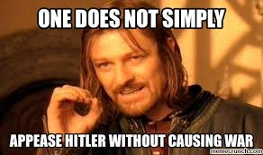
Appeasement
Hitler wanted all German speaking people under the Third Reich rule
Initiated Anschluss: union of Austria and Germany, League of Nations only protested it, but didn't take action.
Hitler then turns to Czechoslovakia, wanted the Sudetenland: western part of Czechoslovakia, be given to Germany. France and Great Britain allow it instead of going to war.
Hitler then signs the Nazi-Soviet pact, creating peace with the Soviet Union
With nobody willing to stop Hitler, Czechoslovakia is completely taken over
September 1939, Germany invades Poland, Great Britain and France declare war on Germany.

Slide 17
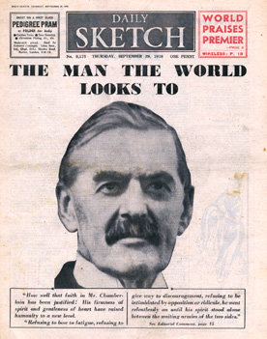
Neville Chamberlain
Prime Minister of England
Led the Munich Conference, a peace treaty to appease to Hitler
Believed giving Czechoslovakia would keep peace.
Notes:
gdsgdfsgf

