Slide 1
Japans rise to imperialism

Slide 2
Objectives
Students will understand how Japan rose to power through the Meiji Restoration through industrialization, societal changes, and militarization.
Students will understand how these changes led to Japan becoming an imperialistic nation.

Slide 3
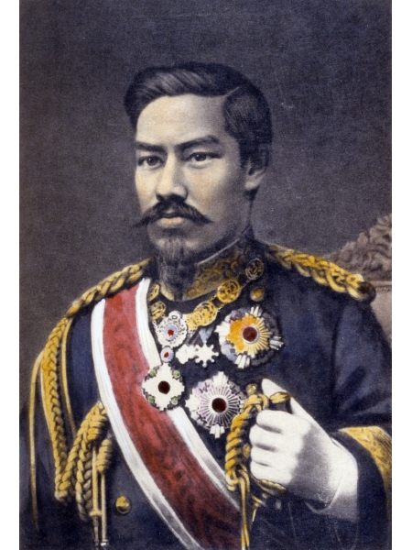
Quick reminder
The Meiji Restoration was a time period for Japan to modernize based on the western powers.
Named after Emperor Meiji, lasted from 1868 to 1912
Led to government, military, and social changes that resembled western powers

Slide 4
A Modern Government
Wanted to create a modern government based on the western powers.
Created a Diet: a democracy with an emperor as the head of the government.
Created separate branches to maintain finance, military and education.

Slide 5
Industrialization
Improving the economy was step one with modernizing Japan.
Creating a modern banking system, built railroads, improved ports, organized telegraph and postal system.
Zaibatsu: Powerful banking and business families formed through economic reforms.
Peasants traveled to cities looking for work in factories.

Slide 6
Societal Changes
Classes from feudal japan ended.
Women gained some rights, but still played a secondary role in society.
Japan was able to improve so rapidly because they are a homogeneous society: people who share a common culture and language.
In order to resist foreign powers, Japan had to learn from western cultures.

Slide 7
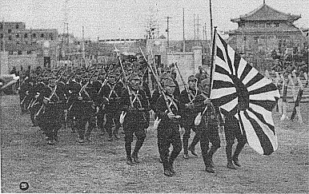
Japan Militarized
Rise in economy fed imperialist notions.
Had the technology to fight off foreign powers, but needed raw materials from other countries.
Wanted to create an empire in East Asia.

Slide 8
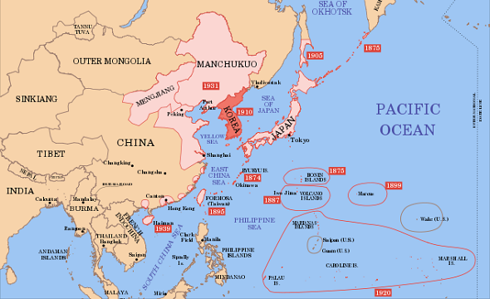
First target: Korea
Korea was the main focus of Russia, China, and Japan.
Korea (ran by the Chosun Dynasty), was isolated, didn‘t allow foreigners.
1876, Japan forced Korea into unequal treaties for trade.
1894 Sino-Japanese war: China and Japan fought, Japanese claimed victory and trade ports.
Conquered a new territory in Northern China called Manchuria.

Slide 11
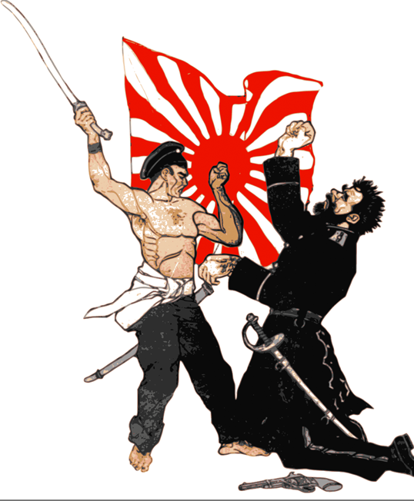
Conflict with Russia
Japanese conflict and expansion into Korea led to issues with Russia.
The Russo-Japanese war 1904: War between Russia and China, Japan wins and claims Russian territory in China.
The significance of it was an Asian power defeating a European power.

Slide 12
Japan Conquers Korea
After defeating Russia, Japan controlled Korea from 1905-1945.
Created a rule that copied their European counterparts.
Industrialized Korea, but took control all of their resources.
Because of this, Korea revolted against Japan March 1, 1919. Was called the March First Movement: created a rise in Korean nationalism.
Ended with the massacre of hundreds of Koreans.
By the early 1900s, Japan was the strongest power in Asia.

