Slide 1
Appeasement

Slide 2
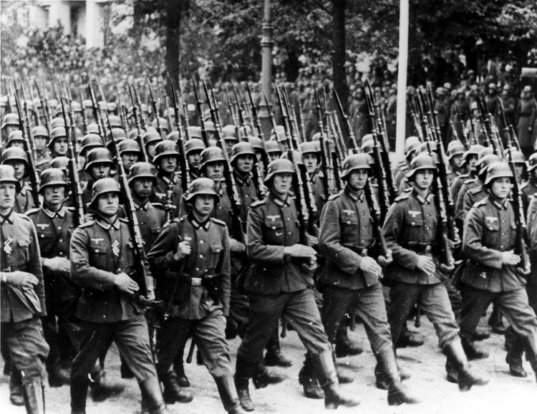
German Rearmament
By 1938, Germany had rebuilt its military under Hitler in violation of the Treaty of Versailles.
Hitler was looking to expand Germany’s borders, claiming that he was attempting to unite ethnic Germans in Europe.
Recent memories of the First World War left European countries reluctant to prepare for war.
Review of German Troops, 1939
Notes:
Image credit: Warschau, Parade vor Adolf Hitler [Photograph]. (1939). Retrieved September 25, 2012 from: http://en.wikipedia.org/wiki/File:Bundesarchiv_Bild_146-1989-034-21,_Warschau,_Parade_vor_Adolf_Hitler.jpg

Slide 3
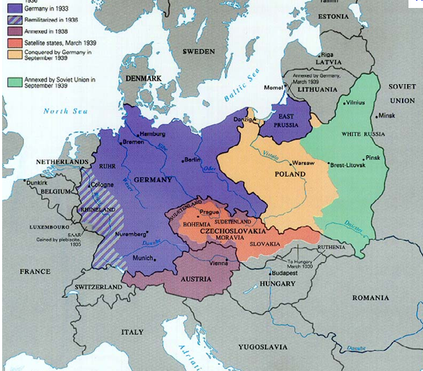
German Aggression
Between 1936 and 1938, Germany:
Re-militarized the Rhineland
Annexed Austria
Demanded that Czechoslovakia give Germany the Sudetenland, a region with a heavy ethnic-German population
German Aggression 1936-1939
Notes:
Image from: http://users.humboldt.edu/ogayle/hist111/unit2WWII.html

Slide 4
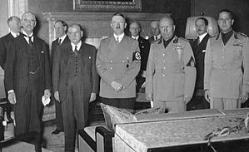
The Munich Agreement
The British government took the role of negotiating with Germany.
British Prime Minister Neville Chamberlain met with Hitler in Munich to find a compromise over the Sudetenland.
The “Munich Agreement” stated that Germany would receive the Sudetenland, along with a promise not to take further land from Czechoslovakia.
Munich became synonymous with
“appeasement.”
Signing of the Munich Agreement
Notes:
Image from: http://users.humboldt.edu/ogayle/hist111/unit2WWII.html

Slide 5
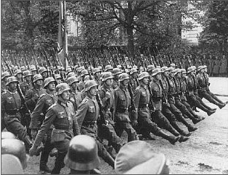
Further German Aggression
On March 13-14, 1939, Germany violated the Munich Agreement by occupying Czechoslovakia.
On September 1, 1939, Germany invaded Poland, which initiated World War II in Europe.
On September 3, 1939, Great Britain and France declared war on Germany.
German Troops Entering Poland, 1939
Notes:
Image from: http://users.humboldt.edu/ogayle/hist111/unit2WWII.html

Slide 6
Central Historical Question
Was Appeasement the right policy for Great Britain in 1938?

