Slide 1
Frillio’s Pizza
Opening Soon!

Slide 2
Project/Book Discussion
Read and discuss book to get familiar w/ Frillio’s
Website -- www.frilliospizza.com
Design tips (pg 14-18)
Design elements & shapes
Choose words wisely (pg 21-22)

Slide 3
Letterhead
Stationery sheet w/ contact information used to communicate w/ customers and vendors
Keep it Simple (KIS)
8 ½ X 11 (use either Illustratrator or In Design)
Make sure to include all contact info (pg 32)
Keep type to 10 or 12 pts and use one font
Keep info inside .5 inches

Slide 4
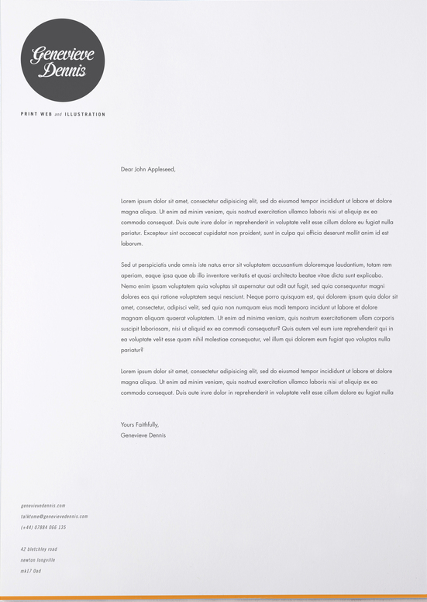
Examples

Slide 5
Envelopes
Go hand-in-hand w/ letterhead
#10 size is standard (4.125 inches tall by 9.5 wide)
Mirror the letterhead
Return address .25 inch from top left edge
Address the envelope to yourself using your address
Include a stamp (you create) in top right

Slide 6
Business Cards
Announce identity and intention, advertise
Keep consistency w/ letterhead & envelope

Slide 7
Assignment
Create and design letterhead
Create and design envelope
Create and design business card

