Slide 1
Vegetarianism
Foods&Wellness

Slide 2
What is it?
Vegetarians are people who choose not to eat meat, fish, and poultry
Vegans: do not use any product that comes from an animal source
Honey
Wool
Silk
Leather

Slide 3
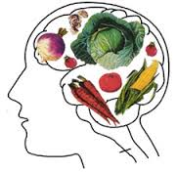
Why choose vegetarianism?
Health reasons
Environmental concerns
Ethical concerns
Dislike of meat
Non-violent beliefs
Compassion for animals
economics

Slide 4
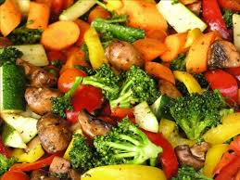
Vegetarian History
Practiced among religious groups of Egypt around 3,200 BC
The Vegetarian Society formed in 1847
1880s-Vegetarian restaurants popular in London
1960s- vegetarianism became popular with counter-culture
In 2012, 5% of Americans saw themselves as vegetarians

Slide 5
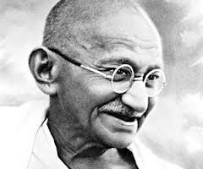
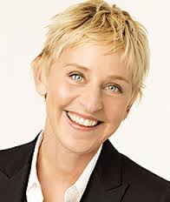
Famous Vegetarians
Pythagoras
Leonardo Da Vinci
Dr. John Harvey Kellogg
Mahatma Ghandi
Ellen DeGeneres
Paul McCartney

Slide 6
Types of Vegetarians
Lacto-Vegetarian
Diet based on grains, legumes, vegetables, fruits, nuts, seeds and DAIRY
Ovo-vegetarian
Diet based on grains, legumes, vegetables, fruits, nuts, seeds and EGGS
Lacto-ovo vegetarian
Diet based on grains, legumes, vegetables, fruits, nuts, seeds, DAIRY and EGGS

Slide 7
More…
Vegan
Macrobiotic
Principles of harmony with nature and the universe
Grains, legumes, vegetables (nuts, seeds, fruits to a lesser extent), sea vegetables, seafood may be consumed
Fruitarianism
Based only on fruits, botanical fruits, nuts and seeds
Excludes meat, fish, poultry, dairy foods, eggs, grains, legumes and most vegetables

Slide 8
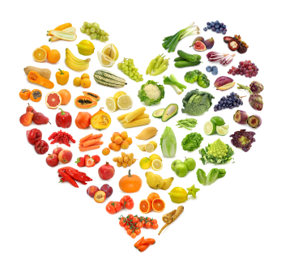
Even more…
Raw Foodism
Includes raw vegetables, fruits, nuts, seeds, sprouted grains and beans
Flexitarian
People who could be described as part time vegetarians-will sometimes eat meat, poultry, and fish

Slide 9
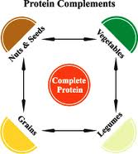
Protein?
Where do vegetarians get their protein?
Write three sources

Slide 10
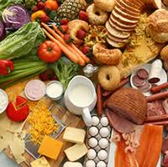
Health Benefits
Lower risk for developing…
Heart disease
Colorectal, ovarian, and breast cancers
Diabetes
Obesity
Hypertension (high blood pressure)

Slide 11
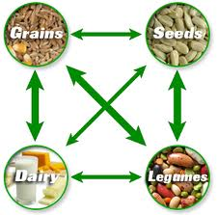
Foods to Eat
Whole-grain products
Vegetables
Fruits
Legumes
VARIETY is key to staying healthy

Slide 12
https://www.vegsoc.org/sslpage.aspx?pid=876
http://brown.edu/Student_Services/Health_Services/Health_Education/nutrition_&_eating_concerns/being_a_vegetarian.php
http://www.gallup.com/poll/156215/consider-themselves-vegetarians.aspx
http://www.vrg.org/nutshell/nutshell.htm

