Slide 1
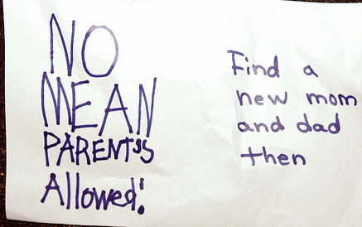
Parenting Styles
Objective: Learn about common patterns parents exhibit when parenting their children and what factors contribute to those patterns.

Slide 2
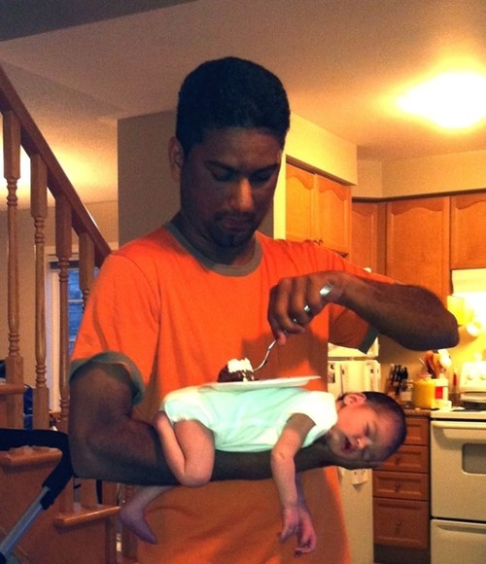

Slide 5
Authoritative/Democratic Parents
Reasonable balance of three key aspects:
Nurturance
Discipline
Respect
Direct children’s activities in a rational, issue-oriented manner
Display firm control
Do not restrict children
Recognize children’s interests and unique personalities
Show respect for their children while expecting respect from them
Willing to discuss behavioral guidelines that have been set

Slide 6
Children of Authoritative parents
High levels of familial involvement and closeness
High levels of academic achievement
Higher levels of conscientiousness=better grades
Higher levels of self-esteem
Cooperative with peers, siblings and adults
More mature, resourceful, empathetic, and higher reasoning ability
Less likely to exhibit behavior problems
More likely to turn to parents for decision making
Higher levels of self-actualization
What does self-actualization mean? Its aesthetic, creative, philosophical, and spiritual understanding.

Slide 7
Authoritarian Parents
Favor punitive, forceful punishment
Shame children into compliance
Place value on:
keeping children in their place
restricting children’s autonomy
assigning household responsibilities in order to instill respect for work
May use physical punishment to get obedience
Emphasize respect for parents but not children
Discourage children from free expression
“Because I said so!”
Can be emotional detached and unresponsive

Slide 8
Children of Authoritarian parents
Not encouraged to think for themselves
Expected to look to others for approval, answers
Abnormal emotional development
Dependent, passive, conforming, less self-assured, less creative, and less socially adept than other children
Lower psychosocial maturity
Lower resourcefulness and academic achievement
Lower self-esteem
Social problems and externalizing behaviors
Rule breaking, aggression
Higher risk for substance abuse, crime, delinquency
Girls at risk for early sexual behavior

Slide 9
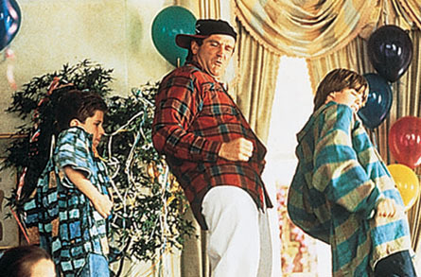
Permissive Parents
Do not help their children learn to set limits
Very lenient parenting style, little restriction
Lack of routine, consistency
Engage less in independence training
Lack of demandingness in responsibilities (household)
Allow children to regulate own behavior
Internet regulation lowest in permissive parents
Fail to exercise sufficient control of their children but also have diminished self-control
Not well organized or effective in running their households

Slide 10
Children of Permissive Parents
Lower academic achievement
Lack impulse control
More immature, less self-reliant
Less socially responsible and less independent
Cannot regulate their behavior
Association with heavy drinking
Boys at risk for early sexual behaviors
Permissive parents are not seen as persons whom they can come to when making important life decisions
More likely to go to peers when making moral decisions
Less happy

Slide 11
Indulgent Parents
Excessively lax parenting pattern
Parents do not exercise control over children
Highest in involvement with children
Lowest in strictness
Few clear expectations
Seldom set limits
Yield to coercion and manipulation from their children
View discipline and control as being potentially damaging to children’s developing creativity
Provide high levels of support and affection
Do not stipulate limits and guidelines but let them do as they please

Slide 12
Children of Indulgent Parents
Manipulative of others, especially their parents
Exhibit externalizing behaviors (outgoing)
Tend to be irresponsible and immature
Conform more to their peers
More involved in risky behaviors (crime & delinquency)

Slide 13
Best outcomes for your children?
Out of the parenting styles you’ve learned about today, which seems like it produces the best outcomes for the children reared by that particular parenting style?
Which parenting style do you think you’d like to aim to use when you have children? Why?

Slide 14
Think Critically
Consider the parent-child interactions of families with whom you are familiar (your own and those of friends or relatives) and see if you can identify a family that fits the authoritative pattern. If so, what are the lives of the children like? See if you can identify some of the positive outcomes of the authoritative parenting in those families.
(Heath, 2013)

Slide 15
Remember…
The most important thing to remember about parenting is to be a good role model.
Patience is important! We all make mistakes.
Listen to your kids and model good problem solving strategies.
Be loving, fair, and consistent.
Don’t threaten, come up with appropriate consequences.
The parent is in charge because they have the most experience.
Have fun with your child! Experiences not things are what they will remember all of their lives.

Slide 16
Resources:
Parent-child Relations: context, research and application
Third edition
By: Phyllis Heath

