Slide 1
Interior Design
FCS Intro

Slide 2
What is design?
“A plan for arranging elements in such a way as to best accomplish a particular purpose.”
-- Charles Eames

Slide 3
Elements of Design
Space
Line
Color
Shape
Value
Texture

Slide 4
Space
An empty area where a design will fit. It is where the design is solved.

Slide 5
Lines
Used to direct, divide, point, make a shape, and emphasize.

Slide 6
Shape
The visible makeup of an item.

Slide 7
Color
Represents emotion and allows objects to stand out from the background

Slide 8
Value
The lightness or darkness of a color.

Slide 9
Texture
Is tactile (touch) or visual (see) surface characteristics, which can imply weight, density and depth.

Slide 10
Conclusion
The elements of design are found in every object, whether natural or human-made. If you become aware of the use of these elements, you grow in appreciation of design.

Slide 11
Interior Design Styles
FCS Intro

Slide 12
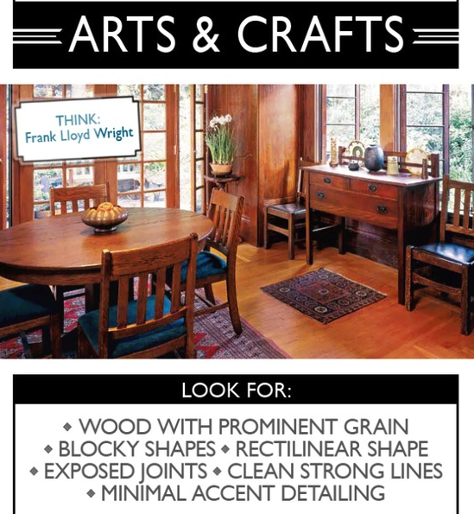

Slide 14
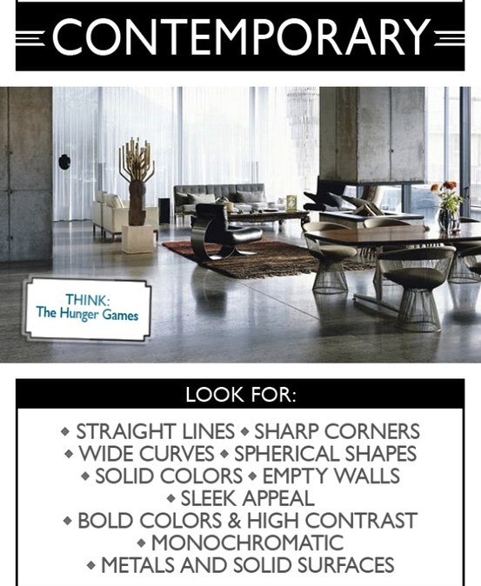

Slide 15
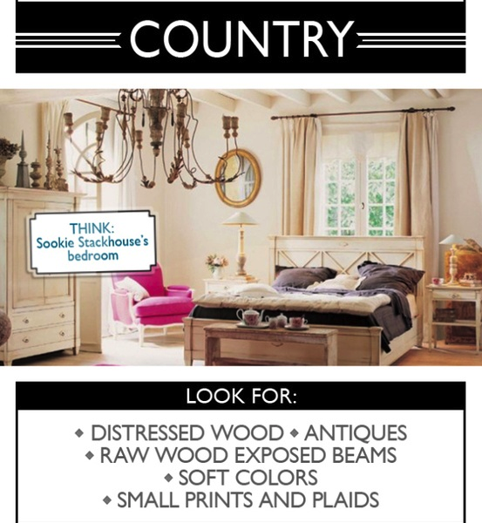

Slide 17
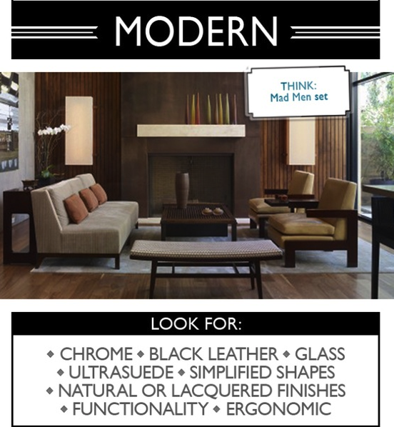

Slide 19
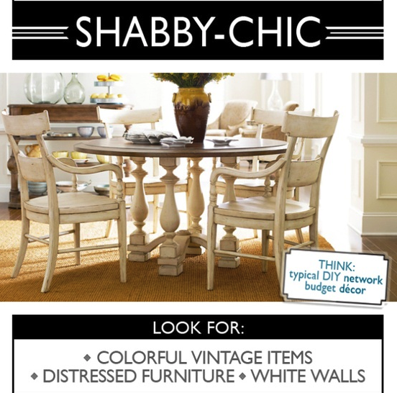

Slide 20
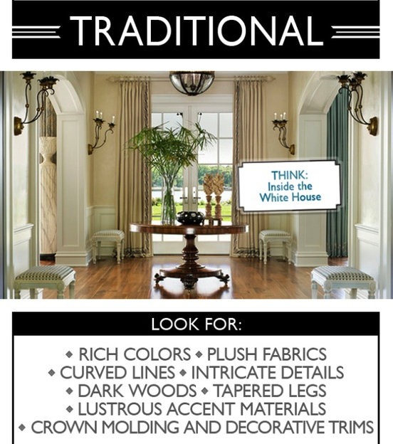

Slide 22
Floor Plans
Rooms, houses, hotels

Slide 23
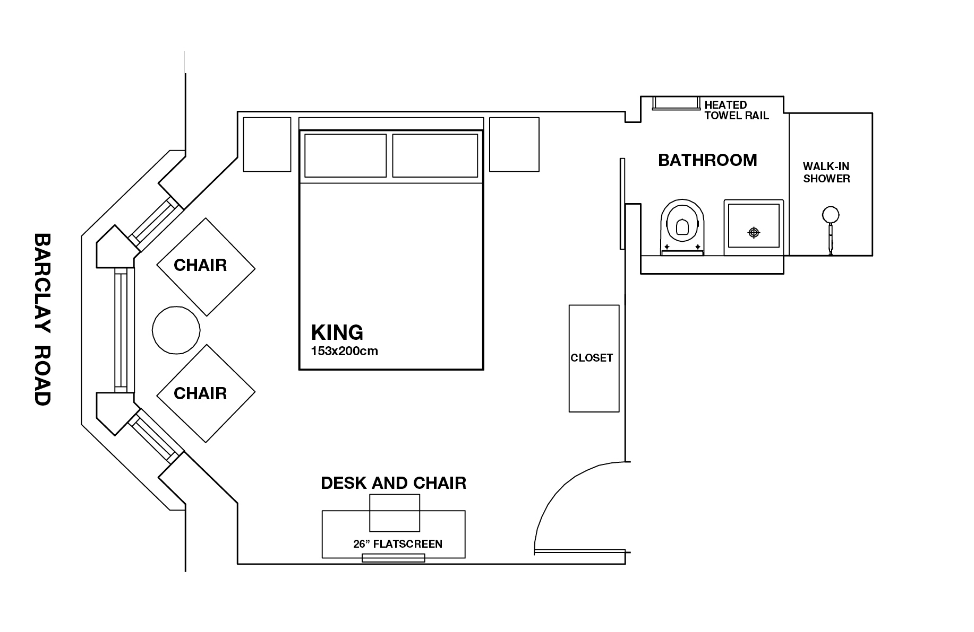

Slide 24
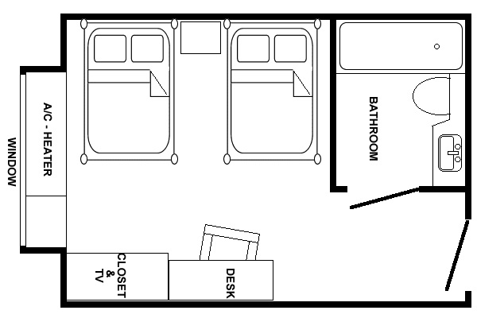
Floor Plans
Two dimensional layout
Shows less detail than blueprint
Used by all tradespeople

Slide 25
Floor Plans show…
Exterior and interior walls
Size and location of windows and doors
Built-in cabinets and appliances
Permanent fixtures
Stairs and fireplaces
Porches, patios and decks
Room names and approximate sizes

Slide 26
Floor plans are used to…
Judge space dimensions in a room
Determine architectural detail placement in a room
Study suitability to lifestyles
Create a decorating plan

Slide 27
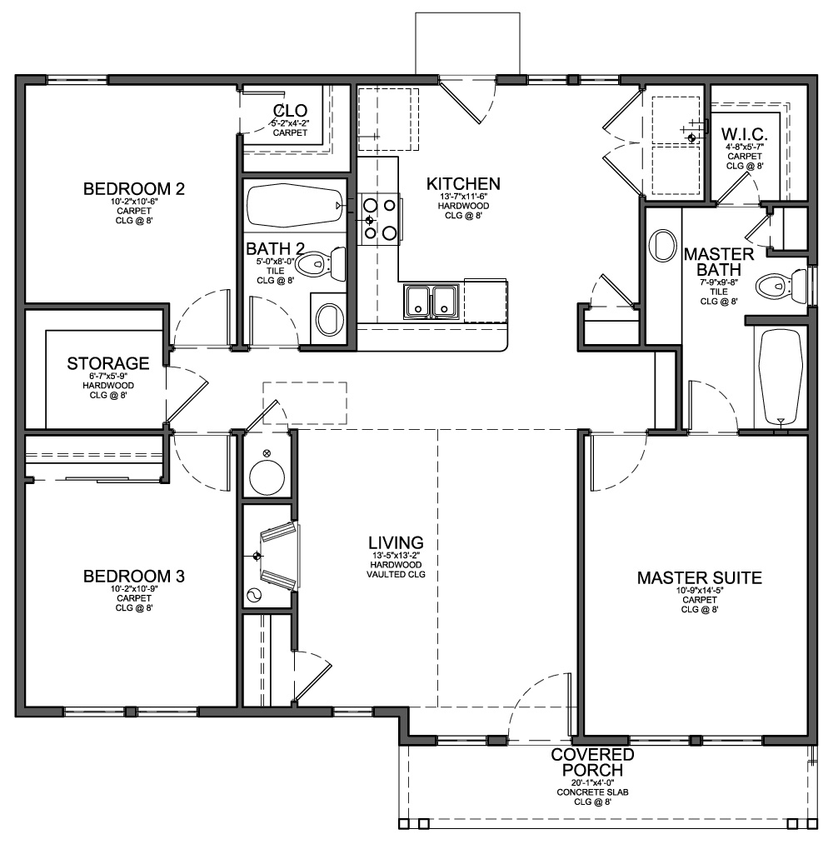
Three Main Areas of the Home
Living
Sleeping
Service

Slide 28
Storage Considerations
Storage space needs to be adequate (10-15% of the home)
Should be convenient and accessible
Incorporated through the entire home
Two types:
Built-in (cupboards, closets, pantries, etc.)
Furniture (desks, chests, dressers, trunks, etc.)

Slide 29
Create Your Own Floor Plan
Using the Bird’s Eye view, create your bedroom or dorm room (35 Points)
In addition, write a paragraph explaining your layout and how you would design your room. Include and explain all the elements of design.
Creativity, Color, and Detail- Is it creative, colorful, yet practical and realistic?
Floor Plan Guidelines- Does the room design follow the correct guidelines of floor plans we discussed in class?
Doors and Windows (2 or more) – Does it include door/s windows, closet, etc.
Birdseye View- Does the room stick to the Birdseye view? (Example in the book)

Slide 30
Floor Plan Assignment Continued…
Scaling- Is it scaled properly?
Elements of design- Include all the elements of design and explain how you tied them in and why.
Line and Neatness- Was the drawing, organized and neat? Are the lines straight and proportional?
Items you may include: Bed, Night Stand, Rug, Closet, Lamp, Artwork, Desk, House Plants, etc.

