Slide 1
Handling Childhood Emergencies
Objective-
To learn how to handle emergency situations with children with confidence

Slide 2
What qualifications should a person have before they attempt to do cpr?
Take a CPR first aid class
American Heart Association
American Red Cross
National Safety Council
Health Occupations
Life saving class

Slide 3
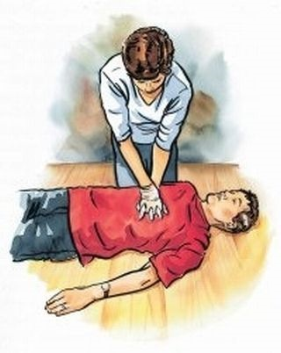
What is the purpose of cpr?
To help a person breath and circulate their blood
CPR stands for “cardiopulmonary resuscitation”

Slide 4
List the abc’s of cardiopulmonary resuscitiation
1. Call for help
A- open airway
B- breath (give 2 breaths over 1 second each)
C- circulation (for a child and adults, 30 chest compressions to 2 deep breaths. For an infant use 2 fingers)

Slide 5
What number do you call in Lincoln for Emergency Medical services
911
At school 9-911
You must know how to dial out of the building.

Slide 6
Choking: What signs might indicate that a child is choking?
They will put their hands on their neck
If the victim is coughing – do nothing but be prepared to act if they grab their neck.

Slide 7
ON WHAT items is a child most likely to choke?
MARBLES
PEANUT BUTTER
HOTDOGS
BALLOONS
BARBIE SHOES
COINS
ANY SMALL OBJECT
THE BEST PREVENTION IS CONSTANST SUPERVISION

Slide 8
What is the Heimlich Maneuver?
For children & Adults – Make a fist with one hand and place it just above the belly button. Thrust inward and upwards with quick jerks.
For infants – Support the babies head in one hand, with the torso on your forearm. Give 5 back slaps between the shoulder blades with the heel of your hand.
If they stop breathing begin CPR

Slide 9
Seizures & Convulsions What steps should you follow if you think a child is have a seizure or convulsions?
Do not try to move or restrain the person
Do not put anything in their mouth
Prevent injury
Loosen tight clothing
Gently turn the person onto one side if vomiting occurs
Call 911 if necessary

Slide 10
Drowning: What are some possible sources of water in which a small child might drown?
Bathtub
Swimming pool
Bucket of water
Pond
Lakes
Any small body of water that can cover their mouth and nose

Slide 11
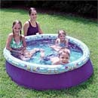
What is the best protection against drowning?
Constant supervision
Lifejackets
Lifegaurds
Swimming lessons
Safety first

Slide 12
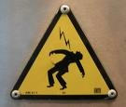
Medical Shock:what are the signs that a person is going into shock?
Anxiety
Confusion
Agitation
Restlessness
Dizziness
Light headed
Cool
Clammy
Sweating, pale, bluish skin
Rapid, shallow breathing
Thirst
Nausea
Vomiting
Changing levels of responsiveness

Slide 13
What should be done while you are waiting for EMS to arrive?
Have the victim lie on their back and raise their legs 8 – 12 in. (unless the victim has a spinal injury)
Loosen clothing
Watch for vomiting
Maintain normal body temperature
No eating, drinking, or smoking
Use the recovery position if necessary

Slide 14
Poisoning:
What is the number to call for Poison Control?
1-800-222-1222
911
What do you need to know when you call?
Name
Child’s name
Age
What they took?
How much?
Child’s weight

Slide 15
Head Injury
What symptoms might you expect to see in a child with a serious head injury?
Deformed area of the skull, depressed area in bone felt by touch, blood, or fluid coming from the eyes or ears
What to do about a head injury?
Do not clean , press, or remove objects
Cover the wound
For small bumps apply ice and have the child rest

Slide 16
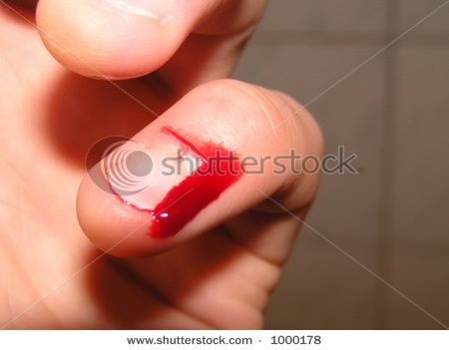
Bleeding:
What procedures are used to stop bleeding?
Call 911 if necessary
Cover with bandage
Apply pressure
Treat for shock
(minor wounds may be cleaned, dressed and bandaged – ice)

Slide 17
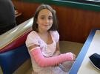
Broken Bones:
R –I-C-E
Rest the injured area
Place ice on the area
Put a compress the area with a roller bandage
Elevate an injured extremity (sling
Transport the child to the emergency room or call 911

Slide 18
Burns:
1st degree burns
sunburns
(red, dry & Painful)
2nd degree burns
Swollen with blisters
3rd degree burns
Damage, charred, white & leathery
Chemical burns
Electrical Burns
Call 911 for all burns except 1st degree
Remove the heat source
Cool 2nd degree burns
Do not cool 3rd degree burns
Remove chemical
Unplug the power source
Treat for shock if necessary
Keep clean dressing on burns

Slide 19
Eye Injury:
If a child complains about something in their eye, what should you do?
Remove the small item carefully
Large items should be stabilized and call 911
Black eyes should have ice for 15 minutes and seek medical attention in needed

