Slide 1
Functional vs. Dysfunctional
Objective:
To compare and contrast between functional and dysfunctional characteristics between families and to distinguish that no one family is ideal or measurable of perfection.

Slide 2
Functional
Of or relating to a function or functions
Performing or able to perform a function
Intended to be useful

Slide 3
Dysfunctional
Abnormal, impaired or incomplete functioning, as of a body organ or part

Slide 4
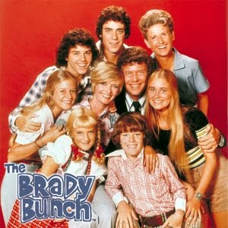
Functional families
What do you think of when you think of a functional family?

Slide 5
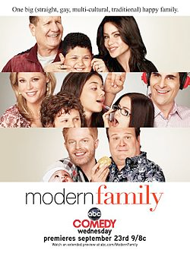
Dysfunctional families
What do you think of when you think of a dysfunctional family?

Slide 6
Activity
Split into 4 groups of 3-4 individuals per group.
Pick up the following from the counter:
a blank sheet of paper
An envelope that says “functional vs. dysfunctional” on it
Use the heading titled, “Familes” and categorize the slips of paper with qualities of families on them based on if you think they are “functional/nurturing” or “dysfunctional.” You can use the blank sheet of paper as a background for this.
When you feel like you and your group has finished, think about the characteristics that resonate with you and your family.
We will discuss this activity once everyone is finished.

