Slide 1
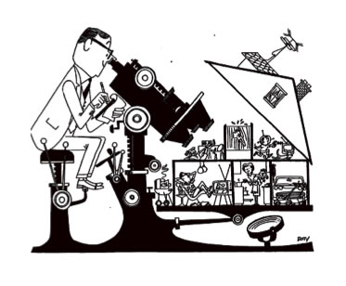
Theoretical Perspectives

Slide 2
Psychoanalysis
Sigmund Freud (1856-1939)
Focuses on abnormal behavior
Freud connected unconscious drives and conflict often stemming from childhood

Slide 3
Psychoanalysis Cont’d
Relies on personal observation and reflection instead of controlled laboratory experimentation as its means of discovery
Since Freud’s death in 1939 many of his theories have been disproved however elements from his original theory are still apart of pop culture
Notes:
Freudian slip – Mistatement reflective on something one would like to say

Slide 4
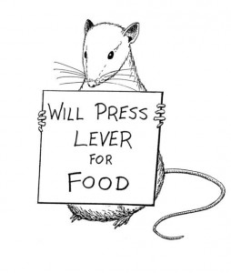
Behaviorism
John B. Watson (1878-1958)
Studies only observable and objectively describable acts
Does not focus on anything you cannot see.
Today, behaviorism focuses on learning through rewards and observation

Slide 5
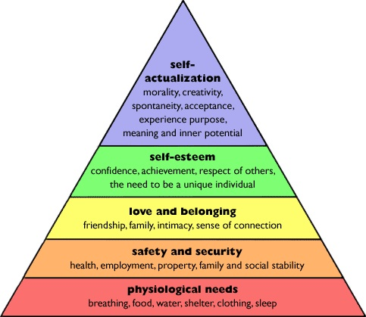
Humanistic
Carl Rogers (1902-1987) & Abraham Maslow (1908-1970)
Emphasizes the conscious experience humans go through
Humans have free will in their decision making and are not controlled by rewards and reinforcements

Slide 6
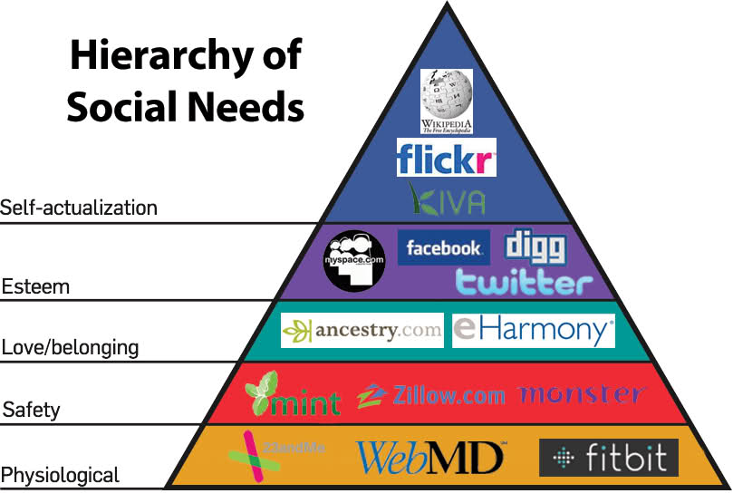

Slide 7
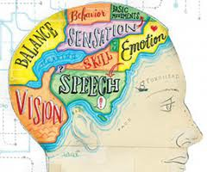
Biological
Looks to understand behavior through the biological structures, emotions, and thoughts
If a person lacks a certain chemical in their brain they suffer affects to their behavior and actions.
Notes:
Stranger situation

Slide 8
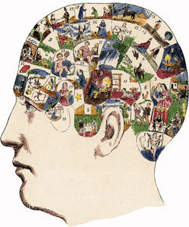
Cognitive
Focuses on how people think, take in, store, and retrieve information
Remembering things you have learned or are learning from past actions or behaviors
Notes:
Stranger situation

Slide 9
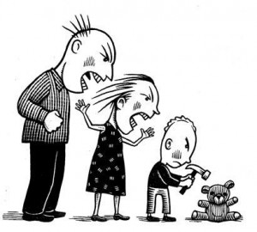
Socio-Cultural
Looks at how thinking and behavior change depending on the situation or setting
How you act and think in situations where you are comfortable vs. when you are not comfortable
Notes:
Stranger situation

Slide 10
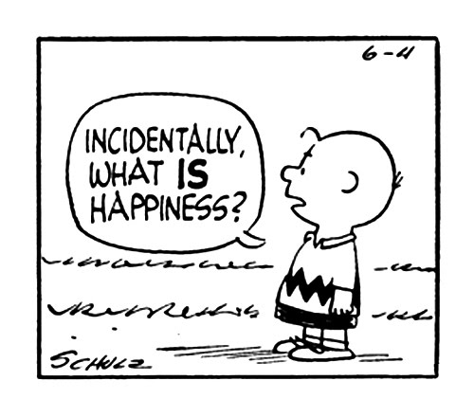
Positive
Movement that focuses on the study of optimal human functioning and the factors that allow individuals and communities to thrive
Firmly grounded on psychological science, thereby avoiding humanistic psychology’s lack of scientific research to support its theoretical foundation
Notes:
Define community
Do we have optimal human functioning at S.E.
And Lincoln vs. Ponca

Slide 11
Outrageous Celebrities
Choose a famous person i.e. Brittany Spears, Justin Bieber, Richard Nixon or anyone else and explain their outrageous behavior using Three theoretical concepts we have discussed in class
Make a connection between the behavior and the psychology perspective
Answers should be in complete sentences

Slide 12
Lindsay Lohan

Slide 13
Behaviorism
Learned some of her disruptive behaviors from her parents and the people around her growing up
Watched her dad drink
In the celebrity world alcohol is common
Stars get attention from the media, the more disruptive, the more attention they receive

Slide 14
Socio-Cultural
Her mother pushed her into fame at a very young age
Dina Lohan was a bad example for Lindsay
Dina admits to having a drinking problem in the past
Dina and her husband had a bad relationship, they would always fight and blame each other for Lindsay’s disruptive behavior
Both Lindsay’s mother and father went to the press to humiliate the other

Slide 15
Socio-Cultural Cont’d
Sam Ronson was Lindsay’s girlfriend
It was an unhealthy relationship where Lindsay relapses into drug abuse
They were often out partying all the time which lead to media attention for Lindsay
The media attention was rough on Lindsay, she was in the limelight since she was 12
All of her actions were caught on tape

Slide 16
Humanistic
Lindsay is stuck in Maslow’s Hierarchy of Needs pyramid
She has no sense of love and belonging which stops her from having self-esteem and self-actualization
Her morals are out of whack based on the environment she grew up in and the environment she is surrounded in

