Slide 1
Period 1: 1491-1607

Slide 2
Key Concept 1.1
Before the arrival of Europeans, native populations in North America developed a wide variety of social, political, and economic structures based in part on interactions with the environment and each other
I. As settlers migrated and settled across the vast expanse of North America over time, they developed quite different and increasingly complex societies by adapting to and transforming their diverse environments

Slide 3
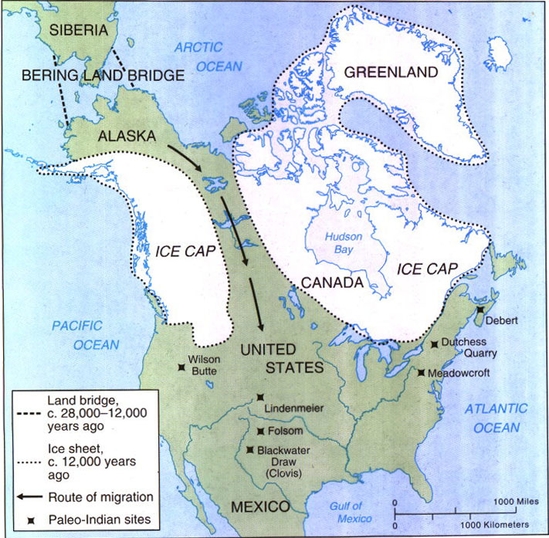
Pre-Contact
Land bridge from Siberia to Alaska
10K+ years ago
Migrated southward from Arctic Circle
Native population in Americas in 1491==50-100 million

Slide 4
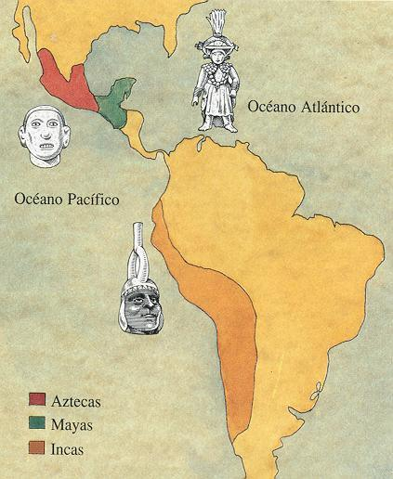

Slide 5
Mayas
Empire covered the Yucatan Peninsula (modern-day Guatemala, Belize, & parts of Mexico)
Rose to prominence by 6th century AD
Abandoned stone cities by 8th century
Reasoning for rapid decline is still debated
Written language, numerical system (Zero!), accurate calendar (2012 Apocalypse???), expertise in astronomy, magnificent temples & palaces
Advanced agriculture
Field rotation
Grew mostly corn, but also squash, pumpkins, sweet potatoes, cucumbers, peppers, tomatoes, tobacco, cacao (Chocolate!), etc.
Domesticated turkeys, dogs (Huh!), ducks
3 months of farming could produce enough food for a family for a year

Slide 6
Aztecs (“Mexica”)
South-central region of modern-day Mexico
Rose to prominence in 13th century AD
Fell quickly after Cortez arrived in 1519
240K Aztecs were killed between 1519-1521
Capital city of Tenochtitlan (later Mexico City) had population of up to 200K
Religion involved human sacrifices
Advanced agriculture:
Maize, beans, squashes, potatoes, tomatoes, onions, peppers, avocadoes, etc.
Irrigation & intensive cultivation
Chinampas
Gardens grown on lakes
Hunting (bows & arrows) & fishing (spears & nets)
Domesticated turkeys & dogs

Slide 7
Incas
Located along west coast of South America; Andes Mountains
Largest empire of the 3
Much territory acquired by force
Arose in 13th century; prominence by 15th century under leadership of Pachacuti
Royal palaces, temples, sewer lines, elaborate water systems, abundance of gold
Conquered by Pizzarro in 1530s; population also devastated by small pox & other disease
Rugged terrain made farming difficult
Terraced the land, irrigation, road system
Corn, potatoes, grains, cotton, peanuts, cacao
Region around Lake Titicaca provided much flat farmland; became a fertile breadbasket
Domesticated llamas & alpacas

Slide 8
Similarities
Highly organized societies
Extensive trade
Created calendars
Cultivated crops & had stable food supplies
Esp. corn for Mayas & Aztecs, potatoes for Incas

Slide 9
North America
Much smaller population
1-10 million
Smaller, less sophisticated societies
More nomadic; corn cultivation spread northward slowly
Hunting, gathering, fishing

Slide 10
Pre-Contact Regions
Your turn to talk!
Get your charts out & be ready to share
The PPT follows the same order as your chart

Slide 11
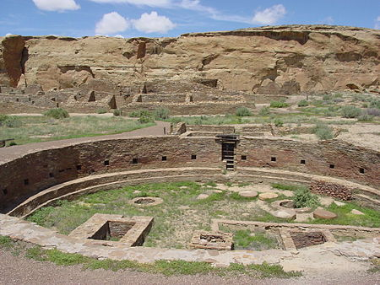
American Southwest
Hokokam, Anasazi, Pueblos
Dry, desert
Farming w/ irrigation
Lived in caves & multi-storied buildings
Stone & adobe structures
Towns were centers of trade & religious activities

Slide 12
California
Varied landscapes
Mountains, desert, enormous central valley, coastline
Shamans served as both religious leaders & healers
Some tribes had rigid caste systems & some groups kept slaves
Limited farming; mostly hunting, gathering (nuts, esp. acorns), & fishing/whaling
Basket-making

Slide 13
Eastern Woodlands
Appalachian Mtns. & Great Lakes dominate the region
Numerous major rivers
Spoke Algonquian, to a lesser extent Iroquoian languages
Hunting, gathering, & fishing
Around 1000 AD started to farm
Maize, squash, beans, pumpkins
Slash & burn
Used up soil quickly & moved
Lived in longhouses & wigwams
Iroquois League founded by 15th century

Slide 14
Great Basin
Between Rockies & Sierra Nevada Mtns.
Very arid
People were highly nomadic
Hunting, fishing, gathering
Deer, rabbits, antelope, seeds, nuts, insects
Extensive trade network reached the Pacific
Minimal housing in warmer months; windbreaks & shade
Conical huts in colder months

Slide 15
Great Plains
Enormous area; 1.5 million sq. mi.
Flat topography
Frigid air in winter, scorching heat in summer
Dramatic weather events; blizzards & tornadoes
Hunting & gathering
Bison, antelope, elk, deer, etc.
Pemmican
Seeds, nuts, berries, wild onions
Villages/sedentary life appeared in region about 2500 yrs. ago
Grew corn, extensive trade, buried dead in mounds

Slide 16
Pacific Northwest
Cool, wet climate; defined by water
Plankhouses/longhouses
Hunting, fishing, & gathering
Nuts, roots, berries
Salmon
Totem poles & other woodworking
Canoes
Caste systems based on accumulation of wealth
Potlatches
Isolation due to mountains
Combined w/ abundance of natural resources, this led to limited trade

Slide 17
Key Concept 1.2
European overseas expansion resulted in the Columbian Exchange, a series of interaction and adaptations among societies across the Atlantic.
I. The arrival of Europeans in the Western Hemisphere in the 15th & 16th centuries triggered extensive demographic and social changes on both sides of the Atlantic.
II. European expansion into the Western Hemisphere caused intense social/religious, political, and economic competition in Europe and the promotion of empire building.

Slide 18
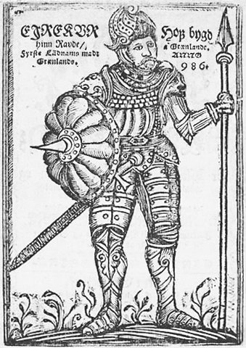
European Exploration
Vikings reached North America by 1000 AD
Voyages had little lasting impact; little reason for others to follow
Why did European exploration take off in the 15th & 16th centuries?

Slide 19
Reasons to Explore
Middle Ages (Dark Ages) are over; Renaissance begins
Cultural movement
Promoted creative thinking & individualism
Started in 14th century
Improvements in Technology
Printing press
Gutenberg, 1450
Europeans started to use gunpowder, sailing compass, sextant, bigger & faster ships
Religious Conflict
Reformation, 1517
Catholics & Protestants hoped to spread their religion
Commerce
Europe’s population had rebounded since Black Death in 1340s
Seeking land, new trade routes, & new products
Inspired by Marco Polo
Nationalism
Strong monarchs, centralized nation-states
Spain, France, England, & Portugal went from small territories into powerful nation-states
Looking to spread power/build empire
Looking to increase wealth

Slide 20
Prince Henry & Portugal
Portugal became naval power in 15th century
Hoped to establish presence in west Africa & find gold
Discovered three important sets of islands
Canaries, Azores, Madeira
Est. slave trade
Bartholomeu Dias sailed around Cape of Good Hope in 1486
Vasco da Gama reached India in 1497-1498

Slide 21
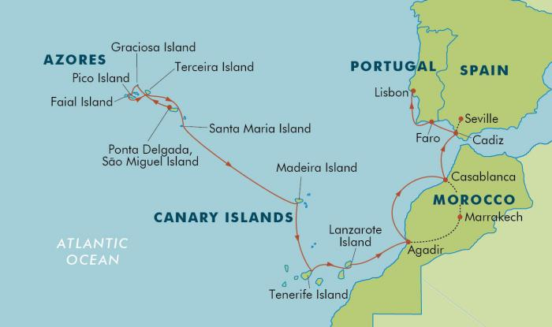

Slide 22
Christopher Columbus
Italian born
Hoped to reach Asia by going West
Could not gain support from Portugal, asked Isabella & Ferdinand of Spain
3 ships set off from Canary Islands
Landed in Bahamas on October 12, 1492; moved on to Cuba (thought it was China)
Returned to Spain w/ native slaves; called them Indians

Slide 23
Christopher Columbus
Made 3 more trips
Found little gold, few spices, no easy route to China & India
Died in obscurity in 1506
America named after another Italian explorer, Amerigo Vespucci
However, he Columbus changed the world: COLUMBIAN EXCHANGE
Additionally, Spain focused more resources on exploration
Vasco de Balboa crossed the isthmus of Panama (1st Euro to see the Pacific) & Ferdinand Magellan’s crew circled the globe

Slide 24
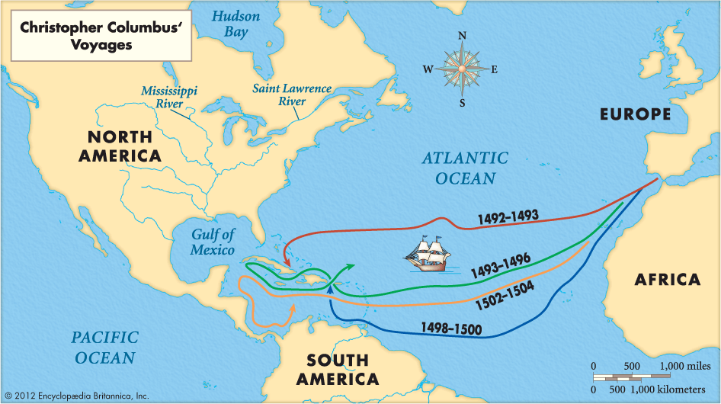

Slide 25
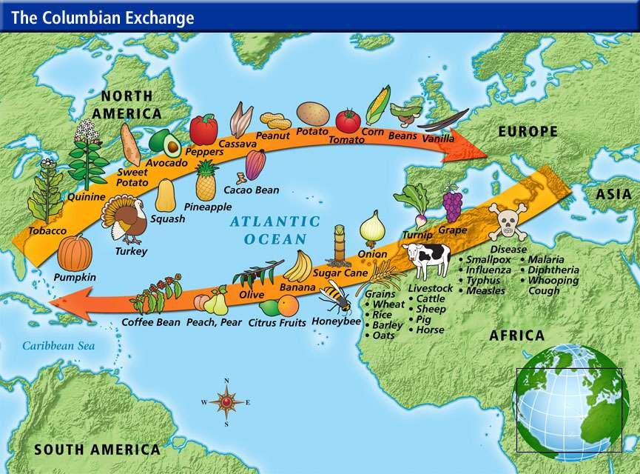

Slide 26
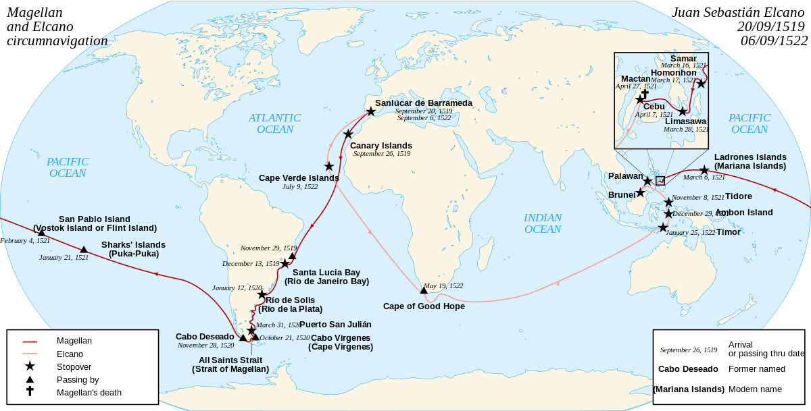
Magellan’s Route

Slide 27
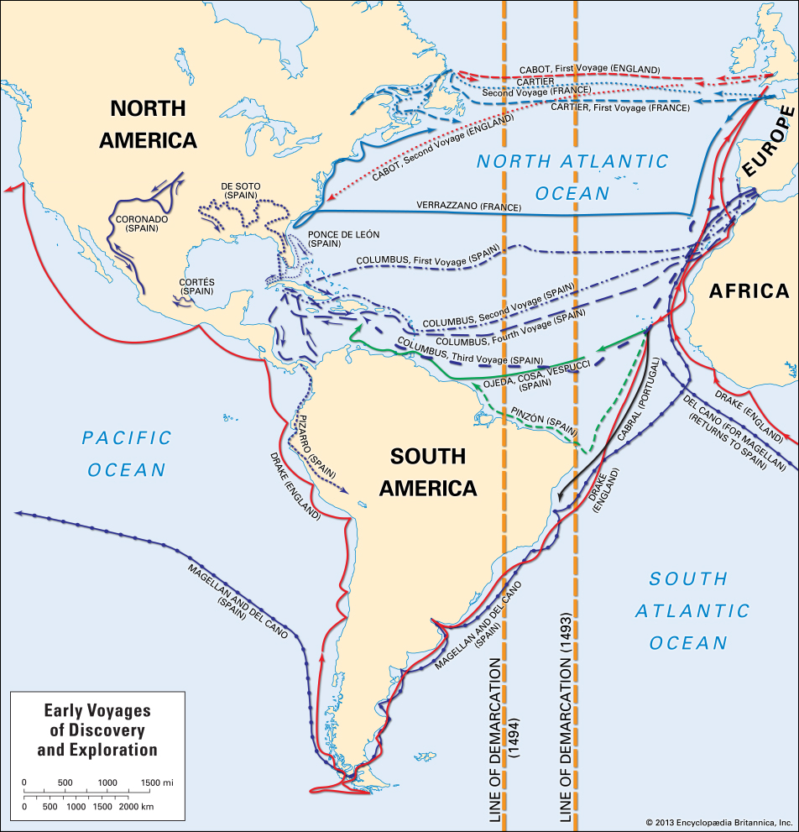

Slide 28
The Conquistadores
America moves from obstacle in way to East & instead a destination
Spain claimed the entire New World, except for Brazil
Cortes conquers Aztecs in Mexico
Small pox
Pizarro conquers Incas
Coronado & De Soto’s expeditions (see map on p. 14)
Conquistadores oppressed natives & decimated their populations

Slide 29
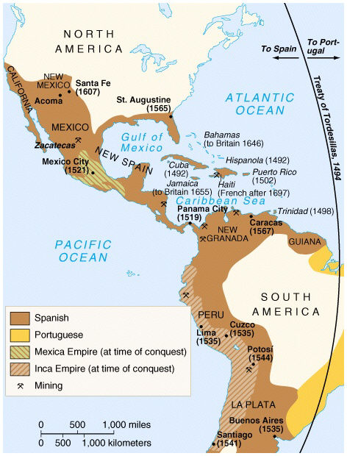

Slide 30
Spanish Empire
Phase 1—Discovery & Exploration
Looked to get rich
Gold & Silver
Spain became richest nation in the world
Biggest empire in world history by 1600
Largely peopled by natives though
Phase 2—Conquest
Phase 3—Colonization
Agriculture/Land
Missions/Catholic Church
St. Augustine, FL—1565

Slide 31
Spanish Empire
Juan de Onate & 500 men est. New Mexico
Land taken from Pueblos
Santa Fe est. in 1609
Set up encomienda system
License to extract labor & tribute from Pueblos
Suppose to protect & Christianize Indians
Often led to enslavement
Mines, farm work
Decimated native population
Led to slaves from Africa

Slide 32
Spanish Empire
By 1680, New Mexico=2K Spaniards & 30K Pueblos
No luck w/ gold; cattle & sheep instead
Attacks from neighboring Apaches 7 Navajos
Pueblo Revolt led by Pope
Killed hundreds of Spaniards (21 priests)
Captured Santa Fe & drove Spanish from region
Spanish would recapture territory in 1690s

Slide 33
Spanish Empire
Few families; mostly soldiers & explorers
Intermarriage w/ Indians & African slaves
Rigid class system
Dominated by pure-blooded Spaniards
How to treat natives?
Were they human or sub-human?
Slaves or morally equal?

Slide 34
Africa & America
Africans=over ½ of all new arrivals to NW from 1500-1800
Most from west coast
Viewed by Euros as uncivilized
But…had elaborate economic, political, & familial relationships
Mostly matrilineal
Mostly sedentary/farming
Ancestor worship
Elderly people often held positions of power
Africans had slaves (usually temporary)
Slaves being traded away from W. Africa started by 8th c.
Portugal popularized trade in 15th c.
African kingdoms battled in order to capture slaves & make profit

Slide 35
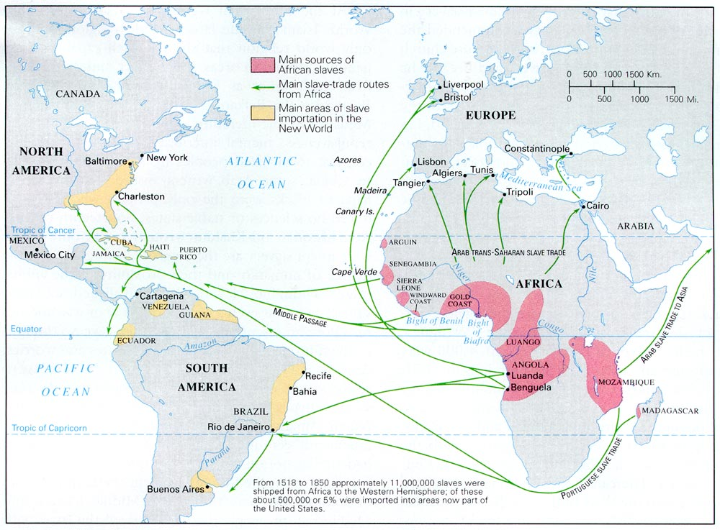

Slide 36
The English
1497—John Cabot (of Italy)—Reached northeast N. America (Newfoundland)
Sponsored by Henry VII
NW Passage?
Limited exploration by England until Queen Elizabeth I in 1570s & 1580s
Economic strife
Enclosure movement (farming to wool), limited land, high unemployment, rising population, & limited food supply
Rising class of merchants
Mercantilism—nation was principal actor in the economy

Slide 37
The English
Colonization viewed as a way to:
Create new market
Alleviate poverty & overcrowding
New resources
Religious reasons
Protestant Reformation 1517; King Henry VIII est. Anglican Church in 1529 (1509-1547)
“Bloody Mary” restores Catholicism, persecutes Protestants (1553-1558)
Back to Protestantism w/ Elizabeth I (1558-1603)
Catholics vs. Protestants
Puritans, Separatists

Slide 38
The English
Experimented w/ colonization in England, 1560s & 1570s
Treated Irish as “savages” & “beasts”
Hoped to suppress & isolate native Irish
English must remain separate from natives
Separate society; “pure” English culture

Slide 39
The English
“Sea Dogs”—pirates—attacked Spanish ships
Francis Drake
Phillip II of Spain launched attack on England in 1588
Spanish Armada was defeated by Brits
Lost more ships in stormy weather while returning
Cleared way for increased English exploration

Slide 40
The English
1583—Sir Humphrey Gilbert—claimed Newfoundland
1585 & 1587—Sir Walter Raleigh--failed attempts to colonize Roanoke
Virginia Dare
“CROATOAN”—The “Lost Colony”

Slide 41
The French
1524—Giovanni de Verrazano (of Italy)—east coast, NY harbor
1534-1542--Jacques Cartier—St. Lawrence River
NW Passage?
1608--Samuel de Champlain—1st permanent settlement, Quebec on St. Lawrence River
“Father of New France”
1673—Louis Jolliet & Fr. Jacques Marquette—explored upper Mississippi River
1682—Robert de La Salle—Mississippi River basin, named it Louisiana

Slide 42
The French
Few in population, but strong influence
Far in to interior of N. America
Fur trading & trapping
Jesuit missionaries
Adapting native ways, inter-marriage
Allies w/ Algonquins, enemies w/ Iroquois

Slide 43
The Dutch
1609—Henry Hudson (of England)—Hudson River & New Amsterdam
NW Passage?
1624—Dutch West India Co. est. permanent settlements along Hudson, Delaware, & Connecticut Rivers
Population was diverse, but small

Slide 44
