Slide 1
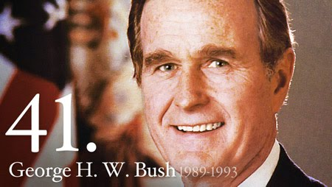
George H.W. Bush

Slide 2
Biography
Born in MA
Raised in CT
Pilot for Navy from 1942 to 1945
Married Barbara in 1945
Enrolled at Yale
Played 1st base
Graduated in 1948 w/ degree in economics

Slide 3
Biography
Moved to West Texas
Entered oil business
Millionaire by age 40
Got involved in politics in 1964
Elected to House of Reps in 1966
Ran for Senate in ‘70 but lost
Ambassador to UN from ‘71 to ‘73
Chairman of Republican Nat’l Committee from ‘73 to ‘74
Unofficial “ambassador” to China from ‘74 to ‘75
Director of CIA from ‘76 to ‘77
Ran against Reagan in ‘80 before becoming his running mate

Slide 4
Biography
VP from ’81-’89
Low key
Avoided criticizing Reagan in any way

Slide 5
Election of 1988
One of the most negative campaign cycles of all time
Dukakis was attacked for being radically liberal (“Massachusetts Liberal”), soft on crime, and unpatriotic
Tried to quiet critics w/ tank photo-op
The “Snoopy Incident”
Bush used video of Dukakis in tank to show that he would NOT be a good commander-in-chief
The Dukakis team tried to connect Bush to troubles w/ Reagan administration, esp. the Iran-Contra Affair

Slide 6
Bush
“Let’s Keep America Moving”
“Let’s Keep the Progress Going”
“Read my lips, no new taxes”
Dukakis
The Best is Yet to Come”

Slide 7
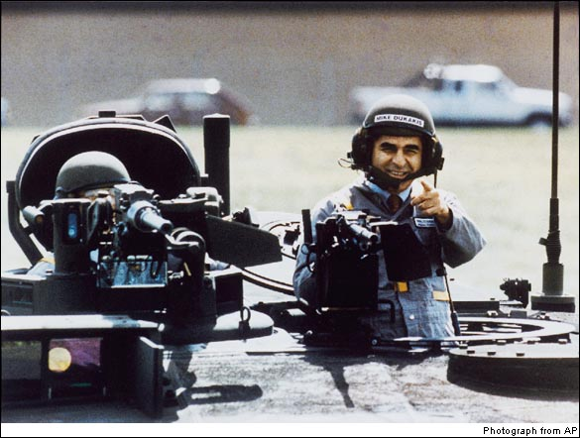
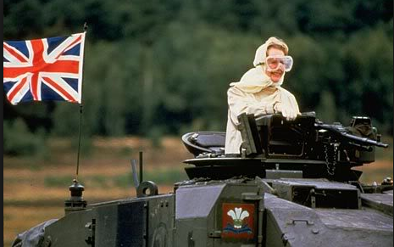

Slide 8
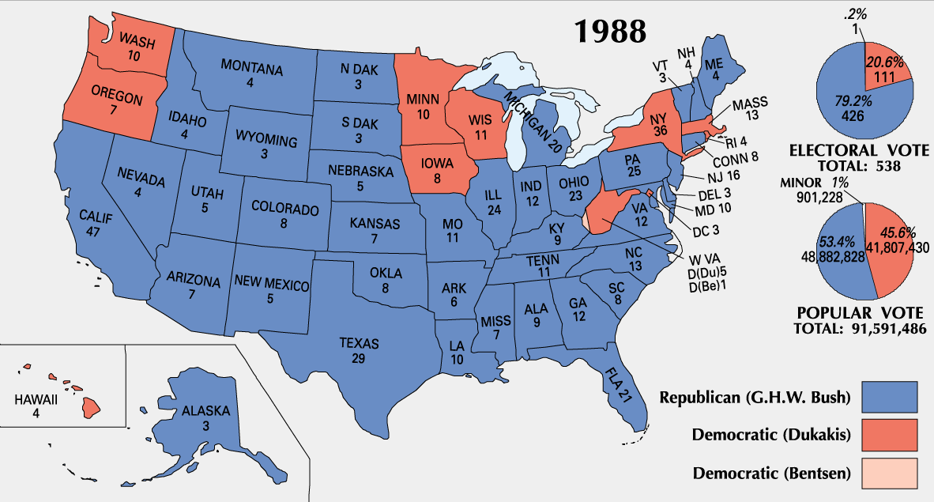

Slide 9
Presidency—Domestic Policy
Had to tackle growing deficit left by Regan
Hit $220 billion in 1990, triple what it was in 1980
Forced to by Democratic-controlled Congress to raise taxes
Broke campaign promise
At same time, U.S. was experiencing a brief recession
Decrease in popularity
In 1992, 7.8% unemployment & 14.2% lived in poverty

Slide 10
Presidency—Domestic Policy
Signed the Americans with Disabilities Act of 1990
Prohibits discrimination based on disability
Intense battle over appointment of Clarence Thomas to the SC
Accusation of sexual harassment
Confirmed by Senate, 52-48

Slide 11
Presidency—Foreign Policy
Panama—”Operation Just Cause”—27K troops—removed Noriega from power—American-backed gov’t installed
Soviet Union—START I—USSR dissolved in 1991
NAFTA—eliminated majority of tariffs on products traded between U.S., Canada & Mexico

Slide 12
Presidency—Foreign Policy
Persian Gulf War, 1990-1991
Saddam Hussein, Iraqi leader, invaded oil-rich neighbor Kuwait
UN forces led by General Norman Schwarzkopf
Airstrikes from mid-January through February of 1991
“Operation Desert Storm”
Results
Iraqi troops leave Kuwait, but Hussein left in power
190 UN deaths
100K Iraqi deaths
Heavily televised
“Video game war”

Slide 13
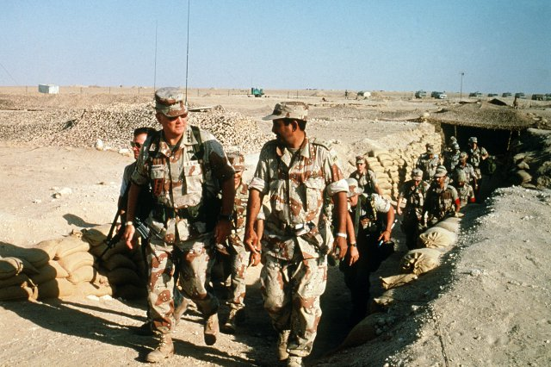
Persian Gulf War

Slide 14
Etc.
VP Quayle misspells “potato”
Bush vomits & faints at banquet held by PM of Japan
Time “Man of the Year” in 1990
Left office with 56% job approval rating

Slide 15
Election of 1992
Some thought Bush ended the Persian Gulf War prematurely
Bush had done little to help the economy
Ross Perot, TX billionaire, Independent
Most votes for 3rd party candidate since 1912
“Ross for Boss”
Bill Clinton, Governor of Arkansas, Democrat
Called Bush “out of touch” w/ common man
“It’s the economy stupid”
Clinton & Gore, both from South, “Bubba” plan
Clinton, 43%, 370 EC votes
Bush, 38%, 168 EC votes
Perot, 19%, 0 EC votes

Slide 16
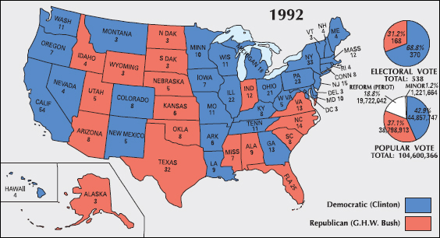

Slide 17
