Slide 1
President Gerald Ford

Slide 2
Becoming President
-Became vice-president in 1973 when Agnew resigned: Nixon chose him as was the provision under the 25th Amendment:
“Whenever there is a vacancy in the office of the Vice President, the President shall nominate a Vice President who shall take office upon confirmation by a majority vote of both Houses of Congress”.

Slide 3
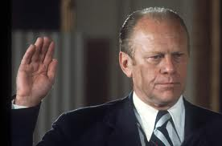

Slide 4
Becoming President
-Took office on August 9, 1974 when Nixon resigned
He took office of president under terms of the 25th Amendment
“In case of the removal of the President from office or of his death or resignation, the Vice President shall become President.”
-He was the first president to succeed a president who had resigned
-His vice-president was Nelson Rockefeller

Slide 5
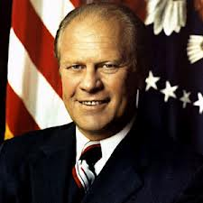

Slide 6
Administration Issues
Issues Ford faced when assuming the presidency:
-massive inflation
-having to revive an economy in a recession
-having to solve chronic energy shortages
-unemployment was at 9%
-keeping the world at peace

Slide 7
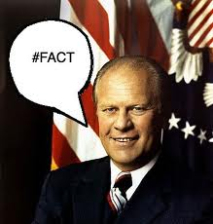

Slide 8
Administration Issues
-Interest rates for borrowing money to buy many expensive items rose to about 18%
-Energy Research and Development Administration was created to oversee fuel use
-Oil prices rose because gas stations had so little fuel available
-Ford decided that it was most important to freeze government spending to solve the economic issues: in other words, little government intervention

Slide 9
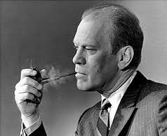

Slide 10
Ford’s goals:
1) curb inflation
2) stimulate the economy
3) vetoed many appropriations bills designed to create domestic programs: vetoed 39 of these measures in his first 14 months in office!
reduced taxes on business by $16 billion to help them operate more freely

Slide 11
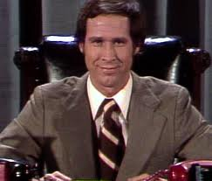
Ford?
Uh, no…

Slide 12
What to do with Nixon
-The issue of what to do with Nixon and Watergate was a huge distraction
it was becoming clear that Nixon was going to be guilty of knowing about the break-in

Slide 13
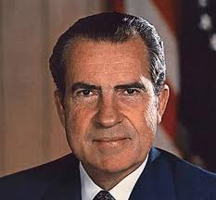

Slide 14
What to do with Nixon
Ford decided to pardon Nixon due to the fact that he wanted the event to end the controversy of Watergate
“a full, free and absolute pardon” to Nixon “for all offenses against the United States in which he…has committed or may have committed or taken part in” while he was president.
-this was not received very well by the general public

Slide 15
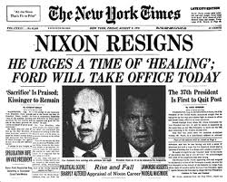

Slide 16
Vietnam and other areas
Ford claimed amnesty for Vietnam War resisters
-those who chose amnesty were required to serve two years of civilian service of some type
-not many chose to participate
-Ford wanted to maintain US power and prestige after the collapse of Cambodia and South Vietnam

Slide 17
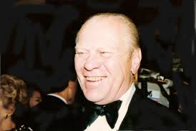

Slide 18
Vietnam and other areas
Cambodia fell in April 1975; in early May the new gov’t seized an American ship as a challenge to American resolve
-Ford ordered a limited Marine and air action to retrieve the ship and the crew
-Ford was applauded for this action, though 41 lives were lost trying to save the 39-member crew

Slide 19
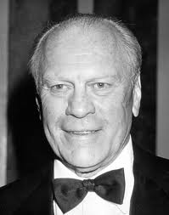

Slide 20
Vietnam and other areas
-Ford also wanted to prevent a war in the Middle East
gave aid to Israel and Egypt; and persuaded both to accept an interim truce to keep the peace at least temporarily
-the issue was that if there was conflict here, petroleum supplies would be cut off to the rest of the world

Slide 21
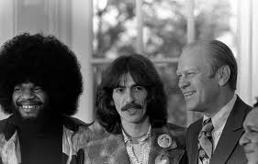

Slide 22
Vietnam and other areas
-détente with the Soviets continued as Ford and Brezhnev set limitations on nuclear weapons
-also with China and Middle East
-fall of Saigon during his presidency
-more than 100,000 Vietnamese refugees resettled in the US

Slide 23
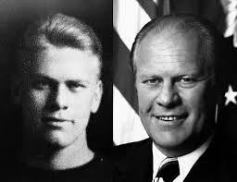

Slide 24
Defeat in 1976
Ford was nominated in 1976 Republican campaign; lost to Carter
Ultimately, the poor economy and pardoning of Nixon led to his defeat

Slide 25
