Slide 1
People at Work and Industrial Society
p. 277-295

Slide 2
Native Workforce
1820’s: 90% of Americans worked and lived on farms
Available unskilled workers were high enough in number for industries
How do industries find workers?
Transformation of American agriculture!

Slide 3
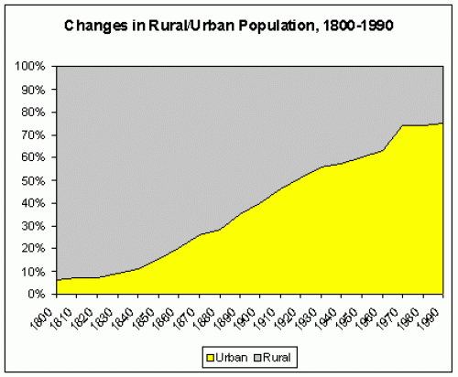

Slide 4
How?
Opening of vast fertile new farmland in Midwest
Improvement of transportation systems
Development of new farm machinery
All increased food production

Slide 5
Recruiting to Industries
In mid-Atlantic: brought whole families from the farms to the mills
Parents tended to looms alongside their children
Kids could be as young as 4-5 years old
In MA: enlisted young women, mostly farmers’ daughters:
Lowell System or Waltham System
Women used wages to help raise families later

Slide 6
Lowell Conditions
Better than in other industries
Lived in clean boarding houses and dorms
Well fed and well supervised
Strict curfews
Regular church attendance
Women quickly dismissed if accused of immoral conduct
Wages were actually better than average

Slide 7
Problems with Lowell
All new environment, away from families
Lived among strangers, suffered from loneliness
Repetition of tasks all day every day was tough
Tedious, but what other options did they have?
Barred from manual labor

Slide 8
Decline of Lowell
Manufacturers found it tough to sustain the high living standards and good work conditions
Wages declined, work hours increased
Factory Girls Association: union that protested a 25% wage cut
Strikes failed
Women moved into other areas or married
IMMIGRANTS became the solution

Slide 9
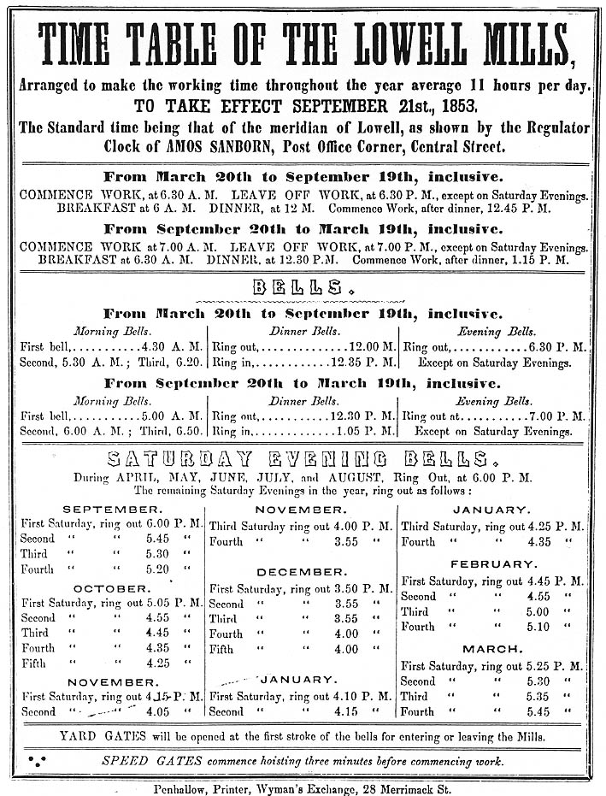

Slide 10
Immigrants
Irish:
Performed heavy labor
Unskilled work on:
Turnpikes
Canals
Railroads

Slide 11
Immigrants
Prejudices against immigrants
Low, low, low wages
Most couldn’t support own families
Lived in shanties, health risk!
Use of Irish:
No pressure for employers to provide for good living/working/wage conditions as there was for women

Slide 12
Misc. Info
Commonwealth v. Hunt (1842)—approves organization of unions
Unions of the time were largely ineffective; courts commonly sided w/ business, not workers
Congress, state legislatures did not little to help working class
Business leaders could easily replace workers w/ immigrants
Most unions excluded women

Slide 13
The Rich & the Poor
Average income rose, but some groups did not benefit
Native Americans, slaves, landless farmers
Wealth distributed increasingly unevenly
5% of families had 50% of nation’s wealth in 1860
A culture of wealth emerged
Examples of this????

Slide 14
Urban Poor
Growing number of homeless
Depended on charity, some times crime
“paupers”
Immigrants—menial, low-paying jobs
Free African Americans—menial, low-paying jobs, no voting rights, banned from public services

Slide 15
Social Mobility
Class conflict was limited
Absolute standard of living rose for most laborers
Chances for mobility within the working class; from one class to the next, however, was rare
Geographic mobility—many farmers gobbled up western land & industrial workers moved from town to town
Politics—voting (white males) provided meaning/importance

Slide 16
Expanding Middle Class
Middle class was the fastest growing group
Shift away from land ownership as only means of acquiring wealth
Workers & artisans became renters
Middle class women increasingly stayed home

Slide 17
Middle Class Life
Cast iron stove
Iceboxes
Some starting to have indoor plumbing
Wider variety of foods, why?
Larger homes

Slide 18
The Changing Family
Due to shift from farm to cities
Children more likely to leave family while looking for work
Decline in traditional economic function of the family
Two worlds—workplace & home life
Birth rate fell from 7 in 1800 to 5 in 1860
Abortions, contraception

Slide 19
“Cult of Domesticity”
Sharper roles for men & women emerge w/ Industrial Revolution
Had already existed—legally, politically, academically—but became more defined
Guardians of “domestic virtues”—custodians of morality & benevolence
Consumers—increasing material comfort
Keeping clean homes, entertaining guests, and looking stylish
Created clubs and associations

Slide 20
“Cult of Domesticity”
Increasingly secluded from public world
Fewer & fewer middle class & upper class women left home for work—became the norm
Lower class women had no choice, but to work
Often worked in domestic service

Slide 21
Leisure
Few vacations; emphasis on holidays
Worked 6 days/week
Men enjoyed taverns; women visited homes
Reading—magazines, newspapers, novels
Theater—loud, raucous crowds
Shakespeare’s works were popular
Minstrel shows
PT Barnum—Freak shows
Lectures

Slide 22
Agricultural North
Agriculture declined in Northeast as farmers moved westward
Truck farming, dairy farming—both took on increased importance
Some industry in Northwest—Cleveland, Cincinnati, Chicago
Meatpacking
Most Northwest farmers had sizeable plots—200 acres
1840s & 1850s saw increasing prosperity for farmers

Slide 23
Agricultural North
Americans were settling in Minnesota, Iowa, Missouri, Illinois by 1850
Timber, wheat, corn, potatoes, raising livestock
New farm technology
John Deere—steel plow
McCormick Reaper
Threshers

Slide 24
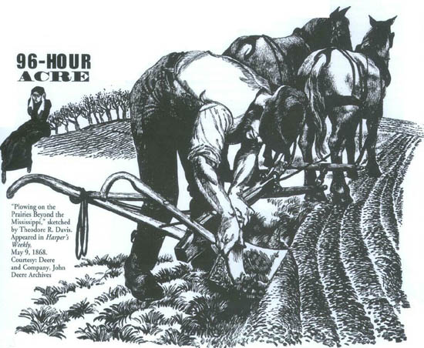
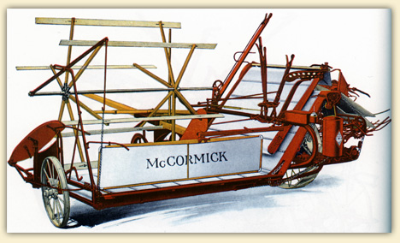

Slide 25
Agricultural North
As people moved west, farmers became more isolated
Church brought people together
Connections to outside world were relished
Magazines, newspapers, letters
Autonomy was enjoyed & eventually looked back on nostalgically

