Slide 1
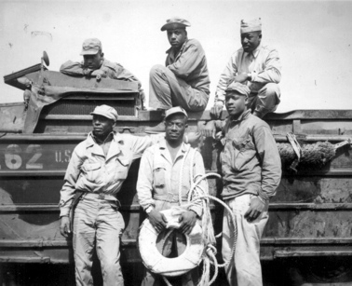
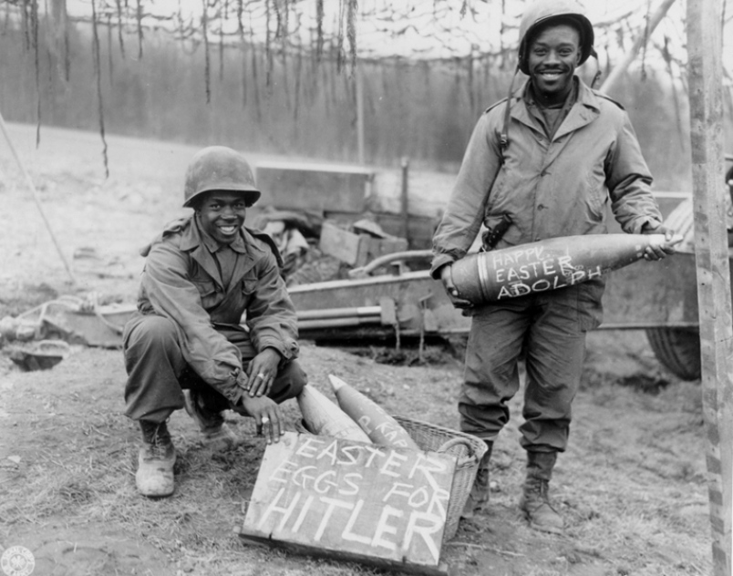
18.5: Social Impact of the War

Slide 2
African Americans
Jim Crow system still endured in the South
Unofficial discrimination (de facto) was present in the North
In 1941, w/ war industries booming, 1 in 5 African Americans remained jobless
Many employers requested “whites only”

Slide 3
African Americans
Labor leader A Philip Randolph threatened a march on Washington on July 4, 1941
FDR acted first by passing Executive Order #8802
It opened jobs & training programs in defense plants to all Americans “w/o discrimination b/c of race, creed, color, or national origin”
It also created the Fair Employment Practices Committee (FEPC) to hear complaints about job job discrimination in defense industries & gov’t

Slide 4
African Americans
During 1940s more than 2 million moved from the South to Northern cities
New jobs, but often new problems too
Segregation/discrimination forced many to live in poor housing
White workers & homeowners resented the newcomers
Race riot in Detroit in 1943, killed 34 people
Race riot in Harlem in 1943, killed 6 people & 400 were injured

Slide 5
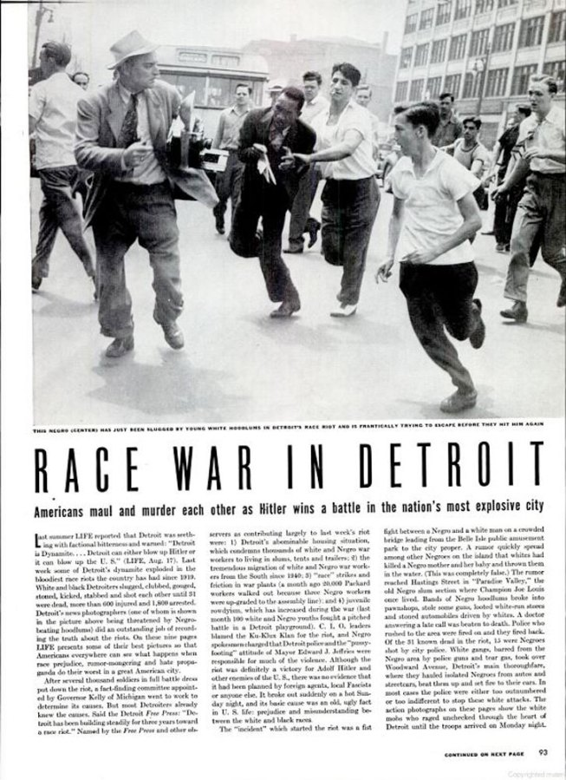
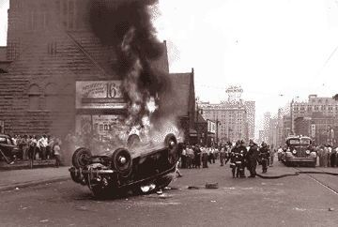
Detroit Race Riots

Slide 6
African Americans
Segregated military throughout WWII
Black soldiers that returned home still faced discrimination
“It made a mockery of wartime goals to fight overseas against fascism only to come back to the same kind of discrimination & racism here in this country.”—Alexander J. Allen

Slide 7
African Americans
In Kansas, the owner of a lunch counter refused to serve African American GIs:
“You know we don’t serve coloreds here,’ the man repeated…We ignored him, and just stood there inside the door, staring at what we had come to see—the German prisoners of war who were having lunch at the counter…We continued to stare. This was really happening. It was no jive talk. The people of Salina would serve these enemy soldiers and turn away from black American GIs.”—Lloyd Brown

Slide 8
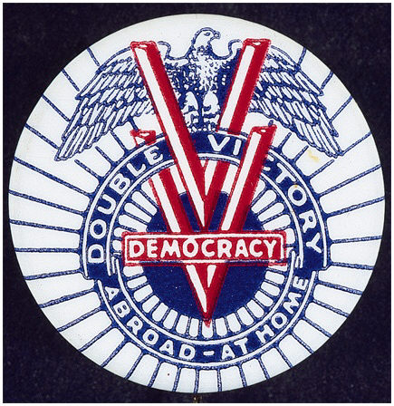
African Americans
In February of 1942 the Pittsburgh Courier, the mostly widely read African American newspaper, launched a “Double-V” campaign
Victory against the Axis Powers
Victory in winning equality at home

Slide 9
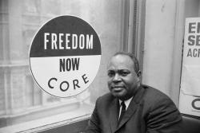
African Americans
Congress of Racial Equality (CORE) was founded in 1942 in Chicago
Believed in using non-violence to end racism
Organized 1st sit-in in 1943; many soon followed
Paved way for civil rights movement of 50s & 60s

Slide 10
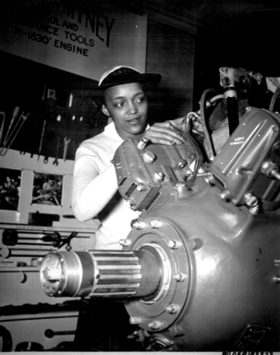
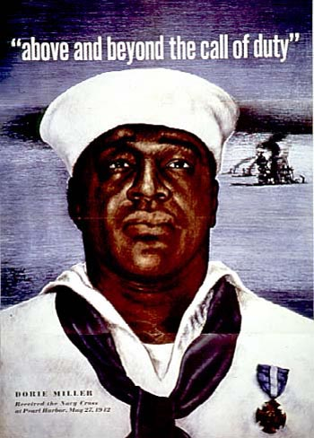
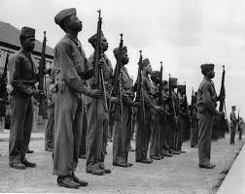
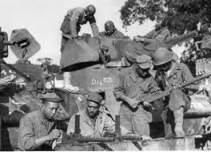
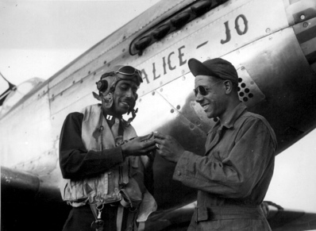

Slide 11
Mexican Americans
Faced discrimination
Wartime offered new job opportunities
17K worked in Los Angeles shipyards in 1944
This # is representative of the work they did across the nation: Texas to KC to Detroit to Chicago to NY C

Slide 12
Mexican Americans
A shortage in farm laborers led the U.S. to turn to Mexico for help
Led to a 1942 agreement in which the 2 nations would provide transportation, food, shelter & medical care for thousands of Mexican farm workers (braceros) brought to work in the U.S.
200,000 braceros worked on U.S. farms between 1942 & 1947
Boosted Latino population in L.A. & many other CA cities
Led to many Spanish-speaking neighborhoods or barrios

Slide 13
Mexican Americans
Some young Mexican Americans in L.A. began to wear “zoot suits” in the 40s
Featured a long draped jacket & baggy pants w/ tight cuffs
Often had slicked back hair
The look offended some, esp. sailors who came to L.A. from nearby military bases
Sailors would roam the streets & beat up/humiliate Zoot Suiters for looking un-American
Led to riots
Zoot Suiters got locked up, not the sailors
Army & navy both restricted GI’s off-duty access to L.A.

Slide 14
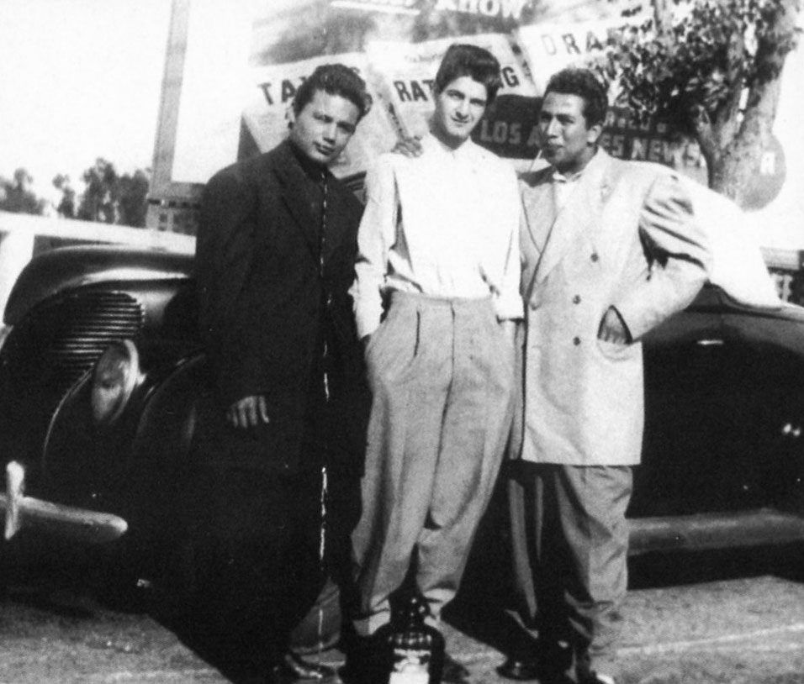
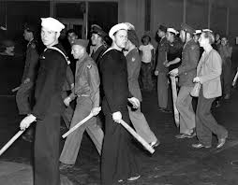
Mexican Americans
Zoot Suits

Slide 15
Native Americans
25K served in armed forces
23K worked in war industries
Many migrated to urban centers to work in defense plants
Navajo code-talkers were applauded for their skill, speed, & accuracy
They were esp. influential @ the Battle of Iwo Jima
Ira Hayes (Pima) was one of the six original flag raisers @ Iwo Jima
The image made him a national hero

Slide 16
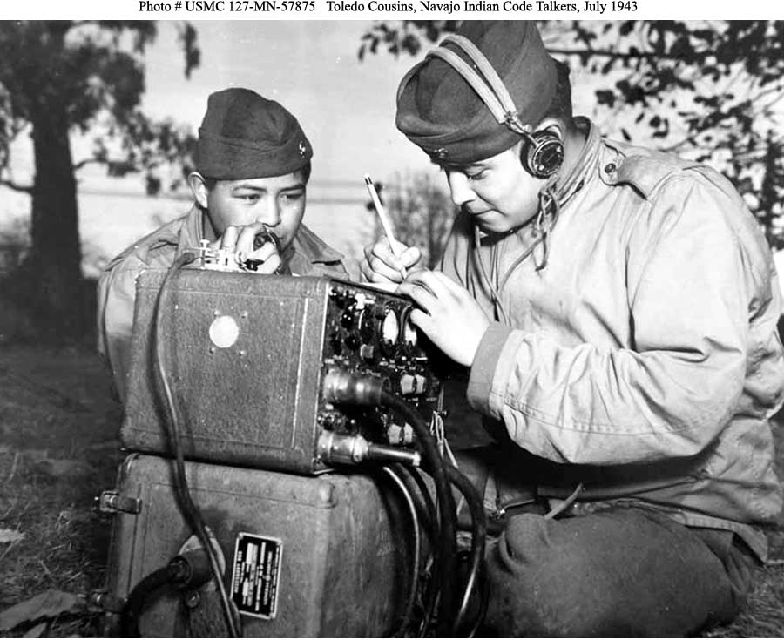
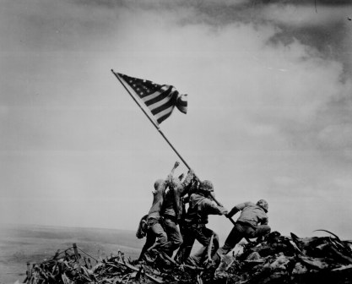
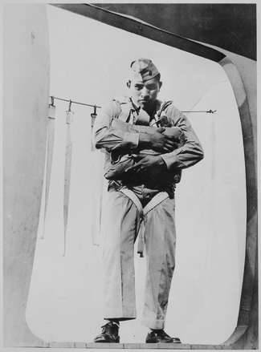
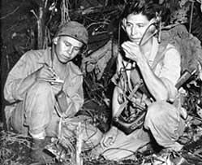

Slide 17
Japanese Americans
127K Japanese Americans in U.S. in 1941
Most lived on West Coast
Faced much discrimination
Hostility grew into hatred & hysteria after Pearl Harbor
Press added to fears w/ false reports:
“Japanese Here Sent Vital Data to Tokyo”
Jap boat Flashes Message Ashore”

Slide 18
Japanese Americans
February 19, 1942—Pres. Roosevelt issues Executive Order #9066
Allowed gov’t to set up the War Relocation Authority to move everyone of Japanese ancestry (all 110K)
They would be put in internment camps, confined in camps in remote areas
Japanese Americans had little time to round up belongings, lost much property
Had no idea where they were going

Slide 19
Japanese Americans
All internment camps were in desolate areas
ID, WY, UT, AZ
Wooden barracks
Had to share toilets, baths/showers, & dining facilities
Barbed wire surrounded the camps, also armed guards

Slide 20
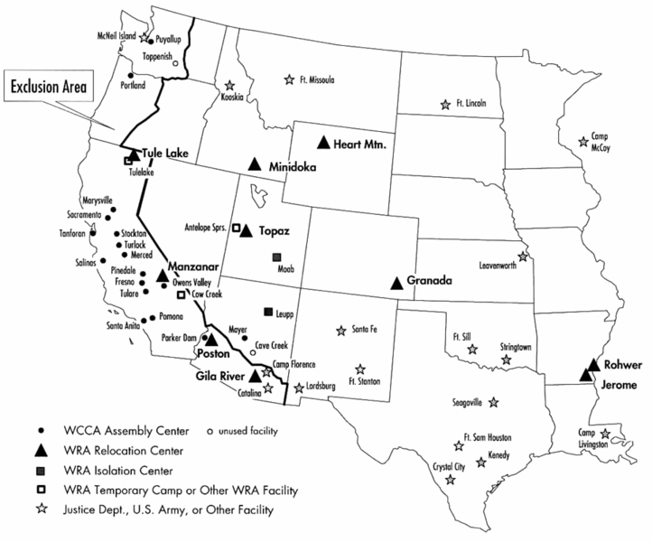

Slide 21
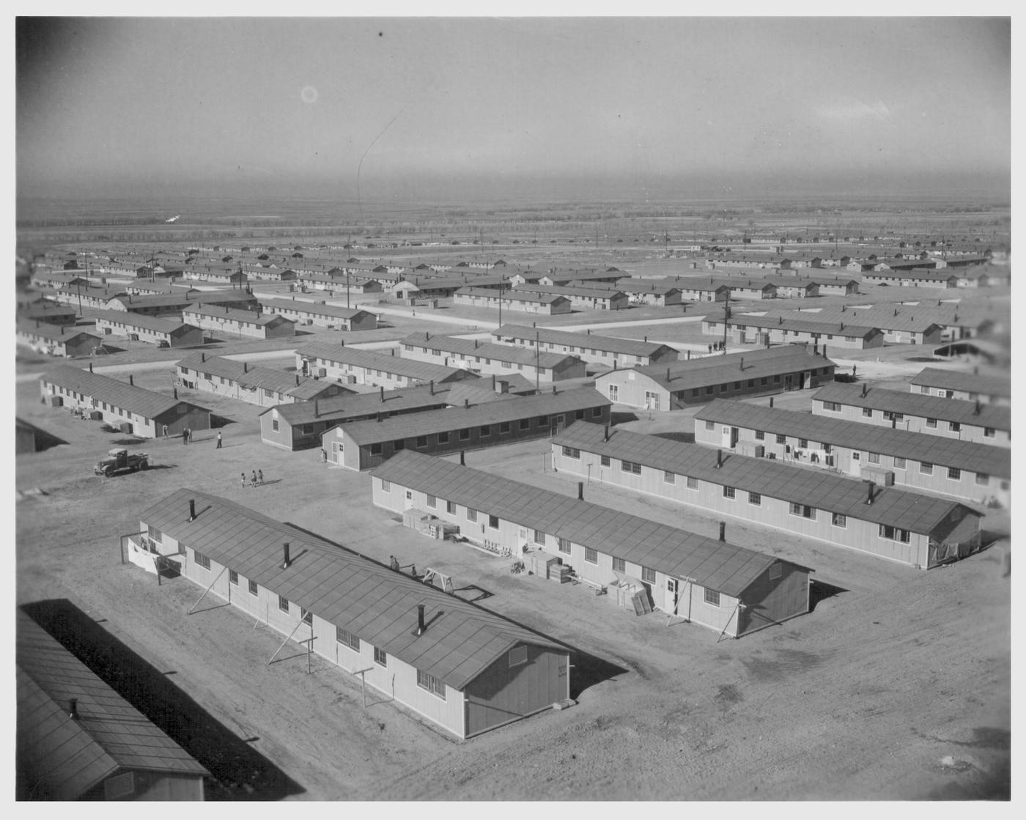

Slide 22
Japanese Americans
Legality of internment camps was questioned
Korematsu v. U.S. (1944)
Ruled policy was not based on race, but instead “military urgency”
Allowed policy to continue
Finally allowed to return in early 1945
Many returned to nothing
In 1988 each surviving Japanese American was given $20K by the gov’t
Gov’t also apologized

Slide 23
Japanese Americans
Not allowed into U.S. armed forces until 1943
17K fought
Most were Nisei, citizens born in U.S. to immigrant parents
Many all-Nisei units gained recognition
All-Japanese 442nd won more medals than any other unit in U.S. history

Slide 24
Working Women
Most female wage earners before the war were single & un-married
Secretaries, clerks, household servants
Almost always women earned less than men
During the war they filled new roles
Many took on jobs related to defense
Aircraft factories, shipyards
Higher paying jobs
# of working women increased by 1/3
35% of civilian workforce

Slide 25
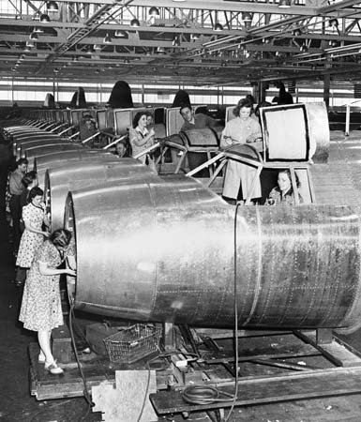
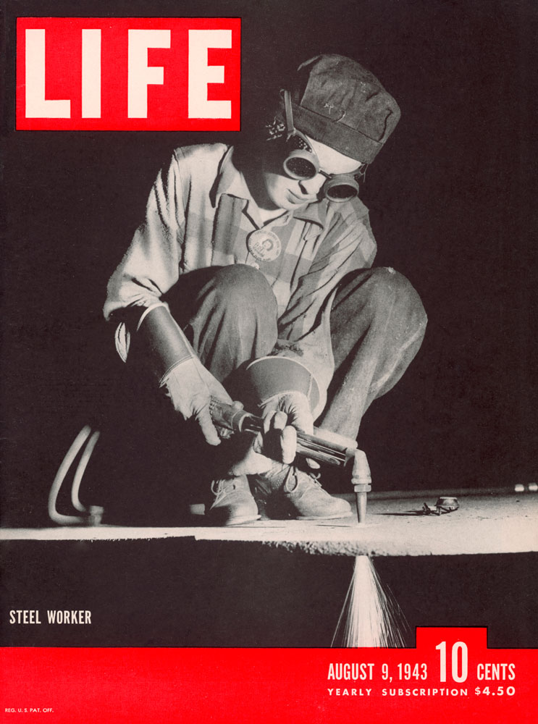
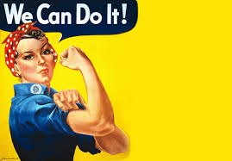

Slide 26
Working Women
Rosie the Riveter created by a popular song in 1942
Rosie was a home front hero
She worked in a defense plant putting rivets on airplanes
Gov’t used images of her in posters, films, etc.

Slide 27
Working Women
Sometimes faced hostile environments, esp. in fields generally dominated by men
Often earned less pay for same work
Daycare centers were scarce
Gov’t assumed women would leave defense jobs after WWII, but many wanted to stay
Post-war twice as many women lost jobs as did men

