Slide 1
Federalists and Republicans
p. 170-175

Slide 2
Alexander Hamilton
Hamilton: GW’s Secretary of Treasury
His goal: to enhance the authority of the national government and favor wealthy financiers and seaport merchants
He exerted more influence on domestic and foreign policy than anyone else during his time in office and after (during this time period)

Slide 3
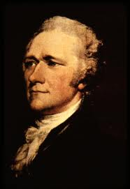
Hamilton

Slide 4
Hamilton’s Financial Plan
1. Public Credit-January 1790
-Congress wanted to buy millions of dollars in securities issued by the Confederation
-these securities were worth much more than their face value, thus creating a profit
-this would bolster the gov’t credit
-would also provide windfall profits to speculators

Slide 5
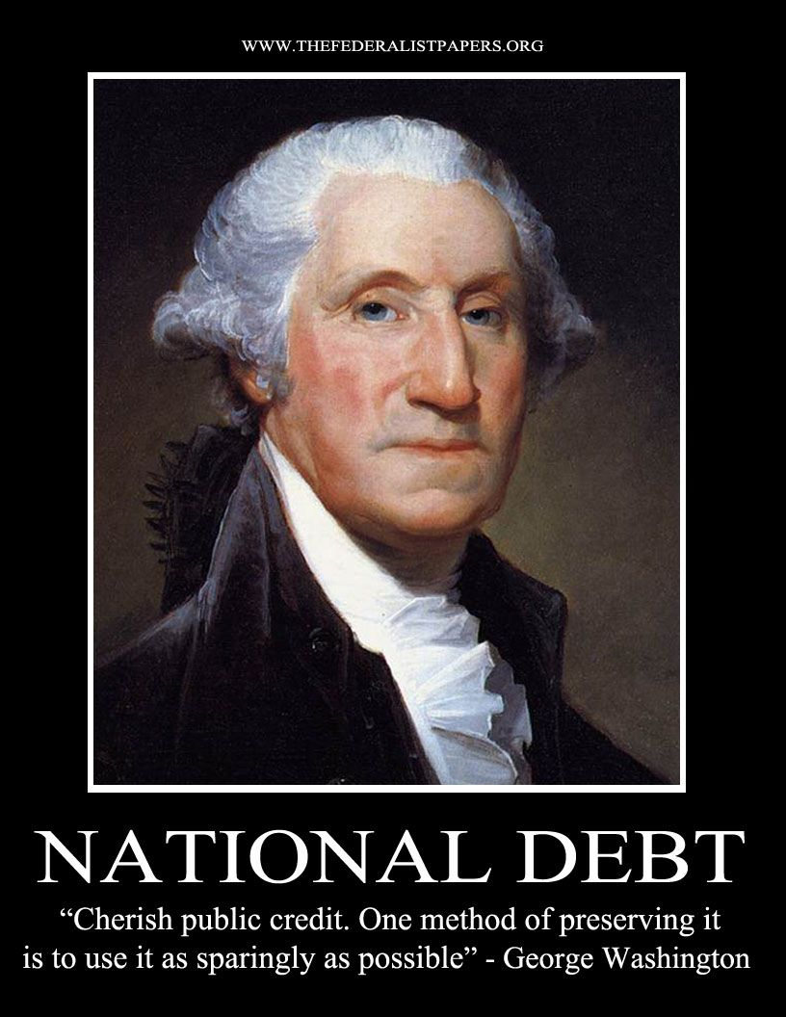
GW’s Idea on Public Credit

Slide 6
Hamilton’s Financial Plan
-Hamilton also proposed a permanent national debt
-this would allow for the gov’t to pay the speculators
-the debt would be paid off by gold and silver coins at a 6% interest rate

Slide 7
Hamilton’s Financial Plan
next, Hamilton wanted the federal gov’t to assume the war debts of the states
those on the inside found out and started buying the war bonds of southern states, thus gaining a huge profit
some states wanted to control the power of the federal gov’t
to get the states (MD and VA) to agree, Hamilton agreed to move the capital to Washington, D.C.
this gave Hamilton the support he needed to move the plan forward

Slide 8
Hamilton’s Financial Plan
National Bank-December 1790
(bullet point) joined by private stockholders and the federal gov’t
by making loans to merchants, handling gov’t funds, and issuing financial notes, would provide a respected currency for the specie-starved American economy and make the new national debt easier to fund

Slide 9
Hamilton’s Financial Plan
Jefferson and Madison stated that a national bank was unconstitutional
incorporating a bank was not a delegated power
Hamilton used Article 1, Section 8, saying that Congress make “all laws which shall be necessary and proper” to carry out the Constitution’s provisions
Washington agreed and signed it into law

Slide 10
Hamilton’s Financial Plan
Revenue and Tariffs-December 1791
(bullet point) Hamilton wanted a national revenue that would be used to pay the annual interest on the permanent debt
1792: Congress imposed several domestic taxes, such as on whiskey
the tax was too small to help much: $1 million annually

Slide 11
Hamilton’s Financial Plan
to raise more $, Hamilton called for tariffs on foreign imports
“Report on Manufactures”: a report calling for self-sufficiency in manufactured goods
to compromise, Hamilton agreed to a mild increase in customs duties, allowing for trade and provide revenue for federal gov’t

Slide 12
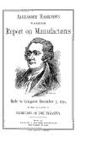
Report on Manufactures

Slide 13
Did it work?
Yes! Customs revenue provided about 90% of the U.S. gov’t income between 1790-1820
**Outcome: provided the federal government with financial stability.

Slide 14
Jefferson’s Agrarian Vision
Hamilton was not totally supported
Federalists were broken up into two factions
Northern Federalists agreed with Hamilton
southerners agreed with Madison and Jefferson
Hamilton’s supporters were named FEDERALISTS
Jefferson’s supporters were named DEMOCRATIC-REPUBLICANS

Slide 15
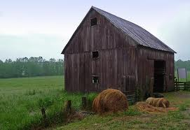
Agrarian Vision

Slide 16
Jefferson’s Agrarian Vision
southern planters and western farmers moved towards Jefferson’s ideas
he thought that workers who depended on wages lacked the economic independence required to sustain a republic
his plan: a West settled by productive yeomen farm families

Slide 17
Jefferson’s Agrarian Vision
he believed that having a massive agricultural society, Americans would be able to feed the US and Europe, and they would give us goods in return
French Revolution gave it a chance, and wheat and cotton prices soared, raising profits in southern region
Americans were divided over sides in the French Revolution, especially after the execution of Louis XVI

Slide 18
Jay’s Treaty
Britain’s navy was bullying American ships going to France
to avoid war, GW sent John Jay to Britain
deal required the US gov’t to make “full and complete compensation” to British merchants for all pre-Revolutionary War debt owed by American citizens
gave British right to remove French property from neutral ships
Americans submitted claims of illegal seizure to arbitration and required British to remove military garrisons from NW Territory and to end their aid to Indians there
many thought it asked America to give up too much, and it barely passed Senate

Slide 19
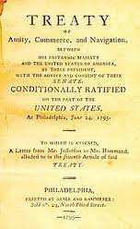
Jay’s Treaty

Slide 20
Pinckney’s Treaty
1795
Spain recognized the right of Americans to navigate MS River to deposit goods at New Orleans
Agreed to fix northern boundary of FL at 31st parallel
Required Spanish authorities to prevent Indians in FL from launching raids across border

Slide 21
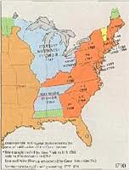
Pinckney’s Treaty

Slide 22
Whiskey Rebellion
Whiskey Rebellion in 1794: a protest on the whiskey tax of Hamilton: challenging federal authority
refused to pay the tax
began terrorizing tax collectors
this cut the demand
GW raised an army of almost 15,000 to stop rebellion, which collapsed

Slide 23
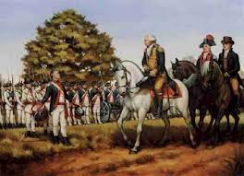
Whiskey Rebellion

