Slide 1
Your Name and Grade
Picture of you!
Computer Applications
Lincoln Northeast
Link to http://lne.lps.org

Slide 2
Prior Computer Classes
Freshmen: What computer classes did you take in middle school?
Upperclassmen: What other computer classes have you taken in high school.
Do you enjoy working on computers?
Clip Art

Slide 3
What do you use a computer for?
List the things you do on the computer outside of school (my space, facebook, IM, email, Internet, research, . . . . .)
Clip art or Picture from Internet

Slide 4
Comfort Level & Typing Skill
How comfortable are you on a computer?
What would you rate your typing skill – 1 being the worst – 3 being average - 5 being the best.
Smart Art Graphic – type text then convert

Slide 5
Job?
If you currently have a job, where do you work and how many hours a week do you work.
What are your duties?
If you don’t have a job – where would you like to work during high school and why?
Picture from Internet with Style or Effect

Slide 6
After High School
Where are your current plans for after you graduate high school?
College – if so where?
Military – if so, what and when?
Job – if so, where?
Other?
Shape with Text

Slide 7
Career Choices
What are some career choices you are interested in?
Word Art and picture

Slide 8
Family
Tell me about your family – mom, dad, guardians?
Brothers? Sisters?
Names and Ages
Anyone else?
Notes that talk about individual family members – picture if you want

Slide 9
Extra Curricular Activities
Are you involved in any extra curricular activities or clubs OR do you want to be involved here at LNE.
Add notes about these activities and picture of some sort

Slide 10
Hobbies
List any of your hobbies you do outside of the school day.
Add notes about these hobbies and a picture of some sort

Slide 11
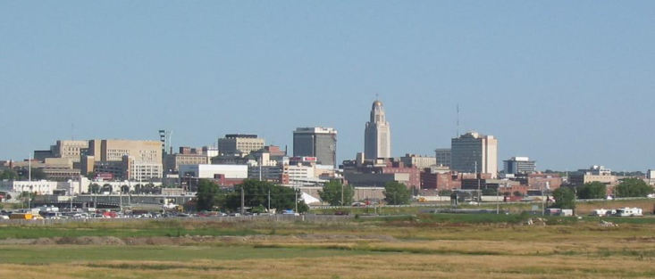
Where have you lived?
Were you born in Lincoln?
If not, where were you born and when did you come to Lincoln?
Picture of Lincoln or another city you’ve lived in.
Use Google Images.

Slide 12
Miscellaneous
Is there anything else you would like to share? Anything special or unique?
If you can’t think of anything – make this slide about some of your favorite things (movies, food, restaurants, etc.)
Picture from Internet in a Shape

Slide 13
Conclusion
Summarize your PowerPoint in several bullets.
Action button linking back to first slide
Sound from Clip Organizer - Clapping

Slide 14
Other Requirements
Apply a nice Design Theme
Add Transitions between all slides
Animate first level bullets on all slides
Save as AboutMeLastName
Upload to DocuShare when finished

