Slide 1
Tutorial 6
Creating a Web Form

Slide 2
Objectives
Explore how Web forms interact with Web servers
Create form elements
Create field sets and legends
Create input boxes and form labels
Create selection lists
Creation option buttons
Create text area boxes
Create check boxes

Slide 3
Objectives
Apply styles to Web forms
Explore HTML5 data types
Create spinners and range sliders
Create form buttons
Validate form data

Slide 4
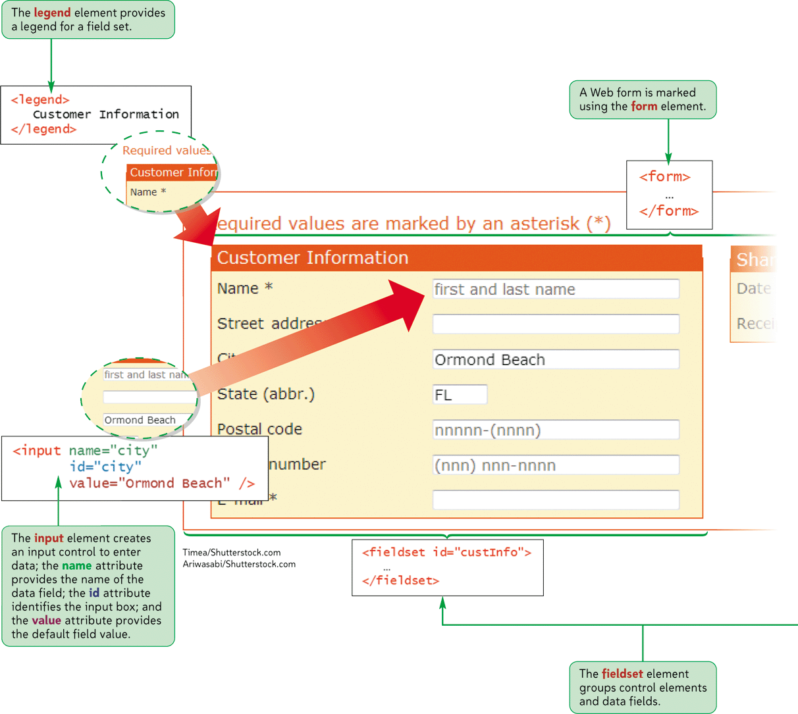
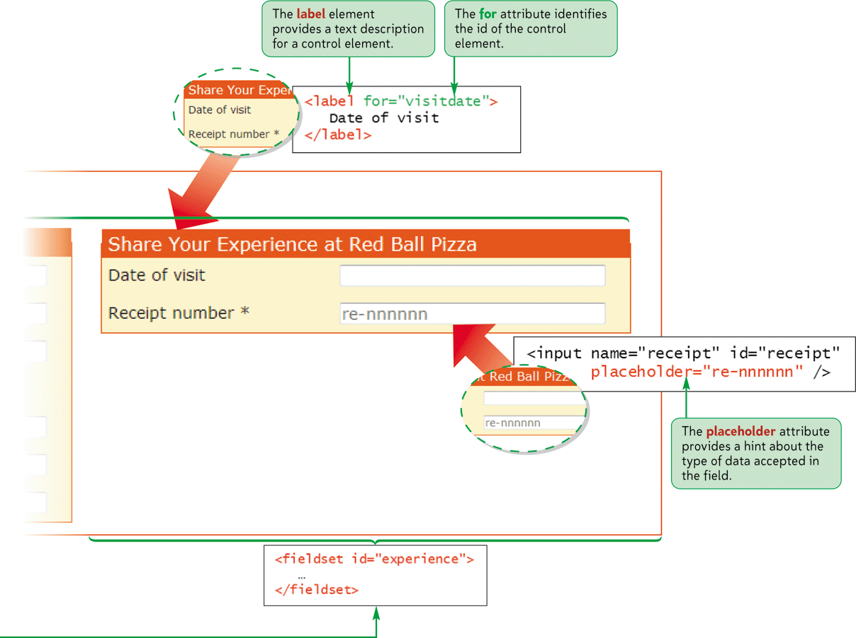
Parts of a Web Form

Slide 5
Introducing Web Forms
Web forms collect information from Web site visitors.
HTML supports the following control elements:
  Input boxes
  Option buttons
  Selection lists
  Check boxes
  Text areas
  Color pickers
  Calendar pickers
  Spin boxes
  Sliders

Slide 6
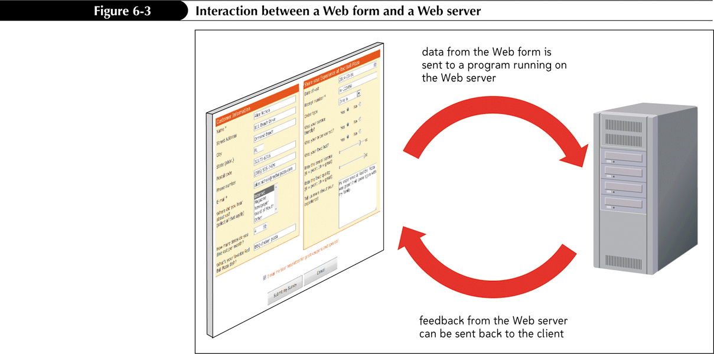
Forms and Server-Based Programs

Slide 7
Forms and Server-Based Programs
Server-based programs are written in many languages
The earliest and most commonly used are Common Gateway Interface (CGI) scripts that are written in Perl.
Other popular languages include:
  ASP/ASP.NET
  ColdFusion
  C/C++
  Java
  PHP
  Python
  Ruby

Slide 8
Creating a Web Form
Forms are created using the form element, structured as follows:
  <form attributes>
  content
  </form>
Where attributes are the attributes that control how the form is processed and content is the content of the form.

Slide 9
Creating a Web Form
Form attributes tell the browser the location of the server-based program to be applied to the form’s data.
Always specify an id or name for the form.
Two attributes are available to identify the form: id and name.

Slide 10
Creating a Web Form
The syntax of the id and name attributes are as follows:
<form id=“id” name=“name”>… </form>
Where id is the id of the form and name is the name of the form.

Slide 11
Creating a Field Set
HTML and XHTML allow you to organize a form into a group of fields called field sets.
  <fieldset id=“id”>
  controls
  </fieldset>
where id identifies the field set and controls are the control elements associated with fields within the field set

Slide 12
Creating a Field Set
To add a legend to a field set, add the following tag after the opening <fieldset> tag:
  <legend>text</legend>
  Where text is the text of the field set caption.

Slide 13
Creating Input Boxes
The general syntax of input elements is as follows:
<input type=“type” name=“name” id=“id” />
Where type specifies the type of input control, and the name and id attributes provide the control’s name and id.

Slide 14
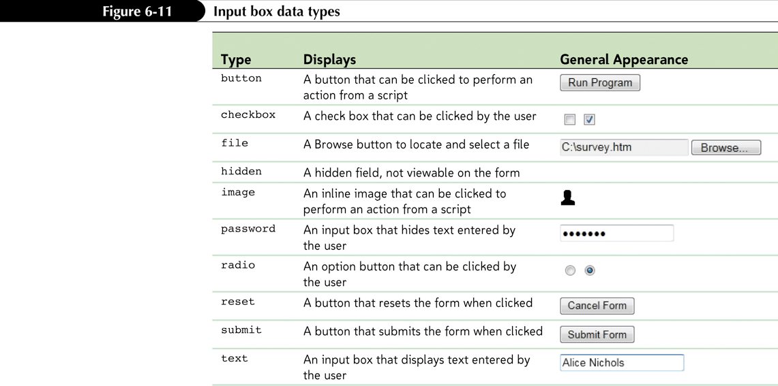
Creating Input Boxes

Slide 15
Adding Field Labels
You can also expressly link text with a control element.
The syntax for creating a form label is as follows:
  <label for=“id”>label text</label>
Where id is the value of the id attribute for a field’s control element, and label text is the text of the label.

Slide 16
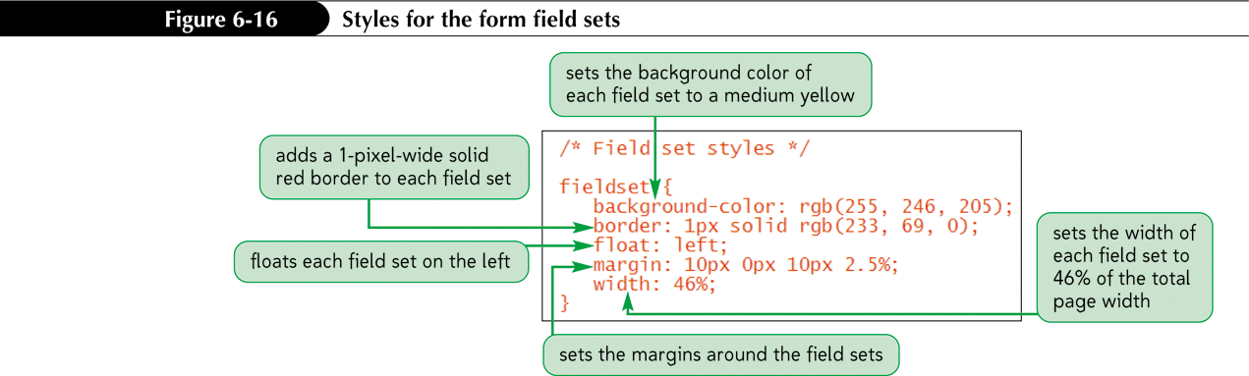
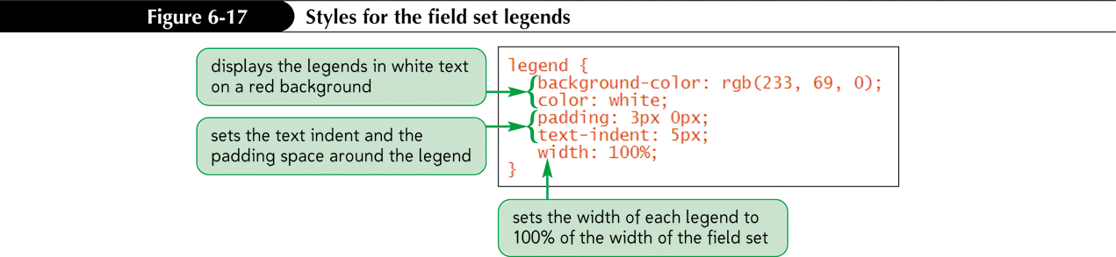
Applying a Style Sheet to a Web Form

Slide 17
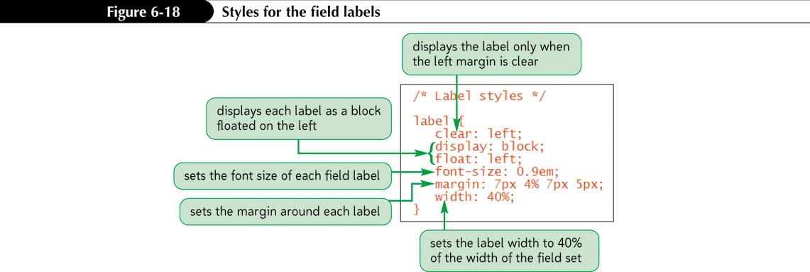
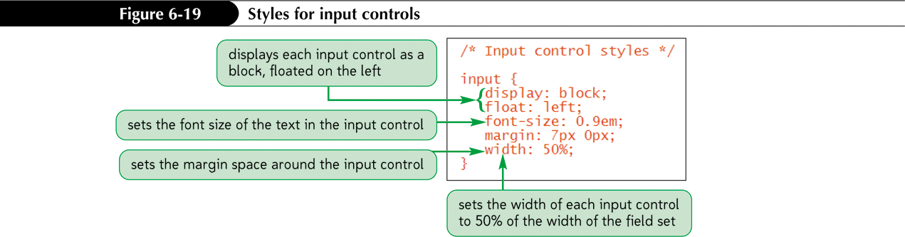
Applying a Style Sheet to a Web Form

Slide 18
Defining Default Values and Placeholders
To define the default value of a field, add the attribute
value=”value”
to the control element, where value is the default value assumed by a browser unless a user enters a different value
Starting with HTML5, you can also populate your input boxes with placeholders. A placeholder is a text string that appears within the control element and provides users with information about the kind of information accepted by the field

Slide 19
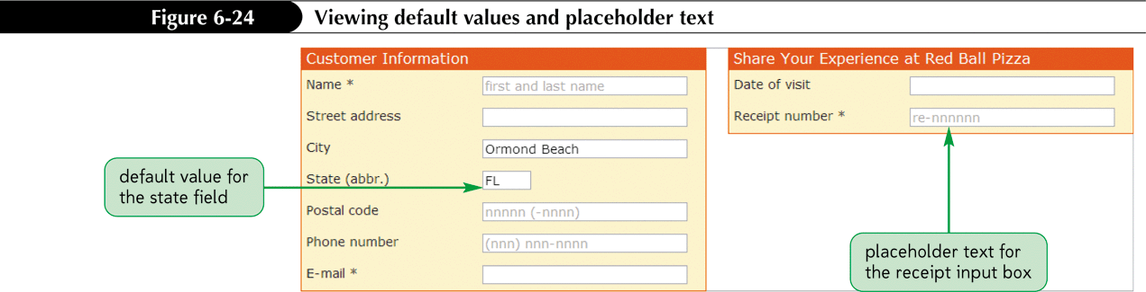
Defining Default Values and Placeholders

Slide 20
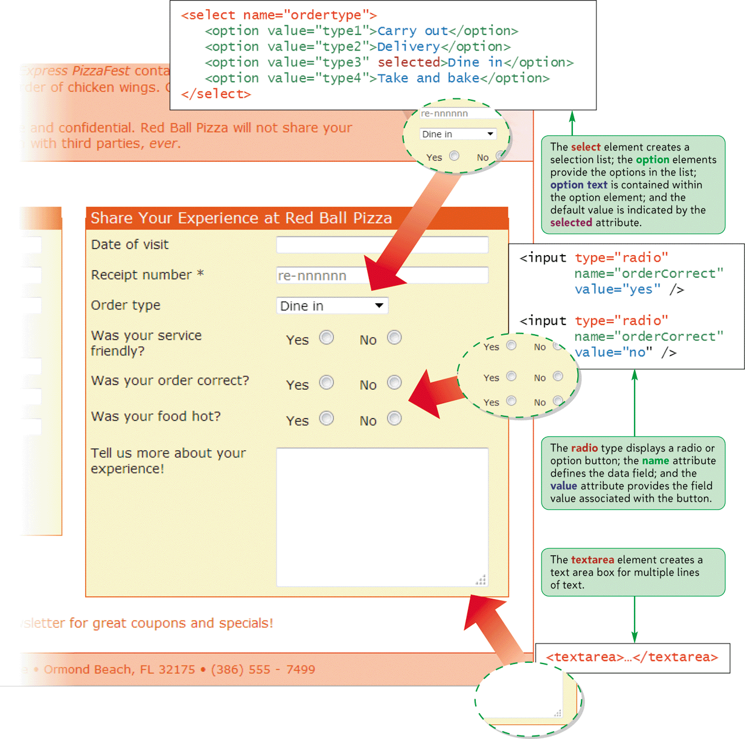
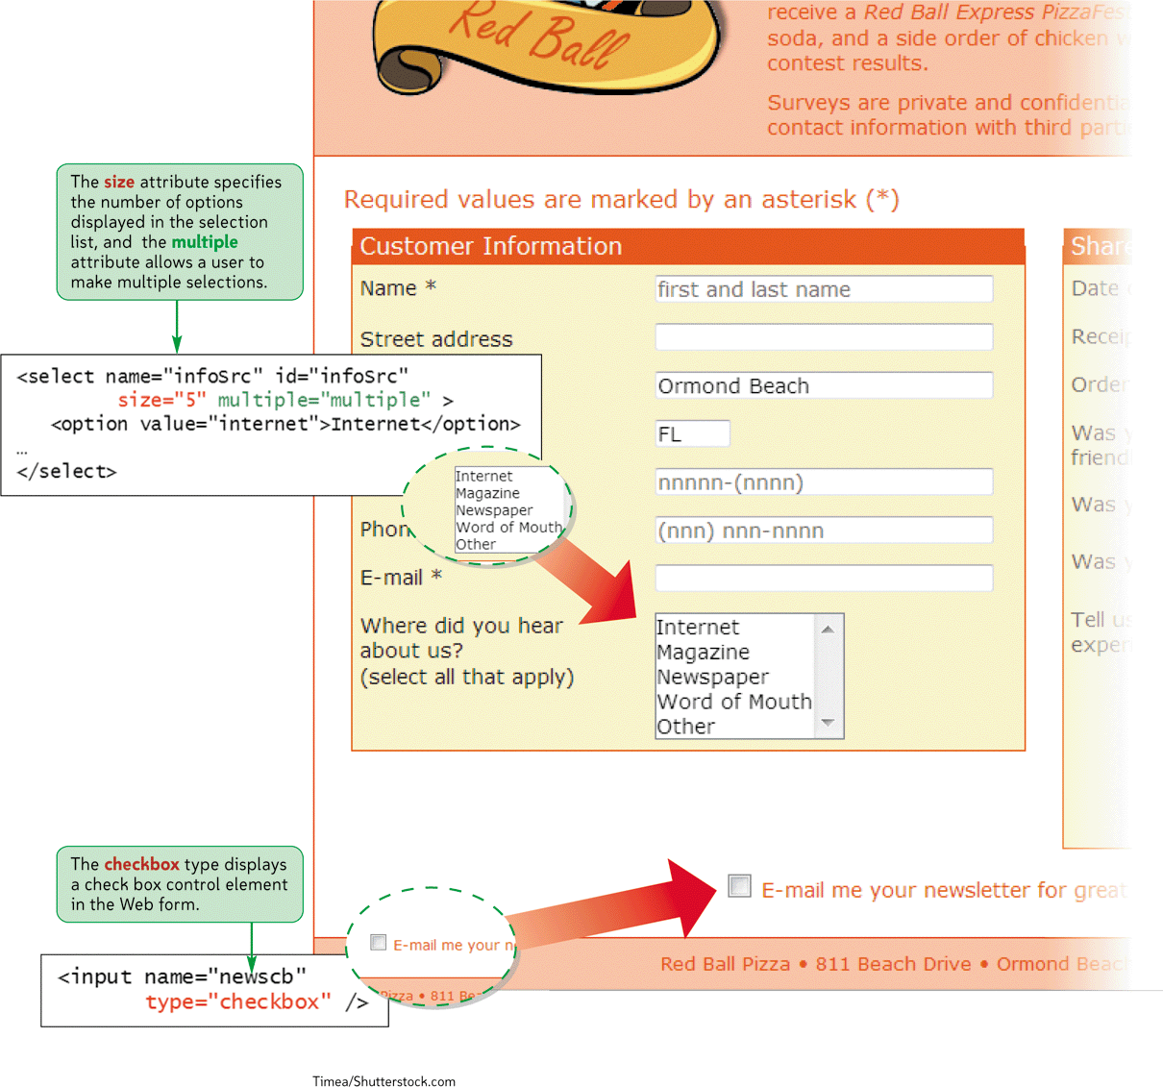
Selection Lists and Option Buttons

Slide 21
Creating a Selection List
A selection list is a list box from which a user selects a particular field value or set of field values.
  Selection lists are useful when there are a fixed set of possible responses from the user.
You can create a selection list using the <select> element.
You can specify each individual selection item using the <option> element.

Slide 22
Creating a Selection List
You can change the number of options displayed in the selection list by modifying the size attribute. The syntax is as follows:
  <select size= “value”>… </select>
Where value is the number of items that the selection list displays in the form.

Slide 23
Creating a Selection List
Add the multiple attribute to the select element to create multiple selections:
  <select multiple=“multiple”>… </select>

Slide 24
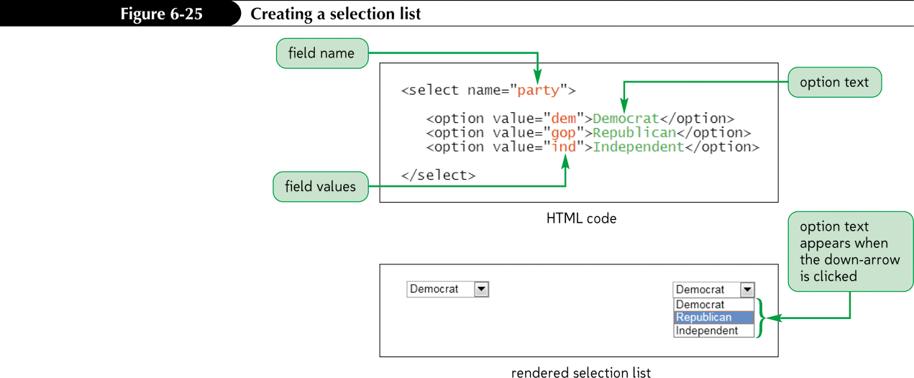
Creating a Selection List

Slide 25
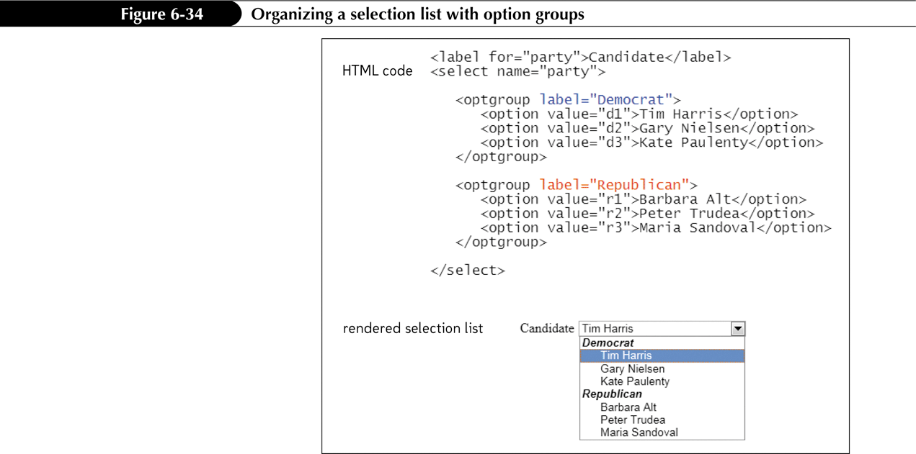
Grouping Selection Options

Slide 26
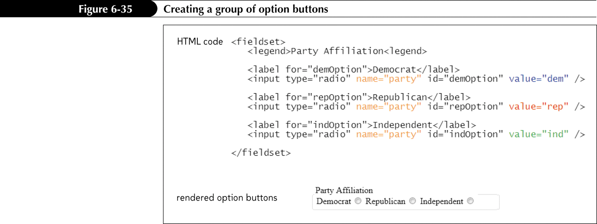
Creating Option Buttons
Option buttons, or radio buttons allow users to make selections.
  Unlike selection lists, option buttons only allow the user to select one option at a time.

Slide 27
Creating a Group of Option Buttons
To create a group of option buttons associated with a single field, add the elements:
<input type="radio" name="name" value="value1" />
<input type="radio" name="name" value="value2" />
<input type="radio" name="name" value="value3" />
where name is the name of the data field, and value1, value2, value3, etc. are the field values associated with each option.
To specify the default option, add the checked attribute to the input element as follows:
checked=”checked”

Slide 28
Creating a Text Area Box
Text area boxes allow users to enter comments.
An input box would be too small to accommodate the length of text for this use.

Slide 29
Creating a Text Area Box
To create a text area box, use the textarea element:
<textarea rows="value" cols="value"> ... </textarea>
Where the rows and cols attributes define the dimensions of the input box and the rows attribute indicates the number of lines in the input box.

Slide 30
Creating a Text Area Box
As you type text into a text area box, the text automatically wraps to a new line as it extends beyond the box’s width
You can determine whether the locations of line wrapping are included in the field value by using the wrap attribute
  Hard
  Soft

Slide 31
Creating Check Boxes
To create a check box, use:
<input type=“checkbox” name=“name” value=“value” />
Where the name attribute identifies the check box controls and the value attribute specifies the value sent to the server if the check box is selected.
To specify that a check box be selected by default, use the checked attribute as follows:
<input type=“checkbox” checked=“checked” />

Slide 32
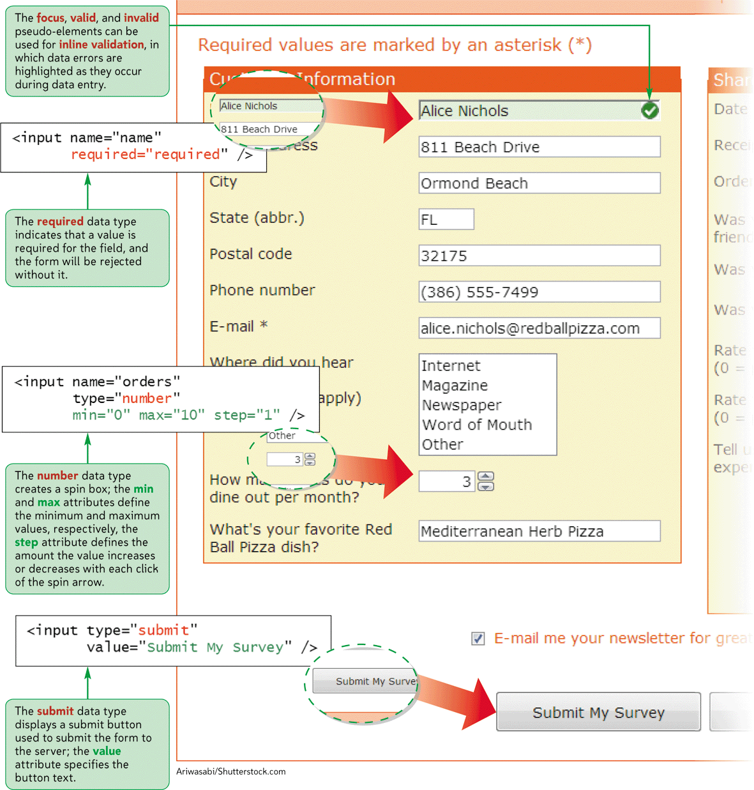
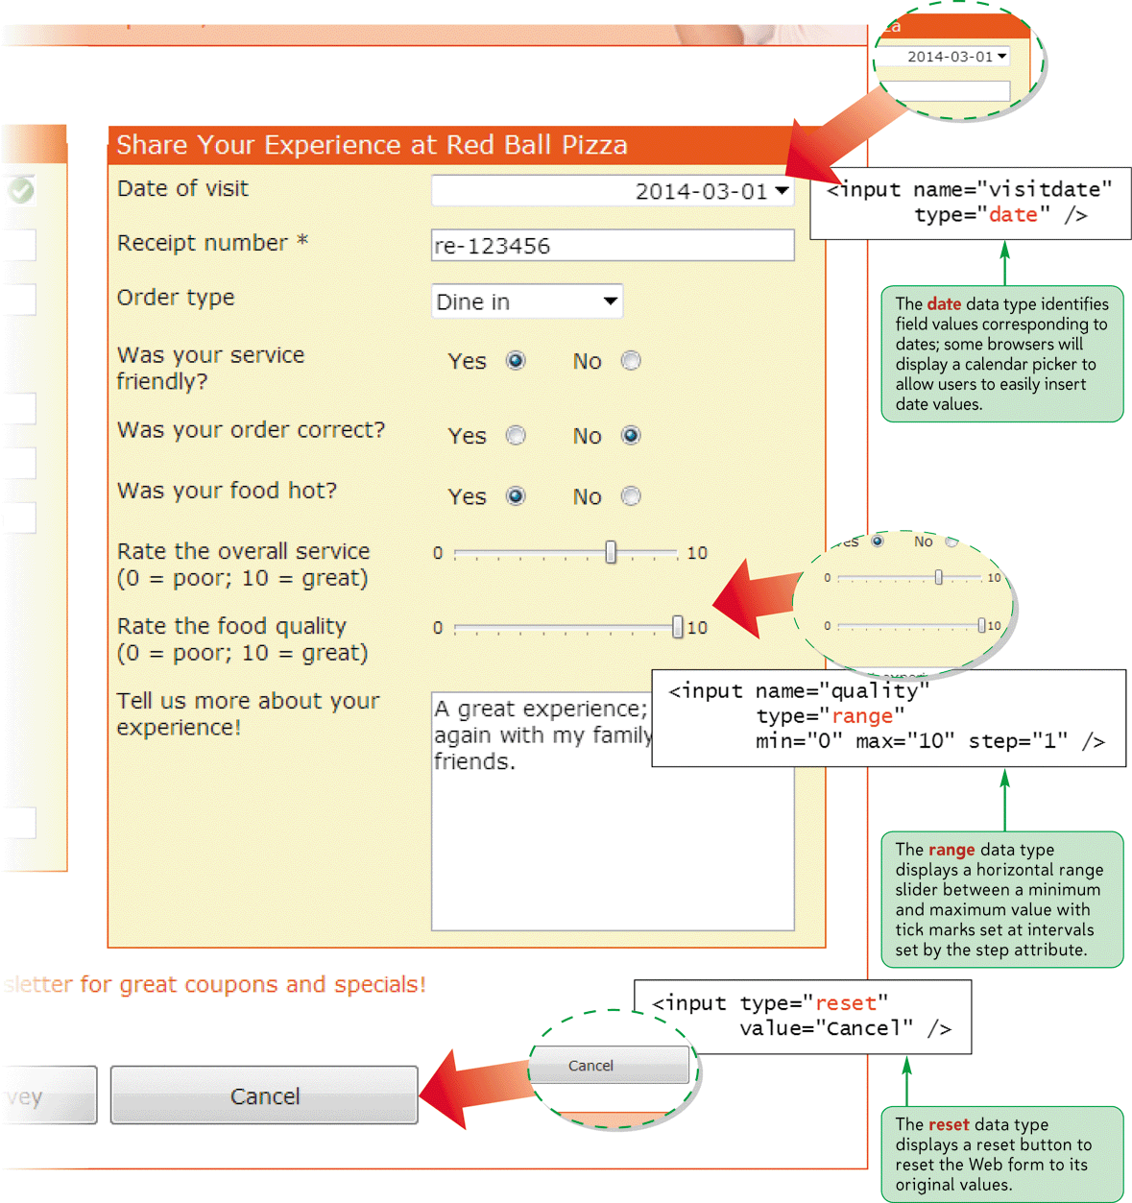
HTML5 Data Types

Slide 33
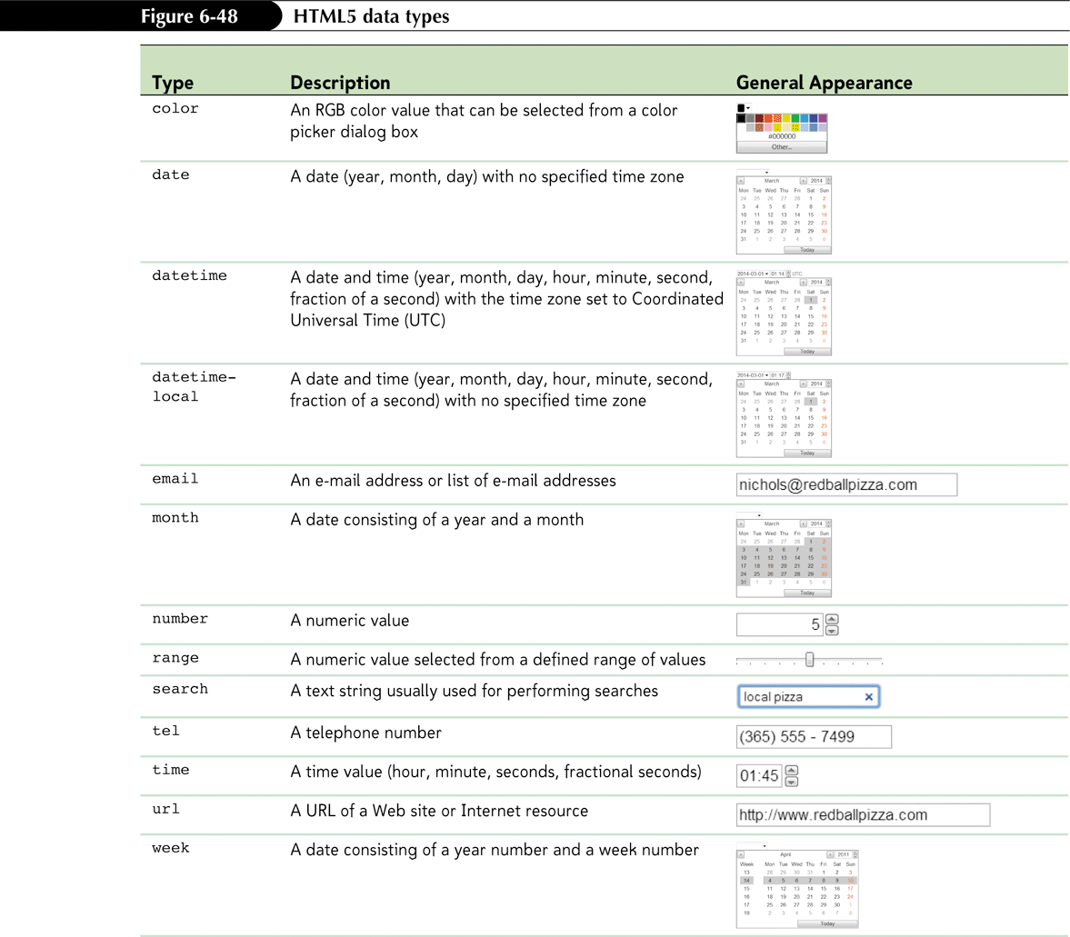
Exploring HTML5 Data Types

Slide 34
Exploring HTML5 Data Types
The email, tel, and url data types are used for storing e-mail addresses, telephone numbers, and Web addresses, respectively
For browsers that support the date type, this will bring up a calendar widget from which users can select a date

Slide 35
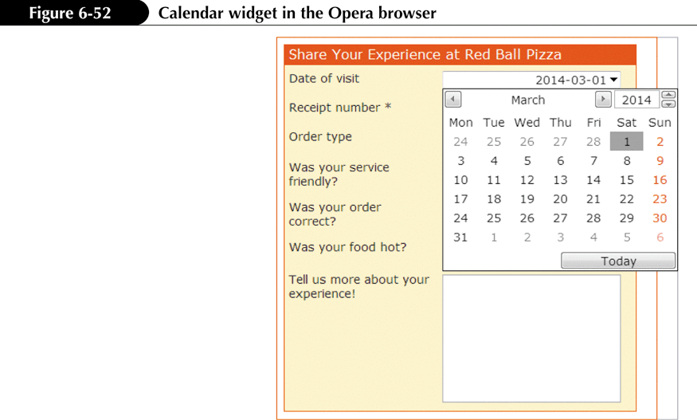
Exploring HTML5 Data Types

Slide 36
Creating Spinner Controls and Range Sliders
To create a spinner control for numeric data, enter the input element
<input name=”name” type=”number” value=”value” step=”value” min=”value” max=”value” />
where the value attribute provides the default field value, the step attribute indicates the amount by which the field value changes when a user clicks the spin arrow, the min attribute defines the minimum possible value, and the max attribute defines the maximum possible value of the field
To create a range slider control for numeric data, use the following input element:
<input name=”name” type=”range” value=”value” step=”value” min=”value” max=”value” />

Slide 37
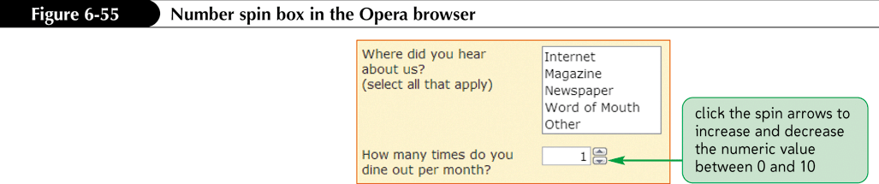
Creating Spinner Controls and Range Sliders

Slide 38
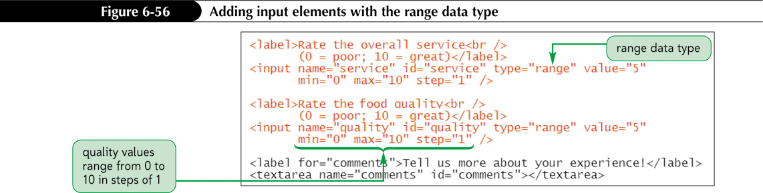
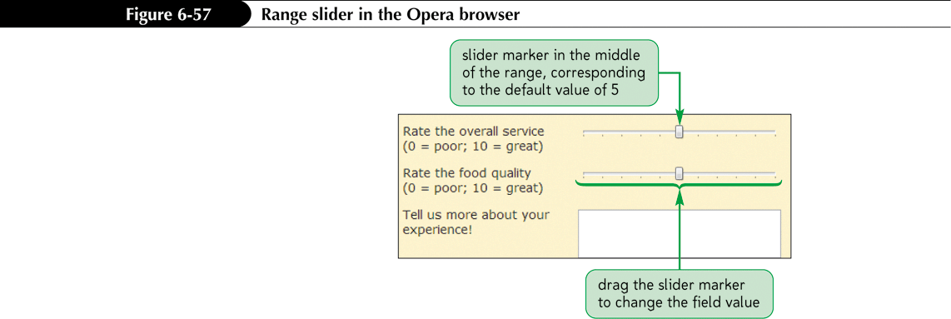
Specifying a Numeric Range with the range Data Type

Slide 39
Creating and Applying a Data List
To create a data list of possible values, enter the HTML code
<datalist id=”id”>
<option value=”value” />
<option value=”value” />
…
</datalist>
where the value attribute provides the text of the possible values in the data list.

Slide 40
Creating and Applying a Data List
To reference the data list from an input control, add the list attribute
<input name=”name” list=”id” />
where id references the id of the data list structure.

Slide 41
Creating Form Buttons
Form buttons are a type of control element that performs an action.
Types of buttons:
  Command button
  Submit button
  Reset button

Slide 42
Creating a Command button
Command buttons are created using the <input> tag:
  <input type=“button” value=“text” />
Submit buttons submit forms to the server for processing when clicked. Syntax is as follows:
  <input type=“submit” value=“text” />
Reset buttons reset forms to their original (default) values. Syntax is as follows:
  <input type=“reset” value=“text” />

Slide 43
Designing a Custom Button
Use the button element for greater artistic control over the appearance of a button.
  <button name=“name” type=“text”>
  content
  </button>
where the type attribute specifies the button type (submit, reset, or button—for creating a command button) and content is page elements displayed within the button

Slide 44
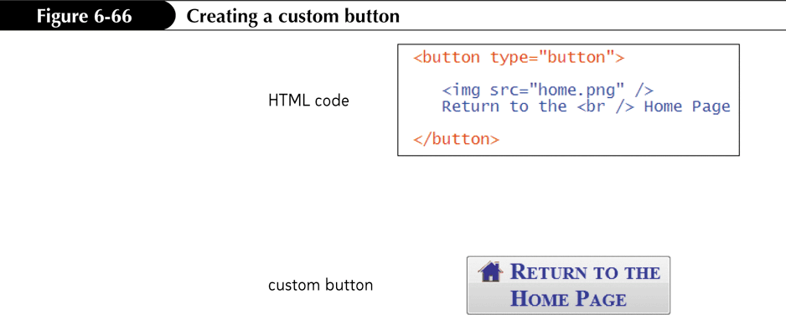
Designing a Custom Button

Slide 45
Validating a Web Form
Data values often need to be tested or validated before they can be used.
  Server-side validation
  Client-side validation

Slide 46
Validating Field Values
To indicate that a field is required, add the required=”required” attribute to the control element
To validate an e-mail address, set the data type to email. To validate a Web address, set the data type to url
To validate that a text input box follows a character pattern, add the attribute pattern=”regex”
where regex is a regular expression that defines the character pattern.

Slide 47
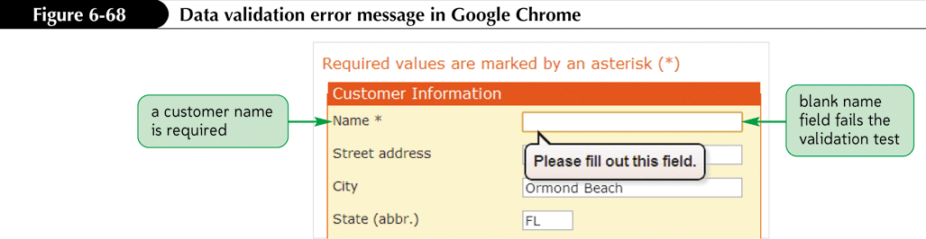
Validating Field Values

Slide 48
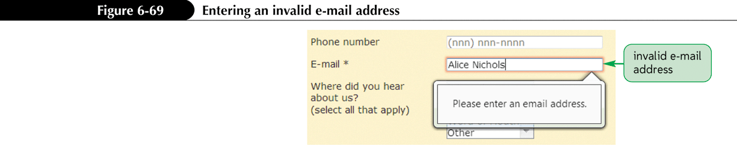
Validating Based on Data Type
The new data types supported by HTML5 also can be used for data validation.
  A data field with the number data type will be rejected if non-numeric data is entered.
  Similarly, fields marked using the email and url fields will be rejected if a user provides an invalid e-mail address or Web site URL

Slide 49
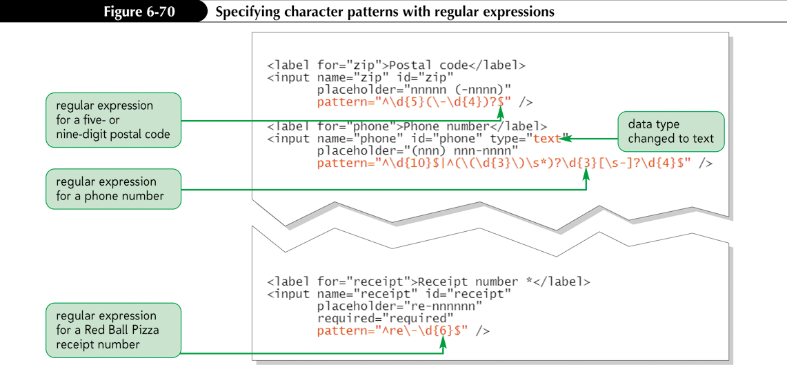
Testing for a Valid Pattern

Slide 50
Applying Inline Validation
One disadvantage with the current validation checks is that they all occur after a user has completed and submitted the form
The technique of immediate data validation and reporting of errors is known as inline validation
One way of integrating inline validation into a Web form is to create style rules that change the appearance of each control element based on the validity of the data it contains
  This can be done using some of the CSS3 pseudo-classes

Slide 51
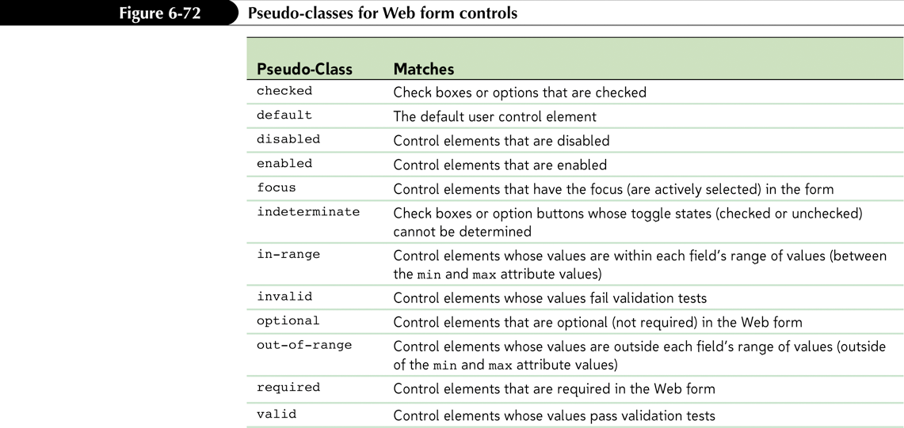
Applying Inline Validation

Slide 52
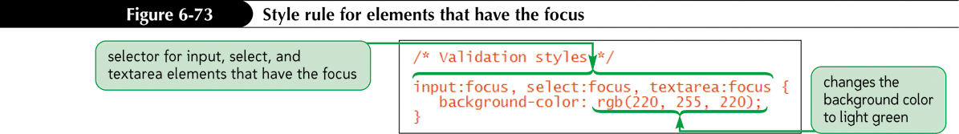
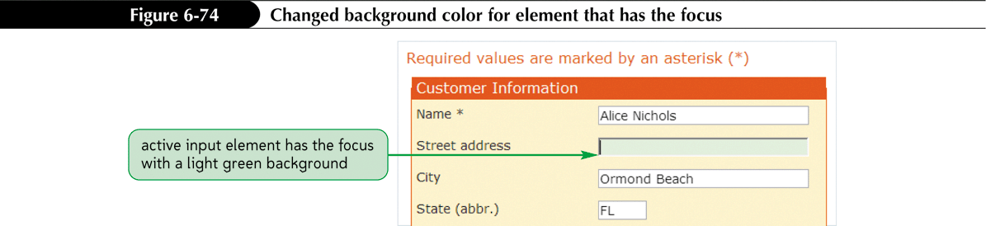
Applying Inline Validation

Slide 53
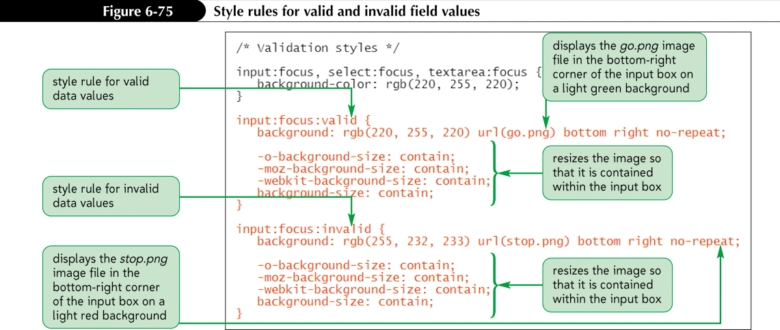
Pseudo-Classes for Valid and Invalid Data

Slide 54
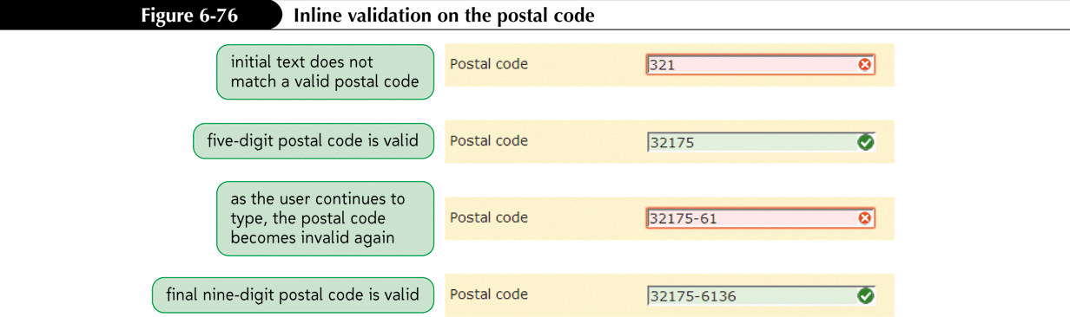
Pseudo-Classes for Valid and Invalid Data

