Slide 1
Tutorial 5
Working with Tables and Columns

Slide 2
Objectives
Explore the structure of a Web table
Create headings and cells in a table
Create cells that span multiple rows and columns
Create row and column groups
Add a summary to a table

Slide 3
Objectives
Format a table using HTML attributes
Format a table using CSS styles
Collapse table borders
Display page elements in tabular form
Create a multi-column layout

Slide 4
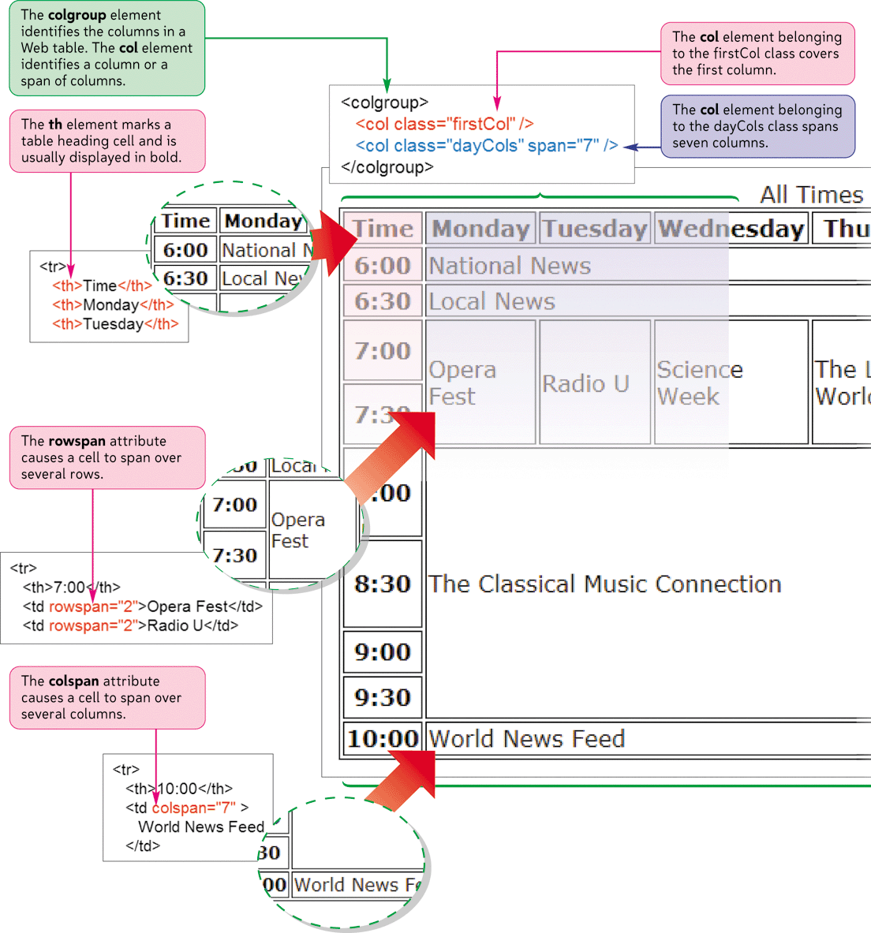
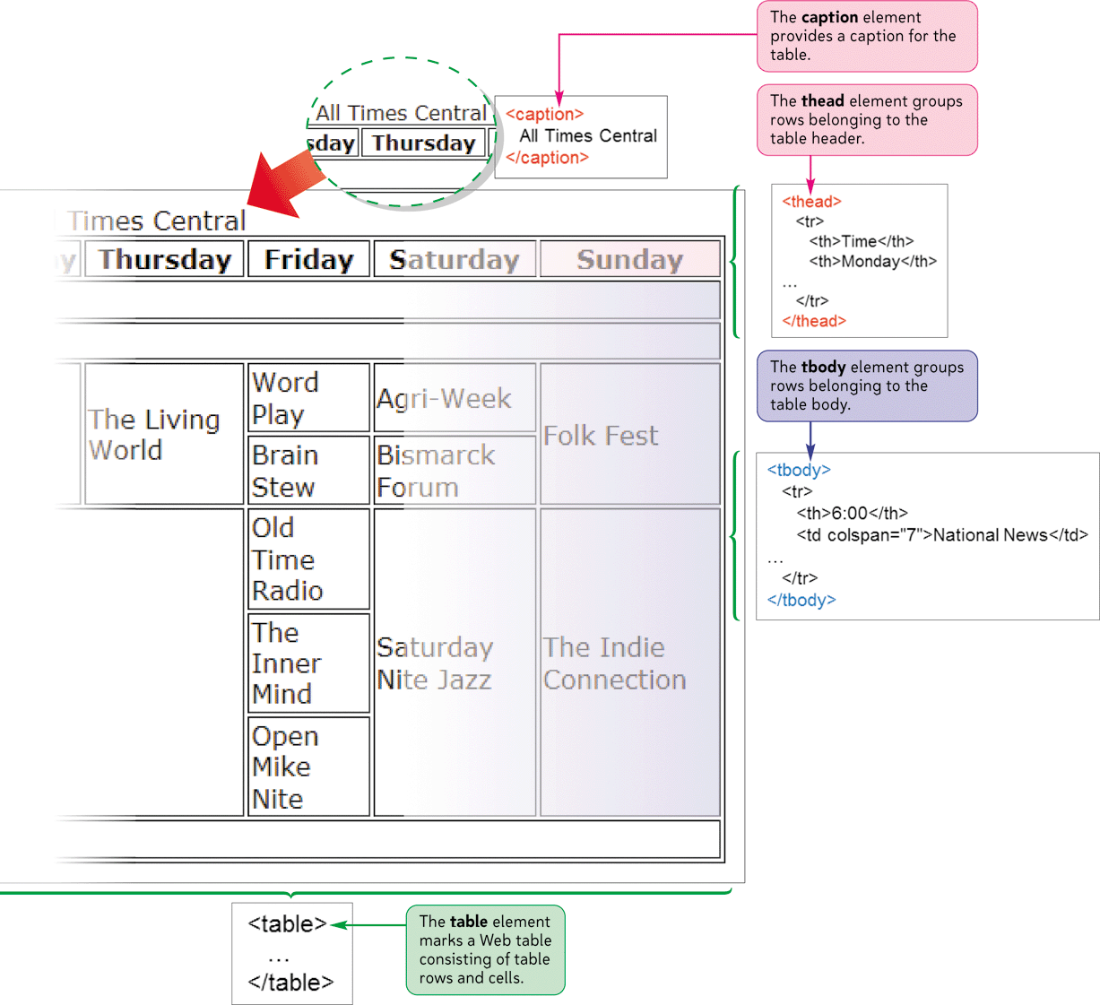
Structure of a Web Table

Slide 5
Introducing Web Tables
Each table in a Web page follows a basic structure consisting of the table element and a collection of table rows nested in the table element
<table>
<tr>
table cells
</tr>
<tr>
table cells
</tr>
...
</table>

Slide 6
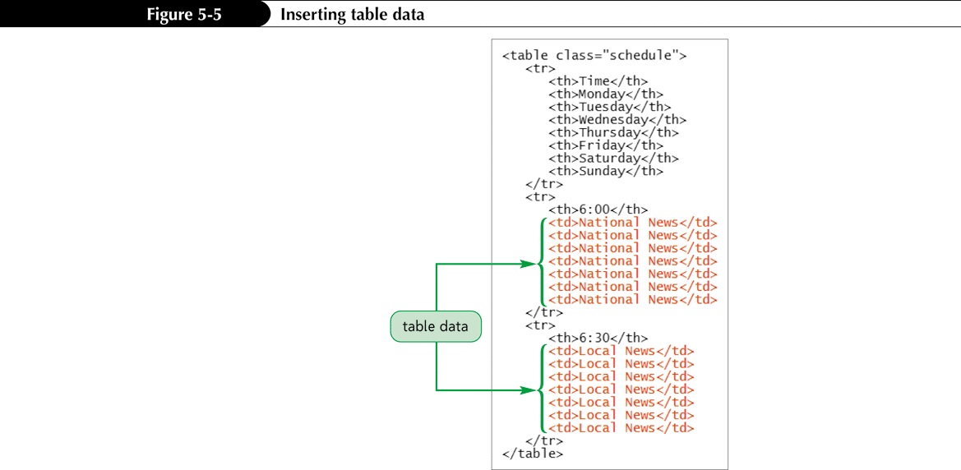
Introducing Web Tables
Table headings, the cells that identify the contents of a row or column, are marked using a th element
Data cells are marked with the td element and are used for any content that is not considered a heading

Slide 7
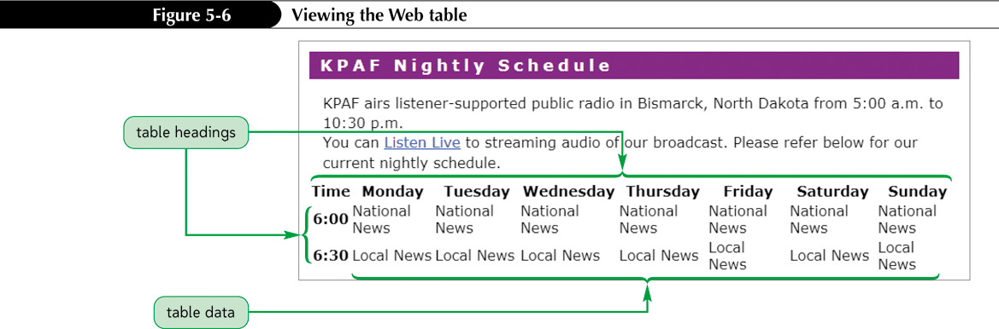
Introducing Web Tables

Slide 8
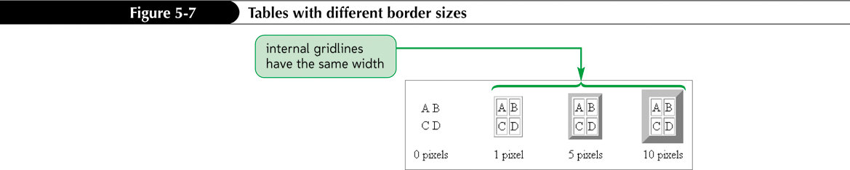
Introducing Web Tables
To add a border to a Web table using HTML, use the border attribute
<table border="value"> ... </table>
where value is the size of the border in pixels

Slide 9
Spanning Rows and Columns
A spanning cell is a single cell that occupies more than one row or one column in the table
To create a table cell that spans several columns, add the attribute
colspan=“columns"
to the cell, where columns is the number of columns covered by the cell
To create a table cell that spans several rows, add the attribute
rowspan=“rows"
to the cell, where rows is the number of rows covered by the cell

Slide 10
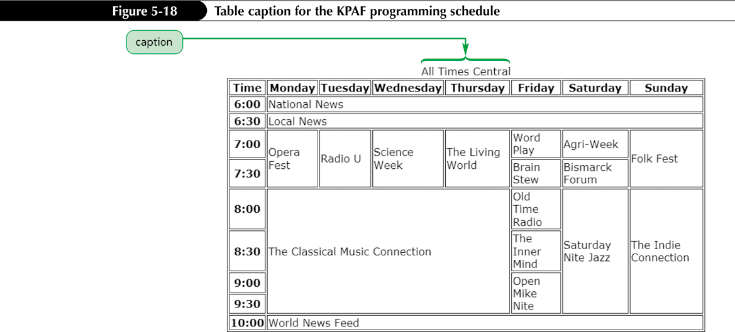
Creating a Table Caption
To create a table caption, add the caption element directly below the opening <table> tag with the syntax
<caption>content</caption>
where content is the content of the table caption

Slide 11
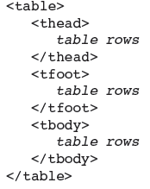
Marking Row Groups
You can divide a table’s rows into row groups, in which each group element contains different types of content and can be formatted differently
A table can have
multiple table
body row groups

Slide 12
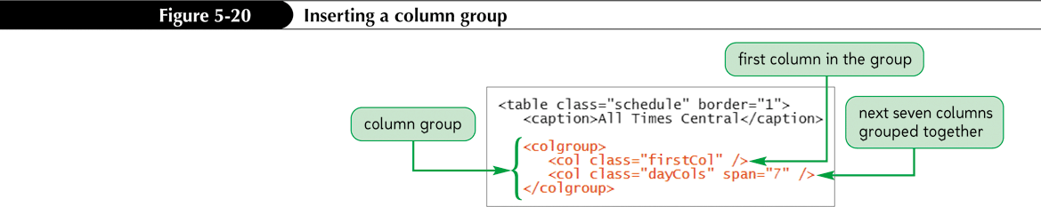
Marking Column Groups
Once the table columns have been determined by the browser, you can reference them through the use of column groups

Slide 13
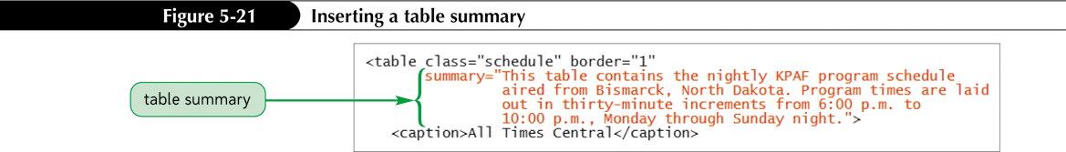
Adding a Table Summary
The summary attribute allows you to include a more detailed description about the table
<table summary="description"> ... </table>

Slide 14
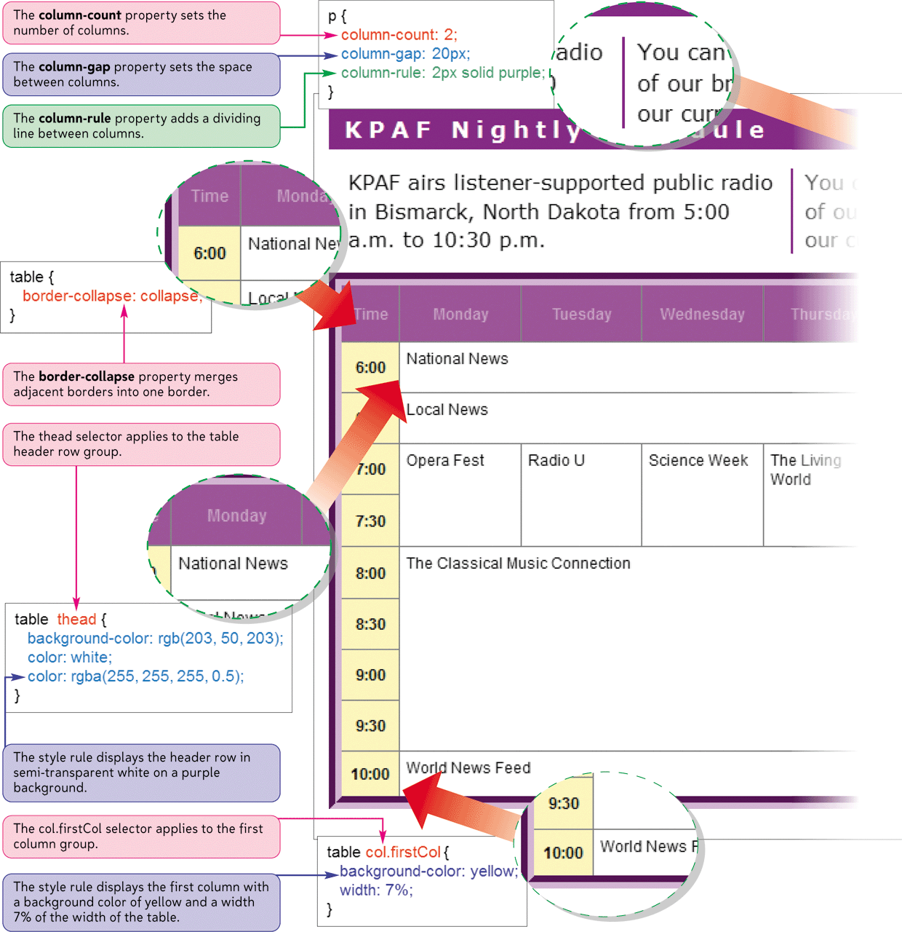
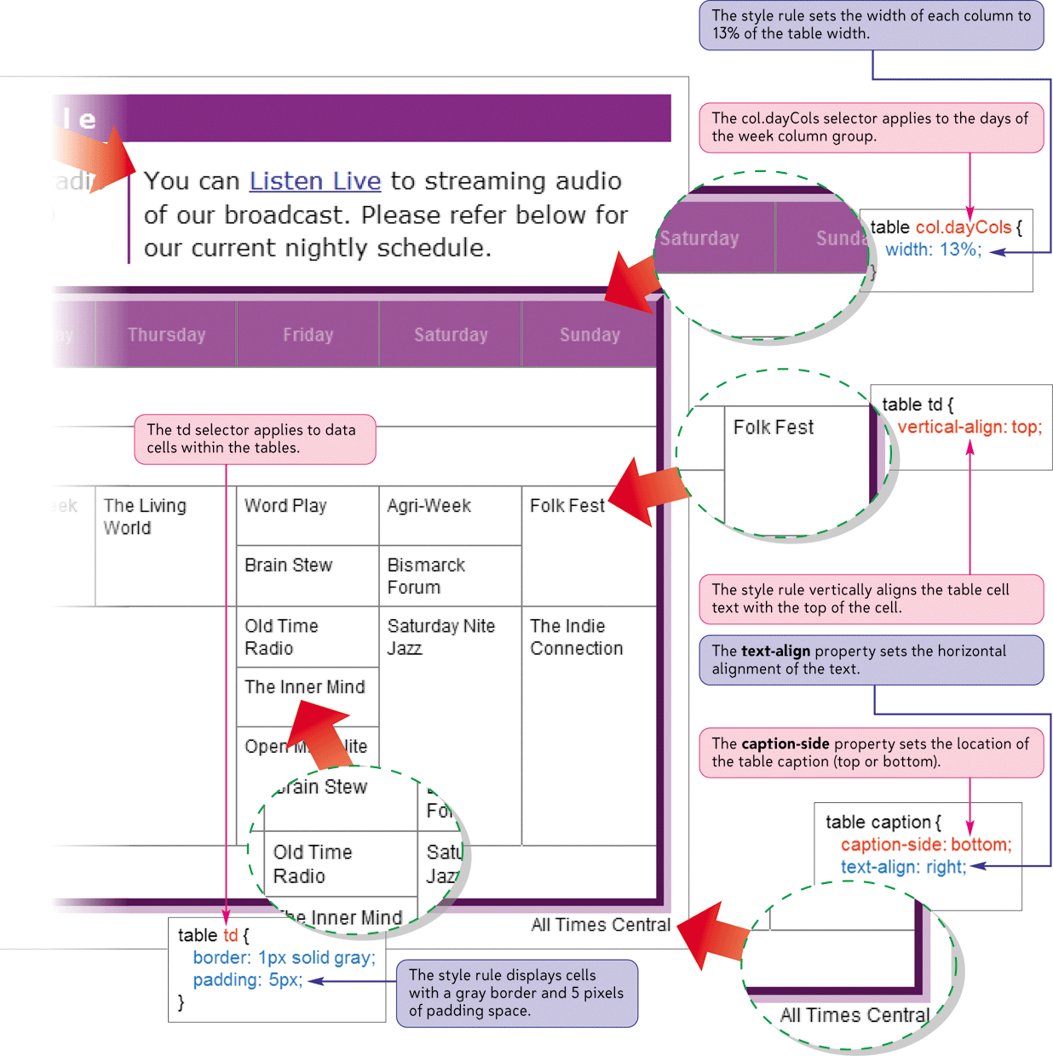
Web Table Styles

Slide 15

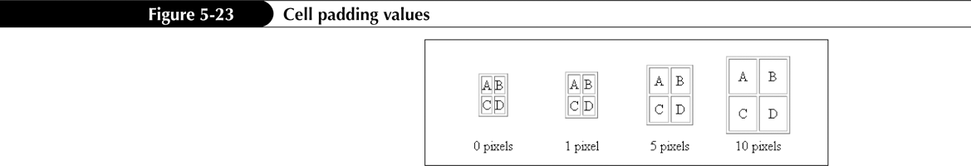
Formatting Tables with HTML Attributes
The amount of space between table cells is known as the cell spacing
The cell padding is the space between the cell contents and the cell border

Slide 16
Formatting Tables with HTML Attributes
To define the space between table cells, add the cellspacing attribute
<table cellspacing=”value”> ... </table>
to the table element, where value is the space between table cells in pixels
To define the padding within table cells, add the cellpadding attribute
<table cellpadding=”value”> ... </table>
to the table element, where value is the size of the padding space in pixels

Slide 17
Formatting Tables with HTML Attributes
To set the width of the table to a specific value, add the width attribute
<table width="value"> ... </table>
Many browsers also support the height attribute
<table height="value"> ... </table>
You can use HTML to set the row heights by applying the height attribute
<tr height="value"> ... </tr>

Slide 18
Formatting Tables with HTML Attributes
A table frame specifies which sides of the table (or which sides of the table cells) will have borders
<table border="value" frame="type"> ... </table>

Slide 19
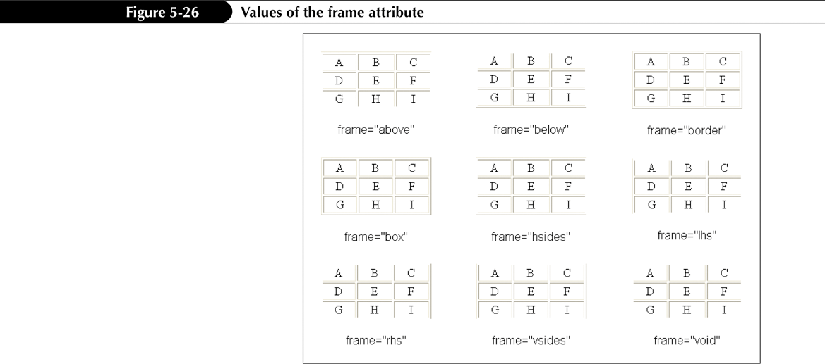
Formatting Tables with HTML Attributes

Slide 20
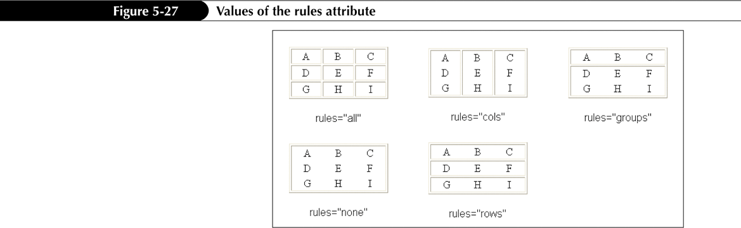
Formatting Tables with HTML Attributes
A table rule specifies how the internal gridlines are drawn within the table
<table border="value" rules="type"> ... </table>

Slide 21
Formatting Tables with HTML Attributes
By default, browsers horizontally center the contents of table header cells and left-align the contents of table data cells
  To control the horizontal alignment
  align="position“
  To control the vertical alignment
  valign="position"

Slide 22
Formatting Tables with CSS
Starting with CSS2, Cascading Style Sheets included support for Web tables
You can apply one set of borders to the Web table itself and another set of borders to the individual cells within the table

Slide 23
Formatting Tables with CSS
To define the border model used by the table, apply the table style
border-collapse: type
where type is separate (the default) to keep all borders around cells and the table itself apart, or collapse to merge all adjacent borders
To set the space between separated borders, apply the table style
border-spacing: value
where value is the space between the borders in any of the CSS units of measure

Slide 24
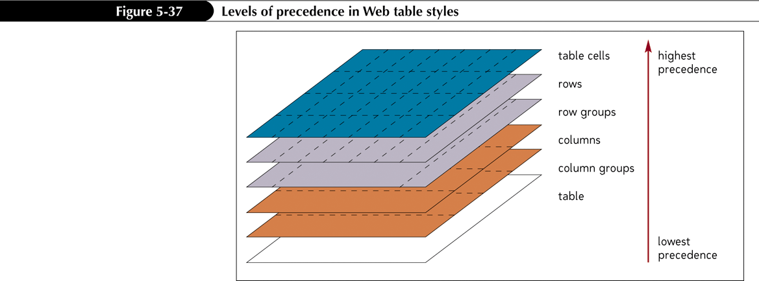
Formatting Tables with CSS
The most general styles are those applied to the entire table

Slide 25

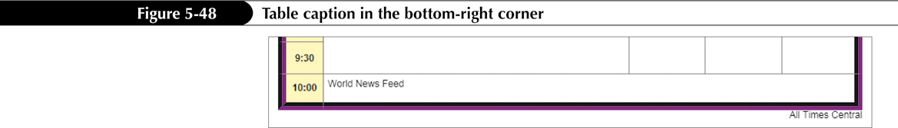
Formatting Tables with CSS
To position a table caption, apply the style
caption-side: position
where position is top or bottom

Slide 26
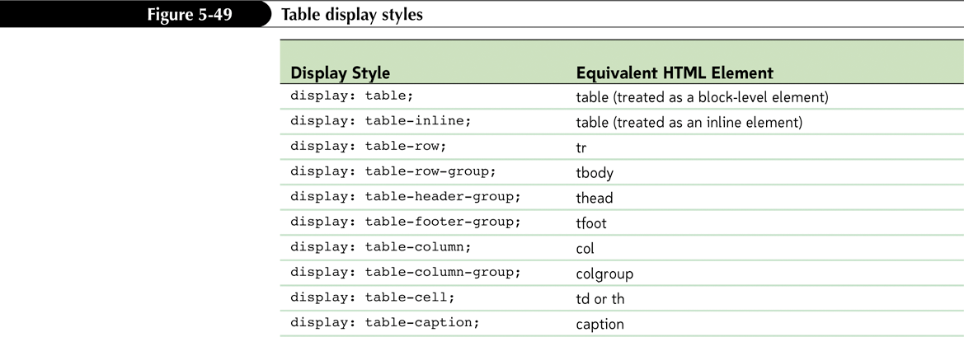
Applying Table Styles to Other Page Elements

Slide 27
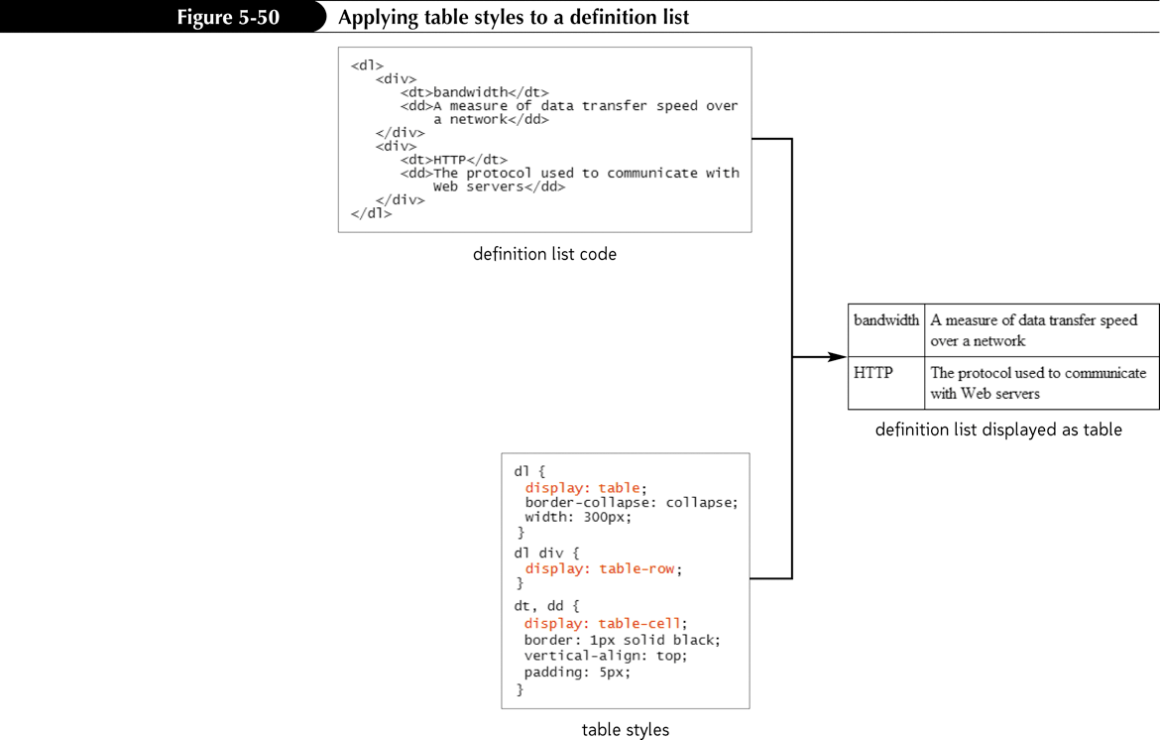
Applying Table Styles to Other Page Elements

Slide 28
Designing Columnar Layouts with CSS3
To specify the number of columns in the layout, use
column-count: number;
where number is the number of columns in the layout.
To specify the width of the columns, use
column-width: width;
where width is the width of the columns expressed in one of the CSS units of measure or as a percentage of the width of the element
To set the size of the gap between columns, use
column-gap: width;
where width is the width of the gap.

Slide 29
Designing Columnar Layouts with CSS3
To add a border between the columns, use
column-rule: border;
where border is the format of the border.
To specify the width and number of columns in a single style property, use
columns: width count;
where width is the width of each column and count is the total number of columns in the layout.
For specific browsers, add the -moz- vendor prefix for Firefox and the –webkit– prefix for Safari and Chrome to these style properties.

Slide 30
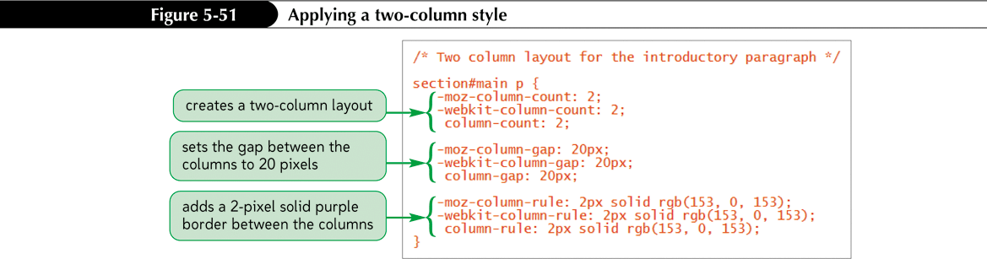
Designing Columnar Layouts with CSS3

Slide 31
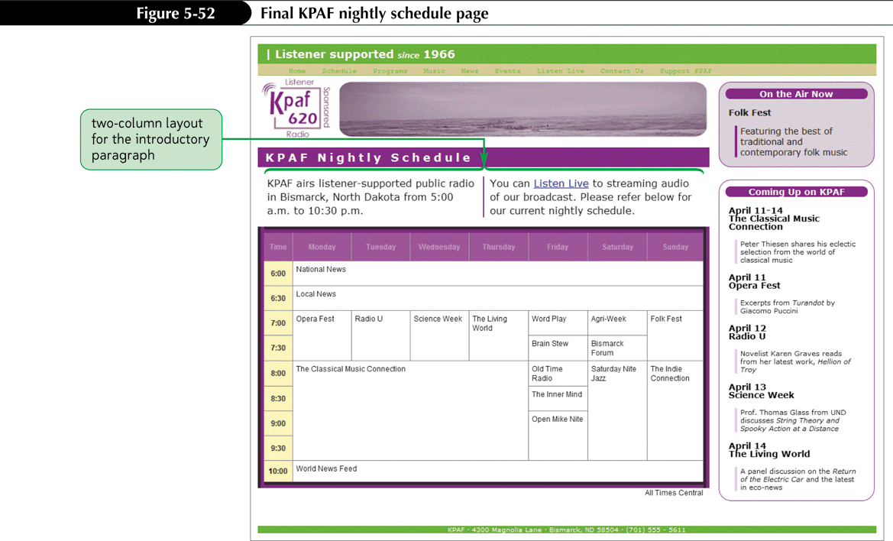
Designing Columnar Layouts with CSS3

