Slide 1
What you need to Know!
OTHER CHARGE OPTIONS
“90 Days same as Cash”
You have 90 days to pay without store charging interest
IF you are a DAY late, you pay all the BACK INTEREST!!!
Higher interest rate than usual
What does this mean?
What about interest?

Slide 2
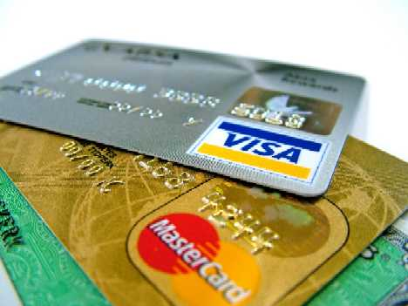
Compare & Contrast
Credit Cards
vs. Debit Cards
Like charge accounts
Can be used at most stores in U.S. and even foreign countries
Examples: Visa, Mastercard
Can borrow cash (like access to a loan)
Must provide a signature
Electronic transactions from your bank account
Need a PIN instead of signature
Do NOT provide loans or credit!

Slide 3
Finance Charges & Annual Percentage Rate (The cost of credit)
Finance charge – cost of credit expressed monthly in dollars and cents
Interest costs plus any other charges connected with credit are taken into account.

Slide 4
Annual Percentage Rate (APR)
Cost of credit expressed as a yearly percentage.
What does that mean?
A company that charges 18% APR would charge you $18 ANNUALLY for every $100 unpaid throughout the year
Notes:
See page R54 to learn about Understanding Percentages

Slide 5
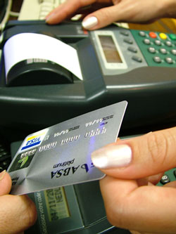
Stores have to pay a percentage of credit purchases to the company that issued the card.
Did you know?
Why would they accept credit cards?
How does this charge get passed on to consumers?

Slide 6
Section 3
Applying for credit

Slide 7
What would you do?
A friend wants to borrow money from you. Would you lend it to him or her?
What factors in to your decision?
How long would you give them to pay it back?

Slide 8
Some Vocabulary
Credit Bureau – private business that investigates a person to determine the risk involved in lending to that person.
Credit Check – Investigation of a person’s income, current debts, personal life, and past history of borrowing and repaying debts.
Credit rating – rating of the risk involved in lending to a person or business

Slide 9
Four C’s of Creditworthiness
Capacity to Pay ~ How much debt do you have in relation to your income.
Character ~ financial reputation as a reliable and trustworthy person.
Collateral ~ something of value that a borrower lets the lender claim if a loan is not repaid.
Cosigner (if needed) ~person who signs the loan with you and promises to repay if you do not.

Slide 10
Will you be able to get credit?
Several factors determine a person’s creditworthiness. When applying for credit:
You will be asked to fill out a credit application.
The lender will hire a credit bureau to do a credit check.
The credit bureau will provide the creditor with a credit rating for you.

Slide 11
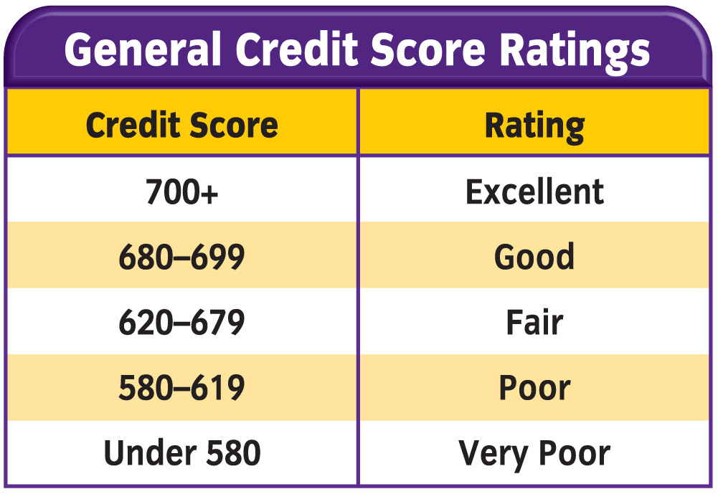
What factors might negatively affect your credit score?
Higher the score, the less risk the person represents
Higher scores get better interest rates
AnnualCreditReport.com
Can get a free credit report every 12 months from:
Equifax
TransUnion
Experian

Slide 12
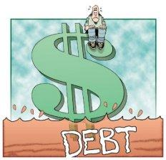
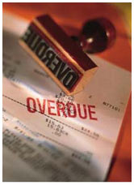
What hurts your credit rating?
Late payments
High debt-to-income ratio
Having many open accounts
Previous bankruptcy
Unemployment
Legal trouble

Slide 13
Types of Loans
Secured Loan
Unsecured Loan
Backed up with collateral.
Can be the item being purchased (house, car, etc.)
Guaranteed only by a promise to repay it.
Not backed with Collateral.
Interest rate is usually higher

Slide 14
Responsibilities of a Borrower
Paying your debts on time
Keeping a complete record of all the charges you have made
Notifying the issuer if your card has been lost or stolen

Slide 15
Personal Bankruptcy
Bankruptcy—the state of legally having been declared unable to pay off debts owed with available income.
Used only as last resort!
When bankruptcy is approved through bankruptcy court, debtors must give up most of what they own, which is then distributed to the creditors.
By law, certain debts, such as taxes, must continue to be paid.
Bankruptcy proceedings remain on your credit record for 10 years.

