Slide 1
Other Ideas for section 1:
Some bellringers are at the back of the powerpoint. Just ideas.
Scarcity activities ideas:
Survival activity
Hasalot, hasalittle, etc. activity
Factors of production:
group activity

Slide 2
Chapter 1
What is Economics?

Slide 3
What is Economics?
The study of how individuals, families, businesses, and societies use limited resources to fulfill their unlimited wants.
Microeconomics – deals with behavior and decision making by small units such as individuals and firms
Macroeconomics – deals with the economy as a whole (large units like government)

Slide 4
Why we study economics?
We want to have good information as consumers to make sure we spend our limited resources in a good way. As a citizen we want to make sure the government is spending our money in a way that we agree with.
If we don’t agree with them then we can exercise our right as a citizen and vote for change.

Slide 5
Wants vs. Needs - Vocabulary
WANTS are the things we wish we could have.
Examples: car, computer, stereo, haircut
NEEDS--Things we must have to survive.
Examples: Food, shelter, and clothing
On your $1,000,000 list, mark which ones were wants and needs (W & N)

Slide 6
Refer to your first list $1,000,000
Now, how would you spend it if it was reduced to $10,000?
Use items from your first list
List on top on page two

Slide 7
Vocabulary continued…
Scarcity – means that there is not enough of a resource to meet all of everyone's wants
Examples: gasoline
Shortage – only temporary
Example: hurricanes or floods destroy goods and property

Slide 8
Factors of Production
Factors of Production – resources needed to produce goods and services
Land (natural resources)
Examples: surface land, fish, animals, trees, minerals, water
Labor (human resources) – work people do to produce goods and services

Slide 9
Goods vs. Services
Services—
Tasks the people or machines perform
Goods—
Can be physically weighed or measured
Both can be exchanged for money or other G&S
(non-material)

Slide 10
Goods or Service?
Business | Goods | Service | Both | Items Furnished
Lumber
Carpet center
Bus Line
Book store
Department store
Telephone company
Dry cleaners
X
X
X
X
X
X
X

Slide 11
Factors of Production continued…
3. Capital – previously manufactured goods used to make other goods and services
Examples: machines, buildings, tools
Increases productivity ~amount of output (G&S) that result from a given level of inputs (land, labor, capital, and entrepreneurship)
4. Entrepreneurship – when individuals take risks to develop new products and start new businesses in order to make profits.

Slide 12
Entrepreneurship cont.
Discussion Question:
Should a society actively work to increase the supply of its entrepreneurs? Discuss your opinions and suggest ways a government might encourage entrepreneurial behavior.

Slide 13
Factors of Productions
5. Technology—new methods for producing goods and services more efficiently
Examples: computers (vs. a typewriter)

Slide 14
Demonstrate Factors of Production activity
** Teacher picks a product and demonstrates how you can break that down in to the 4 Factors of Production. Easier on the white board so it can be student-driven. On the structured notes, the example is a Hard Shell taco.
**Follow up with group activity where each group gets a product, a poster sheet, markers and demonstrates their understanding of the F.O.P.
Land (Natural)
Labor
(Human)
Capital
Entrepreneurship

Slide 15
Group Activity
Groups of 3
Get poster sheet, markers and “item” from me
Notes:
Big Mac, back pack, tennis shoe, magazine, lap top, diamond ring, pizza, candy bar, movie: Dark Knight movie

Slide 16
Main Idea: Economic decisions always involve trade-offs that have costs
Trade-off: sacrificing one good or service to purchase or produce another
Example: if you choose to buy an iPod, you are exchanging your income for the right to own the iPod.
The Cost of Trade-Offs
Opportunity Cost: the value of the next best alternative given up for the alternative that was chosen

Slide 17
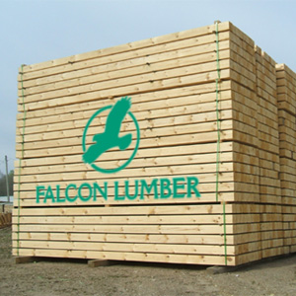
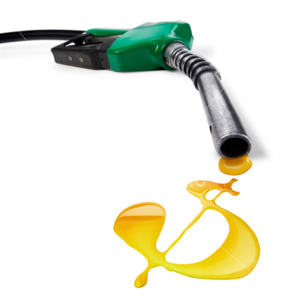
Bell Ringer
Identify these items as wants or needs?
Are the following items scarce or is there a shortage?
a
b
c
d
e
f

Slide 18
Get Notes & Bell Ringer Sheet
Identify the following as scarce, or not scarce:
Petroleum in Japan, a country without its own oil fields and without oil reserves.
Petroleum in Saudi Arabia, a country with many oil fields and oil reserves.
One economics textbook, five students who wish to do well in the economics course, and an important test in the economics class the next day.
One economics textbook, five students who are not taking economics, and an important test in the economics class the next day.

Slide 19
Scarcity Activity – Plan (Think ahead) before doing
You will be divided into 8 groups. Each group represents 1 of 4 countries. Hasalot, Hassome, Hasalittle and Needsalot.
Each group must complete the tasks on the task sheet on the front of your envelope.
You will have 15 minutes to complete as many tasks as you can.
When the time is up your group needs to answer the questions about the activity on the next slide and then we will discuss them.

Slide 20
Activity Discussion – answer on the back of your notes
Was everyone able to complete the tasks?
What tasks were you unable to complete? Why were you unable to complete the tasks?
How did you choose which tasks to complete?
If your country didn’t finish the tasks, how did you feel?
Did anything happen that made the tasks more difficult to complete?
Is there anything that can be done to help each country complete all the tasks?
What activity would make all the countries happy?

Slide 21
Respond (summary form) to one of the following
In the simulation, were any of the countries unable to complete their tasks? How did that make you feel?
Is there a good way to solve the problems the countries encountered?
Use terms from the class: scarcity, resources, etc.

