Slide 1
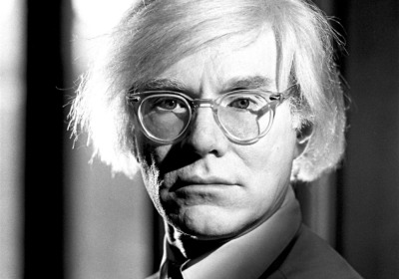
Andy Warhol, was an American painter, printmaker, and filmmaker who was a leading figure in the visual art movement known as pop art. After a successful career as a commercial illustrator, Warhol became famous worldwide for his work as a painter, avant-garde filmmaker, record producer, author, and member of highly diverse social circles that included bohemian street people, distinguished intellectuals, Hollywood celebrities and wealthy patrons.

Slide 2
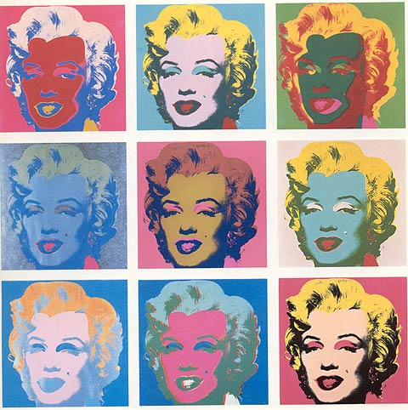

Slide 3
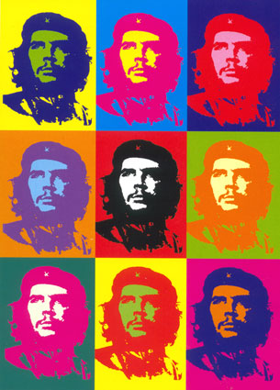
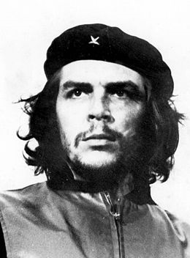
Che Guevara – Argentine Revolutionary
Symbol of Rebellion

Slide 4
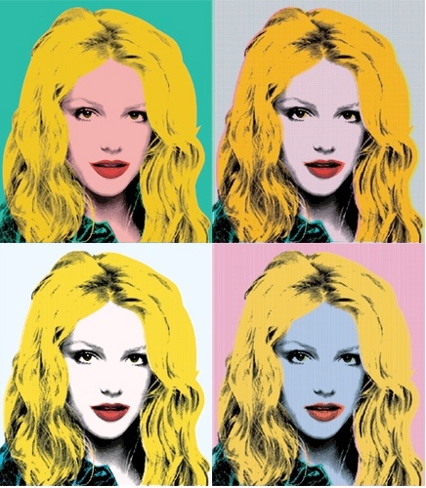

Slide 5
Your name here!!!

Slide 6
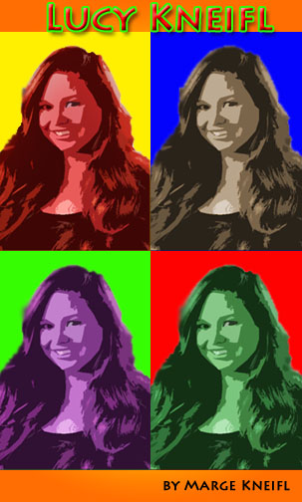
Your name here!!!

Slide 7
Your name here!!!

Slide 8
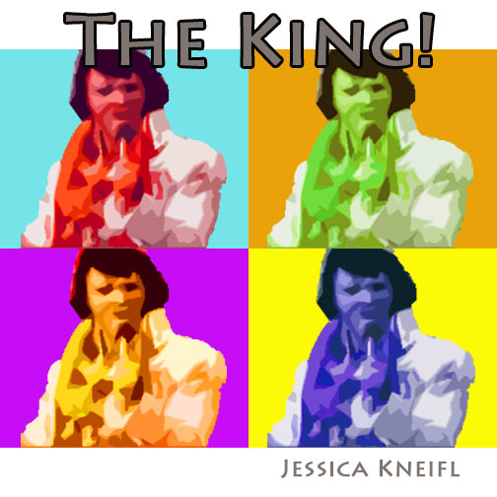
Your name here!!!

Slide 9
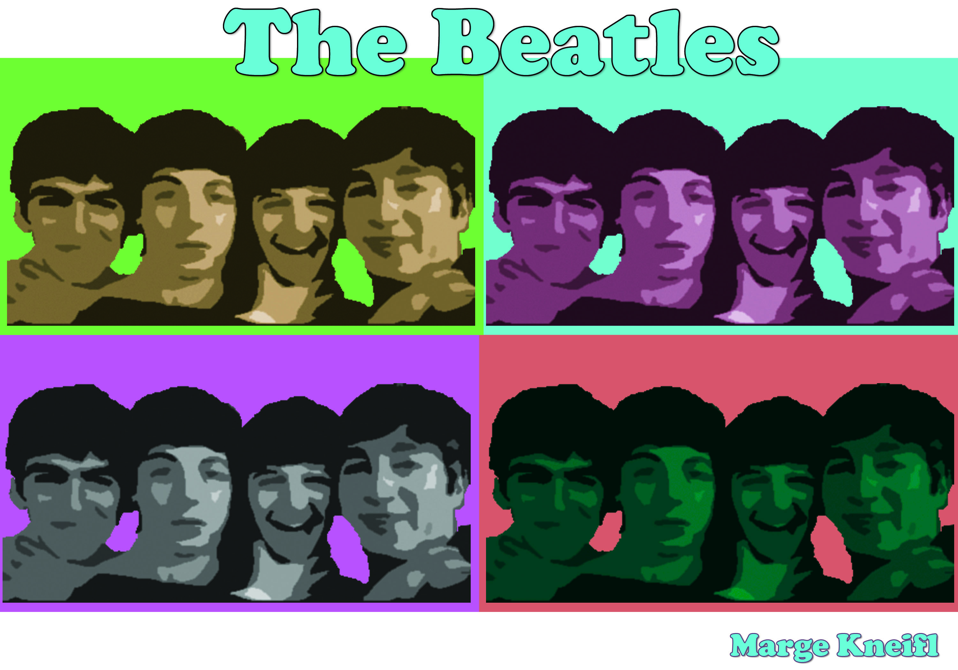
Your name here!!!

Slide 10
Steps to a Warhol
Using Photoshop

Slide 11
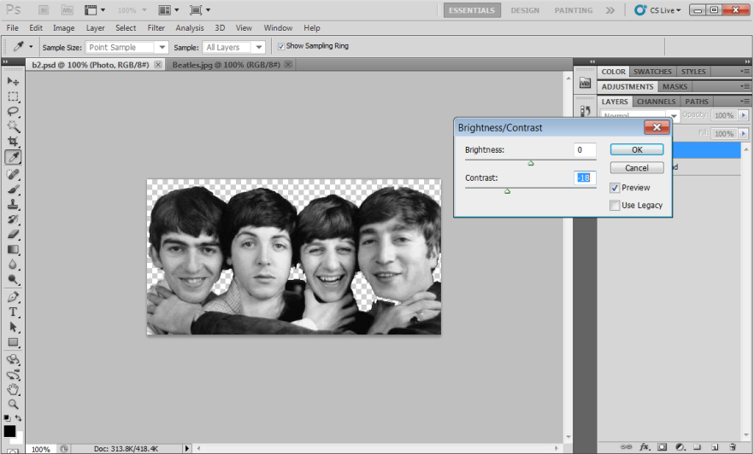
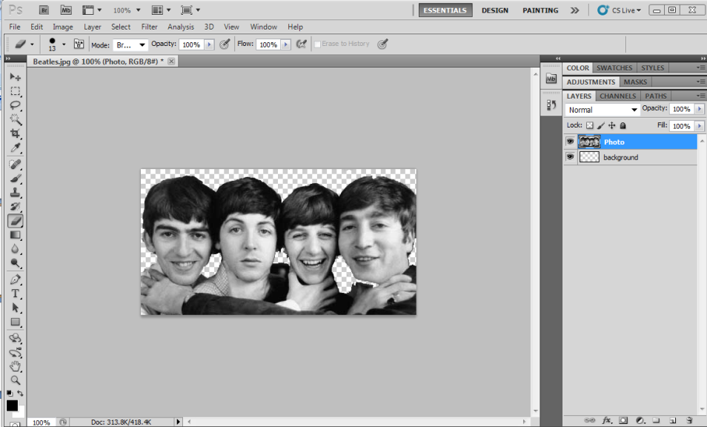
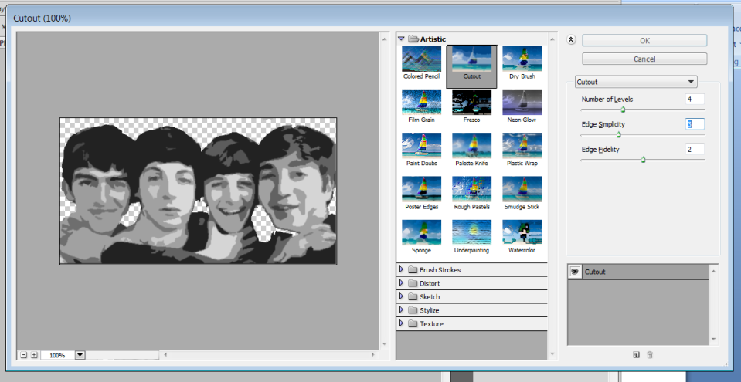
Step 1: Abstracting the Photo
Find your perfect photo
3. Adjust brightness and contrast
Turn to black and white – remove
background - crop
4. Apply cutout filter (artistic)

Slide 12
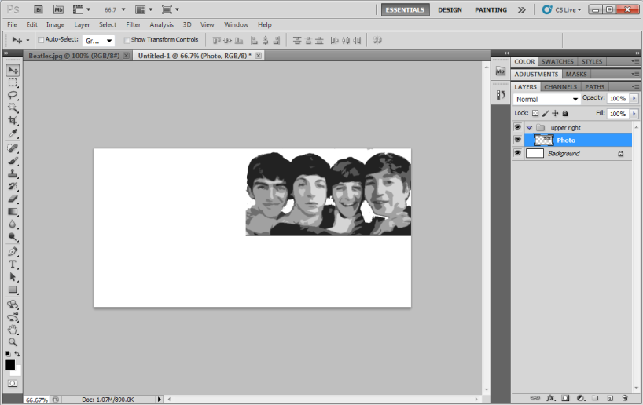
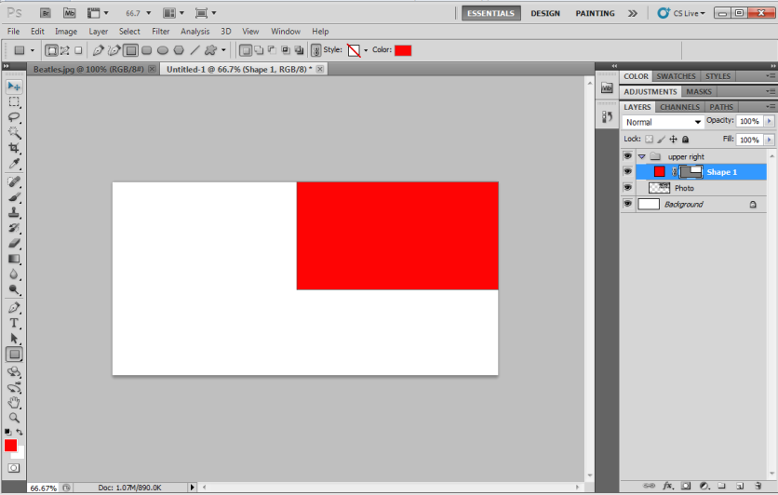
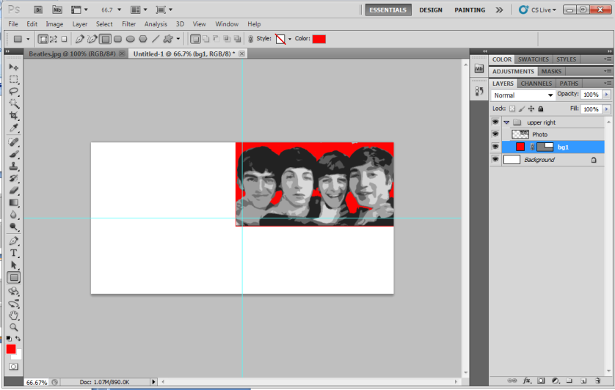
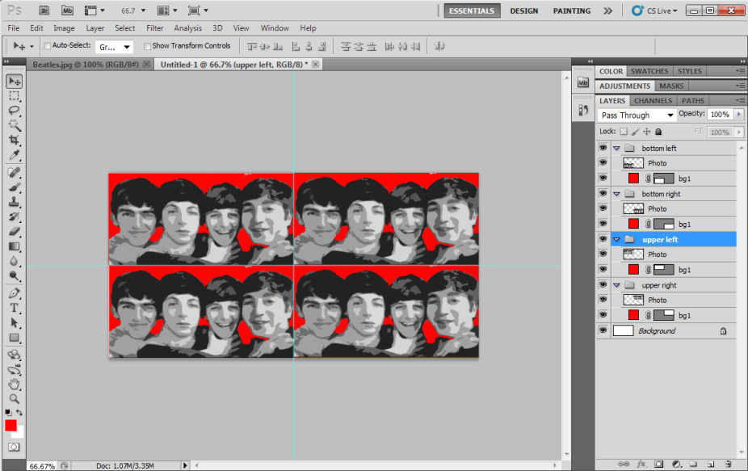
Step 2: Repetition Canvas
New document – drag layer over
Make a group
3. Change layer order
2. Draw the background
4. Turn on guides – resize group
5. Duplicate group - move

Slide 13
Step 3: Color the Poster
Change the shape colors
Change the hue and saturation on photo layers – colorize!!!

Slide 14
Step 4: Finishing Touches
All good artists “title” their masterpieces!
You may need to resize canvas and set a background color
2. Sign your work!!
Note: Enhance your text layer to make it stand out!!

