Slide 1
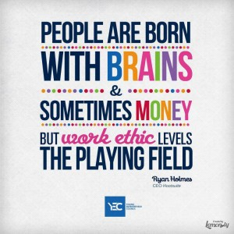
Character, Work
Ethic and Soft Skills :
What you want your references to say about you!

Slide 2
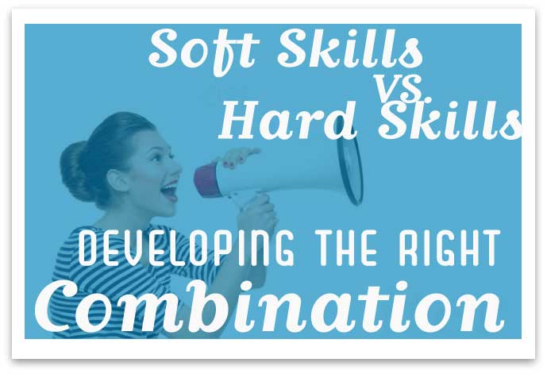
Positive Attitude
Teamwork
Ability to Prioritize
Top 3
Soft skills-- personal attributes that enhance an individual's interactions, job performance and career prospects.
Hard skills-- about a person's skill set and ability to perform a certain type of task or activity.

Slide 3
Each year, the National Association of Colleges and Employers (NACE) surveys employers across the country and asks them to rate the top qualities and skills they seek in their new college hires. In addition to the knowledge they gain in academic classes, these skills are necessary to help them be competitive as they apply for internships, jobs, or graduate school. The most recent list of desired skills?
Top Five Qualities Employers Look For
Ability to work on a team
Leadership
Communication skills
Problem-solving skills
Strong work ethic
http://growingleaders.com/blog/qualities-employers-look-for/

Slide 4
Once they’ve earned their degree, success over the long term may depend on a number of attributes that employers look for in job candidates and employees. Still another list, posted by Everest University Online, suggests five top qualities are:
You’re a team player. You understand that working well with others is necessary to get ahead. You understand your role on the team and how you can add value to the bottom line.
You’re a problem solver. You have the ability to think clearly and solve complex problems. Having the ability to think on your feet may set you apart from others and place you in line for the next promotion.
You’re a wordsmith. You have the ability to speak and write well. Your talents for writing and communication are valuable commodities that may be able to place you on the fast track to success.
You understand the bottom line. You have a strong understanding of how a company’s products or services can make an impact at the local or international level, and you can translate that knowledge into a workable format of numbers and statistics.
You possess a heightened sense of integrity. You know how critical it is that customers and colleagues be able to convey trust in you. If a person loses confidence and trust it may be difficult to rebuild the relationship.
- See more at: http://growingleaders.com/blog/qualities-employers-look-for/#sthash.oyKrLMYT.dpuf

Slide 5
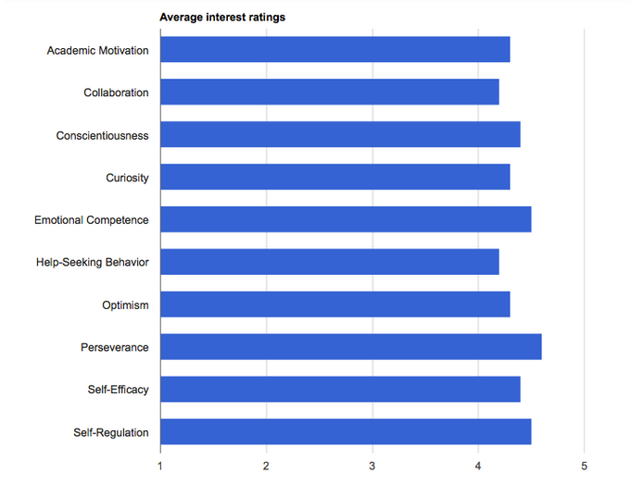
Perseverance garners most attention in soft skills poll

Slide 6
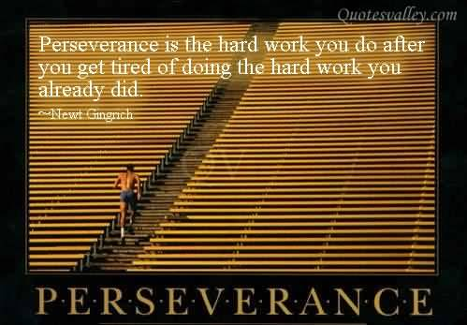
Perseverance
The capacity to stick to a goal or complete a task despite difficulties.
Qualities like grit, tenacity, delayed gratification, self-discipline, self-control, and passion for long-term goals.

Slide 7
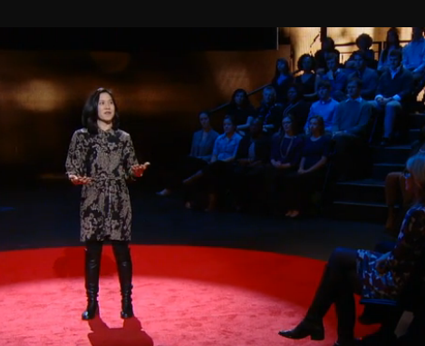
Personal Grit as Key to Success
Passion, perseverance, and stamina outweigh IQ
as a predictor of success.
GRIT
Self-control
Motivation

Slide 8
Perseverance
Think of a task that you started but did not finish. What happened to stop your progress?
Think of an activity that required you to do lots of practice before you got good at it. Why did you stick with it?
Who is a person in your life or a famous person you admire who never seems to give up on a goal?

Slide 9
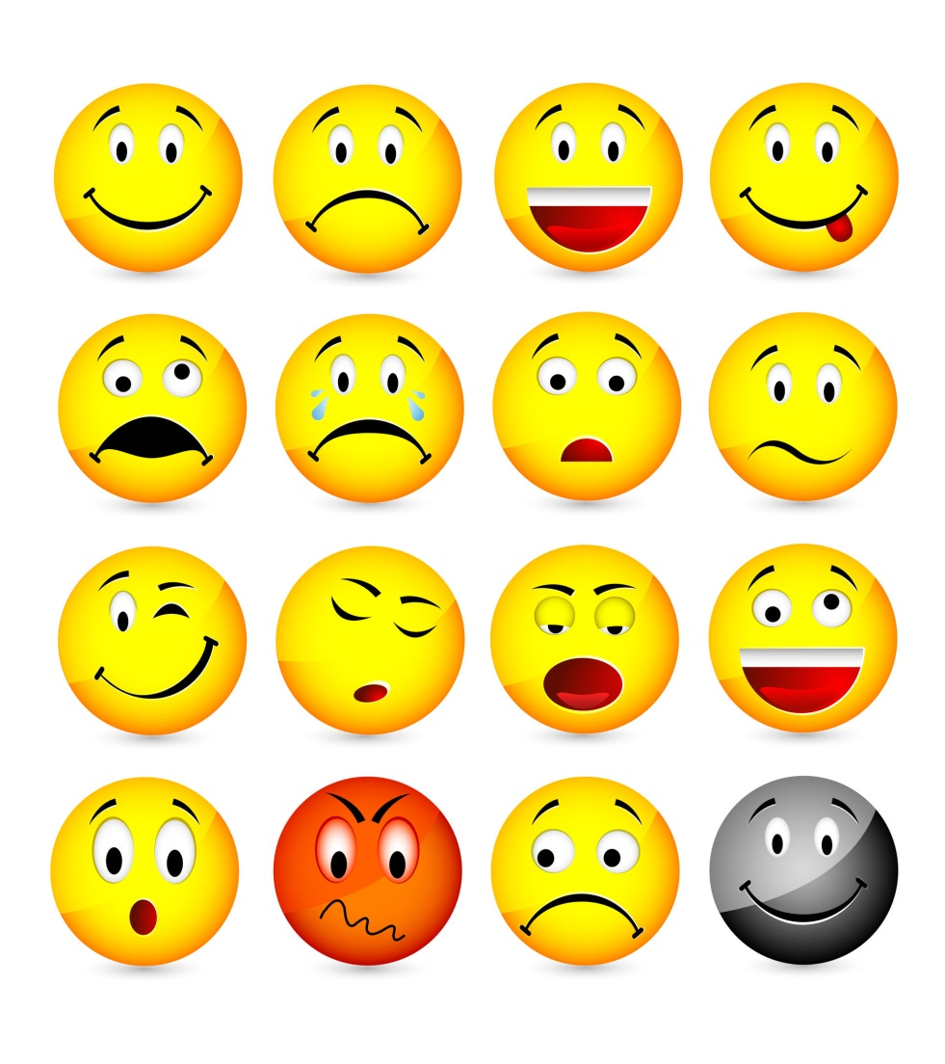
Emotional Competence
The capacity to experience and express feelings in ways that are appropriate and effective in a given situation as well as the capacity to understand and sympathize with the feelings and experiences of others.
Emotional competence includes empathy, emotion management, self-awareness, and social awareness.

Slide 10
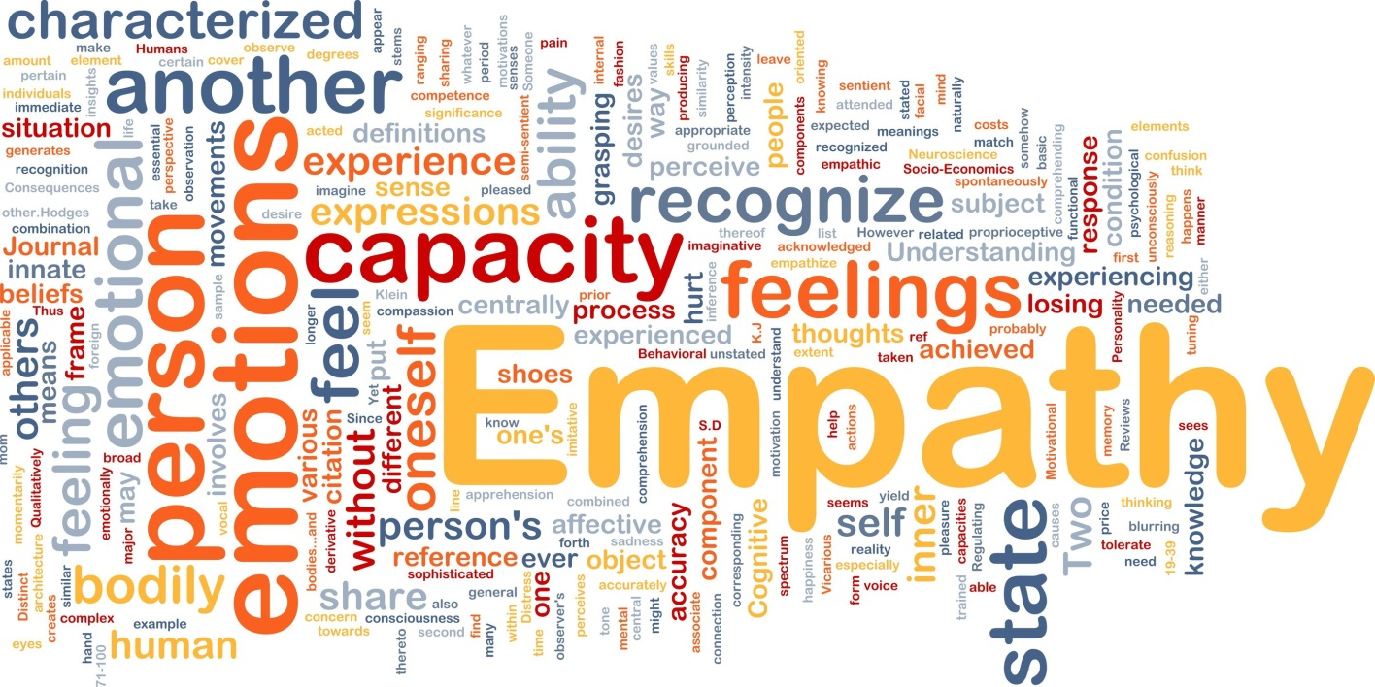
Emotional Competence
Have you ever felt an emotion but didn’t understand why?
How much do you care about how other people are feeling? Are there some people whose feelings you care about more than others?
Have you ever been surprised at how someone felt about something?
How well do you manage feelings of anger and frustration?

Slide 11
Qualities of a successful _____________________:
Persistence
Independence
Positive attitude
Self-discipline
Energetic
Confident
Creative
Organized
Work Ethic
Risk-Taker
Action-oriented
Strong desire to achieve
Good business sense
Goal Setter
Good communicator
Tolerance for uncertainty
Soft Skills are important for EVERY job!

