Slide 1
Happy Monday! January 12, 2014
Please grab your name tents and your Marketing Mix / Core Standards of Marketing handout from the file holder at the front of the room
CURRENT EVENTS!?!?! – Remember 1st one is due by next Friday! – don’t put it off!
Review – what are the 4 parts of the Marketing Mix?
Review – what are the 7 Core Standards of Marketing (really 6 plus one extra)
Group Activity – using the product given to your group, decide on how the 7 core standards of marketing went into the sell/purchase of such product.
Ideas for some of you on price—what could you have sold it for “then”, and what could you sell it for “now”.
**Think of the sweatshirt and shoes from Friday

Slide 2
What is Sports Marketing?
Objective: Define/Discuss Sports Marketing, Target Markets/Demographics, and Gross Impressions

Slide 3
What is SPORTS MARKETING?
Sports Marketing—using sports to market products.
Wide array of products (food, apparel, equipment, automobiles)

Slide 4
Demographics
Describe yourself
age, marital status, gender, ethnic background, income level, and education level
Demographics – common characteristics of a group, such as age range, marital status, gender, ethnic background, income level, education level, attitudes, beliefs, etc.
Notes:
Describe yourself by age, marital status, gender, ethnic background, income level, and education level. Then, explain how all of these factors are used to describe demographics. Ask students to explain why politicians should be interested in the demographics of the district they hope to represent. Then, explain how knowing the demographics give an individual a better understanding of a selected population’s needs and wants.

Slide 5
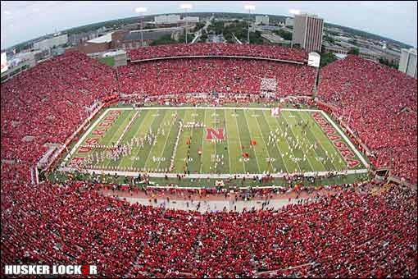
Demographics – College Football

Slide 6
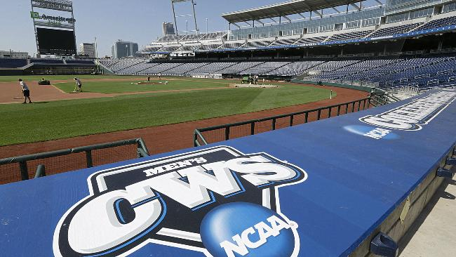
Demographics - College World Series

Slide 7
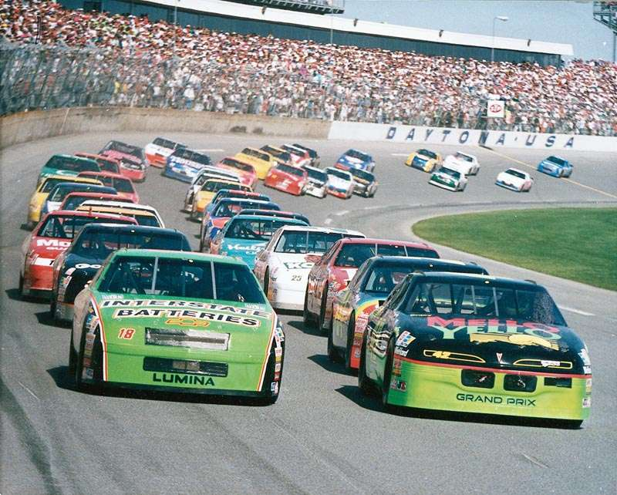
Demographics - NASCAR

Slide 8
Spending Habit of Fans
Why is it important to know this?
Maximize profits
Example—Price people will spend on a ticket depends on:
Interest of the target market
National importance of the event (ex. –National title game)
Popularity of the participating athletes (ex.- Heat v. Thunder)
Rivalry associated with the contest (ex.-NU v. Texas)
Example—fans are willing to pay for team (or celebrity) identified clothing or expenses (as well as food and travel to & from a game)

Slide 9
Sports Marketing and Demographics
Research, research, research (remember Marketing-Information Management)
Finding a group of spectators’ interests and planning a product or service that the spectators will buy
OVERALL GOAL: use the right marketing mix to meet customer needs while still generating a profit!
Must consider 3 factors: new opportunities, gross impressions, and timing

Slide 10
New Sports, New Opportunities
Sports marketers always search for new ways to appeal to customers
Offer new opportunities for endorsement and marketing
Think of skateboarding and snowboarding
Arena Football
New Sports = New Opportunities!

Slide 11
Gross Impressions
The number of times per advertisement, game, or show that a product or service is associated with an athlete, team, or entertainer.
Backs of shoes
Scene in a movie (Talladega Nights)
License-plate holder on a car
Media mentioning a player, team or product (example Heisman Trophy)
Logos on jerseys
Fiesta Bowl (Tostitos)
YOUR BRAIN RECORDS THAT IMAGE
Marketers hope you remember it when it comes time to buy!

Slide 12
HOMEWORK
CFP National Championship Game is TONIGHT!
Who is going to win? Spread?
Watch a college or professional sporting event on TV. Select a sports brand represented in this presentation and keep track of how many gross impressions were made during the telecast.
YOU ONLY NEED TO WATCH ½ THE GAME

Slide 13
Tuesday, January 13
Current Events?
Discuss CFP National Championship Game
Gross Impressions?
3-2-1 Review
3 – name 3 of the core standards or marketing and provide a description/example of each
2 – Define the following 2 terms
Sports Marketing
Demographics
1 – Provide 1 example of how gross impressions are used in the sports industry

Slide 14
Reminder: Sports Marketing & Demographics
OVERALL GOAL: use the right marketing mix to meet customer needs while still generating a profit!
Must consider 3 factors: new opportunities, gross impressions, and timing

Slide 15
TIMING
Popularity is based almost completely on continued winning.
Fans want to be associated with winning
Competition has to be monitored so that a company’s marketing can remain unique
15 minutes of fame
Reality shows
Concerts provide CDs and other merchandise related to the musician or group, merchandise is ready when a national or world championship is won
What other examples can you think of that must be available to fans while teams/celebrities are “hot”?

Slide 16
Value of Sports Marketing
A multi-billion-dollar global industry that has a major impact on the economy
cities building stadiums and arenas to attract teams and sporting events
hotels, restaurants, service stations, and other related businesses benefit for the sports industry
Job opportunities – parking lot attendant to a marketing executive
Building managers
Horticulturalists
Security
Maintenance
Trainers
Copyright © Texas Education Agency, 2011. All rights reserved.
Notes:
Sports marketing is a huge industry that has a major impact on universities, cities, and states. Numerous hospitality businesses benefit from sporting events.

Slide 17
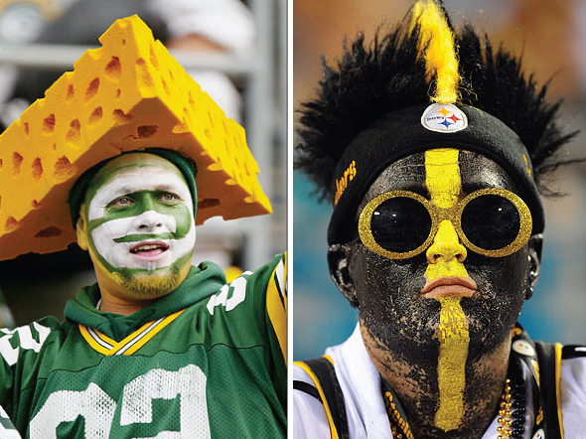
Emotional Value of Sports
Fans are emotionally tied to their favorite teams.
This connection motivates fans to buy tickets to games
And sometimes strange costumes! ☺
Winning teams stimulate the sale of merchandise related to the team.
Copyright © Texas Education Agency, 2011. All rights reserved.
Notes:
Fans who become emotionally tied to their favorite teams tend to spend money on merchandise that represents their teams. Go to a college bookstore and a large section is devoted to sporting goods for that particular university. Professional teams have separate gift shops to sell related merchandise.

Slide 18
Many Channels of Distribution for Sports
High profile sporting events generate strong promotional revenues for broadcasters.
Major and cable television networks
Radio
Internet (computer and cell phone)
Pay for View
Copyright © Texas Education Agency, 2011. All rights reserved.
Notes:
Popular sporting events bring big money to television networks. College teams want to be on television for national exposure and revenue.

Slide 19
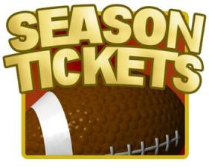
Sports Marketing Helps Local Economies
Ticket sales
Food sales
Lodging sales
Gas sales
Miscellaneous sale
SUV sales
Copyright © Texas Education Agency, 2011. All rights reserved.
Notes:
Even small communities rally around sports. The community emotionally ties itself to the high school athletic team. Regional baseball and basketball tournaments held in the community generate more revenue for local businesses.

Slide 20
Assignment
College Football Research!
Move to lab 215

