Slide 1
Virtual Business Challenge
Sports Franchise Simulation – Professional Football

Slide 2
Virtual Business Challenge
Learn about how to manage and run a sports franchise and learn about relevant marketing areas.
Ticket Pricing
Stadium Staffing
Ingress & Egress
Parking
Concessions
Sponsorships
Promotions with Traditional Media
Promotions with Social Media

Slide 3
Team Value
Who do you predict are the most valuable teams and why?
Who do you predict are the least valuable teams and why?
Should teams be required to participate in revenue sharing?

Slide 4
Team Value
MLB Team Value Infographic
Measures Value of Team, Regional Sports Network, Related Business, MLB Advanced Media and Confidence Rating
Ranks Team by Total Revenue, Gate Receipts, Concessions, Sponsorship, Media Rights, Parking, Attendance

Slide 5
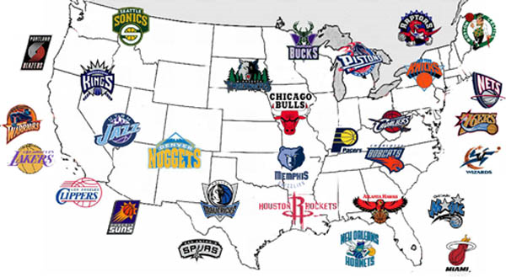
Franchise
A franchise is the permission contracted to a group or single entity to sell a company’s goods or services within a certain region.
In Virtual Business - Sports, a franchise is an association within a professional football league.

Slide 6
Franchise Location
A very important decision for any sports team
Demographics –
total population of the city, the number of people enthusiastic about their sport, and their ability to afford tickets.
Infrastructure –
the available venue (stadium), parking capacity, and possible financial incentives offered by the local government

Slide 7
Franchise Location
No city is perfect but some are superior to others
Franchises can move if the choice of location proves wrong, but it’s a difficult task that will require rebuilding awareness and loyalty in the new location.
Expansion can be costly
2002 NFL Expansion $700 Million Houston Texans

Slide 8
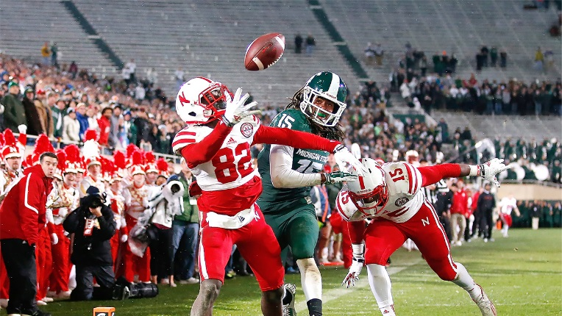
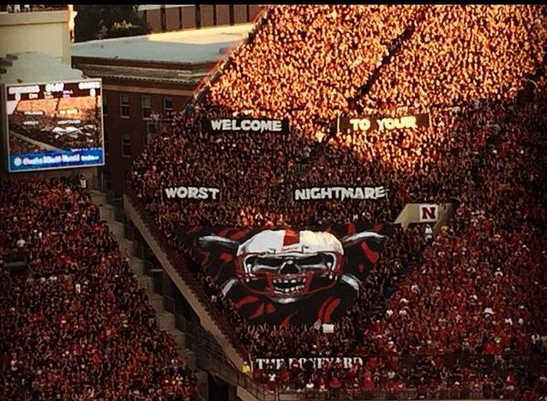
Fan Loyalty
Loyalty is devotion to an entity.
Sports fan loyalty largely determines how much fans are willing to pay for sporting event tickets and how many games they are likely to attend.
A losing record is likely to decrease sporting event attendance, but there is usually a segment of extremely loyal fans that will continue to attend games.

